Slide 1

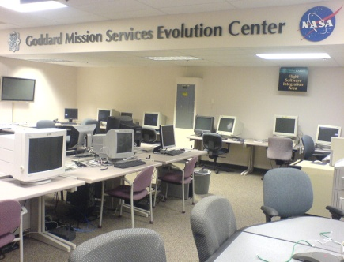
Goddard Mission Services Evolution Center (GMSEC)
Overview
June 2011
Ryan Detter
NASA Goddard Space Flight Center
Software Engineering Division
GMSEC-Support@lists.nasa.gov
301-286-7325

Slide 2
GMSEC Background and Introduction
GMSEC was established in 2001 to coordinate ground and flight data systems development and services at GSFC
  Goals
    Simplify development, integration and testing
    Facilitate technology infusion over time
    Support evolving development and operational concepts
    Allow for mix of heritage, COTS and new components while avoiding vendor lock-in
  Concepts
    Standardize interfaces – not components
    Provide a middleware infrastructure
    Allow users to choose – GMSEC doesn’t decide which components are best or dictate which components a mission must use. It’s the mission/user’s choice!

Slide 3
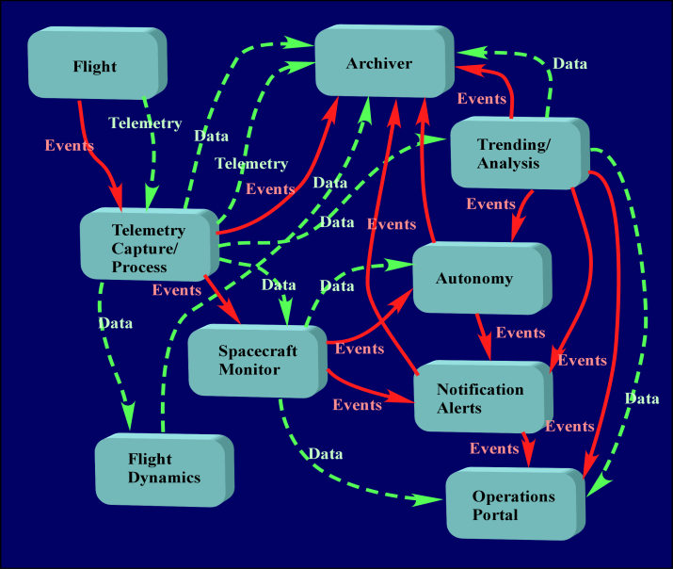
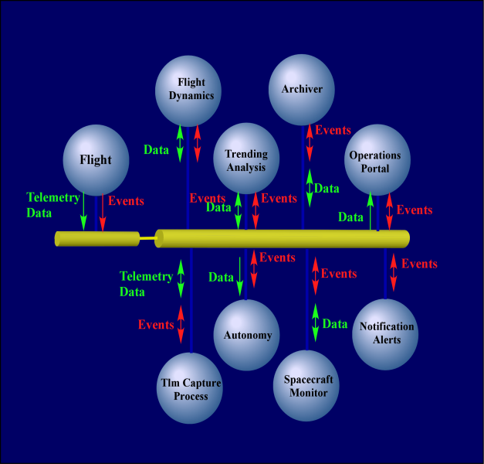
History of Software System Architectures
Shared Commons
(1970’s -1980’s)
Traditional Design
Socket Connections
Current Advanced Designs
Middleware Connections
Process
Process
Shared
Commons
Process
Shared
Global
Common
Process
API and Middleware
Process
Process
GMSEC software applies modern development approaches to ground system applications.

Slide 4

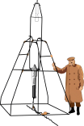













GMSEC and the Satellite Control Domain
MSFC
Avtec Systems
DesignAMERICA
Users can choose the best products for their needs. Nearly all COTS command and control systems are now GMSEC compatible.

Slide 5
GMSEC Framework
The GMSEC Framework consists of the GMSEC API, standardized GMSEC messages , and an underlying middleware to interface with other components.
GMSEC supports a number of programming languages, COTS and GOTS middleware products, and operating systems.
Appliances
Programming languages: C, C++, Java, and Perl
Middleware Products: TIBCO SmartSockets, Apache ActiveMQ, IBM WebSphere MQ, GMSEC Message Bus, Oracle Weblogic
Operating Systems: Microsoft Windows XP (32 & 64 bit), Microsoft Windows 2003 Server; Red Hat 3, 4, 5 & 6 (32 bit & 64 bit); Solaris 10; Mac-Intel OSX;

Slide 6
Applications Programming Interface (API)
Features:
Provides a set of common message communication functions with both synchronous and asynchronous delivery mechanisms:
Connection Services: connect, disconnect
Message Services: create message, add field(s) to message, get next message, and destroy messages
Message Interchange Services: publish/subscribe, request/reply
Each application uses the connect service to establish communications with the middleware, and uses the publish/subscribe and/or request/reply services for passing messages. Applications subscribe only to those desired messages.

Slide 7
GMSEC Components
GREAT – GMSEC Message Visualization/Storage
GEDAT – GMSEC System Display
SA – GMSEC Node Interface
RAA – GMSEC Environmental Data Tool
GPD – GMSEC Parameter Display
CAT – GMSEC Automation/Action Tool
ANSR – GMSEC Paging Tool
GRASP – GMSEC Remote Data Access Tool

Slide 8
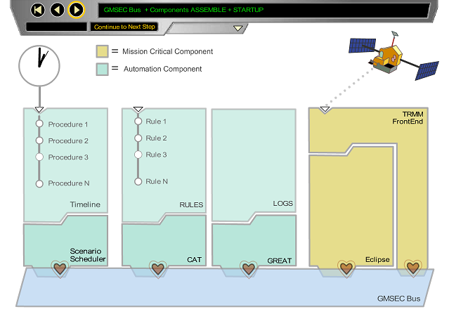
GMSEC Animation Example

Slide 9
GMSEC Reusable Events Analysis Toolkit (GREAT)
GREAT is a collection of GMSEC compliant components for analyzing messages in a GMSEC architecture system. It is consists of 4 tools:
Event Analyzer (EAN) receives message over the middleware according to the subscription(s).
  Remote Access Event Analyzer (Historical Retrieval) – remotely query the Event Archive database for archived GMSEC messages via the Event Analyzer Remote Query website. It is configurable via the XML configuration file. Also include the option of saving the result to html file.
Event Archive (EAR) receives messages over the middleware according to the subscription(s) and stores them in the database, which provides a platform for event retrieval, event analysis, and report generation. It also accepts directives to insert a record into the database using information contained in a message field.

Slide 10
GREAT (cont)
Event Report (ERP) provides the capability to create and/or edit customized report template(s) and accepts directives over the middleware to generate reports. The process of report generation involves data retrieval from the database and populates the database field in the template
database
report
EAR
EAN
GREAT
components
ERP
GMSEC Middleware

Slide 11
GMSEC Environmental Diagnostics Analysis Tool
(GEDAT)
Overview
The GMSEC Environment Diagnostic Tool (GEDAT) provides a visual representation of the GMSEC environment. The display shows numerous network components performing message-based publish/subscribe communications via one or more GMSEC message buses. The display is intended to be a common software application capable of displaying data system activity at any level within the network.
Key Features
  Identifies components and tracks status by monitoring heartbeat messages
  Provides drill down access to detailed component information
  Display can be initialized with an expected environment
  Collects and plots node resource information (CPU, memory, network, disk utilization)
  Brings attention (audible/visual) to key events such as spacecraft passes, telemetry downlinks, alert notifications
  Provides user configurable buttons to publish messages

Slide 12
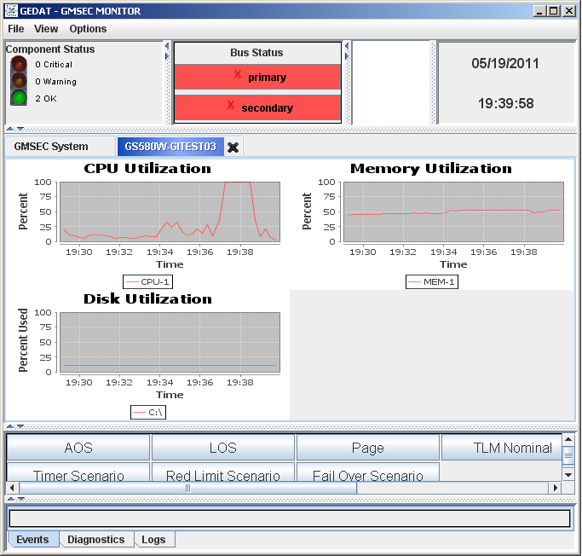
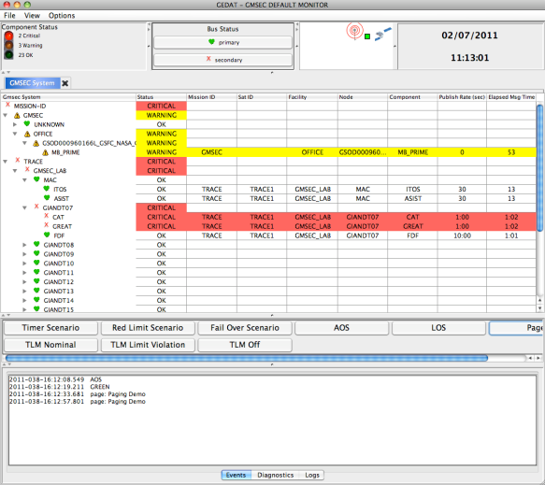
GEDAT (cont)

Slide 13
System Agent (SA)
Overview
The GMSEC System Agent (SA) is a GMSEC-compliant software component that provides health information about the computer hosting the agent to other GMSEC components utilizing a middleware-based architecture. Monitoring more than one workstation can quickly turn into a tedious and expensive task. Having an agent that reports a machine’s health status using the middleware paradigm can support a more generic, automated, and centralized monitoring tool for the entire GMSEC system.
GMSEC Features
Messages can be displayed using GMSEC Environment Diagnostic Tool (GEDAT) allowing Flight Operations Teams (FOT)s to monitor the health of the entire GMSEC system in one centralized location.
Resource messages contain information such as: Percentage of CPU utilized, Amount of total physical memory, Percentage of each disk space among others.
Criteria Action Table (CAT) rules can be used to send commands to SA for error detection and correction. Ex. If the CPU usage is too high, CAT will send a Directive Request to the SA, and the agent will take a corrective action such as rebooting the machine.

Slide 14
System Agent
SA, GEDAT, other GMSEC components
SA, GREAT, other GMSEC components
GMSEC Message Bus
SA, CAT, other GMSEC components
SA, ANSR, other GMSEC components
GMSEC system using SystemAgent

Slide 15
Room Alert Adapter (RAA)
Overview
The GMSEC Room Alert Adapter is a GMSEC-compliant software component that provides an interface between AVTECH Room Alert™ environmental devices and the GMSEC message bus. The Room Alert™ device supports various sensors including: temperature, humidity, power, flood, etc. The devices enables 24/7 remote situational awareness of environment conditions, as well as detects and reports anomalous conditions with immediate alert notifications (email, email-to-SMS, SNMP, web page).
GMSEC Features
Parameters from each Room Alert device can be shown on a local display (GEDAT, GPD).
Alerts and status can be archived & retrieved using a GMSEC-compliant event analysis toolkit (e.g. GREAT).
Automatic corrective action, such as failovers, can be defined and implemented with a configurable rule-based component (e.g. CAT).
Comprehensive paging and notification capabilities are available using the GMSEC ANSR or Attention Software.

Slide 16
Room Alert Adapter
Room Alert Adapter Architecture Diagram

Slide 17
GMSEC Parameter Display (GPD)
Overview
The GMSEC Parameter Display is a GMSEC-compliant software component that enables the users to quickly create and view a display page consisting of parameter and telemetry mnemonic values. The GPD operates within a GMSEC architecture-based system. As such, it utilizes standard GMSEC messages to request the user-defined parameters from various data providers. The parameters and their values received from the data providers will be displayed, as is, to the display pages.
In addition to displaying the telemetry values, the GPD also displays the attributes associated with the telemetry mnemonic values. Both text and color are used to show the mnemonic attributes and provide a visual delineation of their status. From the display, the user can quickly assess the value and state of the displayed parameters.

Slide 18
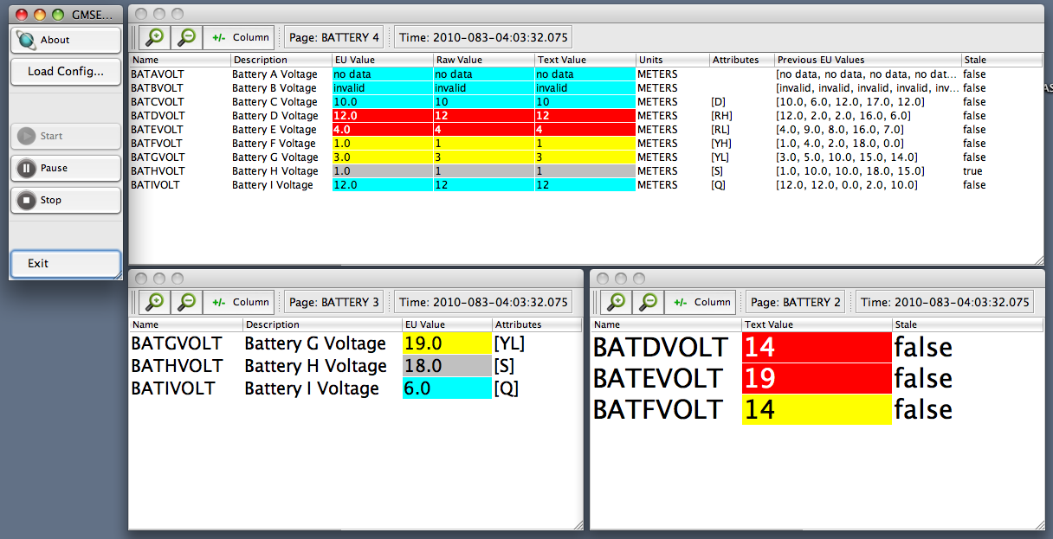
GMSEC Parameter Display

Slide 19
Criteria Action Tool (CAT)
Overview
The Criteria Action Table (CAT) is an autonomic computing tool for spacecraft ground systems under the GMSEC architecture. CAT captures data from its managed elements and environment, performs the data analyses to generate the actionable data, and makes decisions based on the combination of the actionable data and the rules or policies from the management. This results in actions being sent as either GMSEC standard Directive messages or event Log messages to the relevant component.
GMSEC Features
Automates detection of anomalous conditions
Provides more automation and autonomy to mission operations
Assists in efficient ground system operations
Non-Intrusive to Current Missions (monitor only mode)
Simple to complex monitoring criteria are user configurable
GUI rule editor to allow easy creation of rules and monitors

Slide 20
CAT Diagram

Slide 21
Alert System Notification Router (ANSR)
Overview
The GMSEC Alert Notification System Router (ANSR) is a GMSEC-compliant software component used in mission operations for operator notification and paging. Notifications are done through standard devices, such as pagers and emails. ANSR is commonly used in GMSEC supported ground systems as the notification gateway between an automated system and the operators.
GMSEC Features
ANSR can be instructed to send pages by other GMSEC-compliant components, for example, using the Criteria Action Table (CAT)
ANSR broadcasts the status of pages to the entire GMSEC system, but does not require any component to listen or react to these messages. Other components, such as the GMSEC Reusable Event Analyzer Toolkit (GREAT), can collect and archive the messages.
ANSR can be configured to select which operators to be paged and e-mailed, as well as configuring if the messages need to be acknowledged or not, among other options.

Slide 22
Alert System Notification Router (ANSR)

Slide 23
GMSEC Remote Application Service Provider (GRASP)
Overview
The GMSEC Remote Access Service Provider (GRASP) is a GMSEC-compliant software component that provides the capability for users to access selected GMSEC messages from a web server operating in an unsecure space without risk of contamination to the secure GMSEC network. It also provides access to selected functional capabilities via the GMSEC Directive Request message.
GMSEC Features
Provide a means for messages to be sent from a secure GMSEC network to a web server, ensuring that the messages are encrypted and signed, if GRASP is configured to encrypt and sign.
Provide the administrators of the secure GMSEC network the ability to control by subject which messages are pushed to the web server.
Provide assurance that no information from the web server shall be placed in the secure GMSEC network.
Provide a general-purpose capability for messages to be available to web applications. The messages must be available in such a way that they can be accessed by any Java based web application framework.

Slide 24
GRASP Diagram
Secure Environment
Remote Device
Remote Device
GMSEC Bus
WASP Environment
Web Application
Web Application
Heartbeat & Log
Data & Directive
Web Application Service Provider (WASP)
Message Provider (MP)
Intercomponent Communication

Slide 25
GMSEC Multi-Component Synergy
Environmental Alert Scenario
Red Limit Exceeded Scenario
Component Failover Scenario
Middleware Failover Scenario

Slide 26
Final Notes
GMSEC is not a radical technology
GMSEC currently being used by many operational missions
Many in-house and out-of-house components that are GMSEC compliant to meet mission requirements
The value is that it addresses key issues for a certain class of users
  Allows for use or mix of heritage or COTS software
  Evolvable over time
  Does not assume “one size fits all” will work
  Does not enforce a specific operations concept
  Simple enough for vendors to invest in
Air Force, NRO, ORS are moving in this direction
Appropriate architecture for more than just satellite control

Slide 27
Additional GMSEC Information
Dan Smith, Project Manager
NASA Goddard Space Flight Center
Code 580
Greenbelt, Maryland 20771
301-286-2230
dan.smith@nasa.gov
LaMont Ruley, Product Development Lead
NASA Goddard Space Flight Center
Code 583
Greenbelt, Maryland 20771
301-286-5805
LaMont.T.Ruley@nasa.gov
GMSEC e-mail: GMSEC@nasa.gov
GMSEC Public Website: http://gmsec.gsfc.nasa.gov
  General, high level, copies of component fact sheets
Other materials available on request.

Slide 28
Acronym List
API | Application Programming Interface |  | MSFC | Marshall Space Flight Center
APL | Applied Physics Laboratory |  | NASA | National Aeronautics and Space Administration
CCB | Configuration Control Board |  | NOAA | National Oceanic and Atmospheric Administration
CMMI | Capability Maturity Model Integrated |  | NRO | National Reconnaissance Office
COTS | Commercial Off The Shelf |  | OGA | Other Government Agencies
CSTL | Communications, Standards, and Technology Laboratory |  | OPS | Operations
Cx | Constellation |  | ORS | Operationally Responsive Space
ESA | European Space Agency |  | OS | Operating System
ESTO | Earth Science Technology Office |  | OTF | Operations Technology Facility
FDF | Flight Dynamics Facility |  | RBSP | Radiation Belt Storm Probes
GLAST | Gamma-ray Large Area Space Telescope |  | RFP | Request For Proposal
GMSEC | Goddard Mission Services Evolution Center |  | SAMPEX | Solar Anomalous and Magnetospheric Particle Explorer
GOES | Geostationary Operational Environmental Satellites |  | SDO | Solar Dynamics Observatory
GOTS | Government Off The Shelf |  | SMEX | Small Explorer
GPM | Global Precipitation Measurement |  | SOA | Service Oriented Architecture
GSFC | Goddard Space Flight Center |  | ST-5 | Space Technology 5
ISS | International Space Station |  | SWAS | Submillimeter Wave Astronomy Satellite
JSC | Johnson Space Center |  | TLM/CMD | Telemetry and Command
LDCM | Landsat Data Continuity Mission |  | TRACE | Transition Region and Coronal Explorer
LRO | Lunar Reconnaissance Orbiter |  | TRL | Technology Readiness Level
MMOC | Multi-mission Operations Center |  | TRMM | Tropical Rainfall Mapping Mission
MMS | Magnetospheric MultiScale |  | USGS | United States Geological Survey
MOC | Mission Operations Center |  | WIRE | Wide-Field Infrared Explorer

