Slide 1
BCG Account Management
Postage Assessment Key Roles
Signup, Review, Update
October 27, 2016

Slide 2
VAE Service Management

Slide 3
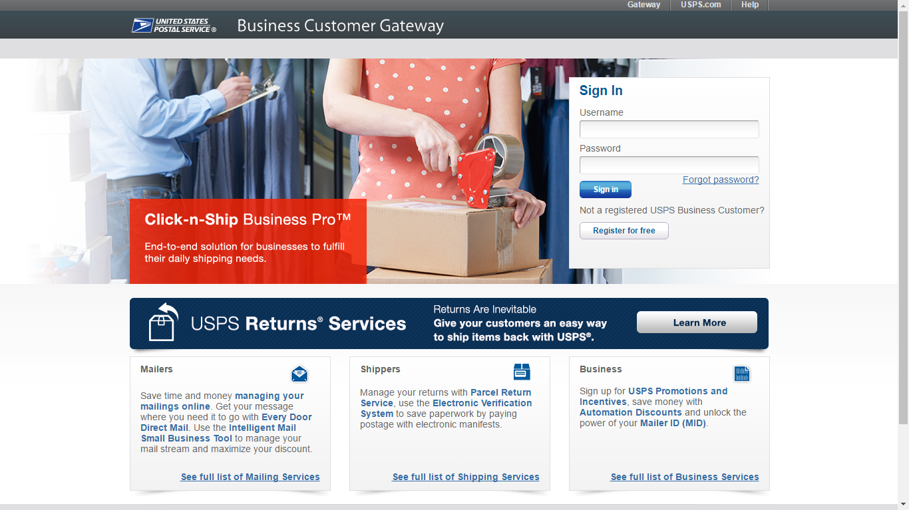
VAE Update/Signup
Every Full-Service mailer must have an employee registered in the Business Customer Gateway with access to the Verification Assessment Evaluator (VAE) Service

Slide 4
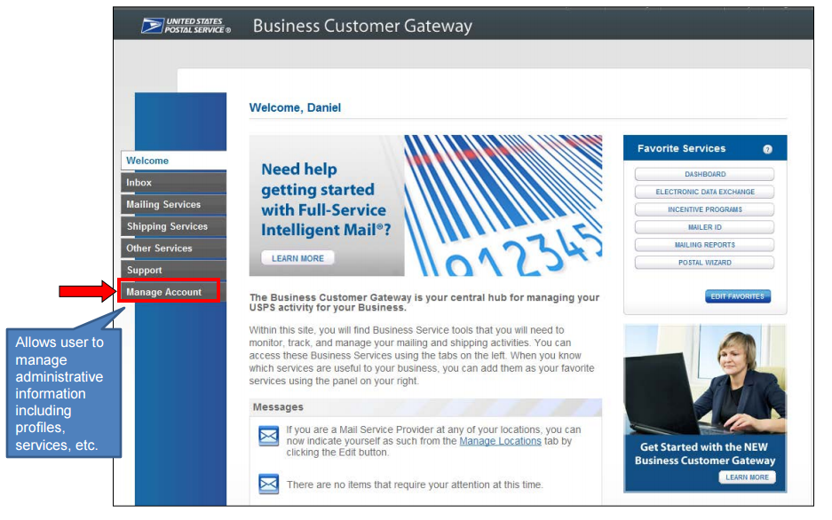
Checking VAE Status
To check VAE assignments, the Business Service Administrator logs into BCG and selects Manage Accounts
Every mailing location participating in Full-Service must be created in BCG, which will have a BSA user

Slide 5
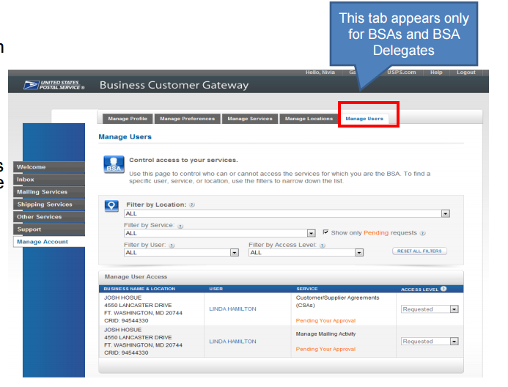
Looking at VAE Services
Users with BSA access can view a Manage Users tab

Slide 6
Looking at VAE Services
On this tab, you want to set Filter by Service to “Verification Assessment Evaluator” and select a business location. Leave all other filters at “All”

Slide 7
Confirming a user has access to VAE services
The search will return a list of all users at a location, and show their status for the VAE service.

Slide 8
Confirming a user has access to VAE services
BSAs should confirm that at least one user has access to the VAE service.
If no user has access, the BSA can grant a user access from this screen.

Slide 9
Granting Access to VAE Services
If no user has VAE Access, the BSA can grant access to a user using the dropdown on the Manage Users screen
BSAs need to repeat the previous steps for all mailing locations, until a VAE has access at each site.

Slide 10
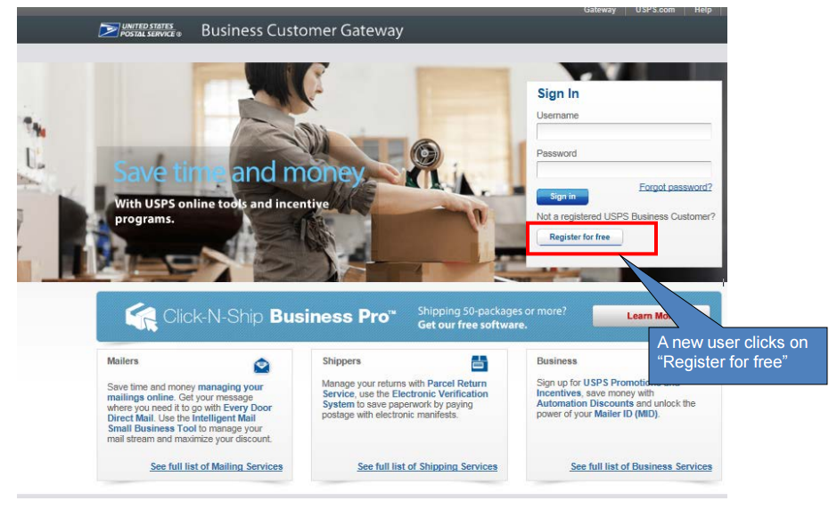
Registering New Users
If a Full-Service mailer needs to create new user accounts and assign them VAE access, the new user and BSA complete the following steps.

Slide 11
Registering New Users
New users start the process by registering for an account.

Slide 12
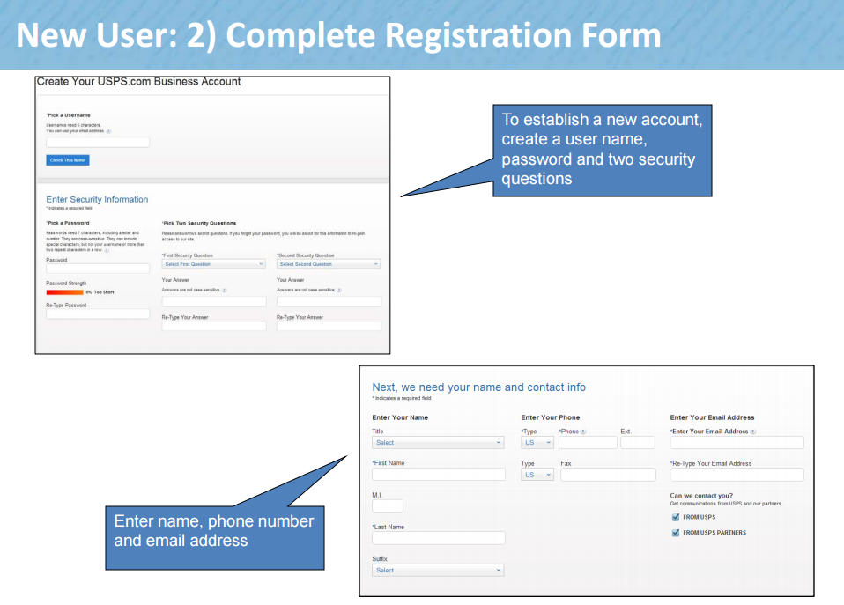
New User Registration

Slide 13
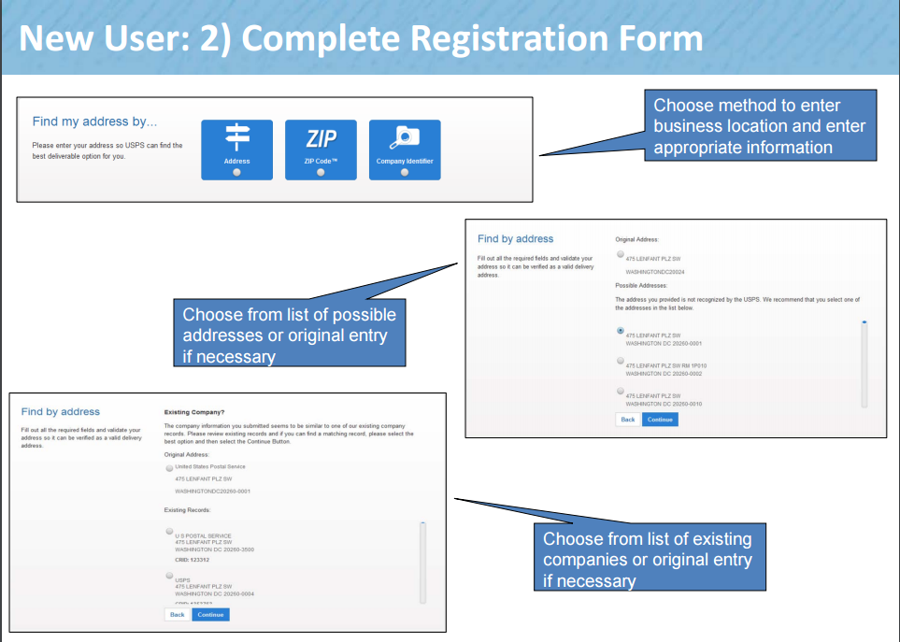
New User Registration

Slide 14
New User Registration

Slide 15
New User Registration

Slide 16
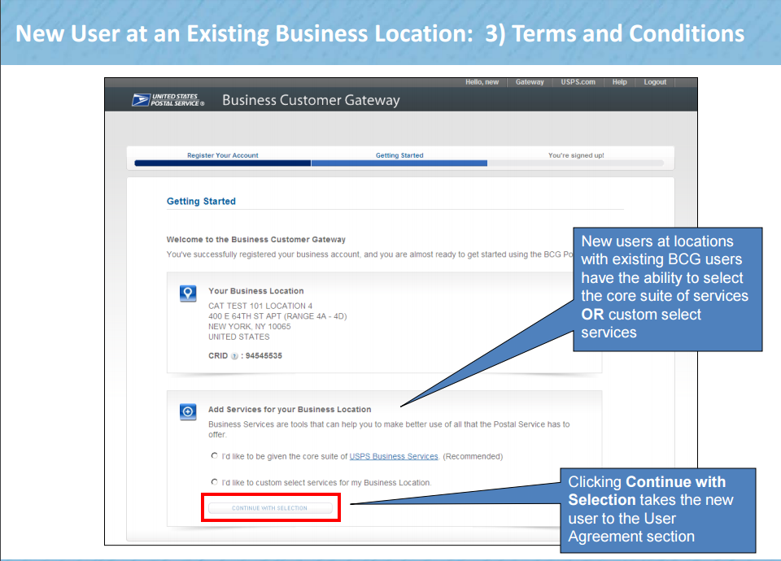
New User Registration
Once the new account is created, the user will request access to VAE Services.
VAE is a custom service.

Slide 17
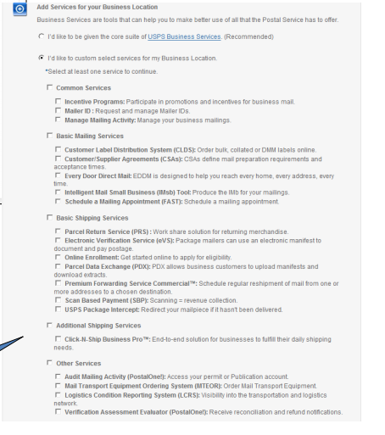
New User Registration
New users select the radio button next to Verification Assessment Evaluator to request VAE services

Slide 18
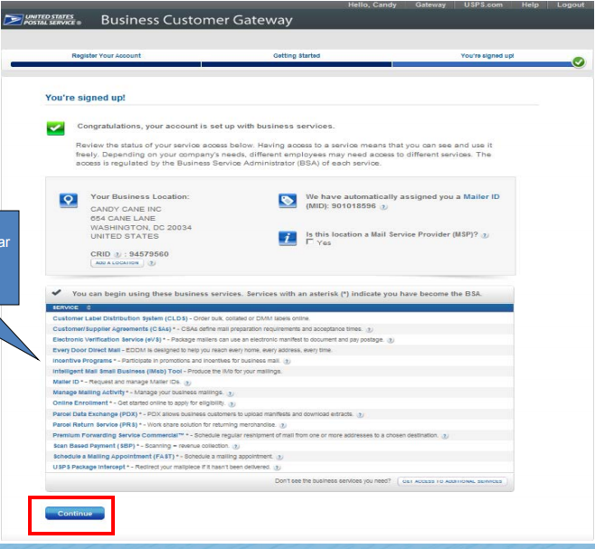
New User Registration
New users will confirm that VAE is listed as a service before confirming registration

Slide 19
New User Registration
!Critical Step!
The BSA must approve the new users request for VAE Services.
The easiest way to approve the requests is to use the Manage Users tab on the manage services page.

Slide 20
Mail Owner Registration

Slide 21
Mail Owner-New User Registration
Notes:
The following slides will illustrate how to register for a new account, navigate to the Business Customer Gateway by typing in gateway.usps.com. Click on “Register for Free” on the BCG home page.

Slide 22
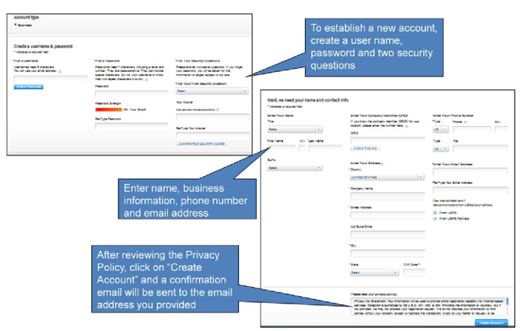
Mail Owner-New User Registration
Notes:
To establish a new account, create a user name, password and two security questions. Enter your name, company name and address, phone number and email address. This information will be used to create a CRID for you upon completion of registration.
After reviewing the Privacy Policy, click on “Create Account” and a confirmation email will be sent to the email address you provided

Slide 23
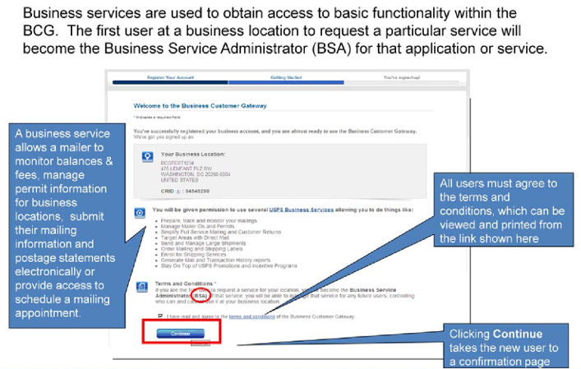
Mail Owner-New User Registration
Notes:
Upon successful registration, a user will eligible to take advantage of the services offered within the BCG. Remember. business services are used to obtain access to basic functionality within the BCG. Business services pertinent to full-service allow a mailer to monitor balances & fees, manage permit information for business locations, submit their mailing information and postage statements electronically or provide access to schedule a mailing appointment.
Remember that the first user at a business location to request a particular service will become the Business Service Administrator (BSA) for that application or service. The BSA manages that service for any future users, controlling who can and cannot use it at a business location.

Slide 24
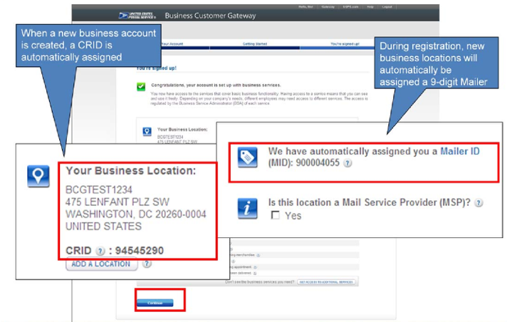
Mail Owner-New User Registration
Notes:
We will talk about the confirmation page in the next two slides. In the top half of the confirmation page, you can see a CRID and a 9-digit MID have been assigned to the new account. Remember that a CRID is a unique ID number issued by USPS to identify a customer’s physical business location (address). When you entered your company name and address during the registration process, this was used to create the CRID. A MID is a six- or nine-digit number issued by USPS to a mail owner or mail service provider. You can see it has also been automatically assigned during the registration process.
Now let’s talk about the information contained in the bottom half of the confirmation page.

Slide 25
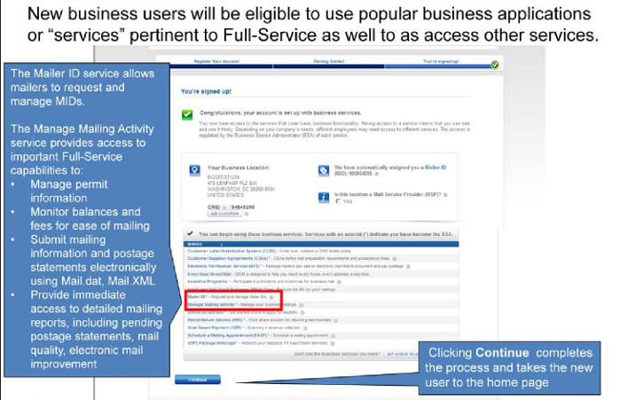
Mail Owner-New User Registration
Notes:
Toward the bottom of the confirmation page you will see the list of services for which the new user is eligible. New business users will be eligible to use popular business applications or “services” pertinent to Full-Service as well as access other services. Two services pertinent to Full-Service capabilities are the Mailer ID service and the Manage Mailing Activity service. The Mailer ID service allows you to request and manage Mailer IDs. In the next slide, we will talk briefly about how and why existing users may want to obtain multiple MIDs.
The Manage Mailing Activity service provides access to important Full-Service capabilities to:
Manage permit information for business locations
Monitor balances and fees for ease of mailing
Submit mailing information and postage statements electronically using Mail.dat, Mail.XML
Provide immediate access to detailed mailing reports, including pending postage statements, mail quality, electronic mail improvement,
In a few moments, we will talk more about an essential step of managing

Slide 26
Mail Owner-New User Registration
Notes:
Toward the bottom of the confirmation page you will see the list of services for which the new user is eligible. New business users will be eligible to use popular business applications or “services” pertinent to Full-Service as well as access other services. Two services pertinent to Full-Service capabilities are the Mailer ID service and the Manage Mailing Activity service. The Mailer ID service allows you to request and manage Mailer IDs. In the next slide, we will talk briefly about how and why existing users may want to obtain multiple MIDs.
The Manage Mailing Activity service provides access to important Full-Service capabilities to:
Manage permit information for business locations
Monitor balances and fees for ease of mailing
Submit mailing information and postage statements electronically using Mail.dat, Mail.XML
Provide immediate access to detailed mailing reports, including pending postage statements, mail quality, electronic mail improvement,
In a few moments, we will talk more about an essential step of managing permit information within the BCG. Click continue to complete the registration process and access the BCG home page.

Slide 27
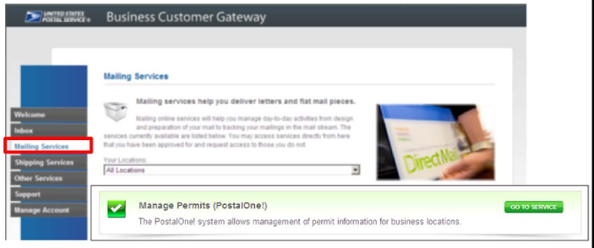
Mail Owner-Linking Permits
Mail Owners can link permits to BCG accounts by:
Calling the USPS PostalOne! helpdesk for assistance
Select Mailing Service>Manage Permits on the BCG homepage
Notes:
Now that we have registered and created a new user account let’s talk about how we link our permit information in the BCG. Before you can view any of your mailing information, you must establish a link between your new BCG account and your mailing permit, if you have one. There are two ways to establish this link. If you are a new USPS customer and do not have any historical payment transactions, you should contact the Help Desk for assistance. If you are an existing USPS customer with historical payment transactions, you may utilize the BCG by going to “Mailing Service” at the BCG Welcome page and then under the “Manage Permits”section, click on “Go To Service.”

Slide 28
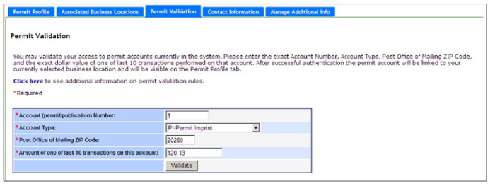
Mail Owner-Linking Permits
The BCG needs to validate that you won the permit to be linked.
Enter the permit information and the value of one of the ten last transactions on the permit
Once validated, the permit is linked to the BCG account and CRID
Notes:
Enter the Permit Type, Permit Number, and Permit ZIP of Post Office where the mailing permit is held. Enter one of the last 10 transaction amounts for your permit and click “Validate”. Once validated, the permit will appear on the “Permit Profile” tab. You will now be able to view all applicable mailing activity for this permit. If you don’t know your transaction amount or have not yet mailed with this permit, contact the PostalOne! Help Desk for permit linkage assistance

