Slide 1
Full-Service Mail Quality Metrics Hotline Call

Slide 2
Postage Assessment Process
Full-Service Postage Assessment to begin:
November based on October data
Industry Testing Timeline:
On September 11, 2016
Postage assessment generated
Viewable through Business Customer Gateway
Auto Generated email sent to VAE for any eDOC Submitter CRIDs with or without postage due.
Mailers will have the opportunity to test the “Review” functionality
Mailers will NOT be able to utilize the “Pay” functionality
Full-Service Hotline calls will remain in place through October for mailers to raise any questions or issues pertaining to Full-Service Mail Quality Metrics or the Full-Service Postage Assessment Process

Slide 3
Postage Assessment Overview
Mailer Scorecard
Mail Entry Postage Assessment Report
Verifications
All errors are logged during a month
Thresholds
Assessments
Only applied to errors in excess of thresholds at end of month
Thresholds drive quality improvement
If the percentage of error is below the established threshold or if the additional postage due is less than $50, then no additional postage is assessed
Postage Assessments are generated only to the eDoc submitter
Notes:
Results from verifications performed throughout the month are displayed on the Mailer Scorecard. These verifications are measured against established thresholds and those that exceed the thresholds will be assessed additional postage. For example, the full-service program uses the submitted eDoc to verify the Mailer ID (MID) in a piece’s barcode. A MID error is logged for each piece in the mailing that fails this verification. When the number of MID errors exceeds the established threshold, the eDoc submitter will be assessed on those errors over threshold for the calendar month. If the percentage of error is below the established threshold or if the additional postage due is less than $50, then no additional postage is assessed. It is important to note that postage assessments are generated only to the eDoc submitter.

Slide 4
Postage Assessment Overview
Mailers can login through the Business Customer Gateway as an eDoc submitter or Mail Owner / Mail Preparer to view their Full-Service Mail Quality Metrics
Notes:
Mailers can login to the Mailer Scorecard through the Business Customer Gateway as an eDoc submitter or Mail Owner / Mail Preparer. Mail Service Providers/Mail Preparers can access their mail quality results at the CRID level by logging into through the eDoc submitter view. This provides a summary of all mailings throughout the calendar month with any errors and postage assessments displayed for review. The Mailer Scorecard gives Mail Service Providers access to individual mail owners’ Scorecards by logging in through the mail service provider/mail owner view. This will display the dashboard summary for each of the mail owners attributed to the Mail Service Provider eDoc Submitter CRID. Through this same view, Mail Owners have the ability to review their mail quality results across mail service providers. Mail Owners will only see results for mailpieces, handling units, and containers where they are identified as the Mail Owner when they are correctly identified as the Mail Owner in the By/For fields within the electronic documentation (eDoc). Please note that thresholds are not provided on the Mail Owner view of the Mailer Scorecard.

Slide 5
Full-Service Updates
eDoc
Verifications
Description
Mailer ID
Threshold 2%
MIDs in the IMcb, IMtb, & IMb™ as listed in the eDoc must be valid and assigned by the USPS®
Service Type ID
Threshold 2%
The STID in the IMb as listed in the eDoc must be valid and correct for the mail class and service level of the mailpiece
By/For
Threshold 5%
By/For –The mail owner and preparer must be identified correctly in the eDoc for a mailing with 5000 pieces or more per day for a single mail owner
Barcode Uniqueness
Threshold 2%
Unique Barcodes in the IMcb, IMtb, & IMb as listed in the eDoc must be unique across all mailings from all mailers over the previous 45 days
Entry Facility
Threshold 2%
The Entry Facility for a container or handling unit as listed in the eDoc must match the entry facility from the Mail Direction File or the Facilities Database
Unlinked Copal
Threshold 5%
All trays/virtual sacks marked for co-palletization at origin must have corresponding eDoc linking to a pallet within 14 days

Slide 6
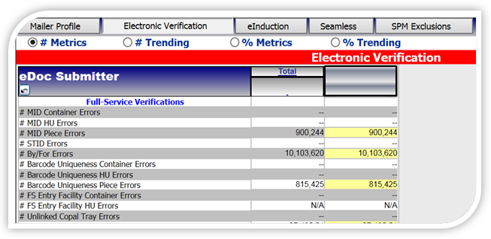
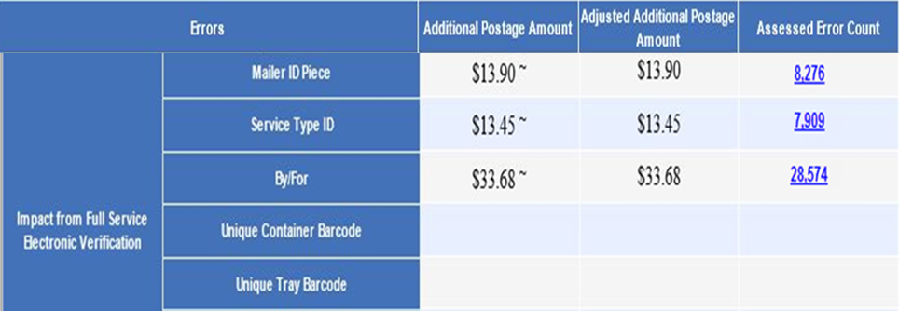
Postage Assessment Overview
Mailer Scorecard displays ALL errors for the calendar month
Mail Entry Postage Assessment Report displays the total number of only the invoiceable errors
Notes:
Thus, the Mailer Scorecard is used to generate the Mail Entry Assessment Report. The difference is that the Mail Entry Postage Assessment Report displays the total number of only the invoiceable errors, whereas the Mailer Scorecard displays ALL errors for the calendar month. A hyperlink from the Assessment Detail report displays the total error count and total percentage each Mail Owner contributed to the overall errors, not just the assessed pieces displayed on the Assessment Report. This drill down matches the total errors on the Mailer Scorecard and allows MSPs to identify top offenders at the mail owner level in order to reallocate the assessment back to the Mail Owners. We’ll discuss the Mail Entry Postage Assessment Report in more detail in Module 2.

Slide 7
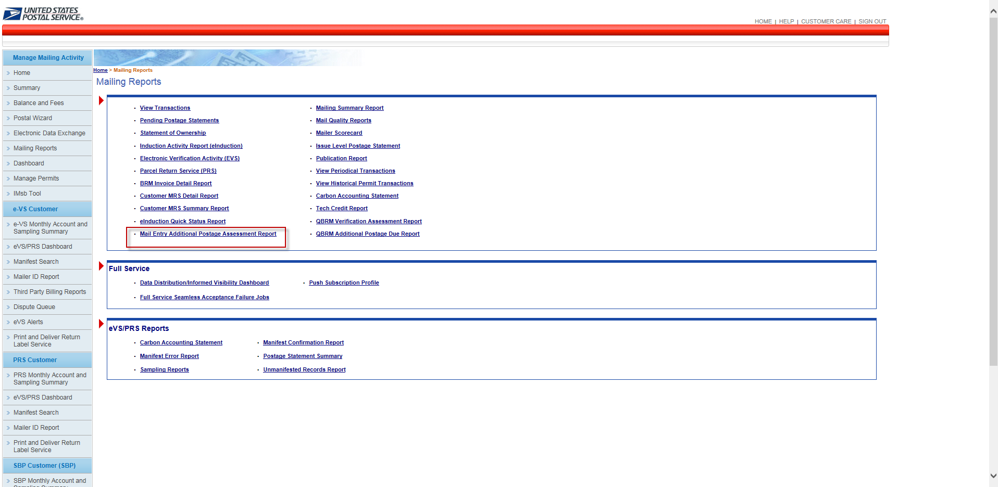
Postage Assessment

Slide 8
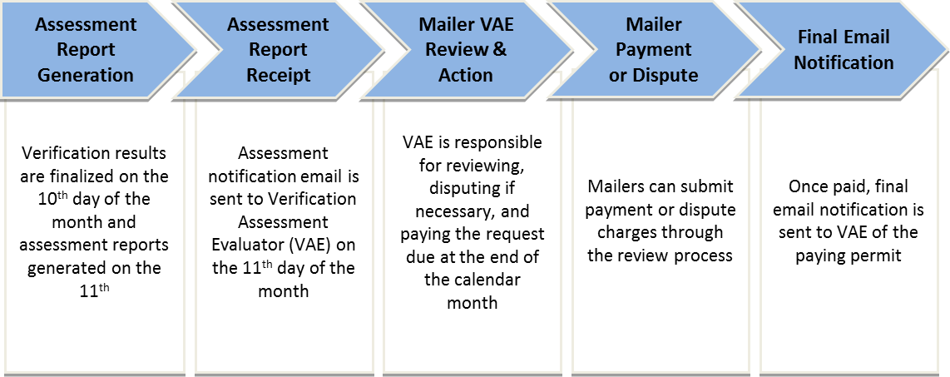
Postage Assessment Process
Notes:
Postage Assessment reports are generated at the eDoc submitter CRID level on the 11th day of the month and a notification email is sent to mailers’ self-appointed Verification Assessment Evaluator (VAE). The VAE is an employee of the mailer who has been assigned permissions in the BCG to review the accuracy of verification assessments and pay any additional postage. A VAE should be designated for each CRID used by the mailer.
eDoc submitters must either pay the assessed amount upon receipt of postage assessment notification, or request review of the postage assessment charges within 10 business days of the email notification. BME Acceptance employees/BMS analysts will work with the mailers who dispute the charges to resolve the issue and may request additional supporting documentation from mailers if needed. Finally, BME/BMS analysts will make a decision based on their findings and a review of the documentation provided by the mailer by the end of that month. The updated amount of postage assessed will be due three business days later.
If payment is not received within 10 business days of initial notification (or three business days after a dispute is resolved), then the Postage Assessment will be considered “Overdue.” BME/BMS analysts will escalate any overdue postage to their designated Managers. If the designated Manager is unable to work with the mailer to resolve the postage review request, postage due will be escalated to Revenue and Field Accounting (RAFA) for collection.
Remember, Postage Assessments will not be generated for assessments less than $50. This $50 is the total across all programs, not at the individual level.

Slide 9
Postage Assessment Review
eMail Notifications for Full-Service Assessments are sent to the eDoc Submitter CRID when:
On the 11th of each month regardless if additional postage is due for Full-Service Assessment
Assessment is paid
Mail Owner of paying permit will receive an email notification
Assessment is in Review
Assessment in “Payment Due” Status after Review
Assessment Closed and/or When Adjusted Postage Due is Below $50.00
Assessment is Past Due
Email notification is sent to VAE users of eDoc Submitter CRID when assessment is put into "Past Due" status
Occurs when VAE did not act upon assessment in the stipulated time (10 business days after assessment is generated or 3 business days after assessment review is closed)
Notes:
An email notification is sent to a BMA reconciliation analyst and to the Mailer disputing the assessment confirming that the assessment is in review. The assigned Acceptance employee will contact the mailer to gather documentation and attempt to exclude any USPS system or process issues that could have contributed to a miscalculation.

Slide 10
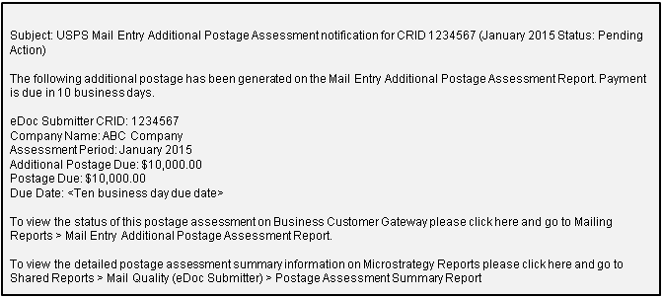
Postage Assessment Process
Sample email
Notes:
An email notification of postage assessment generation is sent to the designated VAE for all CRIDS participating in at least one of the following programs: Full-Service, eInduction, Seamless Acceptance, or Move/Update, even when there is $0 Additional Postage Due for the calendar month. The email will contain hyperlinks to the report itself.

Slide 11
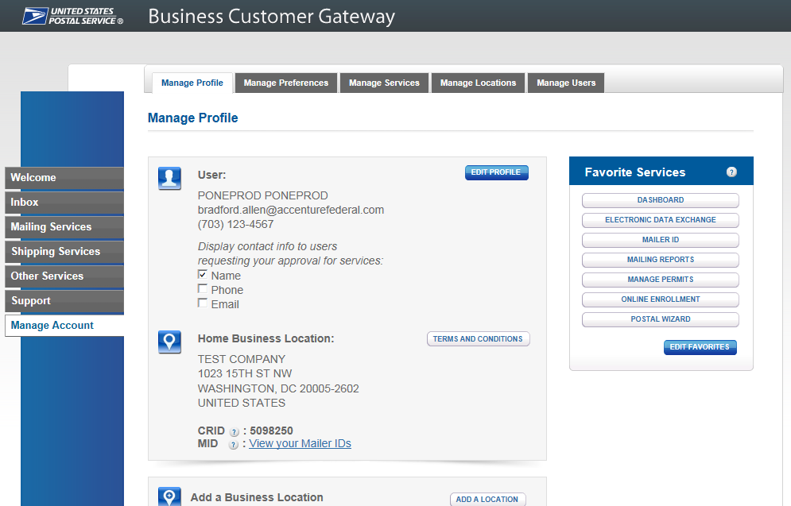
Postage Assessment Process
Upon receipt, the mailer VAE should log into the Business Customer Gateway to review the Mail Entry Postage Assessment Report and pay the outstanding amount due, if applicable
Notes:
Once notification is received, the mailer can login to the BCG to review the Mail Entry Additional Postage Assessment Report. To do so, the mailer VAE signs into Business Customer Gateway and selects “Other Services” option from left sidebar to access the online services screen.

Slide 12
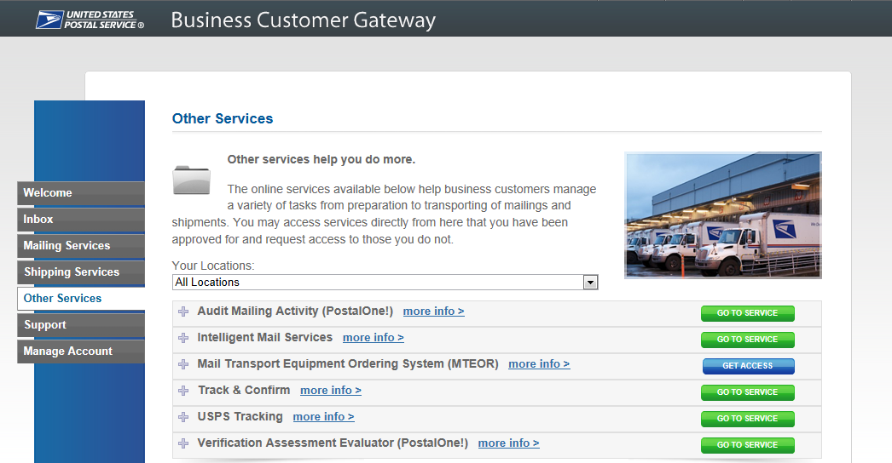
Postage Assessment Process
Mailer VAE enters VAE screen by clicking on the green “Go to Service” next to Verification Assessment Evaluator (PostalOne!)
Notes:
Then, the Mailer VAE enters VAE screen by clicking on the green “Go to Service” next to Verification Assessment Evaluator (PostalOne!)

Slide 13
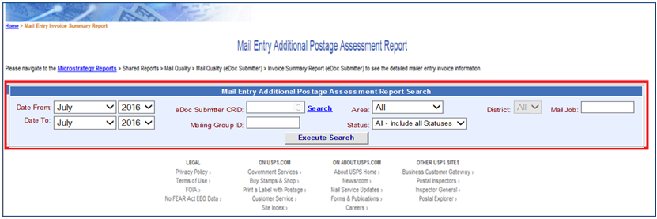
Postage Assessment Process
Mailer VAE can search for postage assessment by entering the eDoc submitter CRID and/or date range, then click “Execute Search”
Notes:
The Mailer VAE can then search for postage assessments by entering the eDoc submitter CRID and/or date range (if left blank, assessments for all CRIDs to which the user has VAE access will appear), then click “Execute Search.”

Slide 14
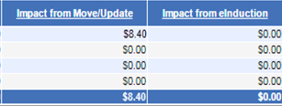
Mail Entry Additional Postage Assessment Report
These steps will bring the Mailer VAE to the Mail Entry Postage Assessment Report, where all active assessments for a CRID are listed and ready for review
14
Notes:
These steps will bring the Mailer VAE to the Mail Entry Postage Assessment Report, where all active assessments for a CRID are listed and available for review. The fields on this report include: [Incentive Services: bullets below correspond to the animation]
eDoc submitter CRID. Clicking on the hyperlinked CRIDs in this column lead to the Additional Postage Assessment Detail Report
Company Name. Note: it is possible to filter the results shown here so that the results display in alphabetical order
Assessment Period
Impact from Seamless
Impact from Move Update
Impact from eInduction
Impact from Full-Service Electronic Verification
The amounts listed in these four columns will display in green when additional postage is due
Additional Postage Due
Adjusted Additional Postage Due
Postage Due
Status
and, Action, which provides the user with two options: request review, or pay

Slide 15
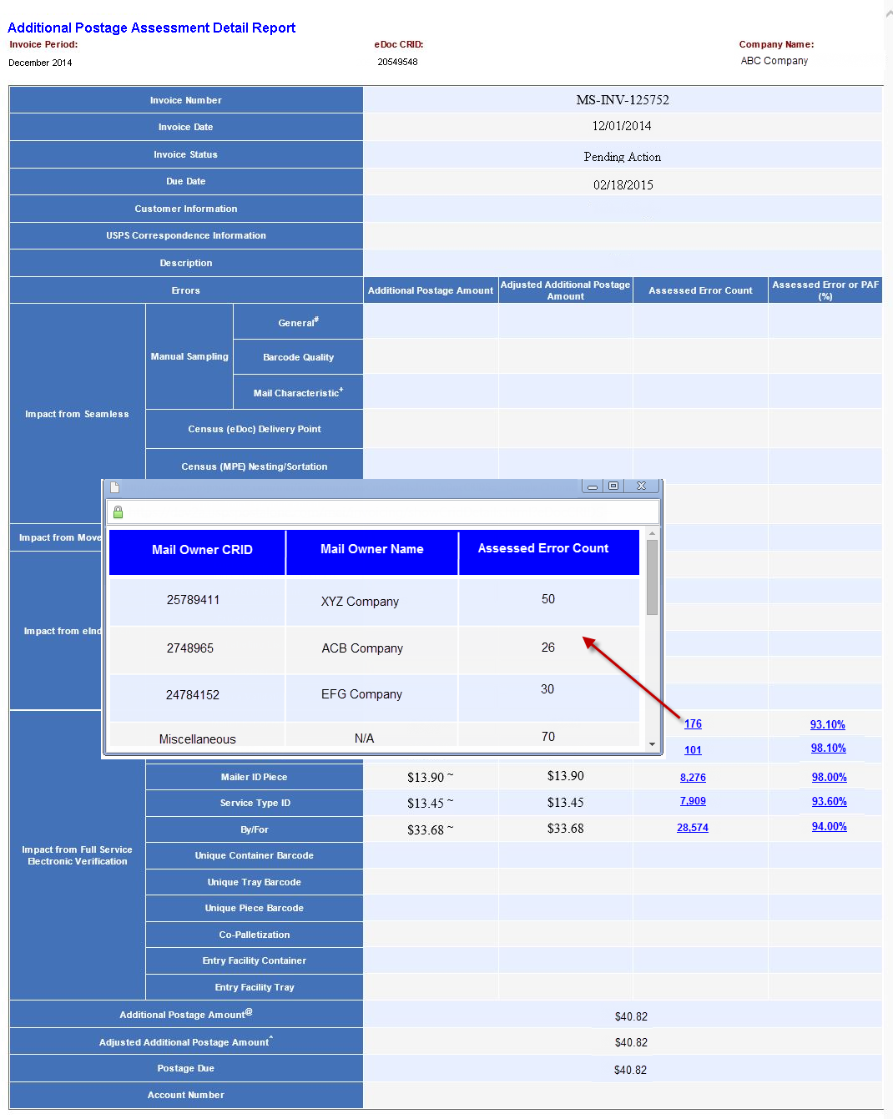
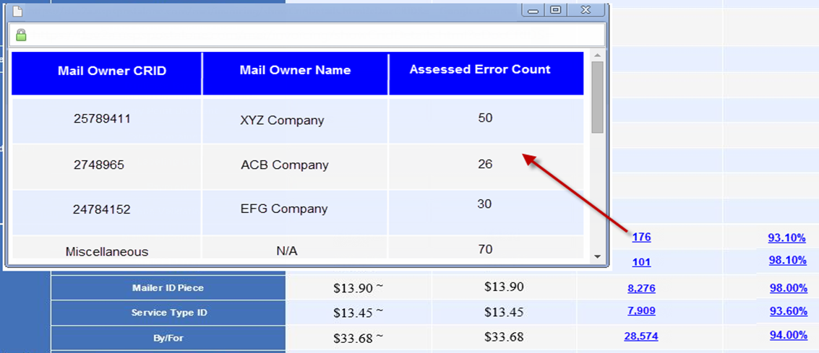
Mail Entry Additional Postage Assessment Report
The Assessment Detail Report shows Error Count and Percentages by Mail Owner
Notes:
As described in the previous slide, right clicking on a CRID listed in the eDoc submitter CRID column of the report opens the Additional Postage Assessment Detail Report Mail Service Providers can view error counts, assessment amount totals, and which mail owners contributed to the errors that caused thresholds to be exceeded. This allows Mail Service Providers to identify the top offenders at the mail owner level in order to reallocate the assessment amounts back to the individual mail owners, which is important for the next step we will discuss, which is how to pay the assessment.

Slide 16
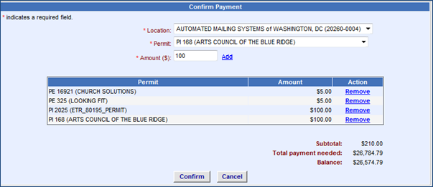
Postage Assessment Payment
Mailer may split payment of assessment and distribute across any associated permit
16
Notes:
When paying, the mailer may split up payment of assessment and distribute it across any associated permit. [Incentive Services: these steps correspond to the animation]
To allocate postage assessment amounts to permits, the mailer must select the location where the desired permit is located from the “Location” drop down menu; then select the desired permit from the “Permit” drop down menu; enter the amount to pay in the “Amount ($)” field, and click “Add.” Permits and amounts allocated will show up in the table after pressing “Add.” Click “Confirm” once all allocations have been verified to complete payment.

Slide 17
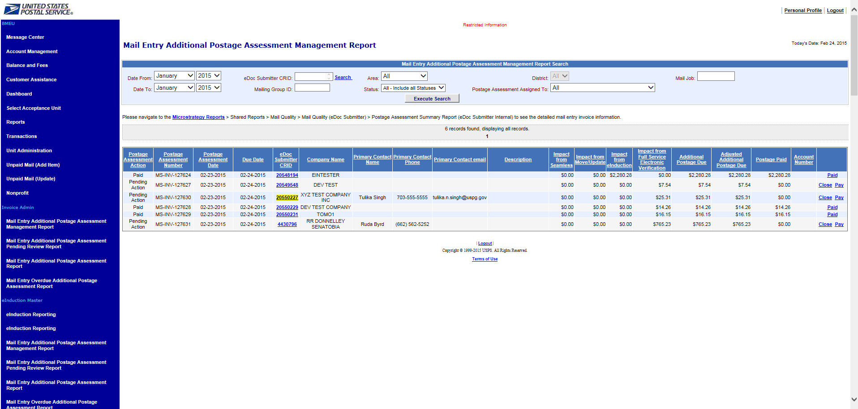
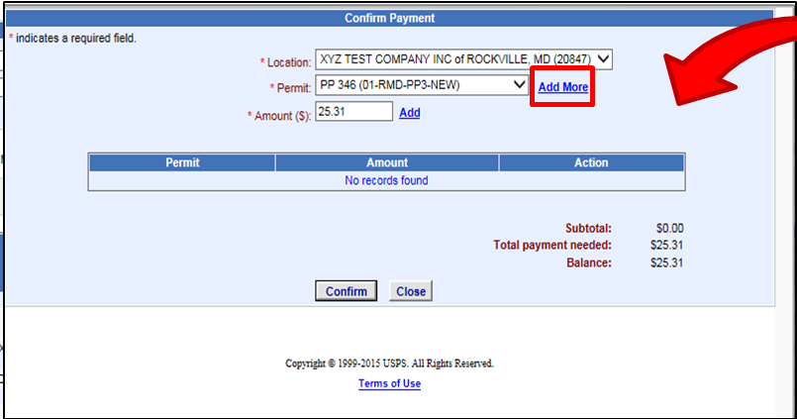
Postage Assessment Payment
Mailers can contact USPS and request that a permit not used during the assessment month be added to their list in the assessment payment screen
Notes:
Mail Service Providers can contact USPS to request that an additional permit not used during the assessment month be added as a payment option. Acceptance employees can assist the mailer by navigating to the Mail Entry Postage Assessment Management Report and clicking on “Pay” as shown here. On the Confirm Payment screen, the employee selects the “Add More” button.

Slide 18
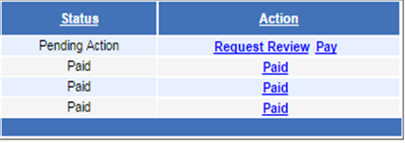
Postage Assessment Review
Mailers can request a review of the postage assessment
Status of assessment changes to Pending
18
Notes:
To do so, the Mailer VAE clicks on “Request Review” in the Action column of the Mail Entry Postage Assessment Report. Subsequently, the status of the assessment will change to “Pending” in the column to the left. The mailer is not able to pay the assessment during the review period until it is complete.

Slide 19
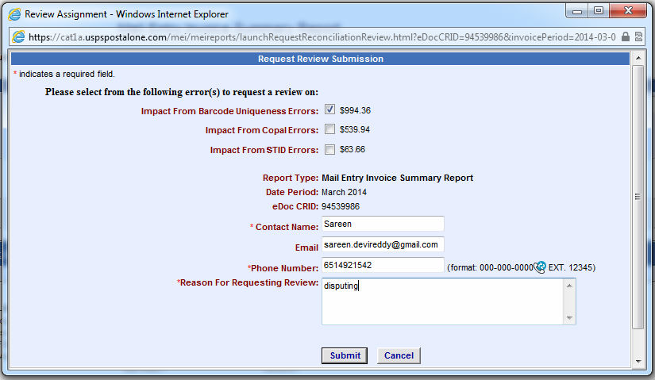
Postage Assessment Review
Mailers can select which errors they would like to be reviewed
19
Notes:
After clicking “request Review,” a window will appear that prompts the mailer to select the errors to be reviewed and enter the following required information:
• Contact name
• Email
• Phone Number
• Reason for Requesting Review
Then click “Submit.” At this point, the assessment status is updated to “Dispute Pending” in PostalOne! and BMS/BME will contact VAE when review has been performed.

Slide 20
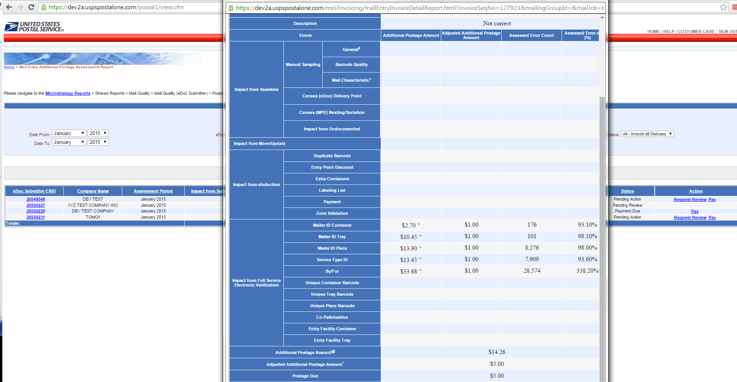
Postage Assessment Review
Mailer VAE can navigate to the Additional Postage Assessment Detail report to see updates to error type dollar amounts that were adjusted
Notes:
The mailer VAE is able to view these updates by navigating to the Additional Postage Assessment Detail report, which they do by right-clicking on the eDoc submitter CRID as illustrated here.

Slide 21
Viewing Transactions
Once paid, mailers can access transaction history for their permits to view the adjustments associated with Mail Entry Postage Assessments
Notes:
Mail Service Providers and Mail Owners can view transactions that have been processed against their permits by logging into the BCG, selecting “Mailer Services” on the left-hand navigation panel, and choosing “Mailing Reports” by selecting the green “Go To Service” button on the right. Then, select “View Transactions.”

Slide 22
Viewing Transactions
The Customer Ref/Reason Code field on the PostalOne! Transaction Summary will include which assessment type and the month/year for the assessment
Notes:
Clicking on View Transactions will display all transactions performed against the permit account (with the option of viewing adjustments only). Selecting the “Adjustment” hyperlink will open a more detailed view of the transaction adjustment.

Slide 23
Viewing Transactions
The Customer Ref/Reason Code field on the PostalOne! Transaction Summary will include which assessment type and the month/year for the assessment
Notes:
Adjustments in the BCG contain a note in the comments with the Mail Entry Assessment-program type (Full-Service, Move Update, eInduction, Seamless), and the two digit month and year that the eDoc submitter CRID was assessed. In the example shown here, “eInduction 01 15 Adj” refers to payment made on a postage assessment for eInduction errors above threshold assessed in January 2015.

Slide 24
Viewing Transactions
Mailers can also view their transaction history in the Centralized Account Payment System (CAPS)
Notes:
Mailers can also view their transaction history in the in the Centralized Account Payment System (CAPS). To view detailed CAPS transactions, customers log into the CAPS system and navigate to “Account Inquiry,” enter the account number and password, and click “Get CAPS Account Information.”

Slide 25
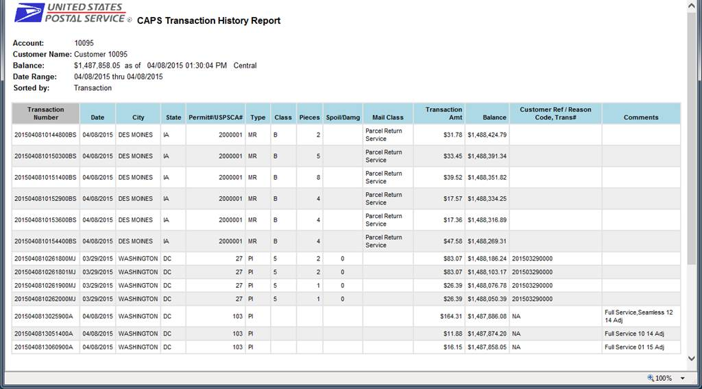
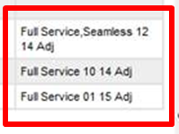
Viewing Transactions
The Customer Ref/Reason Code field on the CAPS Transaction Summary will include which assessment type and the month/year for the assessment
Notes:
The CAPS transaction summary report will include comments in the customer reference field explaining that the debited amount was associated with the Mail Entry Postage Assessment. In CAPS, the full program name is spelled out (as shown here for three Full-Service postage assessments), followed by the two-digit month and year of the assessment.

Slide 26
Appendix

Slide 27
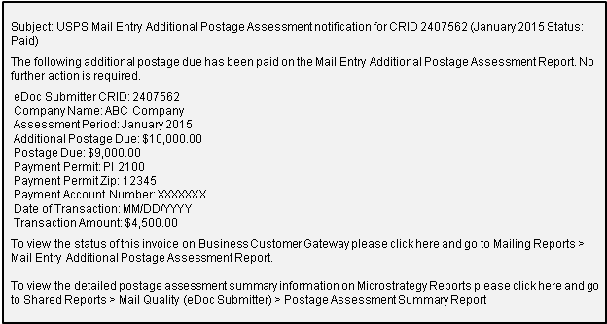
Postage Assessment Payment
Notification Sent When Permit is Used
Email notification is sent to VAE of eDoc Submitter CRID that pays the postage assessment
Email notification to a mail owner when their permit is used to pay a postage assessment
Notes:
When an MSP selects a Mail Owner Permit for payment, the mail owner will be notified by email.

Slide 28
Postage Assessment Enhancements
Mail Service Providers will receive notification when the assessment amount is zero
includes a link to “opt out” of zero assessment notifications
Email sent to the Mail Owner when their permit is selected as a paying permit
Includes the option to “opt out” of future notifications

Slide 29
Postage Assessment Review
Notification Sent When Assessment in “Payment Due” Status after Review
Email notification is sent to VAE users of eDoc Submitter CRID when assessment is put into "Payment Due" status, after review is requested and closed
Subject: USPS Mail Entry Additional Postage Assessment notification for CRID 2407562 (January 2015 Status: Payment Due)
The following additional postage due that you have submitted for review on the Mail Entry Additional Postage Assessment Report has been reviewed by USPS. The total postage due is listed below and represents the amount that is now due for payment in 3 business days.
eDoc Submitter CRID: 2407562
Company Name: ABC Company
Assessment Period: January 2015
Additional Postage Due: $10,000.0
Postage Due: $9,000.00
Due Date: <3 business day from date of review completion>
Response from reviewer: <REVIEWER_RESPONSE>
To view the status of this postage assessment on Business Customer Gateway please click here and go to Mailing Reports > Mail Entry Additional Postage Assessment Report.
To view the detailed postage assessment summary information on Microstrategy Reports please click here and go to Shared Reports > Mail Quality (eDoc Submitter) > Postage Assessment Summary Report
Notes:
The email notification lets the VAE know when the assessment status has changed from “Pending” to "Payment Due.“ Hyperlinks in the email will take the user to the Mail Entry Additional Postage Assessment Report where payment can be made.

Slide 30
Postage Assessment Review
Notification Sent when Assessment Closed and/or When Adjusted Postage Due is Below $50.00
Email notification is sent to VAE of eDoc Submitter CRID when assessment is closed because the adjusted postage due across all programs after review is below $50.00
Also sent when assessment is marked “Closed” on Mail Entry Additional Postage Assessment Management page by Acceptance employee
Subject: USPS Mail Entry Additional Postage Assessment notification for CRID 2407562 (January 2015 Status: Closed)
The following additional postage due assessment had been reviewed by the BMS Analyst and has been closed. No further action is required.
eDoc Submitter CRID: 2407562
Company Name: ABC Company
Assessment Period : January 2015
Additional Postage Due: $10,000.00
Postage Due: $0.00
Response from reviewer: <response by the BMS Analyst>
To view the status of this postage assessment on Business Customer Gateway please click here and go to Mailing Reports > Mail Entry Additional Postage Assessment Report. To view the detailed postage assessment summary information on Microstrategy Reports please click here and go to Shared Reports > Mail Quality (eDoc
Submitter) > Postage Assessment Summary Report
Notes:
If, after review, the Acceptance employee decides to close the assessment or finds that the adjusted amount totals less than $50, the mailer VAE will receive email notification that no further action is required.

Slide 31
Past Due Assessments
Notification Sent When Assessment is Past Due
Email notification is sent to VAE users of eDoc Submitter CRID when assessment is put into "Past Due" status
Occurs when VAE did not act upon assessment in the stipulated time (10 business days after assessment is generated or 3 business days after assessment review is closed)
Subject: USPS Mail Entry Additional Postage Assessment notification for CRID 2407562 (January 2015 Status: Past Due)
The following additional postage is now past due on the Mail Entry Additional Postage Assessment Report.
eDoc Submitter CRID: 2407562CRID
Company Name: ABC Company
Assessment Period: January 2015
Additional Postage Due: $10,000.00
Postage Due: $10,000.00
Due Date: <10 business day due date OR 3 business day due date>
To view the status of this postage assessment on Business Customer Gateway please click here and go to Mailing Reports > Mail Entry Additional Postage Assessment Report.
To view the detailed postage assessment summary information on Microstrategy Reports please click here and go to Shared Reports > Mail Quality (eDoc Submitter) > Postage Assessment Summary Report
Notes:
The email notification sent to the mailer VAE when an assessment is put into "Past Due" status occurs when the VAE did not act in the stipulated amount of time: either 10 business days after the assessment is generated or three business days after an assessment review is closed.

