Slide 1
Your Software is Talking Are You Listening? National Postal Forum March 20 – 23, 2016
Chris Lien President, BCC Software
Jim Wilson
A/Director, Addressing & Geospatial Technology, USPS®

Slide 2
Software Plays a Vital Role
Address Quality
CASS Certified™ software provides a complete and correct address
NCOA^{Link®} provides a current address
Mail Preparation (Presorting)
PAVE™ certified software sorts the addresses, prepares containers, and generates postage
Intelligent Mail® barcodes
Piece and container barcodes
PostalOne!® electronic postage payment
2
Notes:
Chris

Slide 3
Address Quality Connection
Complete
Correct
Current
CASS™, DPV®, DSF^{2®}, LACS ^{Link®}, Suite^{Link®}, AEC II®, NCOA^{Link®}, ANK^{Link®} and ACS™ are registered trademarks of the United States Postal Service®.
3
Notes:
3
Angela and Chris
These numbers are based on the first quarter of FY15.
AEC correction rate: 38%
AECII correction rate: 51%
AECII resolution rate: 85%
These percentages can go up or down around 3-5% or more every quarter because of the various number of bad addresses we may receive at any time.

Slide 4
Address Quality
Perfecto!
Complete the address
Leverage software and data to provide the missing information
ZIP + 4®, street name, directional, city, state
Correct the address
Verifies address is deliverable
Corrects misspellings
Provides approved abbreviations (Publication 28)
Ensures the city, state, and ZIP Code™ are correct
Keep the address Current
Person, family, or business moved
Municipality introduced changes
Ongoing process
Improves merge/purge results
4
Notes:
Chris

Slide 5
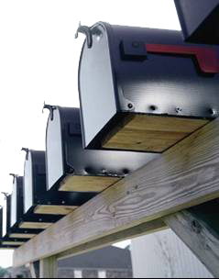
CASS™ Product
USPS® certified benchmark
Sets minimum performance standards for commercial ZIP + 4® address matching software
Developers must pass USPS® test for CASS certification
Address matching software attempts to match addresses against range-based records on USPS ZIP + 4 files
Provides carrier route assignment
Pre-Mailing process
5
Notes:
5
Angela
Phantom Routes
A phantom route is used to provide mail sortation to USPS entities (Post Offices, plants, districts, postmasters, station managers, retail unit supervisors, etc.). Usually C000, R000, B000, and H000 are assigned as carrier route IDs to these routes. Any other route that is not counted as a delivery route is a phantom route.
AMS Coding Guide: Phantom Route
A phantom route is used to provide mail sortation to USPS entities (Post Offices, plants, districts, postmasters,
station managers, retail unit supervisors, etc.). Usually C000, R000, B000, and H000 are assigned as carrier
route IDs to these routes. Any other route that is not counted as a delivery route is a phantom route.
A special phantom route is used to code addresses that are just physical addresses when there is no other route to add those addresses to R777.
AMS Coding Manual: R777 Routes
Phantom rural routes in non-city delivery ZIP Codes may be created and assigned a carrier ID of R777 for the purpose of capturing mail addressed to street addresses for customers who receive mail delivery through a PO Box. In most cases these addresses are not eligible for street delivery and should not be considered as possible deliveries.
Adding the addresses to an R777 route creates a method for automated mail processing equipment to apply a barcode and sort the street-addressedmail to the PO Box section were the mailpiece is actually delivered.
Entering the physical address of customers who do not receive mail at their physical address will also enable those physical addresses to be DPV confirmed.

Slide 6
Form 3553 – Important Numbers
6
6

Slide 7
Form 3553
Other Information
Form 3553 – Important Numbers
7
7
Notes:
7

Slide 8
CASS™ Product Return Codes
CASS Certified™ software products return codes indicating address assignment
10 | Invalid Address | 22 | Multiple Responses
11 | Invalid City/State/ZIP | 23 | Error in Primary
12 | Invalid State | 31 | Single Response
13 | Invalid City | 32 | Default Response
17 | Insufficient Data | 33 | Non-deliverable
21 | Address Not Found
8
Notes:
Angela with Chris – without details

Slide 9
CASS™ Product Return Codes
CASS Certified™ software products return codes indicating address assignment
10 | Invalid Address | 22 | Multiple Responses
11 | Invalid City/State/ZIP | 23 | Error in Primary
12 | Invalid State | 31 | Single Response
13 | Invalid City | 32 | Default Response
17 | Insufficient Data | 33 | Non-deliverable
21 | Address Not Found
9
Notes:
Chris - details

Slide 10
DPV®
Extension of CASS Certified™ Address Matching software
Available through software vendors
Enhances ZIP + 4® Coding & identifies potentially undeliverable addresses
DPV® - extra step to attempt validation of each specific address in the file
Pre-Mailing process
100 MAIN ST
ANYTOWN TN 38138-6038 Confirmed
104 MAIN ST
ANYTOWN TN 38138-6038 Not Confirmed
10
Notes:
10
Angela

Slide 11
DPV® / DSF^{2®} Footnote Codes
AA | Input Address Matched to the ZIP+4 file | P1 | Input Address RR or HC Box number invalid
A1 | Input Address Not Matched to the ZIP+4 file | P3 | Input Address PO, RR, or HC Box number invalid
BB | Input Address Matched to DPV (all components) | RR | Input Address Matched to CMRA and PMB designator present (PMB 123 or #123)
CC | Input Address Primary Number Matched to DPV but Secondary Number not Matched (present but invalid) | R1 | Input Address Matched to CMRA but PMB designator not present (PMB 123 or #123)
N1 | Input Address Primary Number Matched to DPV™ but Address Missing Secondary Number | F1 | Input Address Matched to a Military Address
M1 | Input Address Primary Number Missing | G1 | Input Address Matched to a General Delivery Address
M3 | Input Address Primary Number Invalid | U1 | Input Address Matched to a Unique ZIP Code
11
Notes:
Angela with Chris

Slide 12
DPV® Tables DSF^{2®} Tables
A | Address Table
C | CMRA (Commercial Mail Receiving Agency)
P | PBSA (PO Box Street Address)
V | Vacant
X | No-stat (address not counted for delivery)
N | Door Not Accessible (Added in 2015)
U | No Secure Location (Coming Soon!!!)
 | Includes all DPV Tables and…
B | Business
D | Drop Address
K | Drop Count
E | Educational
L | LACS
S | Seasonal
T | Throwback
1 | Delivery Type – Curb
2 | Delivery Type – NDCBU
3 | Delivery Type – Centralized
4 | Delivery Type – Door Slot / Other
Note: LACS^{Link®} table available separately
12
Notes:
Angela
Delivery Deviations
PO Box Throwback
Residences and businesses that choose to receive delivery through PO boxes are considered PO Box Throwbacks when no delivery is made to the street address.
AMS Coding Guide:PO Box Throwback
Residences and businesses that choose to receive delivery through PO boxes are considered PO Box Throwbacks when no delivery is made to the street address.
PO Box Street Address (PBSA)
In the Competitive PO Box Fee Group, one of the services offered is the creation of a street address that is directly linked to the PO Box address. The PBSA address is the primary address of the manned administrative location of the PO Box address followed by the PO box number. The addresses are always on C770 – C779 phantom routes. They are always marked No Stat and PO box Throwback.
The PO Boxes are located at 123 Main St and the customer rents PO Box 1 there, the PBSA address will be:
123 Main St # 1
Commercial Mail Receiving Agencies (CMRA)
Private companies, such as UPS Store and Office Business Centers (OBC),that rent private mail boxes (PMB) to their customers.
AMS Coding Guide: COMMERCIAL MAIL RECEIVING AGENCY (CMRA)
Private companies, such as UPS Store and Office Business Centers (OBC), use their physical address as the
mailing address. The Private Mail Box (PMB) numbers are not recorded in AMS.
The CMRA delivery points are identified as business in the Usage field. The CMRA field MUST be flagged and
the Drop Count served populated with the correct number of PMB available. Drop Count served information is
obtained from the PS Form 1583 on file at the delivery unit.
Proper address formats can be found in Pub 28, Postal Addressing Standards, Private Mailbox Addresses, and
DMM 508.1.9.
When adding a CMRA delivery point within a high-rise address, the CMRA H record should have a unique
ZIP+4® code.
Drop Address
A drop address is a single delivery point or receptacle that services multiple “families”. Examples of drop addresses include a single door slot shared by two or more families, a box on a wall for duplexes, or a boarding house or dormitory at which mail is delivered to the door for subsequent distribution. Mail for drop addresses is distributed internally by the site.
AIS Tech Guide:
For a carrier route, the number of businesses or families served at drop sites. A drop site is a single delivery point or receptacle that services multiple “families.” Examples of drop sites include a single door slot shared by two families, a box on a wall for duplexes, or a boarding house or fraternity at which mail is delivered to the door for subsequent distribution. Mail for drop sites is distributed internally by the site. Commercial mailbox companies are also classified as drop sites because the carrier delivers the mail to one point, and it is distributed to specific boxes by the company.

Slide 13
PO Box Street Address – PO Box holders, in selected locations, may opt in to use their Post Office’s street address and use their Box number as a secondary address element
DPV® PBSA Identifier
Rec Type | Prim Range | Street Indicia | UNIT | SEC RANGE | ZIP Code | ZIP + 4 Range | CRID
H | 131-131 | S CENTER ST | UNIT | 1706-1722 | 38027 | 0360 | C770
Input: 131 S CENTER ST # 1706
COLLIERVILLE TN 38027
Output: 131 S CENTER ST UNIT 1706
COLLIERVILLE TN 38027-0360
DPV: Y
PBSA TABLE: Y
DPV FOOTNOTES: AABBPB
13

Slide 14
For PO Box Only Delivery Zones – physical addresses are assigned a phantom route of R777 that are not eligible for street delivery
DPV® R777 Identifier
Rec Type | Prim Range | Street Indicia | UNIT | SEC RANGE | ZIP Code | ZIP + 4 Range | CRID
S | 40 | FLETCHER DR |  |  | 38578 | 3001 | R777
Input: 40 FLETCHER DR
PLEASANT HILL TN 38578
Output: 40 FLETCHER DR
PLEASANT HILL TN 38578
DPV: Y
DPV FOOTNOTES: AABBR7
ZIP+4 3553: N
14

Slide 15
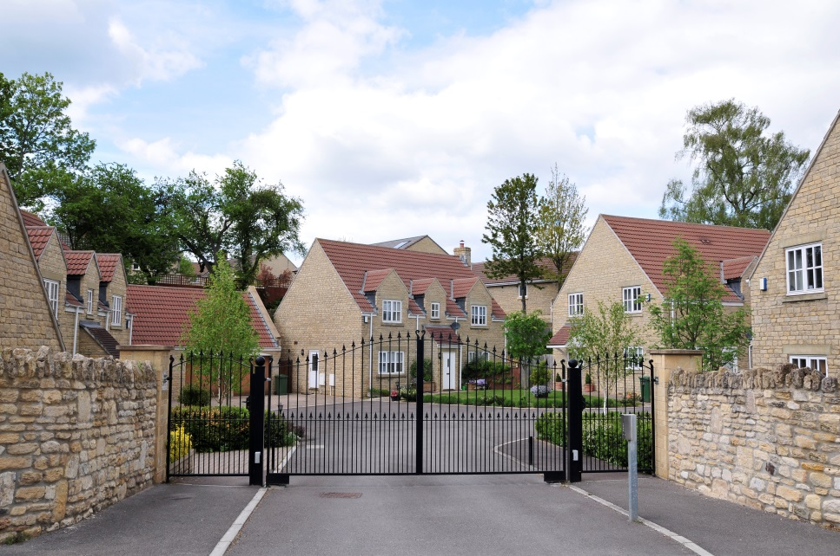
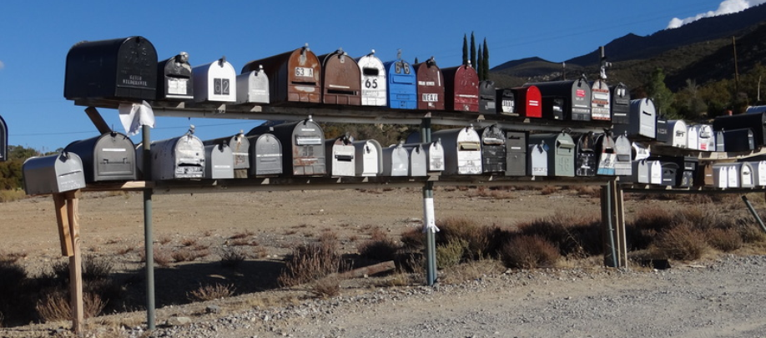
DPV® Door Not Accessible (DNA) Identifier
Record addresses where we cannot knock on a door to deliver
Intended for:
Any situation where we cannot physically get to the residence/building
Rural/HCR long driveway
Gated residence
15

Slide 16
DPV® No Secure Location (NSL) Identifier
Supports situations where USPS® can access the door but we will not leave a package when no one is at the delivery due to security concerns

Slide 17
This address has been identified as a delivery point that is currently vacant (in most cases unoccupied over 90 days) and not receiving deliveries
DPV® Vacant Identifier
Rec Type | Prim Range | Street Indicia | ZIP Code | ZIP + 4 Range | VACANT | CMRA | CRID
S | 1101-1109 | N MARINE BLVD | 28540 | 6136 | Y | N | C028
Input: 1103 N MARINE BLVD
JACKSONVILLE NC 28540
Output: 1103 N MARINE BLVD
JACKSONVILLE NC 28540-6136
DPV: Y
VACANT: Y
DPV FOOTNOTES: AABB
17

Slide 18
LACS^{Link®}
A process that converts addresses that are changed by local governments
Rural route to street style conversion
Renumbering changes
Street name changes
Old Style | New Style
RR 5 Box 234 | 5471 Apple Drive
471 Main St | 1471 Main St
987 Edgewater Dr | 987 Waterways Blvd
Delivery point remains the same and the residents have not moved, but the address has been changed.
18
Notes:
Angela

Slide 19
LACS^{Link®} Return Codes
A | LACS^{Link} Record Match – The input record matched to a record in the master file. A new address could be furnished.
00 | No Match – The input record COULD NOT BE matched to a record in the master file. A new address could not be furnished
09 | LACS^{Link} Record Match: Highrise Default – The input record matched to a record in the master file, but the old address is a high-rise default.
14 | Found LACS^{Link} Record: New Address Would Not Convert at Run Time – The input record matched to a record in the master file. The new address could not be converted to a deliverable address
92 | LACS^{Link} Record: Secondary Number Dropped from Input Address – The input record matched to a master file record, but the input address had a secondary number and the master file record did not. The record is a ZIP + 4 street level or high-rise match
19
Notes:
Both

Slide 20
Suite^{Link®}
Improves address assignments to business addresses by adding known secondary (suite) numbers
Provided a business name and an associated ZIP + 4® coded address matches to a high-rise default, the Suite^{Link} process will return the appropriate suite number when available
20
Notes:
Angela

Slide 21
Suite^{Link®} Return Codes
A | Suite^{Link} Record Match – The input record matched to a record in the master file. An improved business address could be furnished.
00 | No Match – The input business name and/or address COULD NOT BE matched to a record in the master file.
21
Notes:
Both

Slide 22
Suite^{Link®} Examples – Default Match Codes
The input address matches to a high-rise default record. DPV® returns a “D” which indicates the secondary is missing. Software must query Suite^{Link}.
Rec Type | Firm | DPV | Prim Range | Street Indicia | Unit | Secd Range | City | ZIP Code | Unique | ZIP+4 Range | CRID
H |  | Y | 910 | MADISON |  |  | MEMPHIS | 38103 | N | 3403 | C029
H |  | Y | 910 | MADISON | STE | 823 – 826 | MEMPHIS | 38103 | N | 3435 | C029
Required output for CASS certification - the primary street address along with the Suite^{Link} results must be contiguous.
Input: UT Animal Research
910 Madison Ave
Memphis TN 38103
Output: UT ANIMAL RESEARCH
910 MADISON AVE STE 823
MEMPHIS TN 38103-3435
Suite^{Link} Return Code: A
22

Slide 23
Suite^{Link®} Examples – Invalid Suite Number
Rec Type | Firm | DPV | Prim Range | Street Indicia | Unit | Secd Range | City | ZIP Code | Unique | ZIP+4 Range | CRID
H |  | Y | 910 | MADISON |  |  | MEMPHIS | 38103 | N | 3403 | C029
H |  | Y | 910 | MADISON | STE | 823 – 826 | MEMPHIS | 38103 | N | 3435 | C029
Required output for CASS™ certification - the primary street address along with the Suite^{Link} results must be contiguous.
Input: UT Animal Research
910 Madison Ave Ste 9 (invalid secondary)
Memphis TN 38103
Output: UT ANIMAL RESEARCH
910 MADISON AVE STE 823 Dropped Input Secondary
MEMPHIS TN 38103-3435
Output: UT ANIMAL RESEARCH
910 MADISON AVE STE 823 STE 9 Appended Input Secondary
MEMPHIS TN 38103-3435 to end of address line
MEMPHIS TN 38103-3435
Output: UT ANIMAL RESEARCH
STE 9 Moved input secondary
910 MADISON AVE STE 823 to second address line
MEMPHIS TN 38103-3435
23

Slide 24
NCOA^{Link®}
USPS® licensed product using address change information when individuals or businesses inform the USPS of their move
Provides electronic Change-of-Address information
Average correction rate (with new address) – 3.32%
Three different license types
Variable costs
Pre-Mailing process
24
Notes:
24
Angela

Slide 25
NCOA^{Link®} Footnote Codes for Matching Records
A | Match | COA Match: The input record matched a COA record.
91 | Match | COA Match: Secondary Number dropped from COA.
92 | Match | COA Match: Secondary Number dropped from input address.
01 | Match | Found COA: Foreign Move. Foreign Move. The customer has moved to a foreign address.
02 | Match | Found COA: Moved Left No Address (MLNA). The input record matched a COA record, but there was no new address provided.
03 | Match | Found COA: Box Closed No Order (BCNO). The input record matched a COA record, but the PO BOX has been closed and no forwarding addresses was provided.
25
Notes:
Both

Slide 26
NCOA^{Link®} Footnote Codes for Non-Matching Records
00 | No Match | The input record did not match a COA record.
04 | No Match | Family match to a COA with a secondary address, but no secondary address was provided on input.
06 | No Match | There is more than one COA record and the middle names are different.
07 | No Match | There is more than one COA record and the genders are different.
08 | No Match | The input record matched two COA records.
09 | No Match | The input record matched a COA record from a high-rise address.
10 | No Match | The input record matched a COA record for a rural or highway contract route.
11 | No Match | The input record matched a COA record with the same surname and address, but there is insufficient name information on the COA record to produce a match.
19 | No Match | There is a change of address on file but the new address cannot be ZIP + 4 coded. The new address cannot be confirmed on DPV or the new address is temporary.
26
Notes:
Both

Slide 27
ACS™
Traditional ACS™, OneCode ACS® or Full-Service ACS
Provides electronic Change of Address notices for undeliverable mailpieces
Mailers apply a participant code and an optional keyline OR Intelligent Mail® barcode to mailpiece
Requires an ancillary service endorsement
Can reduce costs associated with manual returns and manual keying of data
Centralized fulfillment option (SingleSource)
Post-Mailing process
27
Notes:
27
Angela

Slide 28
ACS™ Return Codes
K | Customer has moved and left no forwarding address
G | Customer’s P.O. Box™ has been closed and no forwarding address was filed
W | Matched with a COA order for a temporary change of address
A | Attempted, not known
B | Returned for better address
D | Outside delivery limits
E | In dispute
I | Insufficient address
L | Illegible
M | No mail receptacle
N | No such number
P | Deceased
Q | Not deliverable as addressed / unable to forward
R | Refused
S | No such street
U | Unclaimed
V | Vacant
X | No such office
28
Notes:
Both – carrier knowledge
Mention workgroup formed to review and simply these return codes. MTAC WG 171 - This workgroup is tasked with reviewing UAA Reason Codes. Focus will be on making recommendations for improvements to the definitions, refinements, and changes to codes and/or processes and procedures in an effort to improve the accuracy, application, and use of UAA Reason Codes in order to reduce undeliverable mail, saving USPS and mailer costs associated with addressing and delivery.

Slide 29
Leveraging Return Codes
Filtered expressions can be built to trigger additional processing based on certain conditions
DPV FN codes of A1, M1, M3, P1, and P3 may be sent to advanced address correction services
AEC and AEC II®
Industry provided Address Resolution Services
29
Notes:
Chris

Slide 30
AEC & AEC II®
USPS® provided service for all customers
Resolves physical address deficiencies
Sent to the USPS on electronic media
AEC cost - $23.00 per thousand
Average correction rate - 38%
AEC II cost - $0.32 per record
Average: 85% resolution rate
Average: 51% correction rate
Pre-Mailing process
30
Notes:
30
Angela and Chris
These numbers are based on the first quarter of FY15.
AEC correction rate: 38%
AECII correction rate: 51%
AECII resolution rate: 85%
These percentages can go up or down around 3-5% or more every quarter because of the various number of bad addresses we may receive at any time.

Slide 31
1
Code address via CASS CertifiedTM address matching software with DPV® and LACS^{Link®}
2
3
4
Did the address DPV Confirm?
Y/N
Send bad addresses to AEC/AEC II®
Bad address fixed/ZIP + 4® coded?
NO
YES
6
Update movers (NCOA^{Link}) (pre mailing process)
NO
YES
7
Apply ACSTM to mail piece (post mailing process)
5
Suppress bad addresses from mailing list
8
Mail
9
Update address list with new ACS information

Slide 32
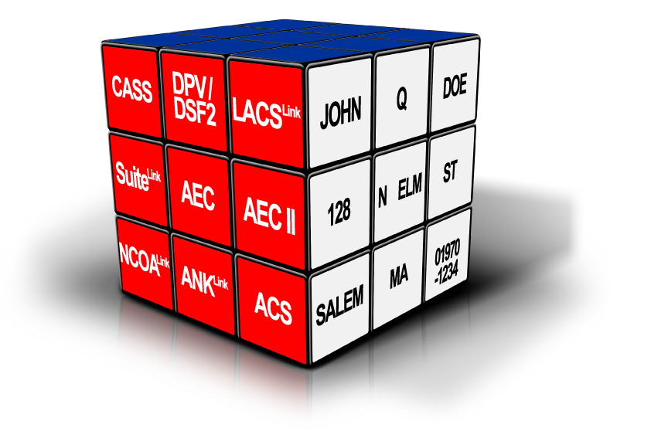
Address Quality Connection
Using the right combination of Address Quality products & services will help you to put your addresses in order!
CASS™, DPV®, DSF^{2®}, LACS ^{Link®}, Suite^{Link®}, AEC II®, NCOA^{Link®}, ANK^{Link®} and ACS™ are registered trademarks of the United States Postal Service®.
32
Notes:
32
Angela and Chris
These numbers are based on the first quarter of FY15.
AEC correction rate: 38%
AECII correction rate: 51%
AECII resolution rate: 85%
These percentages can go up or down around 3-5% or more every quarter because of the various number of bad addresses we may receive at any time.

Slide 33
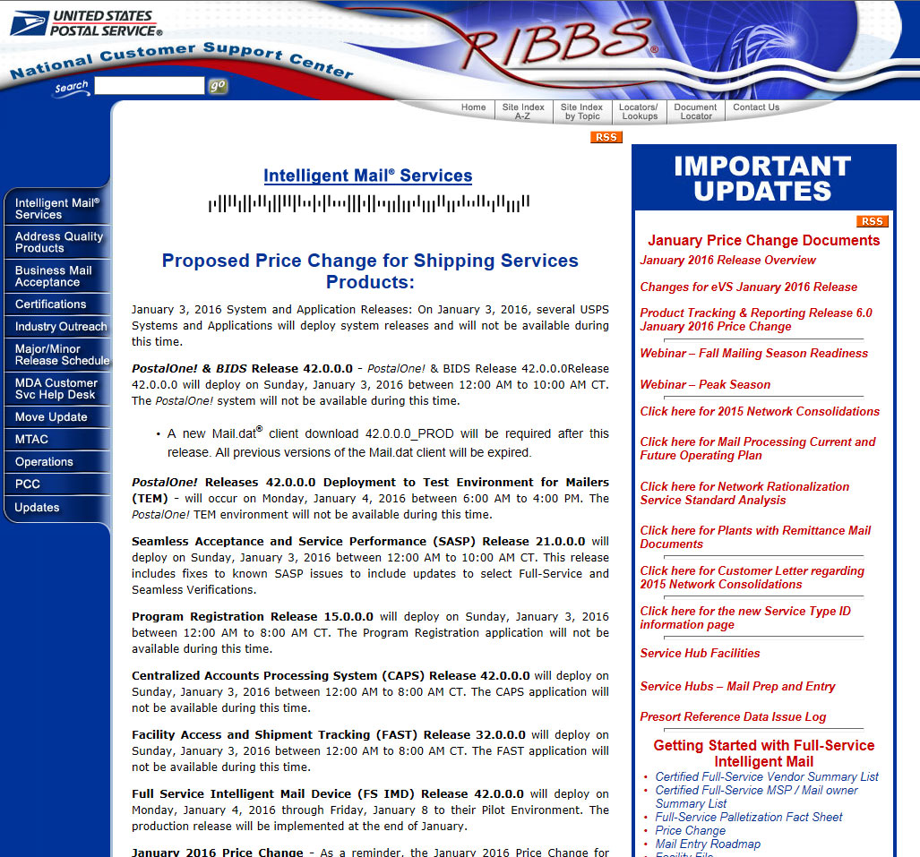
For More Information
ribbs.usps.gov
National Customer Support Center
1-800-238-3150
Notes:
33
33
Angela
On the screen, you’ll see some key resources for you – If you need more information about any of the products or services we’ve talked about today – don’t hesitate to contact us!!
I hope you’ve enjoyed the presentation today… Gained some new insights…. And are motivated to take that step, whether it’s your first step or the next step.
(END)

Slide 34
USPS® Co-Presentations Schedule
Sunday
Address Quality 101 Ed Wanta & Paula Stoskopf Period 5, 2:45 - 3:45 Rm. Bayou E
Monday
Your Software is Talking, Are You Listening? Jim Wilson & Chris Lien Period 10, 4 - 5 Rm. Bayou E
Wednesday
Demystifying UAA Mail - Where Did It Come From? How Can We Fix It? Jim Wilson & Gary Seitz Period 17, 3:15 - 4:15 Rm. Bayou E

Slide 35
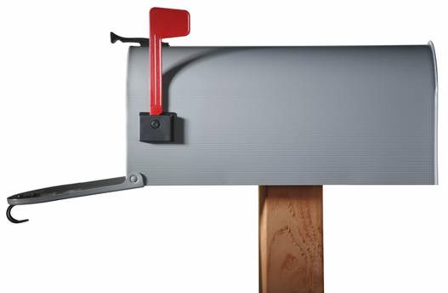
Thank You!
Notes:
35

