Slide 1
PostalOne! January 2014 Release Training
Intelligent Mail Package Barcode (IMpb) Compliance
Notes:
Welcome to the PostalOne! January 2014 Release training for Intelligent Mail Package Barcode (IMpb) Compliance.

Slide 2
Agenda
Benefits of IMpb
IMpb Requirements
  Unique Barcode
  Shipping Services File (SSF)
Exceptions to IMpb Requirements
Postal Wizard Enhancements to support IMpb Acceptance
Providers and Tools for Mailers
Notes:
Throughout this module, we will cover a wide range of topics related to new standards being implemented for the Intelligent Mail package barcode (IMpb). The topics we will discuss include:
Benefits of IMpb
IMpb Requirements including the unique barcode and Shipping Services File (SSF) requirements
Exceptions to IMpb Requirements
Postal Wizard Enhancements to support IMpb Acceptance
Providers and Tools for Mailers
Let’s begin with IMpb benefits.

Slide 3

Benefits of IMpb for Mailers
The Intelligent Mail package barcode (IMpb) offers a number of benefits to mailers by providing piece-level visibility throughout USPS™ processing and delivery operations
Other benefits of IMpb use include:
The best commercial prices with the largest discount available
Piece-level tracking information at no additional charge for most products
Access to new products, services, and enhanced features
Notes:
With this release, several changes are being made related to the Intelligent Mail package barcode, or IMpb. Before we discuss these changes, let’s discuss the benefits of IMpb.
IMpb offers a number of benefits to mailers by providing piece-level visibility throughout USPS™ processing and delivery operations.
Other benefits of IMpb use include:
The best commercial prices with the largest discount available
Piece-level tracking information at no additional charge for most products
Access to new products, services, and enhanced features

Slide 4
IMpb Requirements:
Applicable Classes of Mail
Effective January 2014, the Intelligent Mail package barcode (IMpb) requirements are changing for all parcels entered through commercial channels including, but not limited to:
  Priority Mail ExpressTM
  Priority Mail®
  First-ClassTM Package Services
  Parcel Select
  Parcel Select Lightweight
  Postage paid by:
    Permit imprint
    Postage meter
    PC Postage®
    Precancelled stamps
    Franked Mail or Official Mail Accounting System
Notes:
Effective January 2014, the Intelligent Mail package barcode (IMpb) requirements are changing for parcels entered through commercial channels including, but not limited to:
Priority Mail ExpressTM
Priority Mail®
First-ClassTM Package Services
Parcel Select
Parcel Select Lightweight
Postage paid by Permit Imprint, Postage Meter, PC Postage®, Precancelled stamps, Franked Mail, or Official Mail Accounting System

Slide 5
IMpb Requirements
Effective January 2014
To receive commercial rates, mailers must comply with the following requirements:
Requirements Effective January 26, 2014
Use a unique Intelligent Mail package barcode (IMpb) on each mailpiece Prepared in accordance with DMM 708.5.1 Submit an electronic Shipping Services File (SSF), version 1.6 (or higher) Include the correct destination delivery address or ZIP+4 Code in the SSF Refer to SSF layout specifications in Publication 199 https://ribbs.usps.gov/intelligentmail_package/documents/tech_guides/PUB199IMPBImpGuide.pdf
Notes:
To receive commercial rates beginning January 26, 2014, mailers must use a unique Intelligent Mail Package Barcode (IMpb) which is a barcode that affixes to the package and contains delivery information, such as the destination address, ZIP Code routing and payment information.
Mailers must also submit an electronic Shipping Services File (SSF), version 1.6 or higher.
The Shipping Services File is an electronically submitted document that contains mailing information about each package being sent. The Shipping Services File must contain delivery information which is the correct destination delivery address or ZIP+4 Code.
We will look a little closer at each one of the requirements starting with the unique barcode requirement and also briefly review the exceptions.

Slide 6
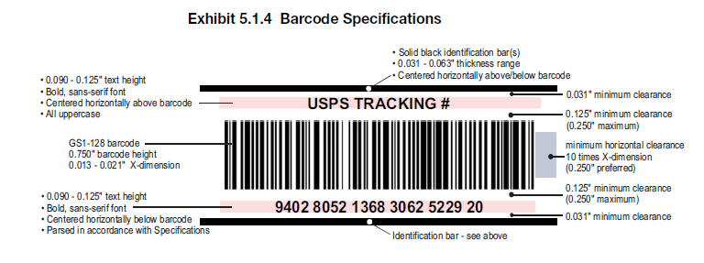
IMpb Requirement: Unique IMpb Barcode
Requirement to use a unique IMpb barcode prepared in accordance with DMM 708.5.1 (Standards for Package and Extra Service Barcodes: Intelligent Mail Package Barcode)
From DMM 708.5.1
The DMM can be accessed through Postal Explorer (pe.usps.gov).
Direct link to DMM section 708.5.1: http://pe.usps.gov/text/dmm300/708.htm#1619562
Notes:
A very important requirement is that commercial mailers must use a unique tracking barcode when mailing packages. This barcode must be prepared in accordance with Domestic Mail Manual (DMM) section 708.5.1, which is titled Standards for Package and Extra Service Barcodes: Intelligent Mail Package Barcode.
An Intelligent Mail package barcode (IMpb) is the USPS-developed barcode that can be read by automated parcel processing equipment and Intelligent Mail scanning devices.
Detailed information about the IMpb barcode is not only found in the DMM but also in Publication 199 on the RIBBS website.

Slide 7
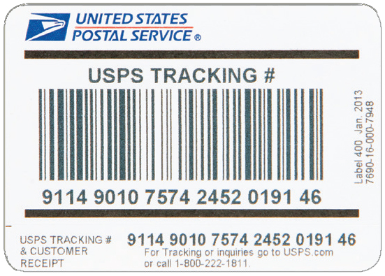
IMpb Requirement: Unique IMpb
Barcode Exception
  Mailers allowed to temporarily use existing barcode formats that include extra services
  Authorization must be granted through an exception process
  Transitional period until January 25, 2015
Notes:
USPS has implemented a process to allow mailers to temporarily use existing barcode formats on parcels and mailpieces that include extra services.
Mailers using legacy barcodes may use the legacy version of the Shipping Services File v1.4 to accompany their mailing. Any such authorization must be granted through an exception process. Mailers requesting an exception must be able to demonstrate their ability to transmit piece-level documentation to the Postal Service through a Shipping Services File and to include a destination delivery address or ZIP+4 code for each record in the file.
These exceptions are intended to provide additional time, when needed, to transition to the use of IMpb. Requests for exceptions must be directed to the Vice President of Sales.
All mailers must be fully IMpb-compliant, using version 1.6 or higher of the Shipping Services File, by January 25, 2015.
Mailers should note that Priority Mail pieces bearing barcodes prepared in the existing format are not eligible for automatic insurance coverage.

Slide 8
Exceptions to IMpb Requirements
Changes Apply to: | Exceptions to the Rules:
All parcels entered through commercial channels, including, but not limited to: Priority Mail ExpressTM Priority Mail® First-ClassTM Package Services Parcel Select Parcel Select Lightweight Postage paid by permit imprint, postage meter, PC Postage®, Precancelled stamps, Franked Mail, or Official Mail Accounting System (There is an exception for meter mailers receiving Commercial Base pricing) | Priority Mail and Priority Mail Express Priority Mail letters and flats prepared in a high-speed environment featuring a unique Intelligent Mail Barcode and electronic documentation Priority Mail letters and flats using stamps as postage or Priority Mail Forever Prepaid Flat Rate packaging Priority Mail Express pieces with postage paid through a postage meter imprint and using a Label 11-B Priority Mail Express pieces entered under a Priority Mail Express Manifesting Agreement (PMEM) and paid via a USPS Corporate Account Standard Mail Standard Mail Marketing® product samples with a simplified address or a Detached Address Label (DAL) Standard Mail pieces presorted and containerized in 5-digit sacks bearing an Intelligent Mail Barcode Retail Packages All packages paid for at the retail price and inducted through retail transactions Periodicals Periodicals parcels Metered Mailers Meter mailers receiving Commercial Base pricing who fail to meet the new requirement will continue to qualify for discounted rates throughout an extended transition period. Merchandise Return Service Merchandise Return Service® (MRS) permit holders not using a PC Postage-based return service – exempt from Shipping Services file
Although the following package products are required to meet the IMpb and data submission requirements, mailers of these package products will be afforded an extended transition period: Bound Printed Matter®, Media Mail®, Library Mail®, Standard Mail® Parcels, Merchandise Return Service®, and meter mailers receiving Commercial Base® pricing. Non-compliance fees for these products will begin assessment at a later date.
Notes:
Now that we have covered the basic IMpb requirements and the classes of mail to which they apply, let’s talk about the exceptions to the requirements.
The IMpb requirements do not apply to:
Priority Mail letters and flats using stamps as postage or Priority Mail Forever Prepaid Flat Rate packaging
Priority Mail letters and flats prepared in a high-speed environment featuring a unique Intelligent Mail Barcode and electronic documentation
Priority Mail Express pieces with postage paid through a postage meter imprint and using a Label 11-B
Priority Mail Express pieces entered under a Priority Mail Express Manifesting Agreement (PMEM) and paid via a USPS Corporate Account
Standard Mail Marketing® product samples with a simplified address or a Detached Address Label (DAL)
Standard Mail pieces presorted and containerized in 5-digit sacks bearing an Intelligent Mail Barcode
All packages paid for at the retail price and inducted through retail transactions
Periodicals parcels
Meter mailers receiving Commercial Base pricing who fail to meet the new requirement will continue to qualify for discounted rates throughout an extended transition period
Merchandise Return Service® (MRS) permit holders not using a PC Postage-based return service – exempt from Shipping Services file
Although the following package products are required to meet the IMpb and data submission requirements, mailers of these package products will be afforded an extended transition period: Bound Printed Matter®, Media Mail®, Library Mail®, Standard Mail® Parcels, Merchandise Return Service®, and meter mailers receiving Commercial Base® pricing.

Slide 9
IMpb Requirement:
Shipping Services File (SSF)
The Shipping Services File (SSF) is required for Intelligent Mail® Package barcode participation by commercial and online package or Extra Service customers who communicate electronically with the USPS
The SSF must contain:
    Unique SSF Transaction ID (SSF TID)
    Rate and Payment indicators
    5-digit ZIP Code where permit is held
    Class of Mail
    Processing category
    Total # of Mailpieces
Refer to SSF layout specifications in Publication 199 https://ribbs.usps.gov/intelligentmail_package/documents/tech_guides/PUB199IMPBImpGuide.pdf
Notes:
Now let’s cover the details needed in the Shipping Services File or SSF, required for Intelligent Mail® Package barcode participation by commercial and online package or Extra Service customers who communicate electronically with the USPS. USPS requires the mailer to send a Shipping Services File containing specific data records for each item being tendered with a given shipment, organized into electronic manifests. The SSF file must contain:
A Unique SSF Transaction ID (SSF TID). The unique Shipping Services File Transaction ID is a crucial data element that is required to be provided to the acceptance clerk by the mailer in order to determine compliance with IMpb requirements. The Transaction ID electronically identifies and links the electronic Shipping Services File(s) and associated data to the corresponding postage statement for shipments presented at BMEUs and DMUs. The TID in conjunction with the Payment Account Number, Method of Payment, and Post Office of Account, enables the USPS to calculate IMpb compliance for each mailing at the postage statement level. We will talk in more detail about this important data element later in the presentation.
The SSF file must also contain: Rate and Payment indicators, the 5-digit ZIP Code where the permit is held, the Class of Mail, Processing category and finally the total number of mailpieces in the mailing.
Mailers are required to correctly populate the Shipping Services file with the piece level detail information that describes the parcels or mailpieces being shipped. Mailers can reference Publication 199:
Intelligent Mail Package Barcode (IMpb) Implementation Guide for: Confirmation Services and Electronic Verification System (eVS) Mailers for details on populating and submitting Shipping Services Files.

Slide 10
IMpb Requirement:
Shipping Services File (SSF)
Recipient delivery address or ZIP+4 is required
Complete piece level delivery address information includes:
  Addressee name (required when needed for the service)
  Private mail box designator and number
  Urbanization name
  Street number and name
  Secondary Address unit designation and number
  City and state
  Correct 5-digit ZIP Code or ZIP+4 Code
Note: elements of a complete address are described in DMM 602.1.4.2
Notes:
Parcels required to include an IMpb must be accompanied by a complete destination delivery address or ZIP+4 in the SSF. This information is critical to the Postal Service package strategy, specifically the implementation of dynamic routing processes and processes to enable package distribution without scheme-trained employees. Beginning January 2014, mailers must include the ZIP+4 Code or the complete destination delivery address in their Shipping Services File or other approved electronic documentation. USPS will require a complete delivery address to include:
Addressee name or other identifier and/or firm name, when needed to support the requirements of an Extra Service, for example Adult Signature or Restricted Delivery services. Inclusion of the addressee name is strongly encouraged for all products.
Additionally a complete delivery address may include a:
Private mail box designator and number
Urbanization name
Street number and name as shown in USPS ZIP+4 Product for the delivery address
Secondary address unit designation and number
(Note that when secondary address elements are used, these elements must be included in the same field of the Shipping Services File as that used for the primary address elements.)
City and state using the authorized two-letter state abbreviation
Correct 5-digit ZIP Code or ZIP+4 Code. If a firm name is assigned a unique ZIP+4 code in the USPS ZIP+4 Product, the unique ZIP+4 Code must be used in the delivery address.
The elements of a complete address are described in DMM 602.1.4.2.

Slide 11
IMpb Requirement:
Shipping Services File (SSF)
Mailers must submit the electronic Shipping Services File (SSF) using one of two methods:
Option 1 – eVS: Electronically submit a Shipping Services File with postage, manifest, and tracking information in one file (through the electronic Verification System - eVS®)
  Submission is one file and includes the Shipping Services File, ZIP+4 or destination delivery information, and postage statement information
  Payment for postage is deducted from a centralized electronic postage payment account (a Centralized Account Processing System – CAPS account)
Option 2 – Postal Shipping Business Tool : Electronically submit a Shipping Services File through the Postal Shipping Business Tool plus a separate Postage Statement (this option is referred to as a Manifest Mailing Solution)
  Submission includes the Shipping Services File, ZIP+4 or destination delivery information
  A hardcopy Postage Statement must be brought to the Business Mail Entry Unit (BMEU) or an electronic Postage Statement submitted through the Postal Wizard
  Payment for postage is made through a local payment or trust account, or a CAPS account
Notes:
Mailers must submit the electronic Shipping Services File (SSF) using one of two methods: The Electronic Verification System, also known as eVS, or the new Postal Shipping Business Tool via the Business Customer Gateway.
Option 1 utilizes the Electronic Verification System (eVS), allowing mailers to submit a Shipping Services File with postage, manifest, and tracking information in one file. Submission is one file and includes the Shipping Services File, ZIP+4 or destination delivery information, and postage statement information. Payment for postage is deducted from a centralized electronic postage payment account such as a Centralized Account Processing System account or CAPS account.
Option 2 is the Postal Shipping Business Tool, accessible through the Business Customer Gateway. Mailers electronically submit a Shipping Services File through the Postal Shipping Business Tool plus a separate Postage Statement (this option is referred to as a Manifest Mailing Solution). Submission includes the Shipping Services File, ZIP+4 or destination delivery information. A hardcopy Postage Statement must be brought to the Business Mail Entry Unit (BMEU) or an electronic Postage Statement submitted through Postal Wizard. Payment for postage is made through a local payment or trust account, or a CAPS account.

Slide 12

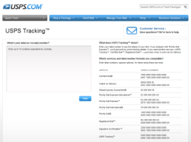
IMpb Requirement:
Shipping Services File (SSF) Validation
Mailers are required to transmit their SSF to Product Tracking and Reporting (PTR) prior to the physical presentation of the mailing
Three types of verifications are performed on an IMpb mailing:
  IMpb Barcode Compliance Verification
    Completed by the acceptance clerk when prompted by PostalOne!
  Shipping Services File (SSF) Compliance Verification
    Compliance percentages are automatically verified by PTR and data sent to PostalOne!
  Zip+4 Address Verification
    Compliance percentages are automatically verified by PTR and data sent to PostalOne!
Note: For more information on SSF submissions, reference Pub 199: The Implementation Guide to IMpb for Confirmation Services and eVS® Mailers
Notes:
Product Tracking and Reporting (PTR), formerly known as the Product Tracking System (PTS), is the database that stores tracking scan data for all barcoded packages and extra services products. This process is important because file and record validations occur in both PTR and eVS (as applicable).
Mailers are required to submit their Shipping Services File to the Product Tracking and Reporting (PTR) database, prior to or at the time of mailing. There are three types of verifications performed on an IMpb mailing:
IMpb Barcode Compliance Verification
Completed by the acceptance clerk when prompted by PostalOne!
Shipping Services File (SSF) Compliance Verification
Compliance percentages are automatically verified by PTR and data sent to PostalOne!
Zip+4 Address Verification
Compliance percentages are automatically verified by PTR and data sent to PostalOne!
The allowable thresholds for these three verifications will be covered later in this presentation.
For more information on Shipping Services File submission and compliance requirements, reference Publication 199: The Implementation Guide to Intelligent Mail Package Barcode (IMpb) for Confirmation Services and Electronic Verification System (eVS) Mailers on RIBBS:
https://ribbs.usps.gov/intelligentmail_package/documents/tech_guides/PUB199IMPBImpGuide.pdf.

Slide 13


PostalOne! Enhancements
Mailers may pay postage for their IMpb mailings in one of three ways:
  eVS (SSF included, no postage statement is required)
  Shipping Services File (SSF) (non eVS), hard copy postage statement
  Shipping Services File (SSF) (non eVS), electronic postage statement
13
Notes:
So now that the Shipping Service file has been submitted the its time to pay for postage. Mailers may pay postage for their IMpb mailings in one of three ways:
eVS (SSF included, no postage statement is required)
Shipping Services File (SSF) (non eVS), hard copy postage statement
Shipping Services File (SSF) (non eVS), electronic postage statement

Slide 14
IMpb Compliance Thresholds
The following compliance thresholds apply for the January 2014 Release:
  Unique trackable barcode or IMpb on the mailpiece– 98%
  Recipient Address or ZIP+4 – 93%
  Shipping Services Files – 90%
  Note: All thresholds are configurable to support percentage increases
Compliance Category | January 2014
Unique trackable barcode (legacy or IMpb) | 98%
Destination delivery address or ZIP+4 in SSF | 93%
Shipping Services File (legacy or v1.6 or higher), including required data elements | 90%
Non-compliant pieces will be assessed a fee based on these thresholds
Notes:
We have now covered all of the requirements and exceptions. Now let’s talk a little more about the compliance thresholds related to IMpb.
USPS is implementing the following compliance thresholds for IMpb mailings.
98% of the mailpieces must have a unique trackable barcode or IMpb on the mailpiece
93% of the mailpieces must list the destination delivery address or ZIP+4 in the Shipping Services File.
90% of the mailpieces must include the required data elements in and be supported by an Shipping Services File or authorized alternative.
These compliance thresholds will gradually increase over the next year.
Thresholds will be applied at the manifest level for PC Postage and postage meter mailings, and at the postage statement level for permit imprint or pre-canceled stamp mailings.
These thresholds are effective January 26, 2014 for competitive products (i.e. Priority Mail Express, Priority Mail, First-Class Package Service®, Parcel Select® and Parcel Select Lightweight). Competitive product mailings that fall below these thresholds will be charged a per-piece fee for noncompliant pieces.
Market-dominant products (i.e. First-Class Mail® parcels (non manifested), Standard Mail parcels, and Package Services parcels), are encouraged to comply with these thresholds. However market-dominant product mailings not meeting these thresholds, will not be charged the per-piece fee for noncompliant pieces, until a future date, pending filing and approval by the PRC.

Slide 15
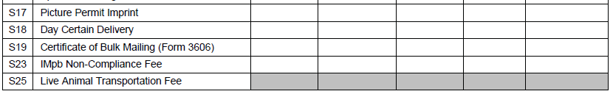
Postage Statement
Enhancement to support IMpb
A new line S23 has been added to Part S (Extra Services) of PS Forms 3600 FCM, 3600 PM, and 3605 (Parcel Select and Parcel Select Lightweight only) for the IMpb Non-Compliance Fee
If the piece count is greater than the percentage allowable for package types in more than one category, PostalOne! will use the greater number of non-compliant pieces
  Pieces will not be double counted for non-compliance
An error message will be displayed for the mailing if the barcode count is below the configurable percentage of packages allowed in a job
Notes:
A new line S23 has been added to Part S (Extra Services) of PS Forms 3600 FCM, 3600 PM, and 3605 for the IMpb Non-Compliance Fee.
Mailers should use this line to report pieces which do not bear an IMpb or contain a ZIP+4 or destination delivery address, as well as those which were not submitted using SSF version 1.6 or higher. Please note that to support the addition of line S23, Mail.dat and Mail.XML will support a new Service Code Type, NP, for the IMpb Noncompliance Fee for parcels.
As previously described, the thresholds for Intelligent Mail package barcode (IMpb) compliance are as follows for January 2014:
IMpb on the mailpiece – 98%
ZIP+4 or Delivery Address – 93%
Shipping Services Files 1.6 or higher – 90% (for Hardcopy and Postal Wizard only).
If the piece count is greater than the percentage allowable for package types in more than one category, PostalOne! will use the greater number of non-compliant pieces. Only ONE verification that yields the largest number of pieces below the threshold will be used for charging the IMpb Non-Compliance fee. Pieces will not be double counted for non-compliance.
For example, a mailer has a total of 100 pieces in their mailing. Three pieces have no IMpb (97% compliance which is below the threshold); 9 pieces are non-compliant for Zip+4 (91% compliance, also below the threshold). The 9 non-Zip+4 parcels yield the greater number of non-compliant pieces, so 2% of total pieces would receive the Non-barcoded Parcel Fee.
An error message will be displayed for the mailing if the barcode count is below the configurable percentage of packages allowed in a job: “The current minimum threshold for pieces with barcodes in a job is X, and your mailing does not meet the minimum threshold for barcode counts.”

Slide 16
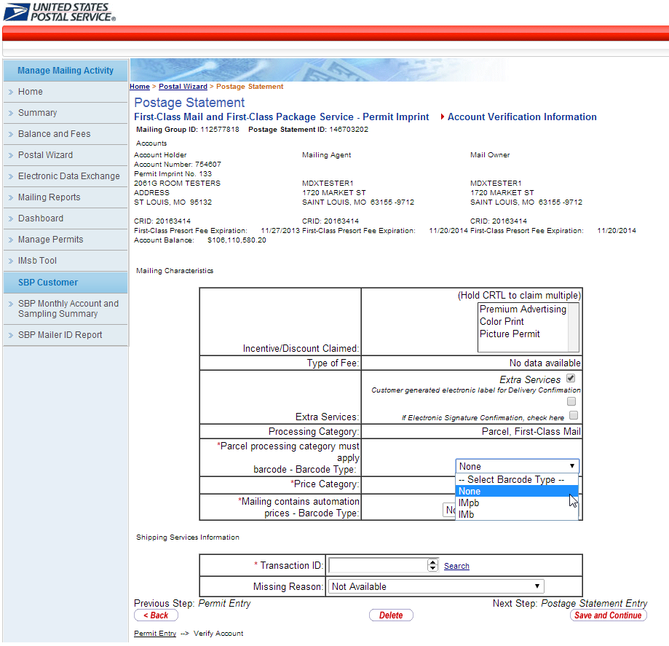
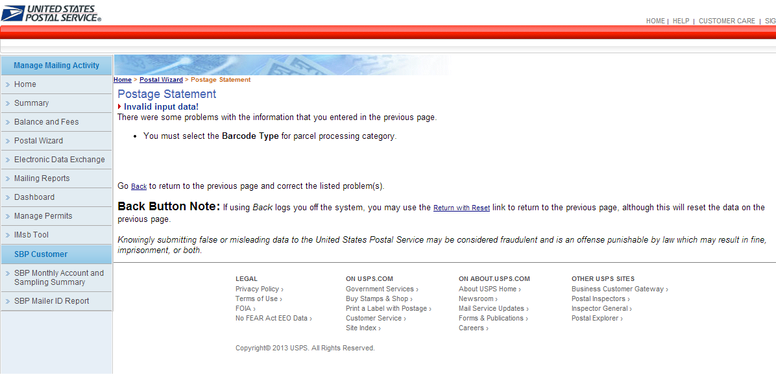
Postal Wizard Enhancements
On the Postage Statement Account Verification page, when the processing category of “Parcels” is selected, the Barcode Type dropdown now includes IMpb.
New parcel “Barcode Type” dropdown now includes IMpb
If no selection is made, an error message will appear
Notes:
Now let’s review what enhancements have been made in Postal Wizard to support the new IMpb requirements.
The first enhancement that has been made to Postal Wizard to support IMpb Compliance is that a new Barcode Type dropdown is displayed when the processing category of “Parcels” is selected, titled “Parcel Processing category must apply barcode – Barcode Type”.
This new dropdown includes “IMpb” as an option, along with “IMb” and “None”. Please note that IMb is only an option for First-Class Mail and Standard Mail parcels – for all other parcels only two options will be shown on the dropdown (IMpb and None).
If no selection is made, an error message will appear requiring the user to come back to this screen and select a Barcode Type.

Slide 17
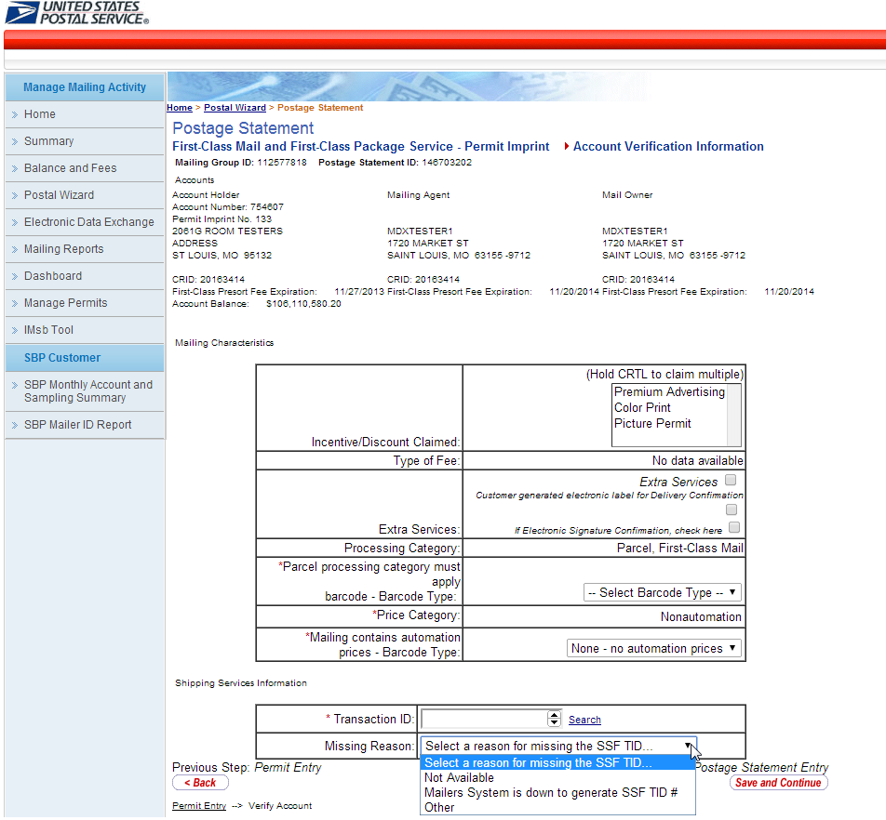
Postal Wizard Enhancements
SSF TID# field is a required field whenever the processing category of parcels is selected
  If no TID# is given, users must select a reason from the dropdown
    Note: if no SSF TID# has been provided, mailers must claim the S23 extra services fee
When a processing category of “parcels” is selected, a Transaction ID field will display as a dropdown with the mailer’s prepopulated Transaction ID (TID).
Notes:
Another enhancement is that on the Account Verification Information page, you will see a new “Shipping Services Information” section upon selecting the processing category of “parcels”.
This new section includes a Transaction ID field. Remember that we spoke briefly about the importance of this field when we were talking about the requirements of the Shipping Services File (SSF). The Transaction ID (TID) is a required field within the Shipping Services File. The Transaction ID electronically identifies and links the electronic Shipping Services File(s) and associated data to the corresponding postage statement for shipments presented at BMEUs and DMUs. The TID in conjunction with the Payment Account Number, Method of Payment, and Post Office of Account, enable the Postal Service to calculate IMpb compliance for each mailing at the postage statement level. The TID is what enables the Postal Service to determine mailer compliance with the IMpb requirements.
Mailers can bring up a list of Transaction IDs by clicking on the “Search” link to the right of the TID field. Mailers also have the option to manually enter the TID, which must be a 12-digit number with numeric values only.
If no TID is given, users will be prompted to select a reason from the dropdown:
Not Available
Mailers System is down to generate SSF TID#, or
Other
As discussed a Shipping Services File is required. Mailings that are presented without a Shipping Services File will be charged an IMpb Non Compliance fee for each piece in the IMpb mailing without a Shipping Services File.

Slide 18
Postal Wizard Enhancements to support IMpb Compliance
If the mailer does not provide a SSF TID or if “None” is selected from the Barcode Type dropdown, the Extra Services will automatically be checked and a non-compliance fee will be assessed
Notes:
To assist in the assessment of the Non-Compliance fee, the Extra Services check box will automatically be selected on the Account Verification Information page if the mailer does not provide a SSF TID or if “None” is selected from the Barcode Type dropdown.
The non-compliance fee must be applied to all of the pieces in the mailing because the mailer failed to place the IMpb barcode on the mailpieces and/or failed to upload a Shipping Services File and provide the Transaction ID.

Slide 19
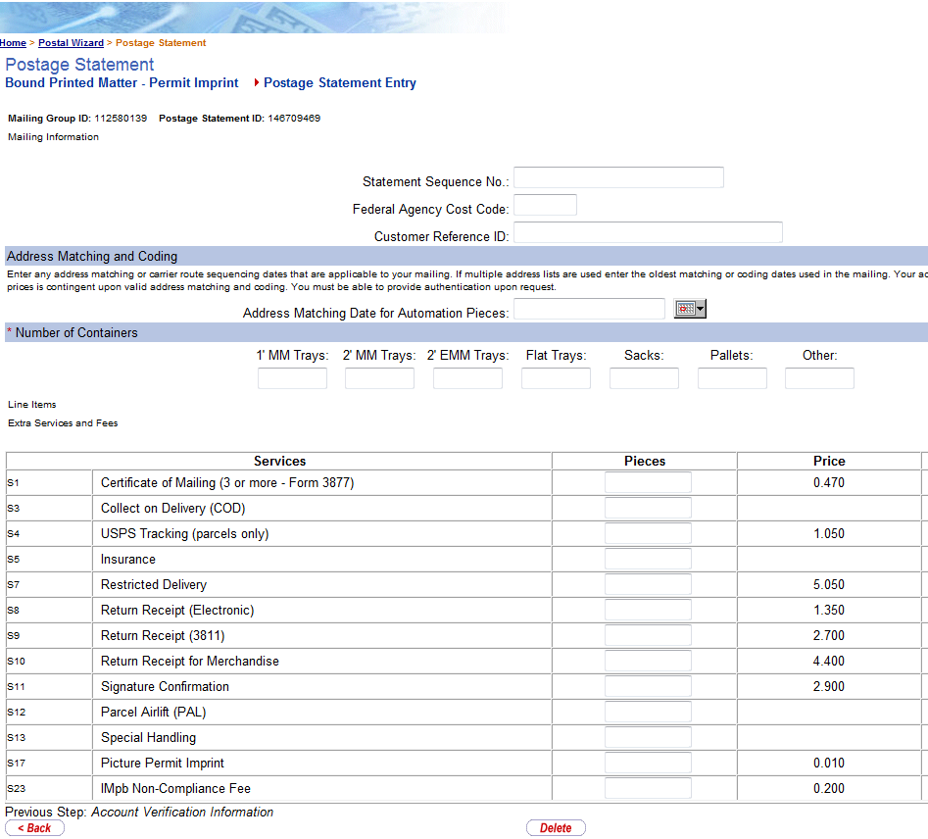
Postal Wizard Enhancements to support IMpb Compliance
If the Extra Services box is checked from the previous screen and/or IMpb barcodes are not provided on mailpieces, users are required to enter the total number of noncompliant mailpieces on line S23
This fee will then be included as part of the postage statement for the mailing and charged to the mailers’ applicable PostalOne! account
Notes:
If no SSF Transaction ID is provided and/or if IMpb barcodes are not provided on mailpieces (also meaning that the Extra Services box is checked on the previous screen), mailers are required to enter the total number of non-compliant pieces on line S23.
This fee will then be included as part of the postage statement for the mailing and will be charged to the mailers’ applicable PostalOne! account, and the mailing will bypass IMpb Compliance Verification.

Slide 20
IMpb Non-Compliance Fee:
Mail.dat and Mail.XML Support
Mail Class - Parcels | Support for processing of IMpb Non-compliance January 2014
 | Mail.dat | Mail.XML
Standard Mail (parcels) | N/A | N/A
First-Class Mail (parcels) | Supported | Supported
Package Services (parcels) | Not supported (Parcel Select, PSLW not currently supported/processed) | Supported (only Parcel Select, PSLW)
Periodicals | N/A | N/A
Priority Mail | Not Supported | Supported (Parcels Only)
For more information about Mail.dat and Mail.XML version support, visit: https://ribbs.usps.gov/intelligentmail_schedule2014/documents/specs/IDEAllianceSpecs.pdf
For Mail.dat and Mail.XML Technical Specifications and Guides, visit: https://ribbs.usps.gov/intelligentmail_schedule2014/releases/jan2014/techspecs.cfm
Notes:
For mailers using Mail.dat and/or Mail.XML to submit mailings, it is important to note that with this release, these software specifications have limited support for processing of the IMpb Non-Compliance Fee. Both Mail.dat and Mail.XML will continue to be upgraded throughout year 2014 to provide support for additional mail classes at a later date.
This chart depicts the Mail.dat and Mail.XML support for IMpb non-compliance in January 2014 at a high level. For more detailed information regarding Mail.dat and Mail.XML IMpb processing and support capabilities, reference Appendix B of this presentation.
The PostalOne! Mail.dat and Mail.XML systems perform the IMpb compliance verification based on the data submitted within the Mail.dat and Mail.XML files. Please note that there is no linkage available between the PTR Shipping Services File and Mail.dat/ Mail.XML eDoc at this time, and no SSF TID is supported.
For the Mail.dat/Mail.XML postage payment scenario: Even when a Shipping Services file is submitted to PTR to support with the Non-compliance verification, since there is no linkage between Mail.dat/Mail.XML and PTS SSF, the IMpb, Zip+4/Recipient Address data needs to be submitted through Mail.dat/Mail.XML, especially since the postage processing is performed within PostalOne!.
More information about Mail.dat and Mail.XML version support and file formats can be found on the January 2014 Technical Specifications and Guides page on RIBBS.

Slide 21
Release 37.0.0 Known Issues
IMpb Non-Compliance Fee:
Mail.dat and Mail.XML - Known issues
The FRN for Package Visibility mandates a 9-Digit ZIP (ZIP+4) in eDoc submissions for Packages beginning January 2014, and an 11-Digit DPV ZIP is proposed for January 2015
  Currently PostalOne! eDoc is requiring the field to be of a length of eleven (11) digits
  The system is being updated to resolve this issue. In the meantime, error 7191 is being turned into a warning
  Mail.dat field: .pdr Piece Barcode
  Mail.XML field: MailPieceCreateRequest IMPackageBarcode field DeliveryPointZip
Periodicals Parcels are not subjected to IMpb Non-compliance processing and fee assessment with this release
  Currently, PostalOne! is including Periodicals IR Parcels in IMpb Non-compliance processing
  The system is being updated to resolve this issue. In the meantime, error 4532 is being turned into a warning
21
Notes:
Currently, two Known Issues exist related to IMpb Compliance.
The Federal Register Notice Final Rule for Package Visibility mandates the use of a 9-Digit ZIP (ZIP+4) in eDoc for Packages for January 2014, and an 11- Digit Delivery Point Validation (DPV) ZIP is proposed for January 2015. Currently, PostalOne! eDoc is requiring the field to be of a length of eleven (11) digits. The system is being updated to resolve this issue, and the system (at a future patch date) will require nine (9) digit ZIP+4. In the meantime, error 7191 is being turned into a warning. In Mail.dat submissions, the ZIP Code field is the .pdr Piece Barcode, while in Mail.XML submissions the ZIP Code field is MailPieceCreateRequest > IMPackageBarcode > DeliveryPointZip.
Periodicals Parcels are not subjected to IMpb Non-compliance processing and fee assessment with this release; however, currently PostalOne! is including Periodicals Irregular (IR) Parcels in IMpb Non-compliance processing. The system is being updated to resolve this issue, and the system (at a future patch date) will remove IR Periodicals from IMpb Non-compliance fee assessment. In the meantime, error 4532 is being turned into a warning.

Slide 22
Tools for Mailers
There are several tools available to help mailers meet the IMpb and data submission requirements:
Use a certified vendor software solution
  See list on next slide; latest are posted on https://ribbs.usps.gov/evs
Use a certified consolidator solution
  See list on next slide; latest are posted on https://ribbs.usps.gov/evs
Become an eVS mailer
  Contact the eVS Help Desk at evs@usps.gov or 877-264-9693 (select option 3) for help signing up or for more information
Use the new USPS Postal Shipping Tool
  Note: Additional information is available at https://gateway.usps.com under “Shipping Services”
Notes:
Now that we have provided an overview of the IMpb requirements, it is important to note where mailers can go to receive assistance in meeting the IMpb and data submission requirements. There are four solutions available:
Use a certified vendor software. These Package Software vendors can help mailers submit IMpb-compliant mailings by generating Shipping Services Files and IMpb barcodes. A list of package vendors who have successfully tested their software with the postal service can be found on the RIBBS.
Use a certified consolidator. Consolidators offer a variety of services to prepare and mail packages, including IMpb generation and drop-shipment. A list of consolidator providers who have successfully tested their software with the Postal Service is also listed on RIBBS.
Another solution is to become an eVS mailer. The Electronic Verification System (eVS) enables parcel mailers to submit documentation and pay postage by transmitting electronic manifest files to the eVS database, which is part of the PostalOne! system. Because eVS integrates with other systems and business processes for data collection and performance measurement, eVS makes it easy for customers to prepare and induct parcel mailings. Encourage mailers to contact the eVS Help Desk at evs@usps.gov or 877-264-9693 (select option 3) for help signing up or for more information.
The last solution is to use the USPS Postal Shipping Business Tool (PSBT). PSBT is a downloadable software solution that allows small and medium business mailers to generate shipping labels with Intelligent Mail Package Barcodes (IMpb) and securely pay postage via electronic manifest files. PSBT usage is available free of charge for small- to medium-business mailers regularly shipping at least 50 packages per day. PSBT leverages the existing eVS infrastructure to provide manifesting and payment capabilities for authorized users. This is an excellent software alternative for smaller mailers and it’s FREE.

Slide 23
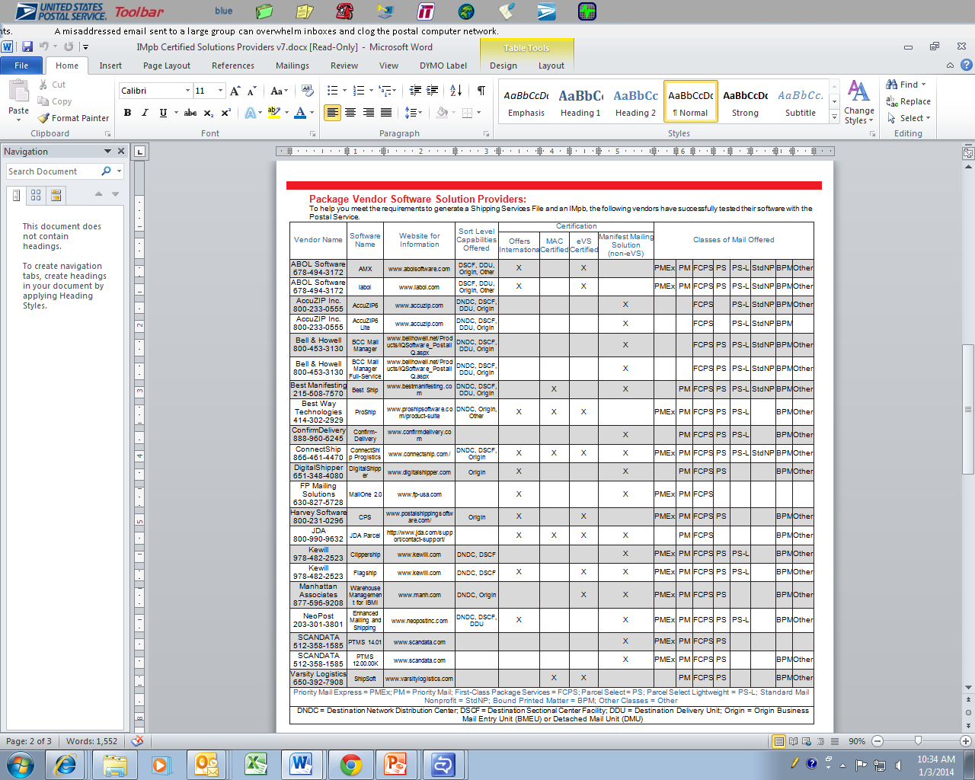
Certified Vendor Software Solutions
The package vendors listed here have successfully tested their software with the Postal Service
Notes:
The package vendors listed on the “Package Vendor Software Solution Providers” chart have successfully tested their software with the Postal Service.
This chart lists the sort level capabilities, supported mail classes, and certifications of each software vendor.

Slide 24
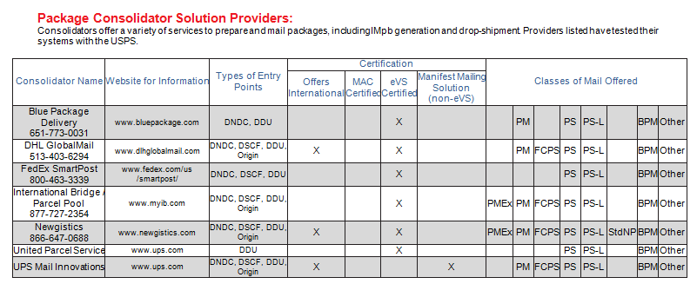
Certified Consolidator Solutions
Package Consolidators offer a variety of services to prepare and mail packages, including IMpb generation and drop-shipment
Notes:
Also with the second solution, Package Consolidators have successfully tested their software with the Postal Service.
They are listed within the “Package Consolidator Solution Providers” found on RIBBS.
These consolidators offer a variety of services to help prepare and mail packages, including the generation of IMpb labels and drop-shipment.
This chart lists the certifications of each vendor as well as the entry points and classes of mail supported by the software.

Slide 25
Electronic Verification System (eVS)
Enables parcel mailers to submit documentation and pay postage by transmitting electronic manifest files to the eVS database, which is part of the PostalOne! System
The first option for meeting the new IMpb requirements is to electronically submit postage, manifest, and tracking information in one file via eVS
  Single file includes the Shipping Services File, destination delivery address or ZIP+4, and postage statement information
  Payment for postage is deducted from a centralized electronic postage payment account (a Centralized Account Processing System – CAPS account)
Contact the eVS Help Desk at evs@usps.gov or 877-264-9693 (select option 3) for help signing up or for more information
Notes:
The third available solution is to become an eVS mailer. The Electronic Verification System (eVS) enables parcel mailers to submit documentation and pay postage by transmitting electronic manifest files to the eVS database, which is part of the PostalOne! system.
Because eVS integrates with other systems and business processes for data collection and performance measurement, eVS makes it easy to prepare and induct parcel mailings, thus streamlining mailers’ internal business processes as well as those with the Postal Service.
This method allows the electronic submission of postage, manifest, and tracking information all in one single file. This single file includes the Shipping Services File, destination delivery address or ZIP+4, and postage statement information.
Postage is deducted from a centralized postage payment account. For more information about becoming an eVS mailer, contact the eVS Help Desk.

Slide 26
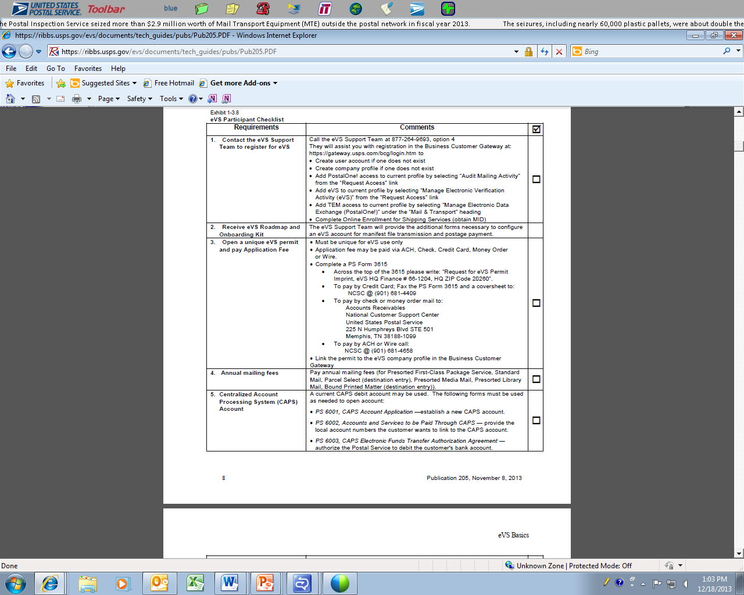
eVS Participation
The eVS Participant Checklist is included as an appendix in Publication 205 , on the RIBBS website
This document outlines the requirements you must meet to become an eVS mailer
Notes:
The eVS Participant Checklist is included as an appendix in Publication 205.
This checklist outlines the requirements that must be met in order to become an eVS mailer.
This checklist can be found on RIBBS at:
https://ribbs.usps.gov/evs/documents/tech_guides/pubs/Pub205.PDF
The first five steps of the checklist are displayed on this slide, you have to:
Contact the eVS support team to register for eVS
Receive eVS roadmap and onboarding Kit
Open a unique eVS permit and pay application fee
Pay annual mailing fees
Open a CAPS account

Slide 27
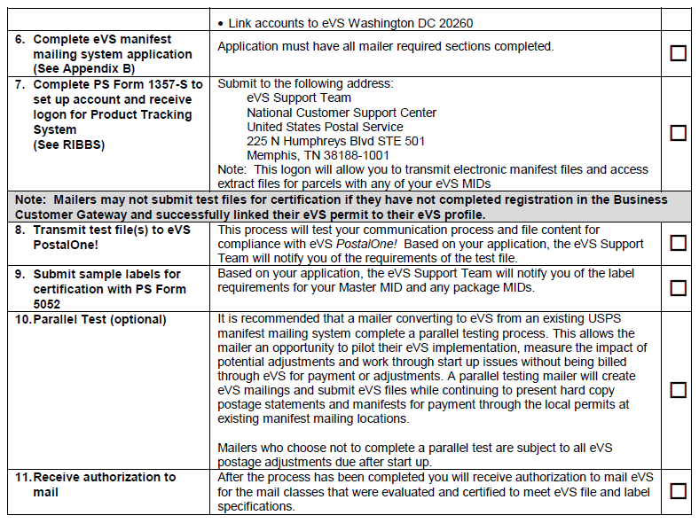
eVS Participation
Notes:
The last six steps of the checklist are displayed on this hard to read slide are:
6. Complete eVS manifest mailing system application
7. Complete PS Form 1357-S to set up an account for Product Tracking and Reporting (formerly the Product Tracking System)
8. Transmit test files to eVS PostalOne!
9. Submit sample labels for certification with PS Form 5052
10. Parallel Test
11. Receive authorization to mail
Upon completion of all eleven requirements, a customer will be authorized to mail as an eVS mailer.

Slide 28
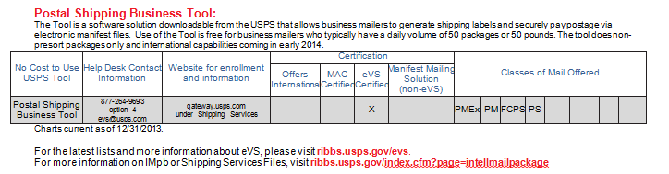
Postal Shipping Business Tool (PSBT)
Downloadable free software solution which allows small and medium business mailers to:
  Generate shipping labels with Intelligent Mail package barcodes
  Securely pay postage via electronic manifest files
Leverages existing eVS infrastructure
Must ship at least 50 packages per day
Supports single-piece and nonpresort packages including First-Class Package Service, Priority Mail, Priority Mail Express, and Parcel Select Nonpresort
Supports International shipments beginning early 2014
Note: Additional information is available at gateway.usps.com under “Shipping Services”
Notes:
The fourth solution available to you is the Postal Shipping Business Tool or PSBT. PSBT is a downloadable software solution that allows small and medium business mailers to generate shipping labels with Intelligent Mail Package Barcodes (IMpb) and securely pay postage via electronic manifest files. PSBT usage is available free of charge for small- to medium-business mailers regularly shipping at least 50 packages per day. PSBT leverages the existing Electronic Verification System (eVS) infrastructure to provide manifesting and payment capabilities for authorized users.
PSBT is a downloadable application designed for you to install and use with minimal onboarding time and IT support. PSBT provides label printing, manifesting, postage payment, and reporting for single-piece and nonpresort packages including First-Class Package Service, Priority Mail, Priority Mail Express, and Parcel Select Nonpresort. PSBT will expand to support International shipments in early 2014.
The PSBT enrollment process creates a business profile and a user account for the registering user. PSBT authorized companies are required to open a permit imprint account and link payment accounts prior to their first shipment. After the PSBT account is authorized for a business location, additional users will be required to create unique user accounts via the Business Customer Gateway prior to downloading their company's PSBT software.
The chart on this page provides an overview of the certifications and supported mail classes for the tool. For additional information, refer to the link under “Shipping Services” on the BCG homepage.

Slide 29
References
Package Information Sheet – Provides an overview of the new requirements and the list of certified solutions providers
  https://ribbs.usps.gov/intelligentmail_package/documents/tech_guides/IMpbCertifiedSolutionsProviders.pdf
RIBBS: Intelligent Mail Package Barcode (IMpb) page:
  http://ribbs.usps.gov/index.cfm?page=intellmailpackage
IMpb Frequently Asked Questions (FAQ):
  https://ribbs.usps.gov/intelligentmail_package/documents/tech_guides/IMPB_FAQs.pdf
Publication 199: IMpb Implementation Guide for Confirmation Services and eVS – provides implementation details regarding the Shipping Services File
  https://ribbs.usps.gov/intelligentmail_package/documents/tech_guides/PUB199IMPBImpGuide.pdf
RIBBS: eVS (Electronic Verification System) page:
  https://ribbs.usps.gov/evs
eVS Help Desk – for assistance in eVS sign-up and questions
  email: evs@usps.gov; phone: 877-264-9693, option 4
Notes:
Additional information and resources can be found on the RIBBS including:
There is a Package Information Sheet – Which provides an overview of the new requirements and the list of certified solutions providers.
On RIBBS: Select the Intelligent Mail Package Barcode (IMpb) page.
There is a IMpb Frequently Asked Questions sheet (FAQ).
Also Publication 199: Which is a IMpb Implementation Guide for Confirmation Services and eVS – provides implementation details regarding the Shipping Services File.
Also found on RIBBS: Go to the eVS (Electronic Verification System) page.
Additionally, for assistance in eVS sign-up and questions, mailers may contact the eVS Help Desk.

Slide 30

Questions?

Slide 31
APPENDIX
Appendix A: MicroStrategy Reports
Appendix B: System Support for IMpb Compliance
  Mail.XML / Mail.dat
  Postal Wizard
  Hardcopy BMEU
Notes:
Now we’ll look at a few Appendix’s.
The first Appendix, covers two MicroStrategy Reports which play a crucial role in the monitoring of IMpb compliance thresholds.

Slide 32
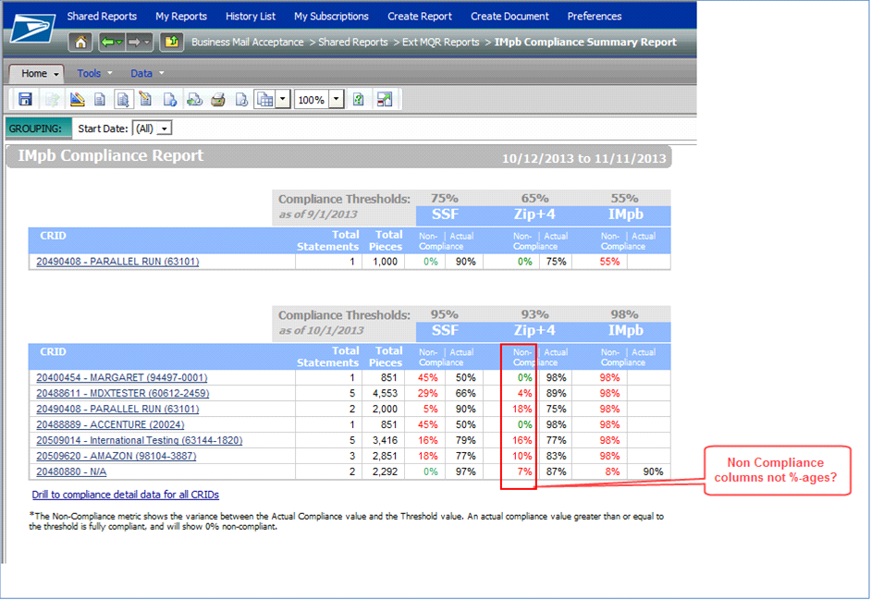
MicroStrategy Report:
IMpb Compliance Percentage Display
Non-Compliance and Actual Compliance
Notes:
There is a report called the IMpb Compliance Summary Report within the Shared Reports then within the MQR Reports folder in MicroStrategy.
This report displays IMpb compliance thresholds over a period of one month. In this report, data will be grouped based on the threshold change dates.
The threshold change dates are currently set to Jan 26, 2014, and July 27, 2014. When the thresholds change, the reports will group the data separately.
When clicking the “Drill to compliance detail data for all CRIDs” link at the bottom of the page, a more detailed view of the IMpb compliance percentages will be shown.
Let’s take a look at this “IMpb Compliance Detail Report”.

Slide 33
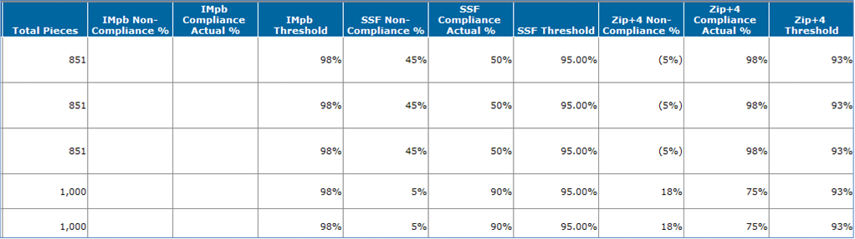
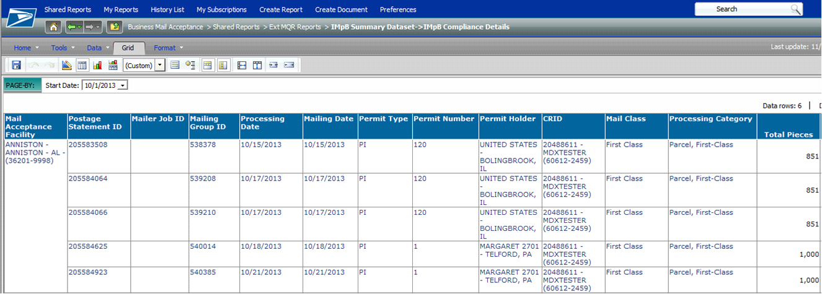
MicroStrategy Report:
IMpb Compliance Percentage Display
Notes:
As you can see, the “IMpb Compliance Details” view displays the IMpb Non-Compliance thresholds, the non-compliance percentage, and the actual compliance percentage for all three compliance categories.

Slide 34
APPENDIX
Appendix A: MicroStrategy Reports
Appendix B: System Support for IMpb Compliance
  Mail.dat
  Mail.XML /
  Postal Wizard
  Hardcopy BMEU
Notes:
The next Appendix includes four detailed tables outlining the system support for processing IMpb compliance.
Please note that the following tables are provided for software vendors and customers who are programming their own software.

Slide 35
IMpb Support: Mail.dat
Mail.dat IMpb Non-Compliance Assessment / Calculation for January 2014 Release
Mail.dat Mail Classes or Products | Mail Processing Category | Barcode Type | Mail Class supported in PostalOne! via Mail.dat | eDoc Files Conversion to PTR | Alternate Option for tracking piece information and to support Shipping Services processing/routing | Extra Service IMpb Non-Compliance Fee S23
First-Class Mail | Parcels | IMpb | Supported | Not available, proposed for future | a) Can submit to PTR the Shipping Services File. (no linkage b/w Mail.dat and PTR file) b) Use other postage submission type, such as eVS, PW+SSF, or BMEU+SSF | Mailers will need to pay, in case pieces fall below compliance thresholds
Standard Mail | Parcels | IMb, IMpb | Supported | Not available, proposed for future | Use other submission type, such as eVS, PW+SSF, or BMEU+SSF | Not applicable, Not assessed
Priority Mail | Parcels | IMpb | Not Supported | Not available, proposed for future | Use other postage submission type, such as eVS, PW+SSF, or BMEU+SSF (or contact Shipping Services Department) | N/A
Priority Mail | Letters, Flats (Only for Critical Mail) | IMb, IMpb | Not Supported | Not available, proposed for future | Use other postage submission type, such as eVS, PW+SSF, or BMEU+SSF (or contact Shipping Services Department) | N/A
Bound Printed Matter | Parcels | IMpb | Supported | Yes | N/A | Not applicable, Not assessed
Library Mail | Parcels | IMpb | Supported | Not available, proposed for future | N/A | Not applicable, Not assessed
Media Mail | Parcels | IMpb | Supported | Not available, proposed for future | N/A | Not applicable, Not assessed
Parcel Select & PSLW | Parcels | IMpb | Not Supported | Not available, proposed for future | Use other postage submission type, such as eVS, PW+SSF, or BMEU+SSF (or contact Shipping Services Department) | N/A
Periodicals | Parcels | IMpb | Supported | Not available, proposed for future | N/A | Not applicable, Not assessed
Notes:
The chart above outlines the Mail.dat capabilities for IMpb non-compliance assessment and fee calculation. The following categories are provided to help you better understand the support currently in place for each class of mail as related to Mail.dat and IMpb compliance they are:
Mail.dat Mail Classes or Products
Mail Processing Category
Barcode Type
Mail Class Supported in PostalOne! via Mail.dat
eDoc File Conversion to PTR
Alternate Option for Tracking
Extra Service IMpb Non-Compliance Fee S23
The first four column titles are self-explanatory so let’s take a closer look at the fifth column, eDoc File Conversion to PTR.
This column indicates when an eDoc file submitted via Mail.dat is automatically converted and sent to Product Tracking and Reporting system (PTR) for tracking and processing purposes, thus bypassing the need to submit a Shipping Services File separately.
This automatic file conversion is proposed to eventually be in place for all classes of mail; however, as you can see, currently with this release the only class of mail that supports this conversion is Bound Printed Matter.
The next column identifies alternate options, if available, for tracking piece information and to support shipping services processing/routing. Mailers can use these methods to submit their mailing rather than submitting their mailing through Mail.dat.
The last column on the right, Extra Service IMpb Non-Compliance Fee S23, identifies whether the Non-compliance fee is assessed for each class of mail through Mail.dat. Those marked as “Not applicable, Not assessed” indicate that the fee is not assessed for that class of mail at this time until a future date. Those classes marked with “N/A” are mail classes that are not supported in PostalOne! through Mail.dat at all. As you can see, the Non-compliance fee is currently only being assessed via Mail.dat for First-Class Mail parcels.
Now that we’ve discussed the chart for Mail.dat, let’s take a look at Mail.XML table.

Slide 36
IMpb Support: Mail.XML
Mail.XML IMpb Non-Compliance Assessment / Calculation for January 2014
Mail.XML Mail Classes or Products | Mail Processing Category | Barcode Type | Mail Class supported in PostalOne! via Mail.XML | eDoc Files Conversion to PTR | Alternate Option for tracking piece information and to support Shipping Services processing/routing | Extra Service IMpb Non-Compliance Fee S23
First-Class Mail | Parcels | IMpb | Supported | Not available, proposed for future | a) Can submit to PTR the Shipping Services File. (no linkage b/w Mail.dat and PTR file) b) Use other postage submission type, such as eVS, PW+SSF, or BMEU+SSF | Mailers will need to pay, in case pieces fall below compliance thresholds
Standard Mail | Parcels | IMb, IMpb | Supported | Not available, proposed for future | Use other submission type, such as eVS, PW+SSF, or BMEU+SSF | Not applicable, Not assessed
Priority Mail | Parcels | IMpb | Supported | Not available, proposed for future | a) Can submit to PTR the Shipping Services File. (no linkage b/w Mail.dat and PTR file) b) Use other postage submission type, such as eVS, PW+SSF, or BMEU+SSF | Mailers will need to pay, in case pieces fall below compliance thresholds
Priority Mail | Letters, Flats (Only for Critical Mail) | IMb, IMpb | Not Supported | Not available, proposed for future | Use other postage submission type, such as eVS, PW+SSF, or BMEU+SSF (or contact Shipping Services Department) | Mailers can voluntarily pay, in case pieces fall below compliance thresholds
Bound Printed Matter | Parcels | IMpb | Supported | Not available, proposed for future | Yes (SSF data sent to PTR for routing and for mailers to receive tracking) | Not applicable, Not assessed
Library Mail | Parcels | IMpb | Supported | Not available, proposed for future | N/A- Not applicable | Not applicable, Not assessed
Media Mail | Parcels | IMpb | Supported | Not available, proposed for future | N/A- Not applicable | Not applicable, Not assessed
Parcel Select & PSLW | Parcels | IMpb | Supported | Not available, proposed for future | a) Can submit to PTR the Shipping Services File. (no linkage b/w Mail.dat and PTR file) b) Use other postage submission type, such as eVS, PW+SSF, or BMEU+SSF | Mailers will need to pay, in case pieces fall below compliance thresholds
Periodicals | Parcels | IMpb | Supported | Not available, proposed for future | N/A- Not applicable | Not applicable, Not assessed
Notes:
Similar to the chart on the previous slide, the chart above outlines the Mail.XML capabilities for IMpb non-compliance assessment and fee calculation. Again, the following table columns outline the support currently in place for each class of mail as related to Mail.XML and IMpb compliance:
Mail.XML Mail Classes or Products
Mail Processing Category
Barcode Type
Mail Class Supported in PostalOne! via Mail.XML
eDoc File Conversion to PTR
Alternate Option for Tracking
Extra Service IMpb Non-Compliance Fee S23
As mentioned on the previous slide, the second column from the right identifies alternate options, if applicable, for tracking piece information and to support shipping services processing/routing. Mailers can use these methods to submit their mailing rather than submitting their mailing through Mail.XML.
As displayed in the last column on the right, the Extra Service IMpb Non-Compliance Fee S23 will only be assessed for First-Class Mail, Priority Mail, and Parcel Select (including Parcel Select Lightweight) in January 2014 for eDocs submitted via Mail.XML.
Now that we’ve discussed the support in place for Mail.dat and Mail.XML, let’s take a look at the IMpb system support for Postal Wizard and PostalOne! BMEU.

Slide 37
IMpb Support: Postal Wizard
Postal Wizard IMpb Non-Compliance Assessment / Calculation for January 2014
Postal Wizard Mail Classes or Products | Mail Processing Category | Barcode Type | Mail Class supported in PostalOne! via Postal Wizard | PW Files Conversion to PTR | Alternate Option for tracking piece information and to support Shipping Services processing/routing | Extra Service IMpb Non-Compliance Fee S23
First-Class Mail | Parcels | IMpb | Supported | N/A- Not needed, combination of PW and SSF supported | System requires a separate SSF submission to PTR | Mailers will need to pay, in case pieces fall below compliance thresholds
Standard Mail | Parcels | IMb, IMpb | Supported | N/A- Not needed, combination of PW and SSF supported | N/A- Not applicable | Not applicable, Not assessed
Priority Mail | Parcels | IMpb | Supported | N/A- Not needed, combination of PW and SSF supported | System requires a separate SSF submission to PTR | Mailers will need to pay, in case pieces fall below compliance thresholds
Priority Mail | Letters, Flats (Only for Critical Mail) | IMb, IMpb | Supported | N/A- Not needed, combination of PW and SSF supported | System requires a separate SSF submission to PTR | Mailers will need to pay, in case pieces fall below compliance thresholds
Bound Printed Matter | Parcels | IMpb | Supported | N/A- Not needed, combination of PW and SSF supported | N/A- Not applicable | Not applicable, Not assessed
Library Mail | Parcels | IMpb | Supported | N/A- Not needed, combination of PW and SSF supported | N/A- Not applicable | Not applicable, Not assessed
Media Mail | Parcels | IMpb | Supported | N/A- Not needed, combination of PW and SSF supported | N/A- Not applicable | Not applicable, Not assessed
Parcel Select & PSLW | Parcels | IMpb | Supported | N/A- Not needed, combination of PW and SSF supported | System requires a separate SSF submission to PTR | Mailers will need to pay, in case pieces fall below compliance thresholds
Periodicals | Parcels | IMpb | Supported | N/A- Not needed, combination of PW and SSF supported | N/A- Not applicable | Not applicable, Not assessed
Notes:
The chart above depicts the January 2014 Postal Wizard support for the IMpb Non-Compliance assessment.
As is the case in the previous two charts, the Extra Services S23 fee is not being assessed for Standard Mail, Bound Printed Matter, Library Mail, Media Mail, or Periodicals until a future date.

Slide 38
IMpb Support: BMEU Hardcopy
BMEU Hard-Copy IMpb Non-Compliance Assessment / Calculation for January 2014
BMEU Mail Classes or Products | Mail Processing Category | Barcode Type | Mail Class supported in PostalOne! via BMEU | BMEU Files Conversion to PTR | Alternate Option for tracking piece information and to support Shipping Services processing/routing | Extra Service IMpb Non-Compliance Fee S23
First-Class Mail | Parcels | IMpb | Supported | N/A- Not needed, combination of BMEU and SSF supported | System requires a separate SSF submission to PTR | Mailers will need to pay, in case pieces fall below compliance thresholds
Standard Mail | Parcels | IMb, IMpb | Supported | N/A- Not needed, combination of PW and SSF supported | N/A- Not applicable | N Not applicable, Not assessed
Priority Mail | Parcels | IMpb | Supported | N/A- Not needed, combination of BMEU and SSF supported | System requires a separate SSF submission to PTR | Mailers will need to pay, in case pieces fall below compliance thresholds
Priority Mail | Letters, Flats (Only for Critical Mail) | IMb, IMpb | Supported | N/A- Not needed, combination of BMEU and SSF supported | System requires a separate SSF submission to PTR | Mailers will need to pay, in case pieces fall below compliance thresholds
Bound Printed Matter | Parcels | IMpb | Supported | N/A- Not needed, combination of BMEU and SSF supported | N/A- Not applicable | Not applicable, Not assessed
Library Mail | Parcels | IMpb | Supported | N/A- Not needed, combination of BMEU and SSF supported | N/A- Not applicable | Not applicable, Not assessed
Media Mail | Parcels | IMpb | Supported | N/A- Not needed, combination of BMEU and SSF supported | N/A- Not applicable | Not applicable, Not assessed
Parcel Select & PSLW | Parcels | IMpb | Supported | N/A- Not needed, combination of BMEU and SSF supported | System requires a separate SSF submission to PTR | Mailers will need to pay, in case pieces fall below compliance thresholds
Periodicals | Parcels | IMpb | Supported | N/A- Not needed, combination of BMEU and SSF supported | N/A- Not applicable | Not applicable, Not assessed
Notes:
The table above displays the PostalOne! support for processing IMpb non-compliance when mailers submit hardcopy postage statements to the BMEU.
Currently the PostalOne! and Postal Wizard system support for IMpb compliance is identical.
As discussed previously, the S23 fee is only being assessed for First-Class Mail, Priority Mail, and Parcel Select (including lightweight) at this time.
For more information on submitting postage statements for parcel mailings and the new IMpb Non-compliance fee, reference one of the links on slide 34 of this presentation.

