Slide 2
IPCC reports are the result of extensive work from scientists around the world.
1 Summary for Policymakers
1 Technical Summary
16 Chapters
235 Authors
900 Reviewers
More than 2000 pages
Close to 10,000 references
More than 38,000 comments

Slide 3
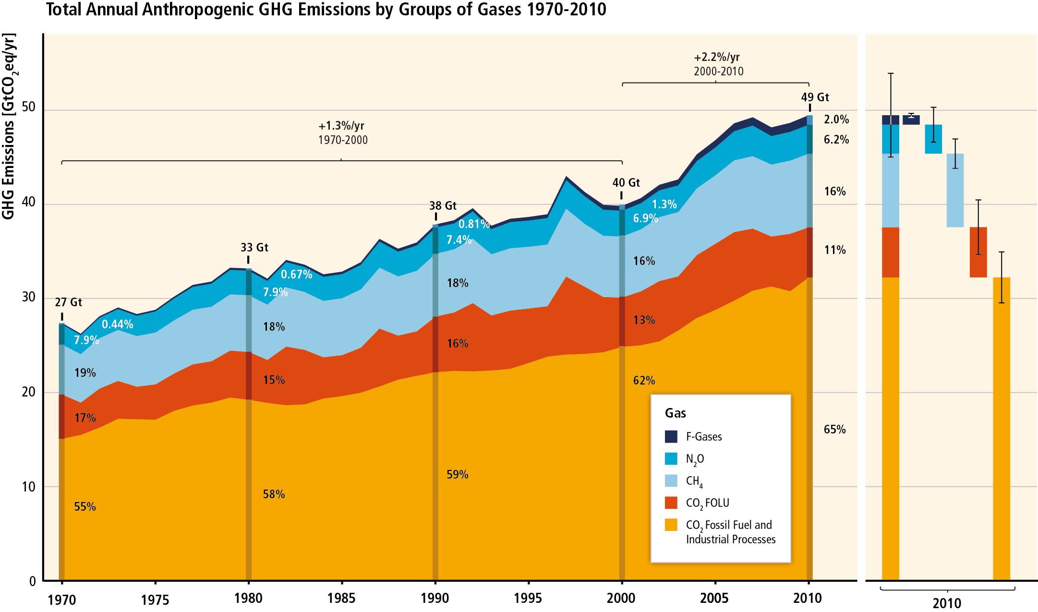
GHG emissions accelerate despite reduction efforts. Most emission growth is CO₂ from fossil fuel combustion and industrial processes.

Slide 4
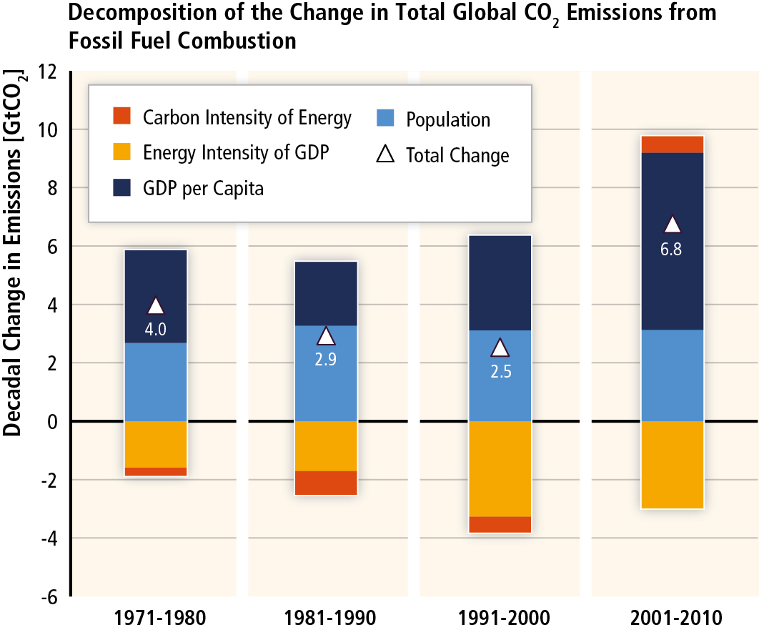
GHG emissions rise with growth in GDP and population; long-standing trend of decarbonisation of energy reversed.

Slide 5
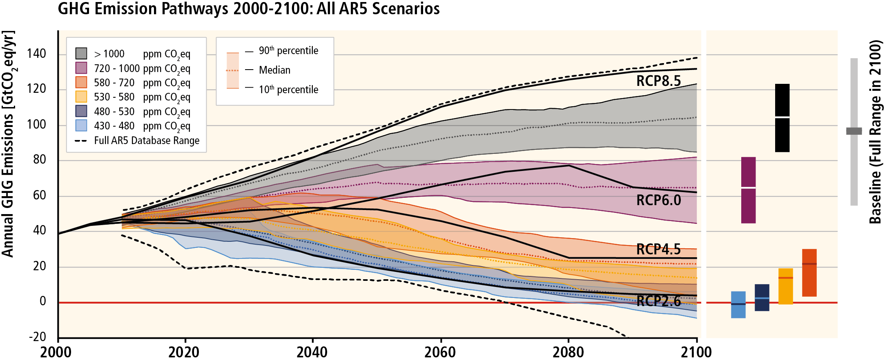
Without more mitigation, global mean surface temperature might increase by 3.7° to 4.8°C over the 21st century.

Slide 6
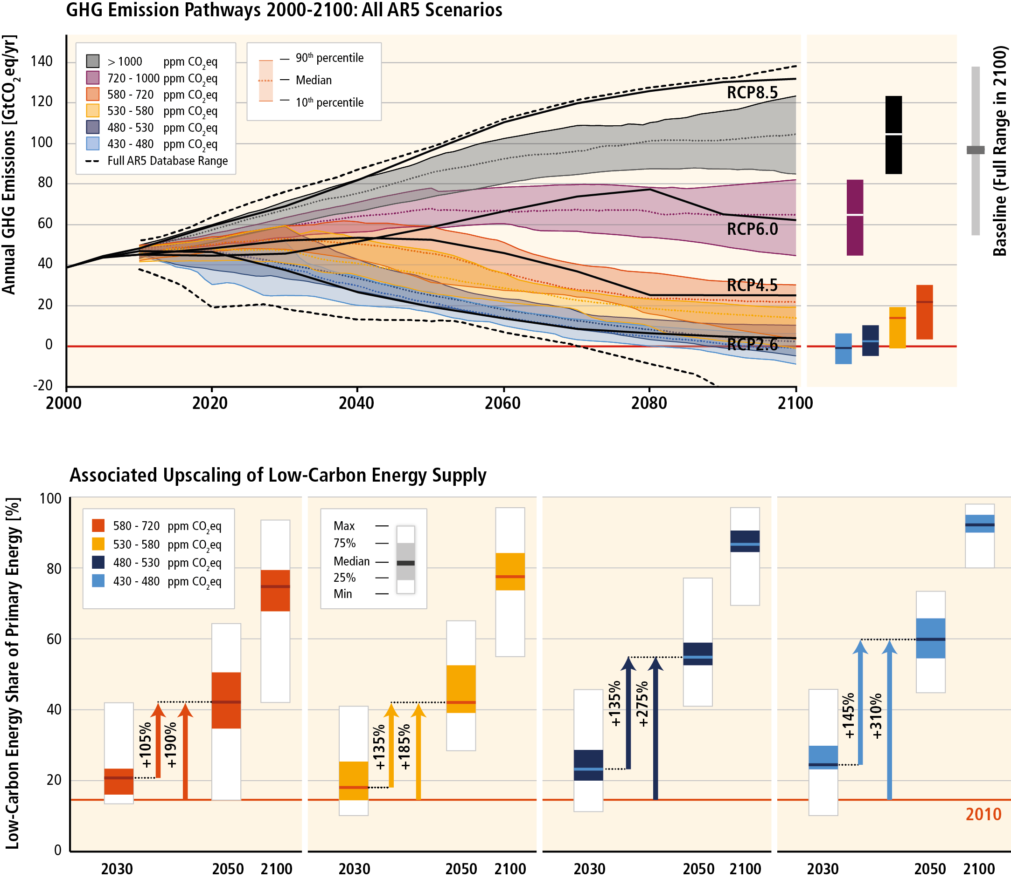
Mitigation requires major technological and institutional changes including the upscaling of low- and zero carbon energy

Slide 7
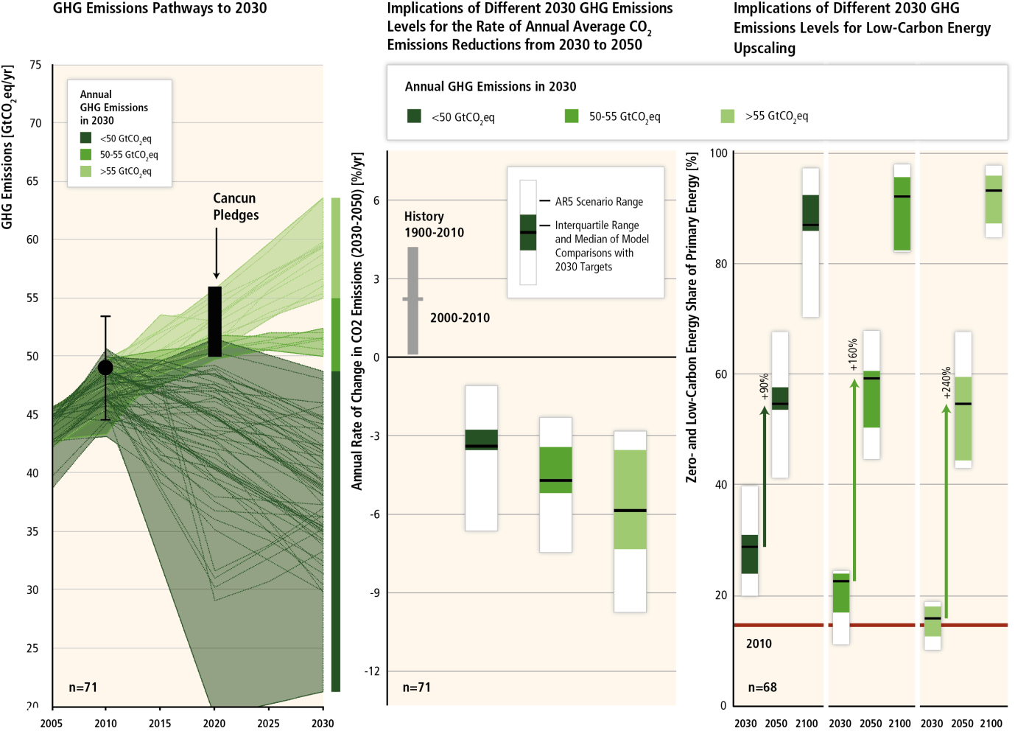
Delaying mitigation is estimated to increase the difficulty and narrow the options for limiting warming to 2°C.

Slide 8
Estimates for mitigation costs vary widely.
Reaching 450ppm CO₂eq entails consumption losses of 1.7% (1%-4%) by 2030, 3.4% (2% to 6%) by 2050 and 4.8% (3%-11%) by 2100 relative to baseline (which grows between 300% to 900% over the course of the century).
This is equivalent to a reduction in consumption growth over the 21st century by about 0.06 (0.04-0.14) percentage points a year (relative to annualized consumption growth that is between 1.6% and 3% per year).
Cost estimates exlude benefits of mitigation (reduced impacts from climate change). They also exclude other benefits (e.g. improvements for local air quality).
Cost estimates are based on a series of assumptions.

Slide 9
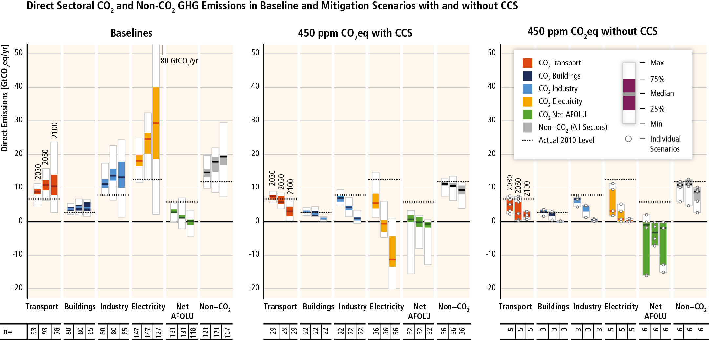
Mitigation requires changes throughout the economy. Efforts in one sector determine mitigation efforts in others.

Slide 10
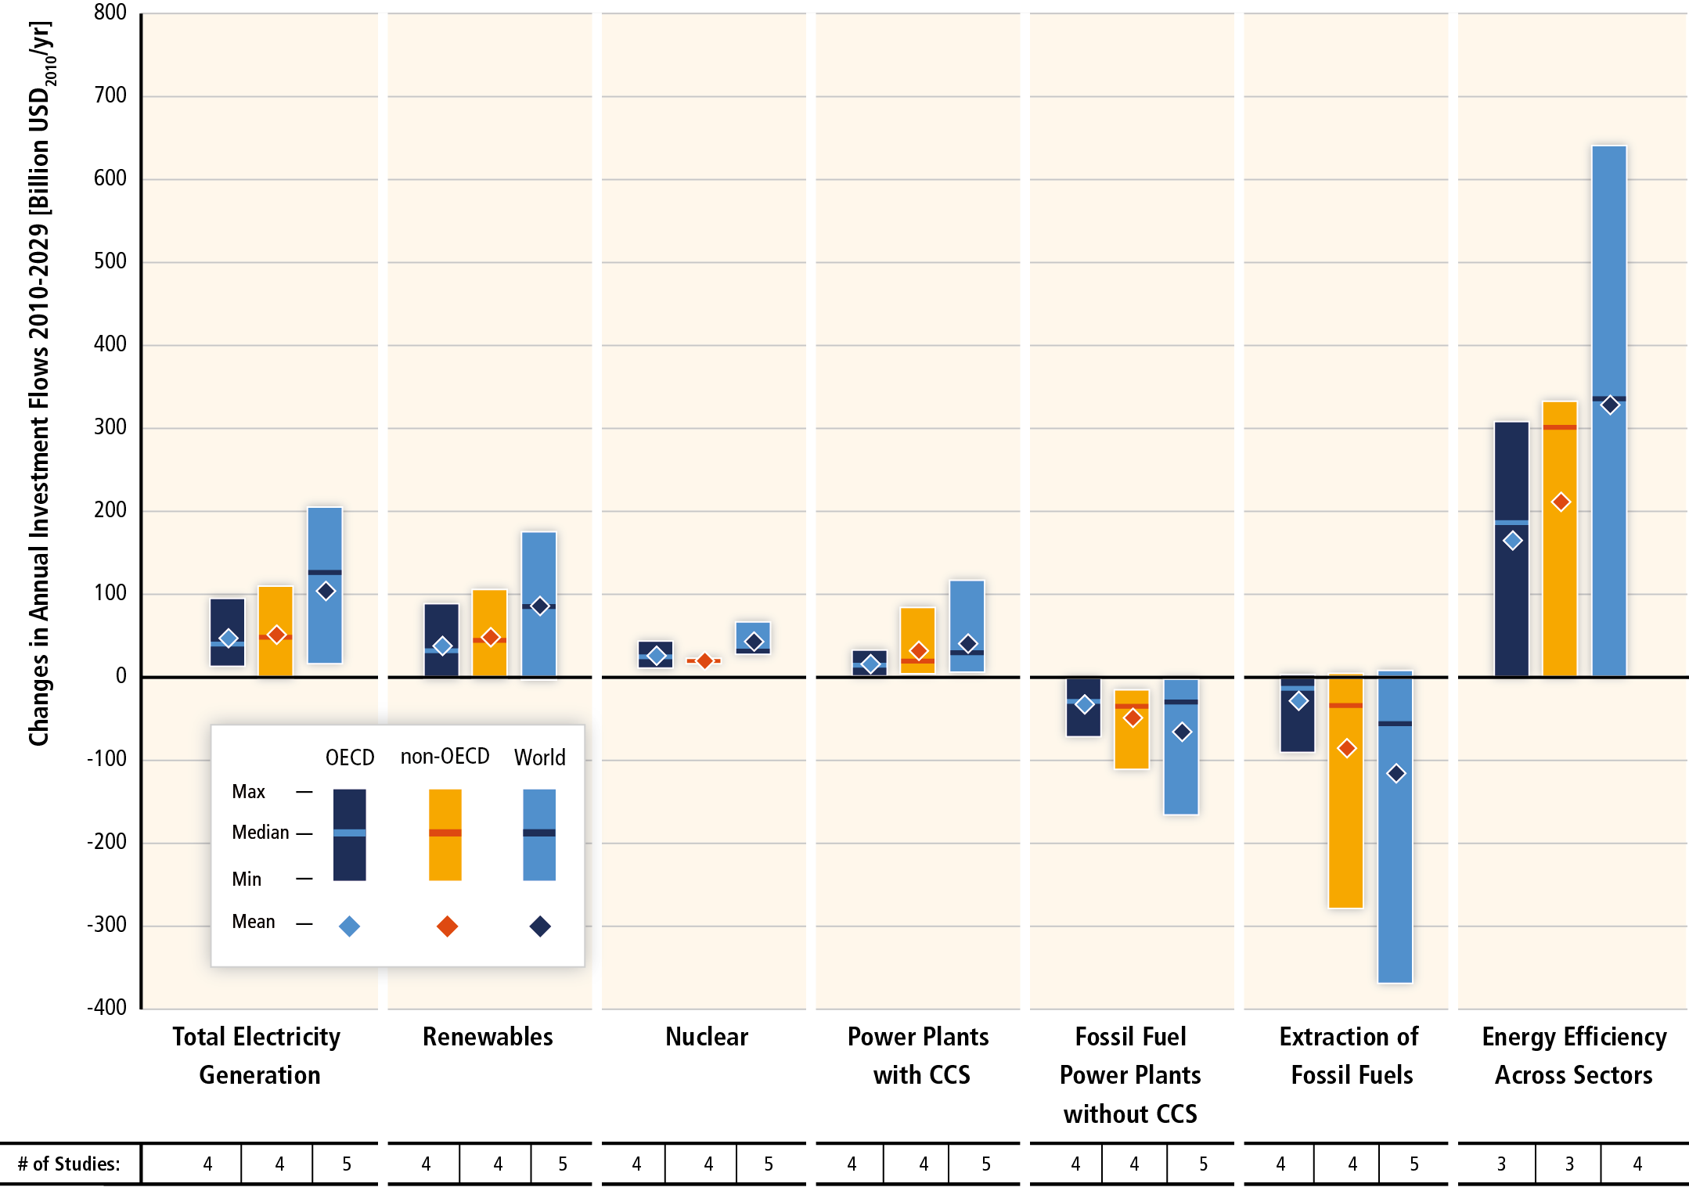
Substantial reductions in emissions would require large changes in investment patterns.

Slide 11
Since AR4, there has been an increased focus on policies designed to integrate multiple objectives, increase co-benefits and reduce adverse side-effects.
Sector-specific policies have been more widely used than economy-wide policies.
Regulatory approaches and information measures are widely used, and are often environmentally effective.
Since AR4, cap and trade systems for GHGs have been established in a number of countries and regions.
In some countries, tax-based policies specifically aimed at reducing GHG emissions–alongside technology and other policies–have helped to weaken the link between GHG emissions and GDP
The reduction of subsidies for GHG-related activities in various sectors can achieve emission reductions, depending on the social and economic context.

Slide 12
Effective mitigation will not be achieved if individual agents advance their own interests independently.
Existing and proposed international climate change cooperation arrangements vary in their focus and degree of centralization and coordination.
Issues of equity, justice, and fairness arise with respect to mitigation and adaptation.
Climate policy may be informed by a consideration of a diverse array of risks and uncertainties, some of which are difficult to measure, notably events that are of low probability but which would have a significant impact if they occur.

Slide 13
www.mitigation2014.org

