Slide 1
Implications of TFTR D-T Experiments for ITER
R.J. Hawryluk
May 23, 2014

Slide 2
How are D-T Experiments
Different from D?
Isotope Effects
  Transport
  Wave-particle Interactions
Alpha-particle Physics
Technology
  Discussed in DT prep talk
This talk on TFTR will not be comprehensive but will provide some highlights to hopefully encourage further research.
  Extensive references are available.
  Also see JET experimental papers for a complementary view.

Slide 3
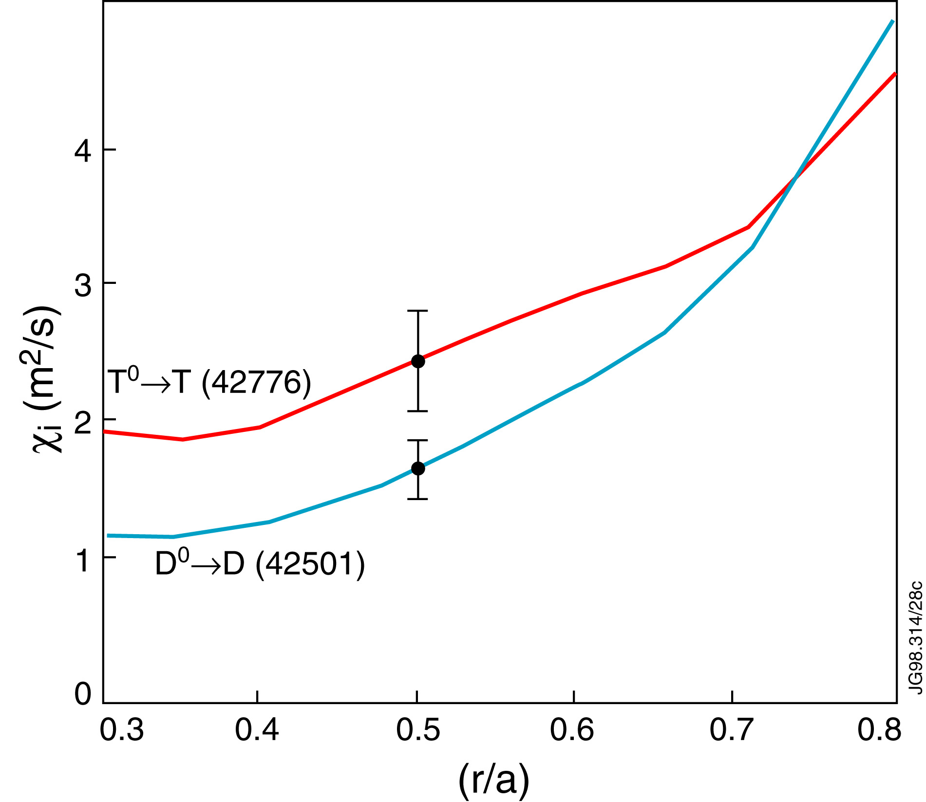
Ion Thermal Conductivity Changes with <A> Depending on Operating Regimes
JET
TFTR
factor of 2
Cordey
S. Scott, M. Zarnstorff
In JET H-modes, χ_{i} scaling in the core consistent with gyro-Bohm.
  τ_{thcore} ∝<A> ^{-0.16±0.1}
In TFTR Supershots, confinement dramatically improved in the core and χ_{i} decreased
τ_{E}^{thermal} ∝ <A>^{0.89±0.1}
χ_{i}^{tot} ∝ <A>^{-1.8 ±0.2}
  χ_{I} ∝ <A>^{0.73±0.4}
ITG model with radial electric field reproduced the T_{i}(r) profile, (Ernst)
• Pedestal scaled favorably with <A> improving τ

Slide 4
Isotope Effect on Confinement Varied Widely Depending on Operating Regime
S. Scott, S. Sabbagh, C. K. Phillips
Diversity of scalings challenges theory and
  gyro-Bohm scaling: <A>^{-0.2}
ITER scaling for ELMy H-mode: τ_{E}^{thermal} ∝ <A>^{+0.19}

Slide 5
Favorable Isotope Scaling Not Observed in Reverse Shear Experiments
TFTR
Scott
Notes:
A “surprise” which was encountered on TFTR was when the stored energy in DT and D reversed shear discharges was compared. This dataset does not include points which had an internal transport barrier. The favorable isotope scaling was not observed. More significantly the power threshold for internal barrier formation increased with isotopic mass.

Slide 6
Power Threshold on JET Going from
L to H-mode Shows Favorable Isotope Scaling
JET
Righi
P_{loss} ∝ <A>⁻¹

Slide 7
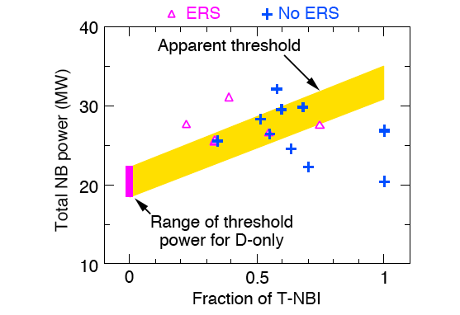
Higher Neutral Beam Power Required for
Enhanced Reverse Shear (ERS) Transition in D-T
M. Bell, S. Scott, M. Zarnstorff
Challenge for theory: same or lower threshold expected
Was this a transport effect or a consequence of the beam deposition profile being different?

Slide 8
Summary of Isotope Effects on Confinement
H-mode isotope scaling studies on JET, together with the worldwide physics database, provide a good technical basis for baseline operation of burning plasma experiments.
  Isotope scaling for τ_{E} and power threshold.
Understanding of isotope scaling is incomplete since it depends on operating regime.
  Not consistent with naive turbulence theory scaling
  What is the role of radial electric field shear in the different regimes?
  What are the implications for advanced operating modes?
Power threshold for internal barrier formation increased with <A>.
  What are the implications for advanced operating regimes in ITER?

Slide 9
ICRF Successfully Heated D-T Supershot Plasmas in TFTR
Δ T_{i} due to 2nd harmonic tritium heating
Δ T_{e} due to direct electron and ³He minority ion heating
Power deposition calculations in good agreement with experiment.
  Ω_{cHe3} to Ω_{cT} transition heating regime shown to give efficient heating suitable for ITER D-T plasma
G. Taylor, J. R. Wilson, J. Hosea, R. Majeski, C. K. Phillips

Slide 10
Implications of ICRF Heating and
Current Drive Studies
  Fundamental heating and current drive physics for ICRF has largely been established for D-He³ minority and second harmonic tritium heating experiments.
  Technology and coupling issues need to be further addressed for optimum ICRF application to ITER.
    Antenna power density limited by voltage standoff/coupling resistance.

Slide 11
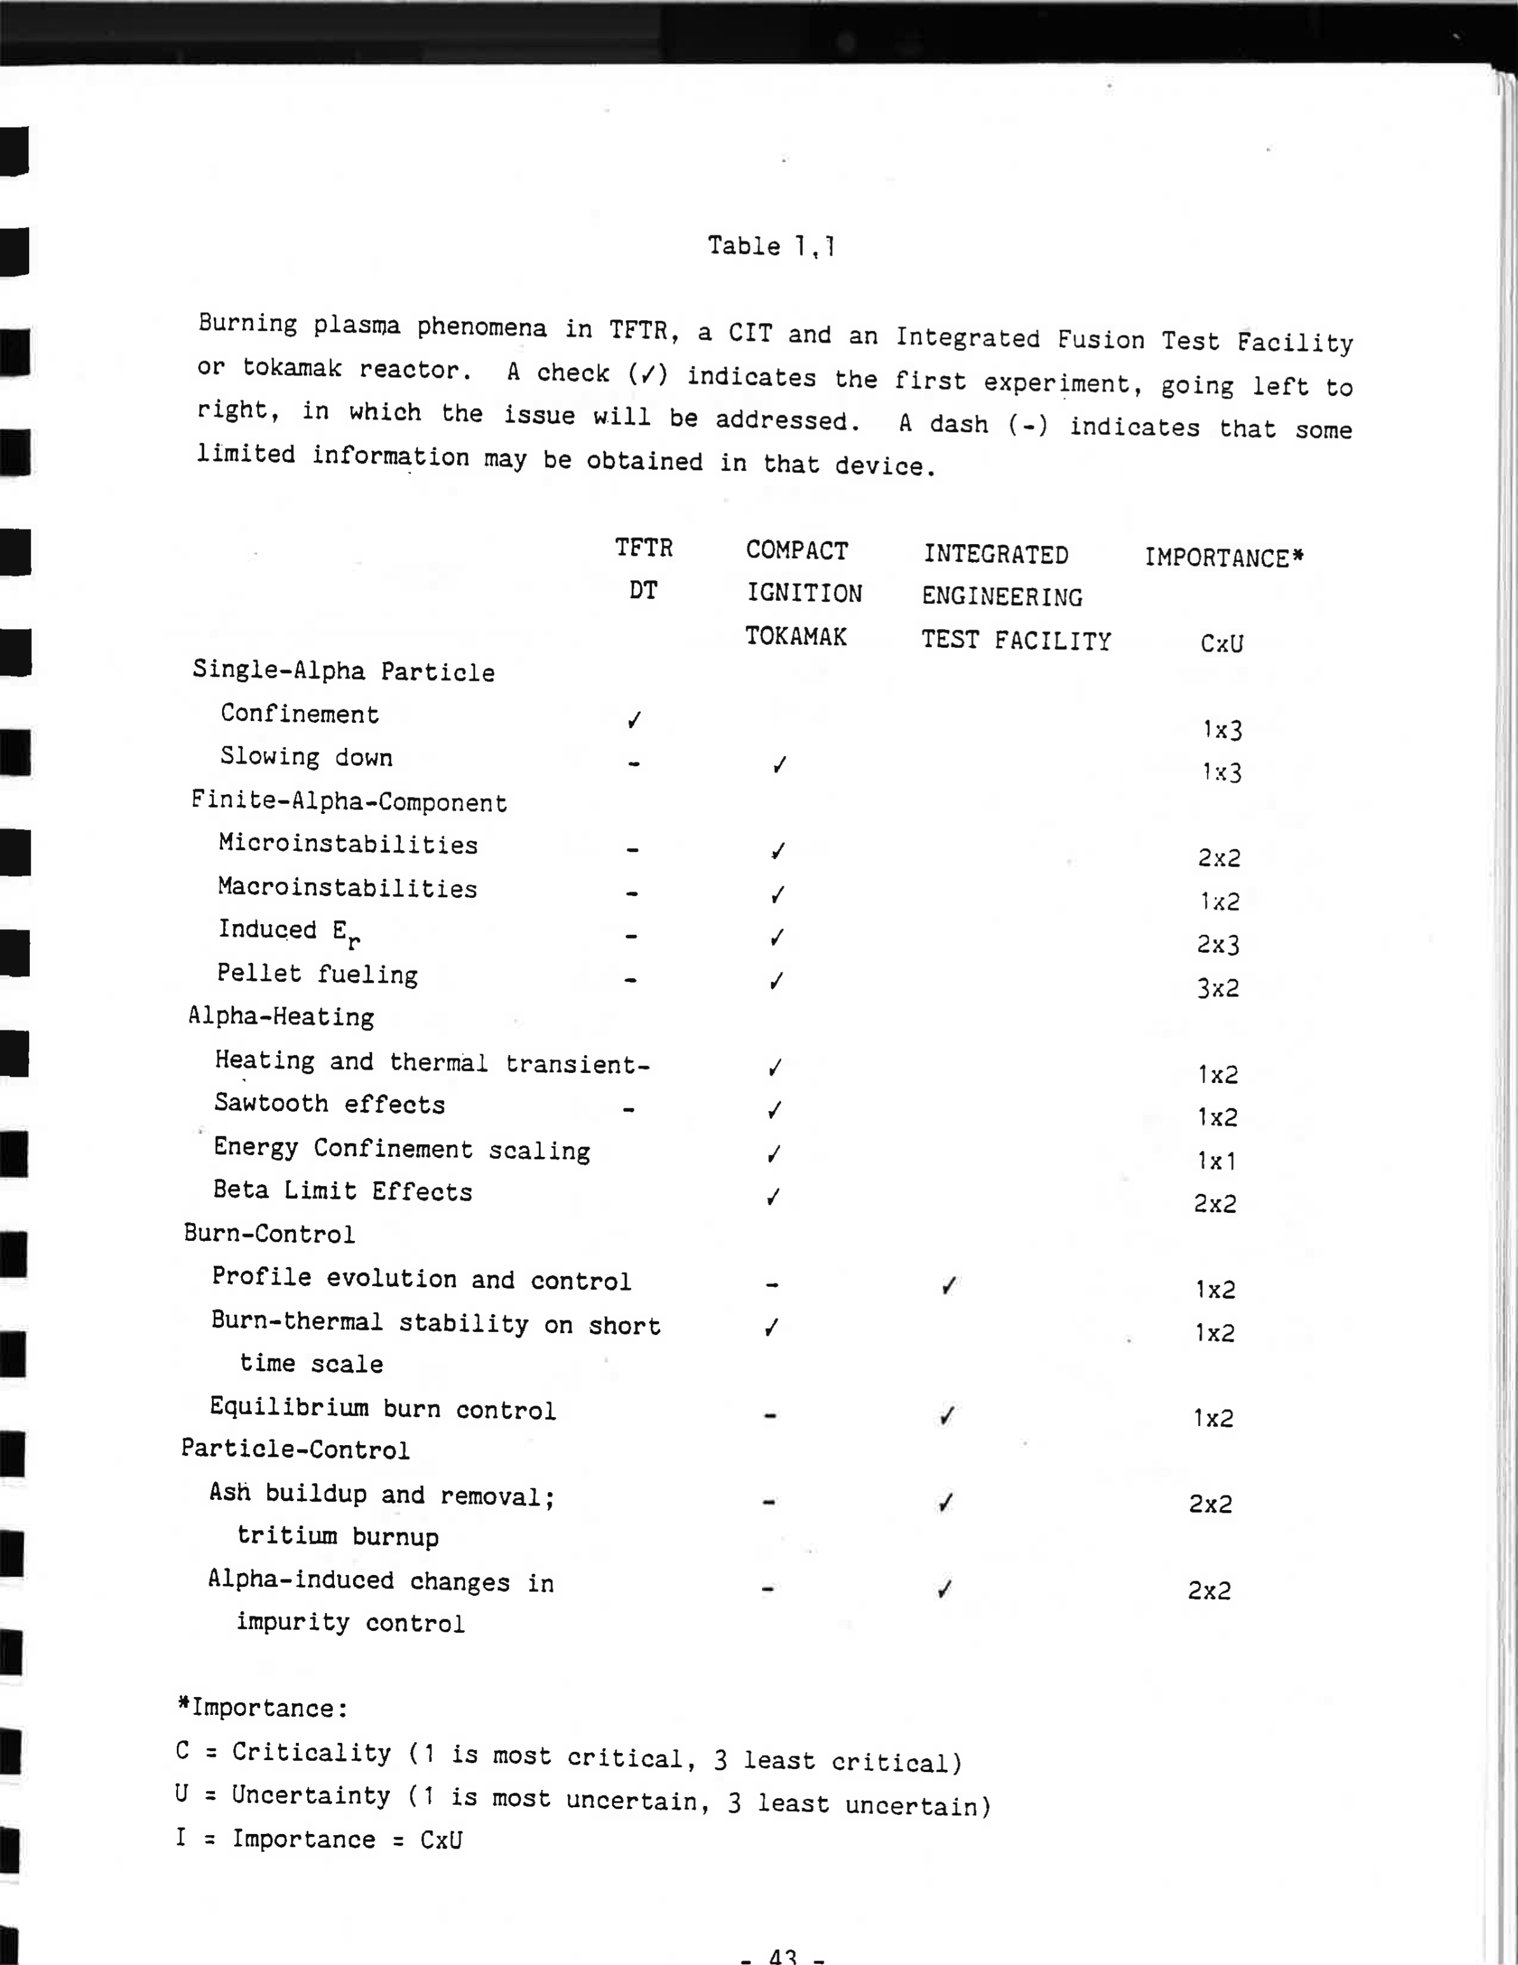
In 1988 D-T Plan Little Attention Was Given to
Alpha Physics on TFTR

Slide 12
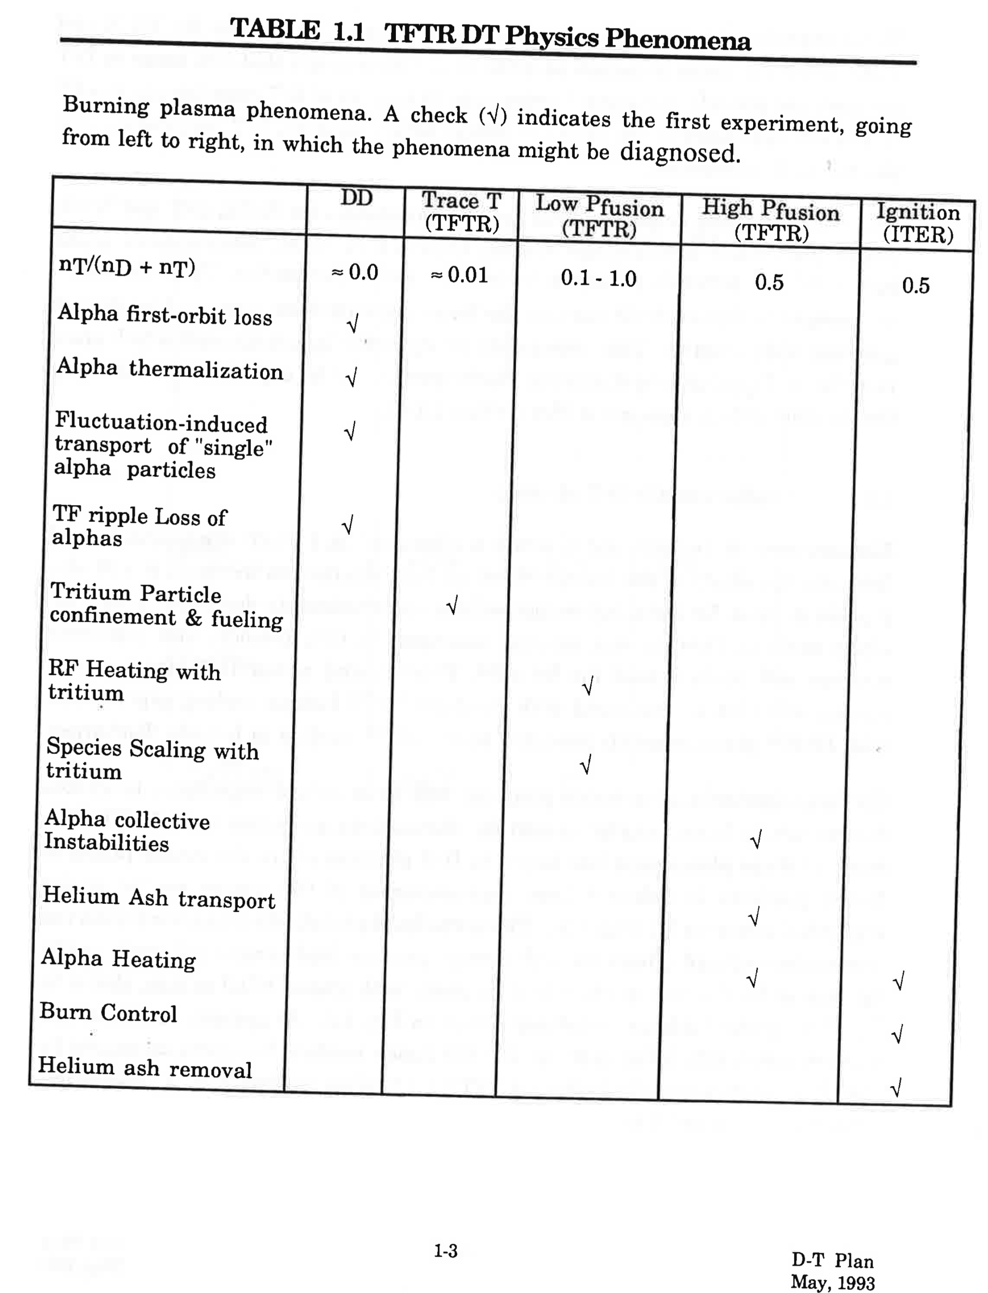
By 1993 Realized that TFTR Could Contribute to Alpha Physics Studies

Slide 13
Alpha-particle Physics Studies
MHD Quiescent
  Alpha-particle heating
MHD Affects on Alpha Confinement
Alpha-Particle Induced MHD Activity

Slide 14
Alpha-Particle Parameters in TFTR/JET Sufficient to Begin Study of
Alpha-Particle Physics
TFTR JET ITER
P_{fusion}(MW) 10.6 16.1 400
p_{α}(0) (MW/m³) 0.28 0.12 0.55
β_{α}(0)% 0.26 0.7 1.2
–R•grad(β_{α})% 2.0 2.3 4.0
V_{α}(0)/V_{Alfvén}(0) 1.6 1.6 1.9
A. Fasoli

Slide 15
Classical Alpha Particle Behavior was Confirmed for Normal Shear (Supershot) Discharges
TFTR
• Alpha birth rate and profile agreed with modeling.
  - Neutron flux in good agreement with calculations based on plasma profile in normal shear discharges.
• Escaping alpha flux at 90º detector was consistent with classical first orbit losses
R. Budny, L. Johnson S. Zweben, D. Darrow

Slide 16
Alpha-particles Were Well Confined in Normal Shear (Supershot) Discharges
TFTR
  Confined alphas in the plasma core showed classical slowing down spectrum.
  Alpha particles were well confined.
  0 ≤D_{α}≤ 0.03 m²/s
  Rapid ash transported from the core to the edge in supershots. (D_{He}/χ_{D} ~ 1)
R. Fisher, S. Medley, M. Petrov R. Fonck, G. McKee, B. Stratton
E. Synakowski
ITER will extend these results especially ash buildup.

Slide 17
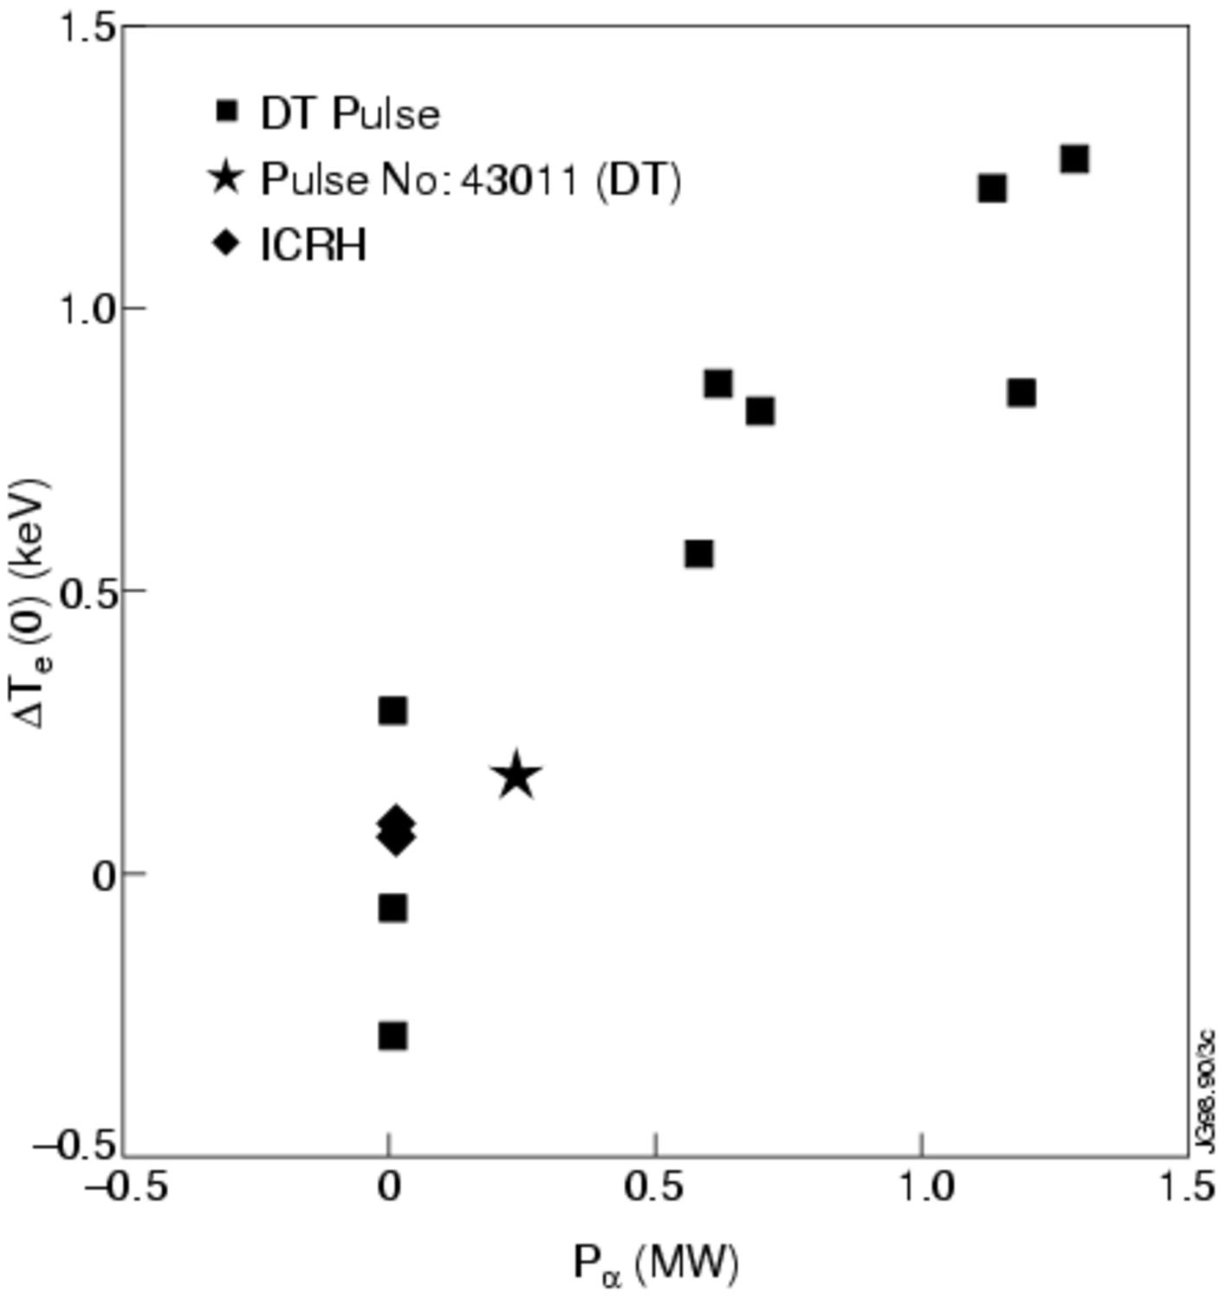
Initial Evidence of Alpha-particle Heating on TFTR and JET
TFTR
JET
T_{e}(R) (keV)
T_{e}(R) (keV)
T_{e}(R) (keV)
T_{e}(R) (keV)
ΔT_{e}(0) (keV)
G. Taylor, J. Strachan
T_{e}(DT) - T_{e}(D) (keV)
P. Thomas, et al.
P_{α} (MW)
• Alpha heating ~15% of power through electron channel.
• P_{alpha}/P_{heat} ~12%
- 30-40% through the electron channel
Comprehensive study of alpha heating requires higher values of P_{alpha}/P_{heat} .

Slide 18
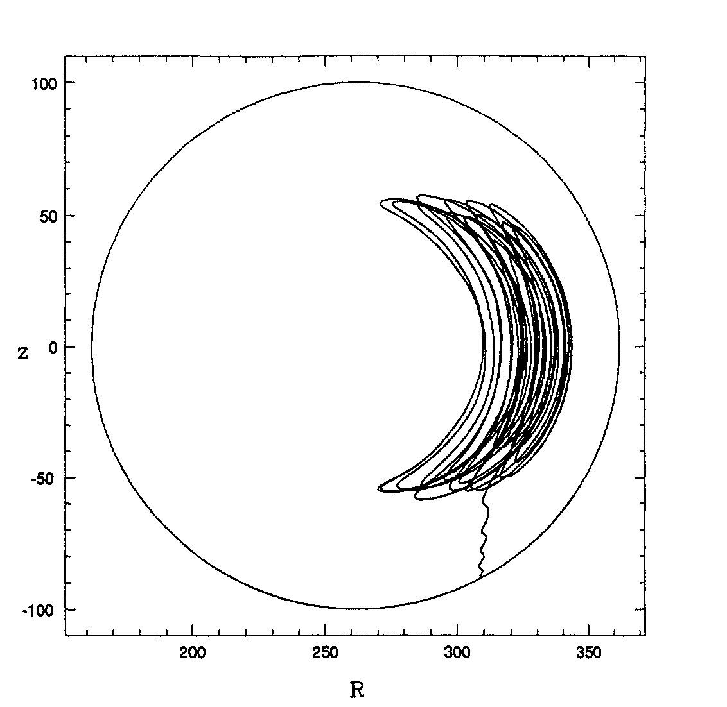
TAE modes Driven by Neutral Beams and ICRF
were Discovered on TFTR.
• ICRF induced TAE with ripple trapping damaged the vessel during D-T operations.
In normal shear D-T discharges, TAE was stable.
E. Fredrickson, D. Darrow, S. Zweben

Slide 19
TFTR Alpha-particle Physics Studies in Reversed Shear Discharges Resulted in New Discoveries.
Alpha-driven TAE (subsequently identified as Cascade Modes) were observed.
TAEs redistributed deeply trapped alpha-particles
Neutron emission in D-T enhanced reverse shear discharges disagreed with TRANSP analysis in some shots by factors of 2-3
  Source of discrepancy was not identified.
R. Nazikian, Z. Chang, G. Fu S. Medley, M. Petrov,

Slide 20
Compatibility with Plasma-Boundary Interface Was a Key Issue
Conditioning the machine for supershots was critical
  Led to the use of lithium wall coatings to improve performance
  Many of the lithium coating techniques were developed or optimized during the DT campaign!
Power handling (carbon blooms) were a constraint.
Substantial tritium retention in graphite was observed in JET and TFTR experiments.
  TFTR tiles 16% retention
  JET 12% retention
Recent retention results from JET with ILW are encouraging
  Plasma behavior is different with W (disruptions, pedestal, ELMs….)
  ITER will provide a critical assessment of power handling, retention, impurity influxes, dust etc…

Slide 21
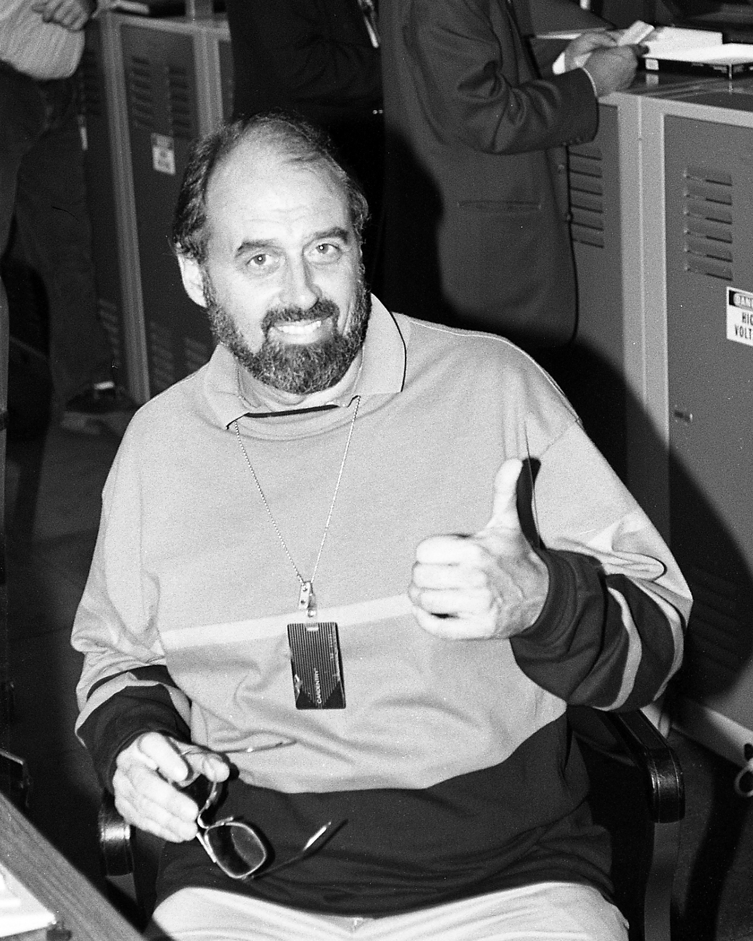
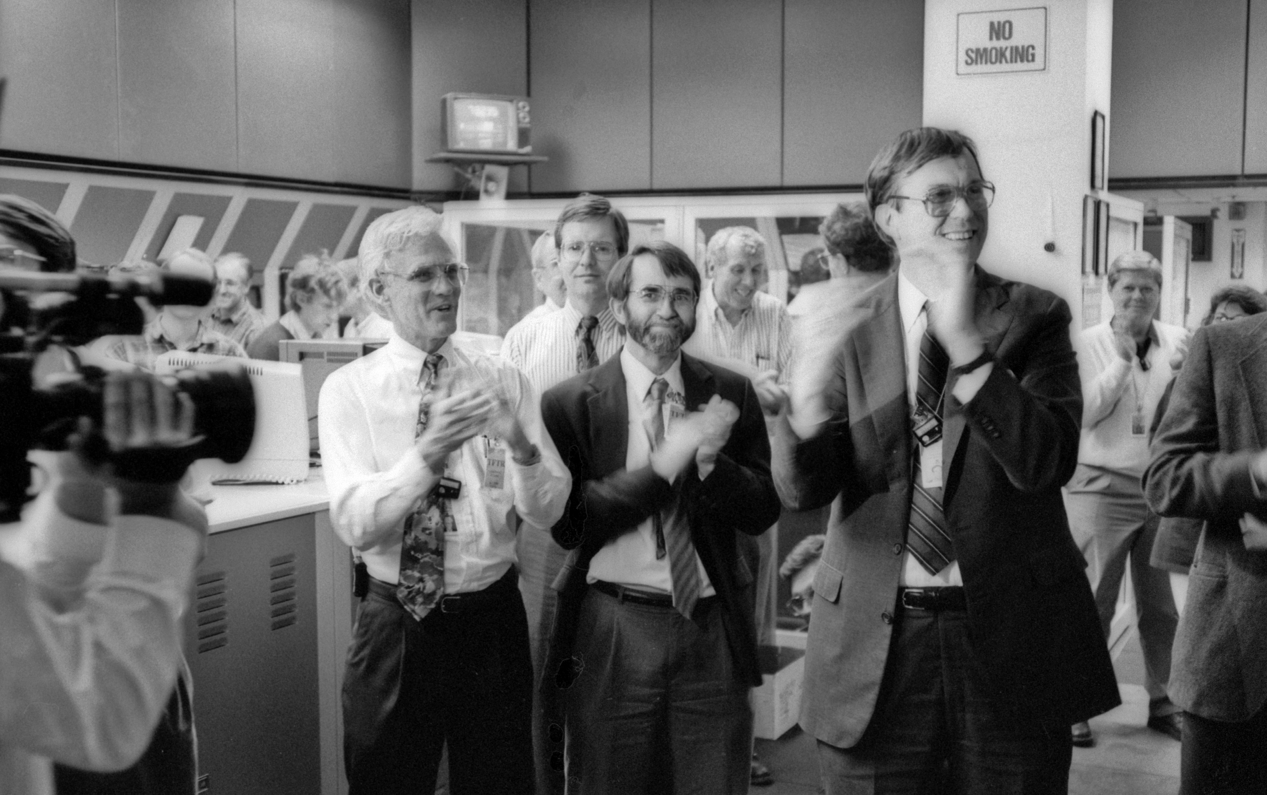
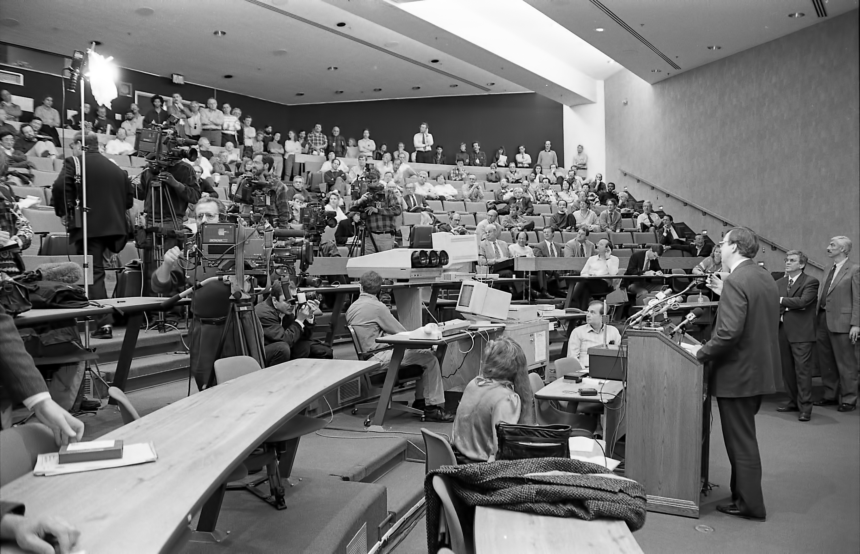
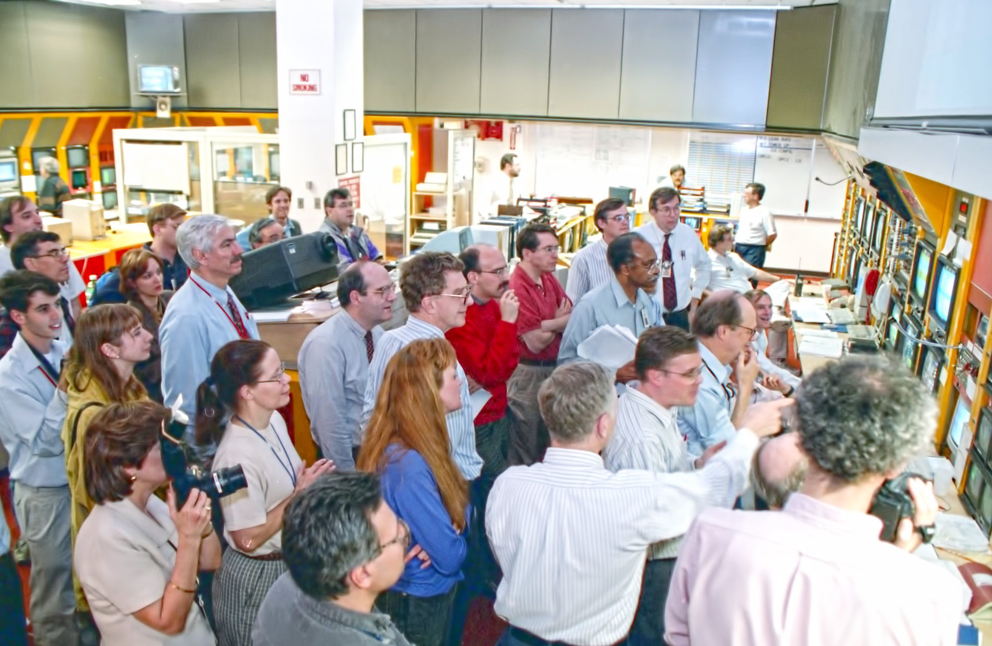
TFTR D-T Experiments Were Exciting From the Start to the End

Slide 22
The Burning Plasma Research Program on ITER will Be Even More Exciting
Results from TFTR and JET together with the results from the world-wide community have
  Provided a solid design basis for a burning plasma experiment.
  Experience on TFTR and JET D-T experiments is that new physics will emerge in ITER
  ITER will respond to what we will learn during the D-T experiments and the plans will be revised.
Full potential and consequences of alpha heating have not been explored!
Congratulations and thanks to the TFTR Team for beginning the exploration of D-T!

