Slide 1
FES update: activities, comments on budget, and on vision
E.J. Synakowski
Associate Director, Office of Science
For Fusion Energy Sciences
U.S. Department of Energy
December 15, 2011
for the Fusion Power Associates meeting

Slide 2
This is an extraordinary time for fusion and the sciences in the U.S.
We are on the cusp of gaining scientific access to burning plasmas in the laboratory: ITER project transformation has been extraordinary. The opportunity for U.S. leadership in this new era is high
Technical gaps for fusion demand some topical shifts in this decade. We must reach across national boundaries and lever our domestic resources in response to some of these needs
There is uncertainty. Budgetary pressures are tremendous. But a 10 year vision describes an exciting destination. With this in mind, the place for the best university-based research in fusion and plasma science this decade and beyond can and should be strong.

Slide 3
On the FES vision and path forward

Slide 4
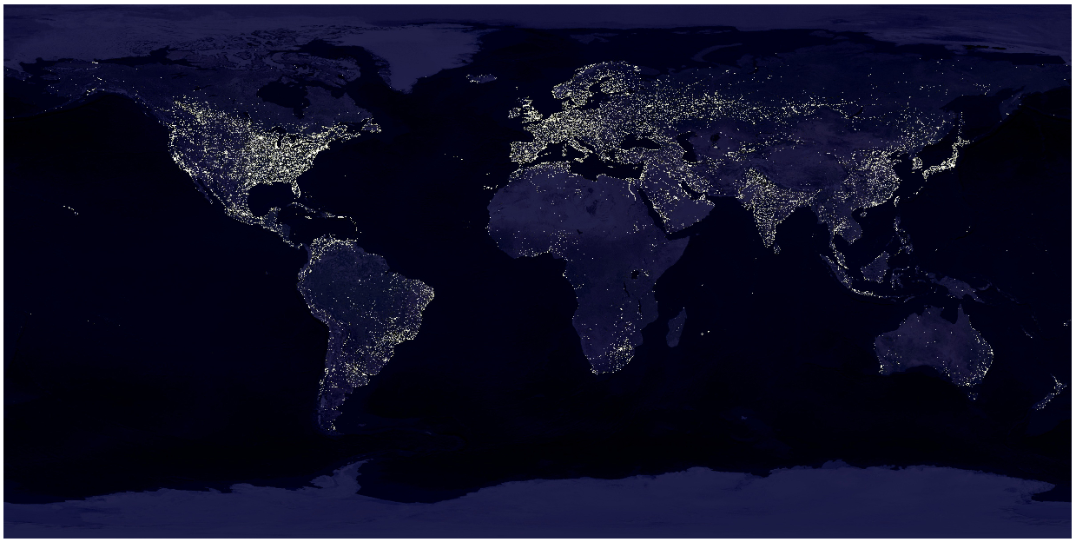
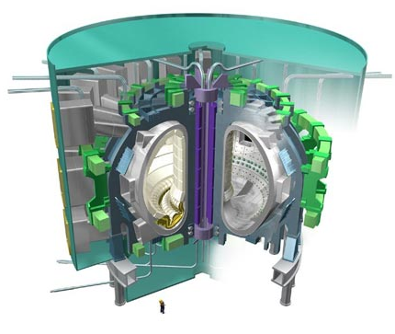
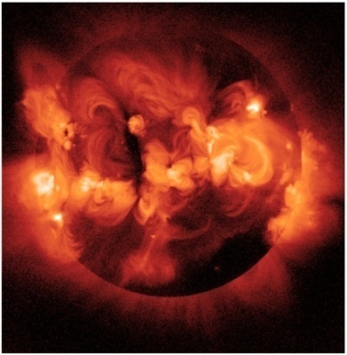
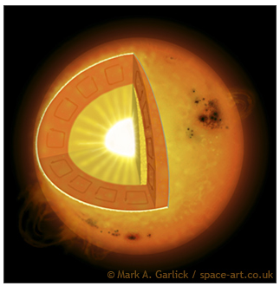
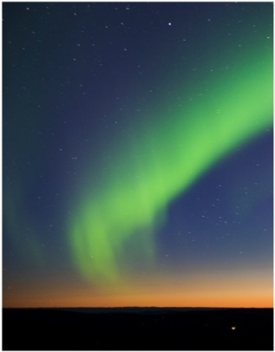
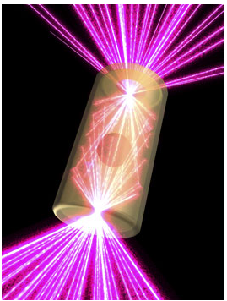
The science at the heart of fusion energy is far-reaching and is poised for a transformation
Stewarding plasma science as a broad enterprise is fully consistent with the leading ambition of powering the planet

Slide 5
We need to develop our path forward in a most challenging environment
The U.S. budget challenge places enormous pressure on all of our scientific endeavors. There are large, not completely known moving parts that may collide as U.S. science budgets are developed and enacted. The outcome is not known; I cannot speak to any particulars
very tough competition between science and energy with other national interests
very tough competition within the Office of Science
The scrutiny on fusion’s budgets will increase sharply as the program becomes more conspicuous and ambitious, especially in such times
➔ the quality of fusion science has to be of the highest order in order to compete successfully

Slide 6
Where we need to be in 10 years (1)
A vision for 2021:
ITER Research - The U.S. has a strong research team hitting the ground on a completed ITER project in Cadarache. This team is capable of asserting world leadership in burning plasma science
Fusion materials science - The U.S. has made strides in fusion materials science and passed critical metrics in tokamak and ST operations with national research teams. It has assessed technical risks associated with moderate vs small aspect ratio and scope of mission, and is prepared to move beyond conceptual design of a fusion nuclear science facility
Extend the reach of plasma control science and plasma-wall interactions- U.S. fusion research has successfully levered new international research opportunities, including program leadership, in long pulse plasma control science and 3-D physics. Opportunities also include the plasma-wall interaction science made possible with long pulses.

Slide 7
Where we need to be in 10 years (2)
A vision for 2021:(continued)
Validated predictive capability- The U.S. is a world leader in integrated computation, validated by experiments at universities and labs. Such computation should be transformational, as it must reduce the risks associated with fusion development steps
IFE science - FES has a leadership role in establishing the scientific basis of IFE through HEDLP and synergy with MFE in materials science
Plasma science for discovery - The U.S. is the world leader in plasma science for discovery. Leverage has been successfully applied across agencies in Discovery Science with NNSA and NSF, and overseas
In every one of the items on these two slides, universities have an opportunity to make contributions of the highest order

Slide 8
Burning plasma science: ITER

Slide 9
ITER progress is dramatic and important
The stakes surrounding ITER’s success for fusion overall could not be higher.
The IO has made significant technical and managerial strides
The Member states are committed and have worked hard under the DG to minimize schedule delays following the Japan disasters

Slide 10
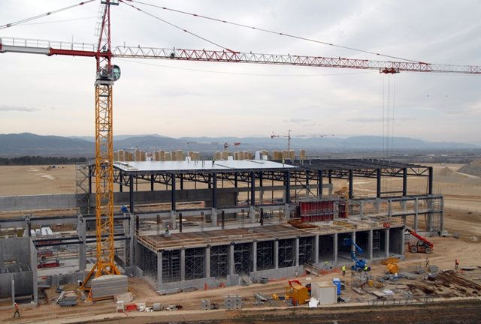
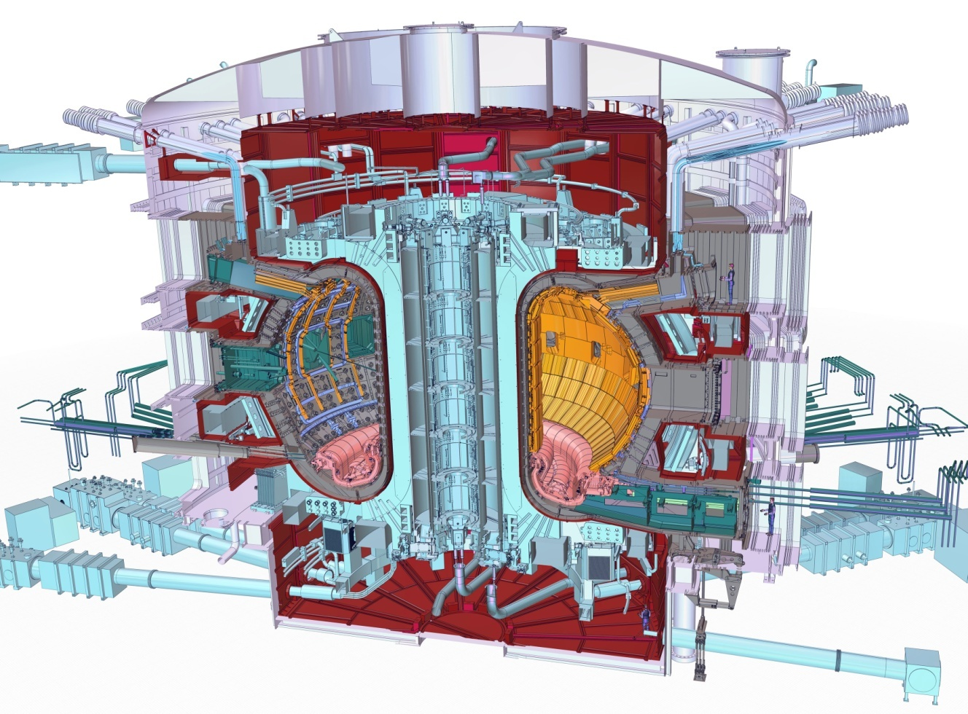
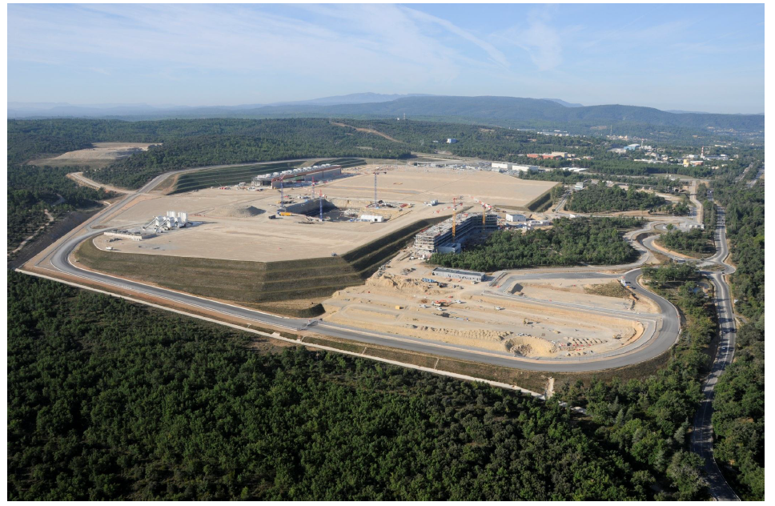
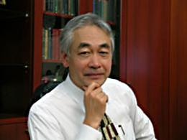
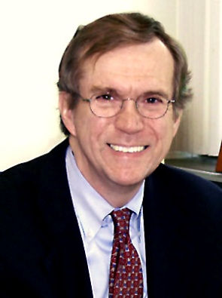
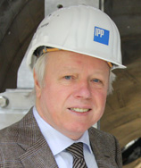
There has been important progress in constructing ITER
Poloidal winding building construction
The ITER Device
Site construction is underway
New project leadership
Rich Hawryluk (U.S., from PPPL); new Deputy Director General for Administration
Rem Haange (Netherlands), new Deputy Director General for ITER Construction
Director General Motojima
Notes:
Provides $380M, a reduction of $46M
Reduces ITER funding to $80M
Supports most program areas at the FY 2010 level
Provides increases for:
HEDLP (+6.5M)
Fusion Simulation Program (+$2M)
NSTX MIE Upgrade (+1.1M)
DIII-D and Alcator C-Mod Facility Operations (+2.3M DIII-D and +1.0M C-Mod)
Materials (+$.5M)

Slide 11
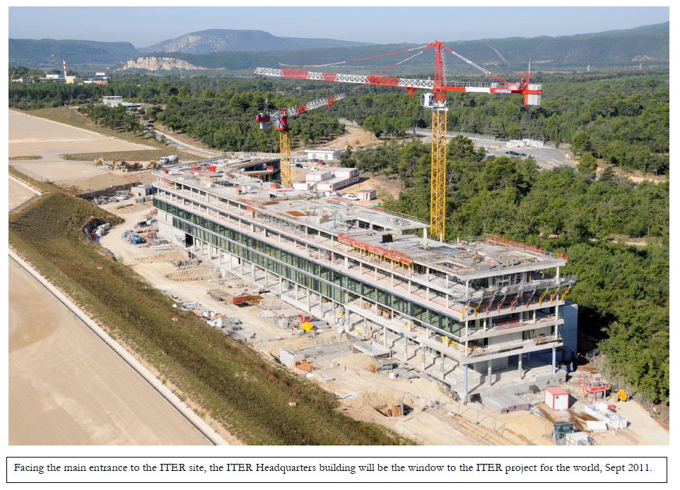
The future ITER headquarters will be completed before the 2012 November ITER Council meeting.

Slide 12
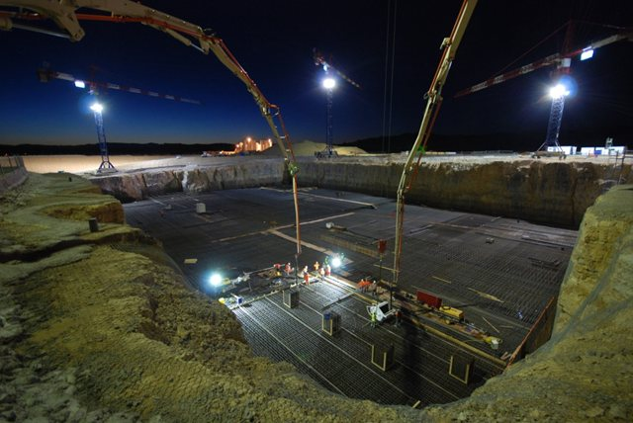
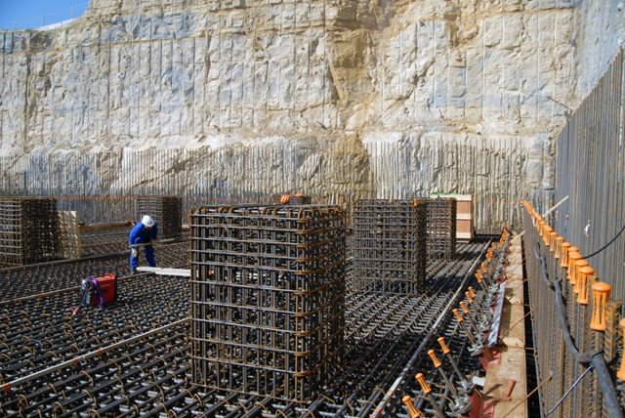
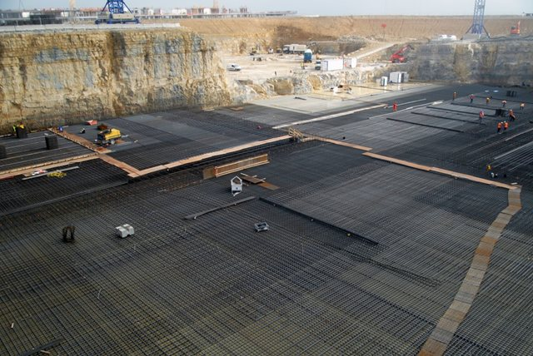
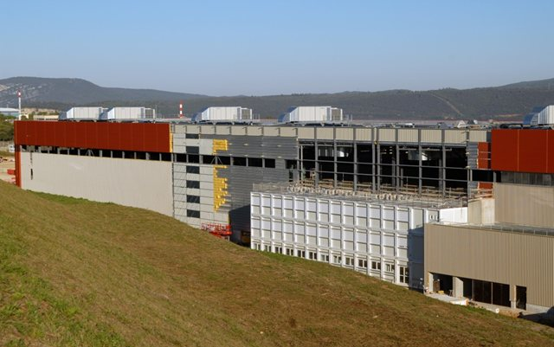
At 5:00 a.m. on Tuesday, 9 August, operations began to create the lower basemat of the Tokamak Complex
Sitting atop the lower basemat, 500 of these 1.8 metre concrete columns will support the seismic pads. These, in turn, will support the upper basemat of the Tokamak Complex—the actual "floor" of the installation (August 2011).
Steel reinforcement bars—each one weighing nearly 100 kilos—are built up to 1.5 meters on the floor of the Seismic Pit. In the distance, the future ITER Headquarters buildings rises above the platform. (August 2011).
Work advances rapidly on the Poloidal Field Coils Winding Facility in August 2011: the cladding is nearly finished, the three-floor office building is in place.

Slide 13
The need for leverage helps clarify the areas where we need to invest
ITER’s place in the budget translates to the need to pursue programmatic moves that can take advantage of leverage
Exercising leverage also makes scientific sense – in fact, it is a necessity. The areas below absolutely require an “all hands on deck” approach. In addition, it offers the opportunity for FES to build relationships where it needs them and to reduce its isolation among the sciences
Leverage opportunities are found in plasma dynamics and control as well as materials
Plasma dynamics and control:
ITER, International collaborations: JET, superconducting tokamaks and stellarators. For IFE, NNSA facilities
Materials:
Exploring FES, BES, NE, NNSA joint interest: “Materials for Nuclear Energy: All Hands on Deck.”

Slide 14
Fusion nuclear science and the plasma-material interface

Slide 15
There is a FESAC charge on materials research being addressed
“What areas of research in materials science and technology provide compelling opportunities for U.S. researchers in the near term and in the ITER era? Please focus on research needed to fill gaps in order to create the basis for a DEMO, and specify technical requirements in greater detail than provided in the MFE ReNeW (Research Needs Workshop) report. Also, your assessment of the risks associated with research paths with different degrees of experimental study vs. computation as a proxy to experiment will be of value.”
Consider near- and long-term (~0-5; 5-15; 15+ years); what can be done with existing facilities, new facilities, and emergent international facilities
Experiment & the role of computation: Identify 2-3 paths with varying emphases on massively parallel computing – what are the risks associated with each path?
Materials = nuclear (dpa’s); non-nuclear (pmi); differential and integrated; harnessing fusion power

Slide 16
Our resources include…
In hand
Non-nuclear: confinement facilities & diagnostics, low and moderate aspect ratio, test stand; computation
Nuclear: proxy with fission; computation
Nearly in hand
Non-nuclear: international leverage on long-pulse, high heat flux facilities
Nuclear: fusion neutron proxy – spallation source
Increased effort in computation (SciDAC)
Building towards
Strong experiment/theory/simulation program in materials, nuclear and non-nuclear
Fusion simulation coupling at disparate scales: physics of the plasma boundary
Sharpened metrics for deciding upon geometry of fusion nuclear science facility as anchor of program in 2020’s

Slide 17
Extend the reach of plasma control and plasma-material interactions science:
Levering domestic and
international research

Slide 18
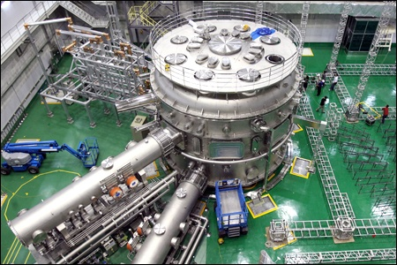
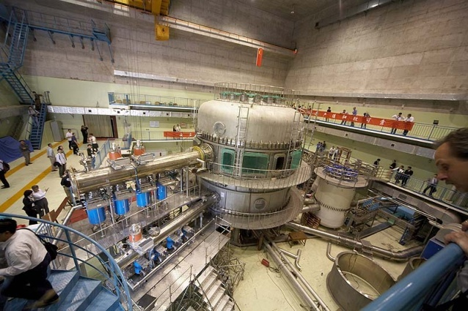
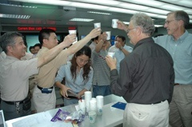
There have been large investments in the steady-state tokamak arena
Opportunities in both plasma control science and high heat flux, long pulse plasma-materials interactions. . .
K-STAR
Daejon, S. Korea
Goal: 300 s pulse
2 MA
EAST
Hefei, China
Goal: 1000 s
1 MA

Slide 19
There are FESAC charges on international collaboration opportunities being addressed
“What areas of research on new international facilities provide compelling scientific opportunities for U.S. researchers over the next 10 – 20 years? Look at opportunities in long-pulse, steady-state research in superconducting advanced tokamaks and stellarators; in steady-state plasma confinement and control science; and in plasma-wall interactions.”
The explicit aim is to focus on the superconducting facilities in Asia and Europe, both existing and emergent

Slide 20
There are FESAC charges on international collaboration opportunities being addressed
“What research modes would best facilitate international research collaborations in plasma and fusion sciences? Consider modes already used by these communities as well as those used by other research communities that have significant international collaborations.”
What lessons can we learn from other scientific fields, e.g. high energy physics, nuclear physics, others, that have had to undergo a transition and take on off-shore research significantly or nearly entirely
FESAC is encouraged to engage members of those fields and representatives from universities where international research efforts are successful, as well as where transitions to an off-shore emphasis have failed
Observations about national lab/university partnerships in new international collaborations will be highly valued. Again, what can other fields teach us?

Slide 21
Aim: Construct domestic/international programs that address great science questions
The reason for reaching internationally: obtain access to new frontiers in plasma control and materials
levering our domestic facilities and computation, launch research centers
Create Topical Centers: possible topics include
Plasma-wall interactions: domestic & superconducting long-pulse tokamaks as experimental focal points
Long-pulse, high beta plasma control
2D-3D physics: domestic ELM coil experiments and stellarators (domestic and international)
These are notional, but the intent is to use any particular facility as a means to a scientific end, rather than a demonstration of performance

Slide 22
Validated predictive capability: mitigating risks in fusion development, and promoting scientific discovery

Slide 23
Massively parallel computing is critical to our predictive science effort, but it is only part of it
Fusion simulation will only be as good as the physics models that go into it
Our reliance on validated prediction to fill gaps will demand a kind of confidence we don’t yet appreciate
Plan: grow our emphasis on validation of physics models that are incorporated in fusion simulation
The continuing strong contributions of universities will be critical for success in this arena on the computational front, and can grow with respect to experimental validation

Slide 24
IFE science, high energy density laboratory plasma physics, and general plasma science for discovery

Slide 25
FES can assume a leading role in IFE science
What I’ve told the National Academies:
Credibility is the key issue for fusion. For IFE, NIF ignition will be a critical part of establishing this, but the challenge is deeper. Both the science and technology need to be advanced in concert for IFE to establish needed credibility
Science ⬄ technology: A future IFE program needs to be deeply scientific as well as technologically aggressive. Technological development (e.g. in drivers or advanced ignition scenarios, for example) will require a strong scientific basis to create attractive innovation pathways.
Fusion can help itself by recognizing and levering common interests between MFE, IFE, and advanced fission. This will be of value scientifically and for program stability and growth.

Slide 26
FES can assume a leading role in IFE science
Necessary ingredients
Scientific chops in FES - ✓
Effective collaboration and cooperation with NNSA - ✓
Budget authority - ?

Slide 27
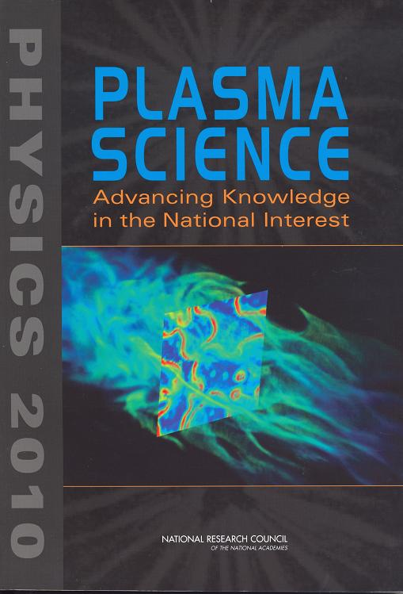
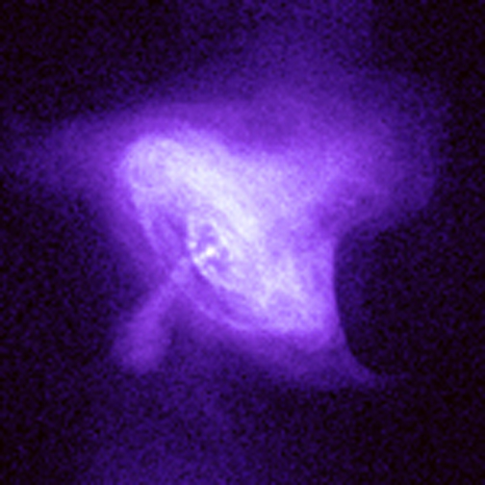
Deepening credibility of plasma science as a discipline demands nurturing the field broadly
FES should be the federal home for plasma science broadly.
The project’s theory is supported in part under the NSF/DOE Partnership in Basic Plasma Science and Engineering

Slide 28
Fusion must take on new classes of challenges; we need to be prepared
Our opportunity and charge is to establish fusion’s scientific credibility
Plasma control science and materials science are the broad categories we need to pursue: supported by National Academies studies and FESAC
Our future program proposals need to be carefully thought out.
A leading challenge: validated, predictive capability
Leverage is key: cross-agency, new international partnerships

Slide 29
There is risk at this time, but the science programs that succeed will have a few things in common
With ITER growth and downward financial pressure overall in Washington, the discussions are vigorous and impactful. However, DOE commitment to Science within the Administration has been impressive.
The quality, richness, and relevance of our science is our best asset.
Successful science programs will be prepared: they will have identified the critical science problems. They will have capitalized on leverage opportunities – cross-agency, internationally

Slide 30
Establishing the scientific basis for fusion requires strong domestic research and leverage across national and institutional boundaries
Scientific basis for burning plasma control & prediction
Plasma science foundation for discovery
The U.S. domestic program, the international research program, and ITER will combine to enable the plasma science for fusion energy to be established
Much of the technology required for a fusion reactor will also be
Plasma control science: self-heated at reactor scale
ITER τ_{pulse} ~ 500-3000 s
Integrated simulation at all relevant scales
Fusion nuclear science: integrated
Components; fuel cycle
Validated understanding: dpa’s, fuel cycle, heat flux
Fusion materials science: elements
Nuclear effects
High heat fluxes
Science basis for fusion nuclear science facility design
Long pulse plasma control
τ_{pulse} ~ 1000 s, 1/3 reactor scale
Simulation at disparate scales
Discovery Science
Leverage: international, cross-agency
The foundation: present day
Domestic Confinement Experiments, low and moderate aspect ratio
τ_{pulse} ~ 1-5 s
Simulation of individual processes
Validation platforms
Discovery science with
Joint U.S. programs
Burning plasma era

