Slide 1
Community Care
Review of Future State
January 26, 2016
Notes:
Good afternoon. My name is Lindsay Hall, for those of you who don’t me. I am a Deputy Associate Director and Program Manager for the VA Center for Applied Systems Engineering, or VA-CASE as you may know it. Today I’m going to give you a very high level overview of what VA-CASE does, how we’ll be participating in this initiative, and a quick crash course in Systems Engineering and Lean.

Slide 2
VA Center for Applied Systems Engineering
(VA-CASE)
1 of 4 interdisciplinary Veterans Engineering Resource Centers (VERC)
Built on philosophy of partnering Healthcare Systems Engineers with VHA administrative and clinical management staff
Comprised of eight Program Offices:
  Clinical Partnerships in Healthcare Transformation (CPHT)
  Smart Service Systems
  VHA Engineering Technical Assistance Program (VE-TAP)
  Professional Development Program
  VISN11 Program
  Transactional Systems Program (TSP)
  Program Management Office (PMO)
  Data Engineering Resources (DER)
Notes:
VA-CASE is 1 of 4 interdisciplinary Veterans Engineering Resource Centers, or VERCs. You will hear some people refer to us as VERC staff or VA-CASE staff, the two are somewhat synonymous. Just like there are many brands of soda and tissues and potato chips, VA-CASE is the specific name of the VERC that is based in Indianapolis, Indiana.
The VERCs were built on the philosophy of partnering Systems Engineers with VHA staff to improve processes and systems for our Veterans at both the facility and national levels. The VERCs have been around for about 6 years now and were founded by Peter Woodbridge and Heather Woodward-Hagg. Over the last 6 years, VA-CASE has grown exponentially and we’re now comprised of eight Program Offices, each with a different focus and area of expertise. I am the Deputy Associate Director for the Transactional Systems Program, or TSP.

Slide 3
Lean Practices
Gemba Walks
  Several teams performed Gemba Walks
  Used to identify current state and create a list of strong practices at different facilities
Gap analysis between current and future state
  used to determine what steps need to be taken in order to move from its current state to its desired, future state
Waste
  By streamlining the future state with inputs from the Gemba walks and SME partners, we can eliminate several forms of waste
    Veteran Wait times
    Excessive processing times
    Variation in processes nationwide

Slide 4
Future State Design
DRAFT future state process map (Version 2.0) created with input from subject matter experts
  Dr. Yehia and Core Team have not seen/approved draft version yet
Still need to map future state processes :
  40 milers
  Appeals
  Pharmacy
  DME (date TBD)
Voice of the customer interviews being conducted to include all perspectives and fill gaps
  Community Providers (date TBD)
Draft (Version 3.0) will be reviewed/confirmed with all Core and Portfolio team members, as well as other stakeholders

Slide 5
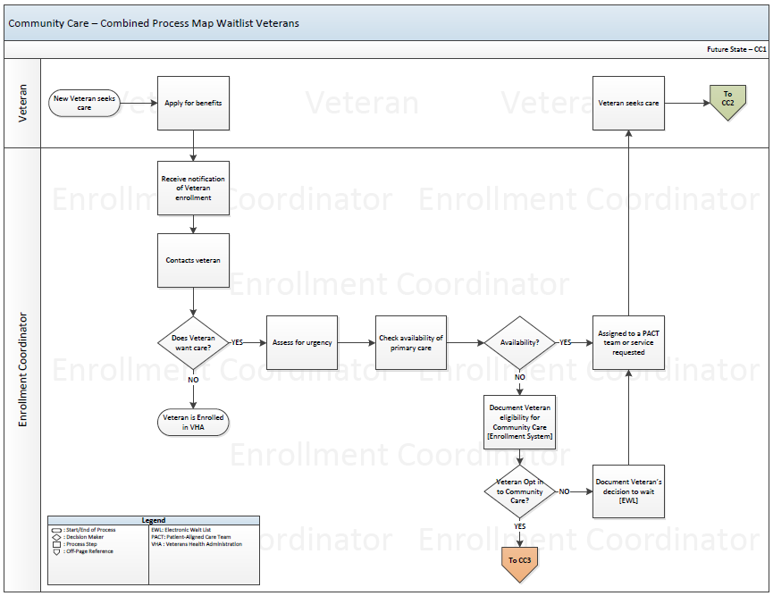

Slide 6
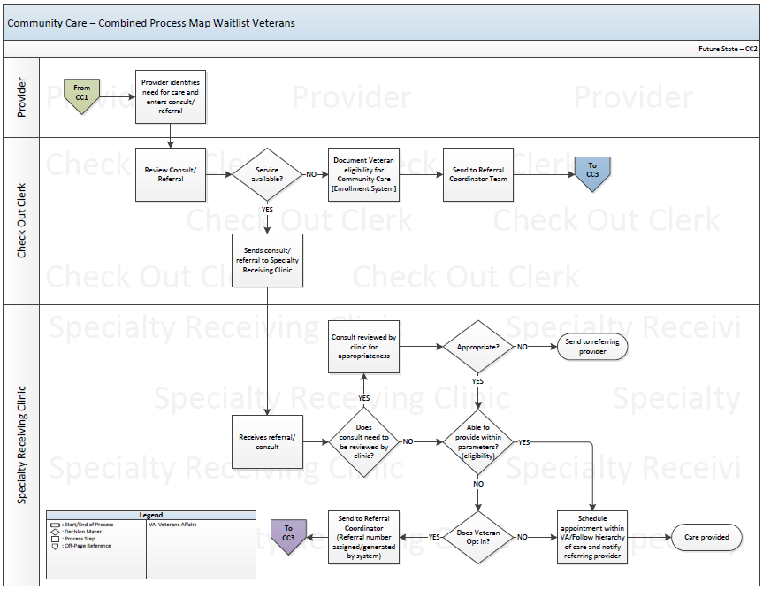

Slide 7
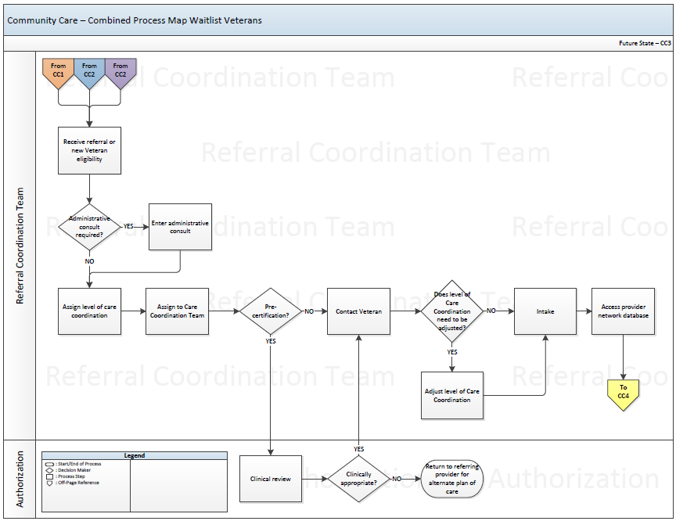

Slide 8
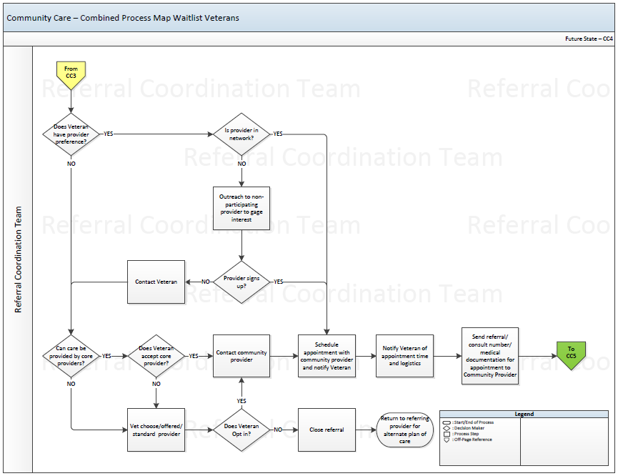

Slide 9
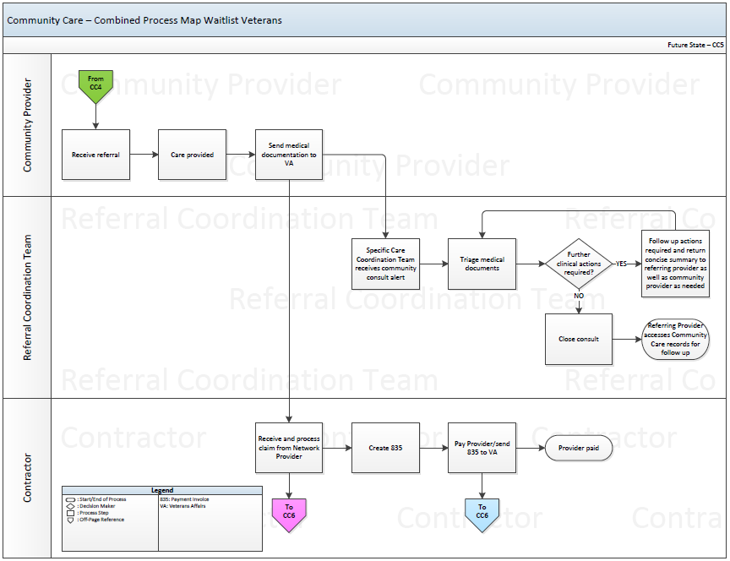

Slide 10
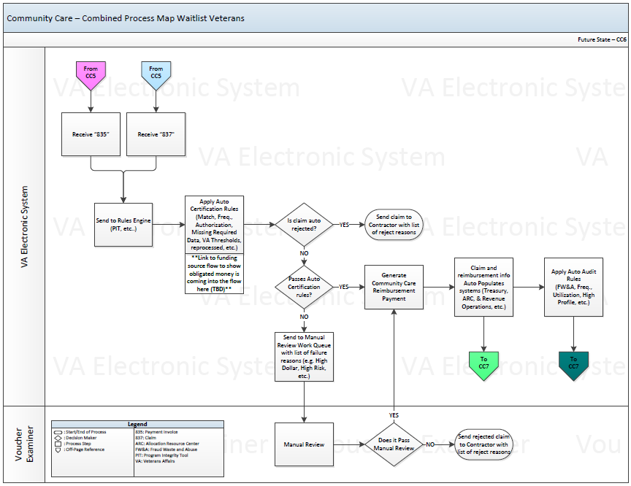

Slide 11
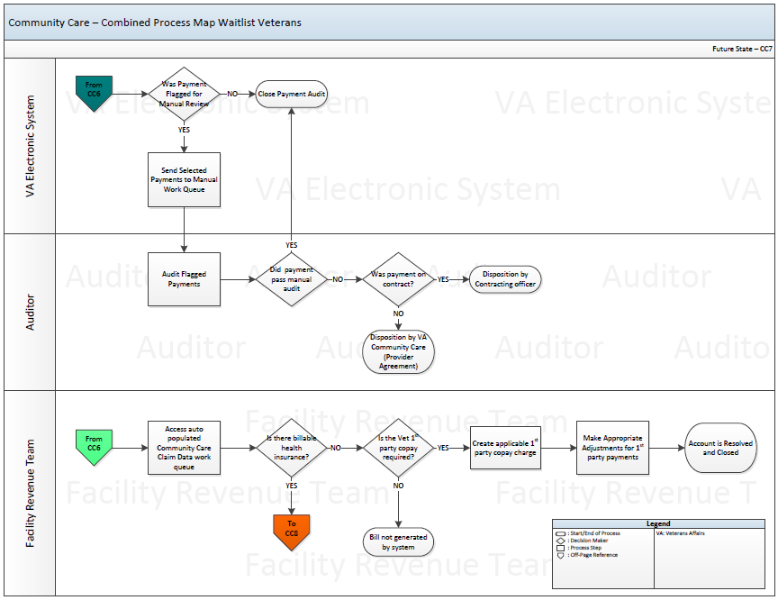

Slide 12
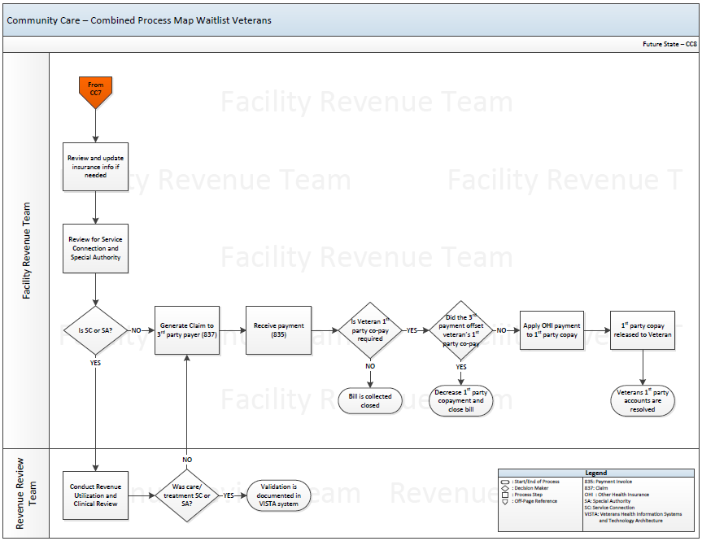

Slide 13
Next Steps
The future state process map includes many different phases of the project
  Next step will include breaking each section into 3 separate phases
    Phase I : Year 1
    Phase II : Year 2
    Phase III : Year 3+
Assist organizations in work effort collaboration
  Develop business requirements
  Long term product solutions
  Sustainable metrics

Slide 14
Questions?

