Slide 1
Mary DiJoseph
Director, Flight Project
October 22, 2014
Flight Projects Directorate
Overview

Slide 2
Administrator
Deputy Administrator
Associate Administrator
Chief of Staff
Associate Deputy Administrator
Associate Deputy Administrator for Strategy and Policy
Assistant Associate Administrator
Advisory Groups
NAC and ASAP
Chief Financial Officer*
Chief Scientist
Inspector General
Chief Information Officer*
Chief Technologist
Diversity and Equal Opportunity
Legislative and Intergovernmental Affairs*
Chief Engineer
Chief, Safety and Mission Assurance
Education
Communications*
Chief Health and Medical Officer
International and Interagency Relations
Small Business
Programs
General Counsel
Mission Support Directorate
Aeronautics Research Mission Directorate
Human Exploration and Operations Mission Directorate
Ames Research Center
Johnson Space Center
Armstrong Flight Research Center
Kennedy Space Center
Human Capital Management
Science Mission Directorate
Space Technology Mission Directorate
Strategic Infrastructure
Glenn Research Center
Langley Research Center
Headquarters Operations
Goddard Space Flight Center
Marshall Space Flight Center
NASA Shared Services Center
Reporting Structure
 | Administrator
 | Deputy Administrator
 | Associate Administrator
Internal Controls and Management Systems
Jet Propulsion Laboratory
Stennis Space Center
Procurement
Protective Services
Note:
* Center functional office directors report to Agency functional AA. Deputy and below report to Center leadership.
NASA Management Office
March 2014
www.nasa.gov

Slide 3
Agency Strategic Goals
Strategic Goal 1: Expand the frontiers of knowledge, capability, and opportunity in space
Strategic Goal 2: Advance understanding of the Earth and develop technologies to improve the quality of life on the home planet
Strategic Goal 3: Serve the American public and accomplish our Mission by effectively managing our people, technical capabilities, and infrastructure

Slide 4
Langley Organization

Slide 5
Organizational Roles
Aeronautics / Science / Space Technology and Exploration Directorates
  Overall management responsibility for all Aeronautics Research Mission Directorate (ARMD), Human Exploration Operations Mission Directorate (HEOMD), Science Mission Directorate (SMD), and Space Technollogy Mission Directorate (STMD) work
    Primary Customer Interface (Up and Out)
    Overall Budget Integration
    New Business
Flight Projects Directorate
  Execution responsibility of all Flight Project work supporting all Mission Directorates (Aeronautics, Human Exploration, Science, and Space Technology)
    Day-to-Day Execution (Down and In, Customer Interface coordinated with Product Units)
    Standard Practices and Processes
    Maintaining and Growing Flight Project Management Capabilities

Slide 6
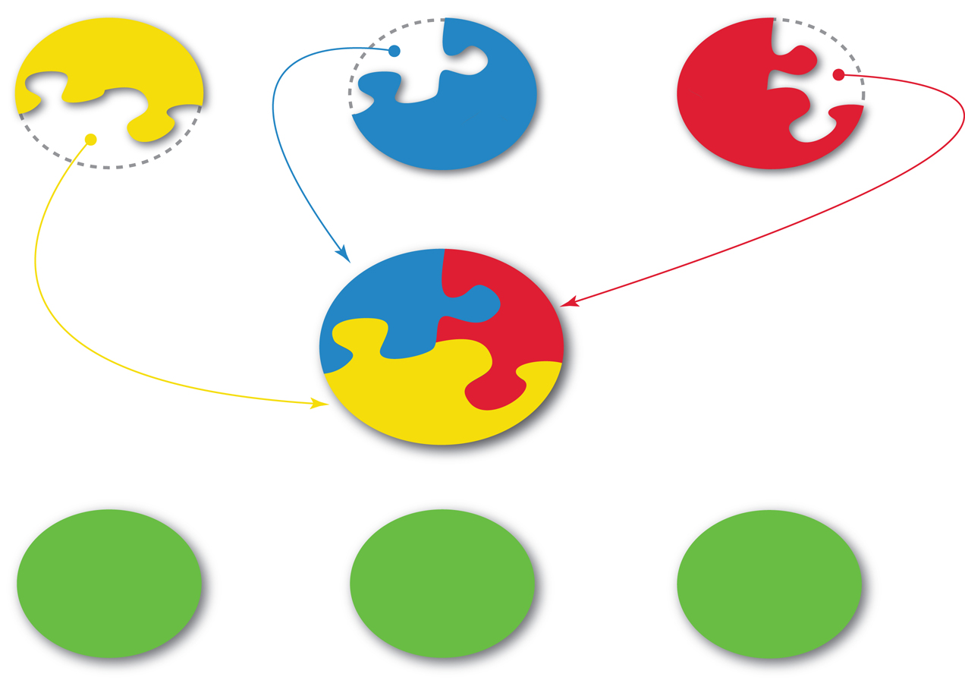
FPD Relationship to PUs and CRUs
Flight
Projects
Flight
Projects
STED
ARD
SD
Flight
Projects
FPD
$
WF, facilities
$
WF,
facilities
WF, facilities
$
RD
ED
SACD

Slide 7
FPD Purpose and Organizational Unit Plan
Purpose Statement
  The purpose of the Flight Projects Directorate (FPD) is to lead the execution of assigned flight projects, to support customers at Langley, at other Centers and external to NASA, to develop and maintain project management practices in alignment with NASA standards and requirements, and to maintain and grow expertise in project leadership, project planning and control, and other project management skills.
Functional Responsibilities
  Acquire, develop, and maintain expert Project Managers, Deputy Project Managers for Resources, Program Analysts, and other project management professionals
  Develop and continually improve an effective system of project management policies, practices, and procedures
  Develop and continually improve project planning and control support resources for projects, including cost, schedule, risk, and configuration and data management

Slide 8
FPD – Delivering on Commitments and Prepared for Opportunities
Project Implementation and execution successes:
  Ares I-X (first Exploration flight test)
  Orion PA-1 (first Orion flight test and critical demonstration of LAS approach/design)
  STORRM (first flight demo of Exploration Autonomous Rendezvous and Docking technology)
  CERES FM5 (maintenance of critical climate data record)
  IRVE-2 (first flight demonstration of inflatable reentry technology)
  IRVE-3 (significant maturation of inflatable reentry technology)
  MEDLI (first extensive aerothermal flight data from actual planetary entry)
  HIFiRE (first scramjet flight test under AF/NASA partnership)
Projects “assigned”/”won”:
  CLARREO
  SAGE III on ISS
  CERES FM6
  RBI
  TEMPO Instrument
  TEMPO Mission
  MISSE-X
  THOR
  RaD-X
Center Strategy of a Dedicated Flight Projects Organization
Including Integrated PP&C is Working

Slide 9
FPD Directorate Organizational Chart
Flight Projects Directorate
Director – Mary DiJoseph
Deputy Director – Kevin Rivers
Associate Director for Formulation - Trina Chytka
Deputy Director for Program Planning & Control – Barbara Mobley
Administrative Officer – Jennifer McCardell*
Lead Secretary – Terrie Seitz
Program Coordinator – Doree Fitzhugh*
PP&C Support
Program Analyst – Jo Sawyer*
C&DM Lead – Heather Altizer
Schedule & Risk Lead – Tara Tveten
Graphics Support – Jonathan Behun
CMC Project
* Position shared with ESOD
Orion LAS (E601)
PM – TBD
DPM – Larry Gagliano (MSFC)
DPM PP&C – Tim Warner
Chief Engr. – Wayne Walters
PA – Cameron Hartman
Admin – Cynthia Weathers
C&DM – Heide Connolly
TEMPO (E602)
Mission PM – Alan Little
Instr. PM – Wendy Pennington
DPM– Craig Jones
PP&C – Don Shick
PA – Kim Cannon
Sch/ Risk – Ken Parkinson
Sch. – Barbara Guilmette
C&DM – Kennedy Delgado, Donna Lewis
Admin – Angela Reason
SAGE III (E603)
PM – Mike Cisewski
DPM – Dianne Cheek
DPM – Steve Hall
PA – Lisa Yoakum
Admin – Carmen Maldonado
EVM – Nicki Healey
Sch - Monique Bynum
C&DM – Dimitri Solga,
Lynn Hadley
Software Engr - Erika Geier
EVM Analyst - Jennifer Wrenn
Small Projects
MEDLI-2
PM – TBD
RaD-X
PM – Kevin Daughtery
SLS/MSA Diaphragm
THOR
PM – Kurt Detweiler
FTMO – AA-2
CERES (E607)
PM – Phil Brown
DPM – Bob Estes
PA – Nicki Healey
Admin – Angela Reason
Sch – Monique Bynum
C&DM – Cynthia Davis
C&DM – Doug Anderson
RBI
PM – Barry Bryant
DPM– Melissa Ashe
Chief Engineer – Barry Dunn
Deputy PM for PP&C – Tara Tveten
Risk Manager – Shawn Scharf
C&DM – Andrew Piske
Schedule Analyst – TBD
Program Analyst – Pam Stacy
Sch/ EVM Analyst – Jennifer Wrenn
CLARREO (E606)
PM – David Beals
DPM PP&C – Don Shick
Integration Mgr. – D. Beals
Sch – Nicole Hintermeister
Other Assignments
Stuart Cooke, ARD, Low Boom Flight Demonstrations
Keith Knight, Researcher
Barmac Taleghani, SMAAART Procurement Development Team
updated: 1/13/15

Slide 10
PP&C Organizational Roles
Program Planning & Control
Deputy Director, Barbara Mobley
Graphics (Teams 2)
Project Coordinator (Teams 2)
Admin Support
Lead, Terrie Seitz
LAMPS Contractors
Resources
Management
Lead, Tara Tveten
Contractors
(Teams 2)
Schedule
Management
Lead, Tara Tveten
Contractors
(Teams 2)
Configuration &
Data Management
Lead, Heather Altizer Contractors
(Teams 2)
Risk
Management
Lead, Tara Tveten
Contractors
(TEAMS)
Earned Value
Management
Lead, TBD
Contractors
(Teams 2)
Human
Capital
Lead, Jennifer McCardell
Cost Estimation
Lead, Barbara Mobley
Staffing provided by OSACB
updated: 1/13/15
Notes:
10

Slide 11
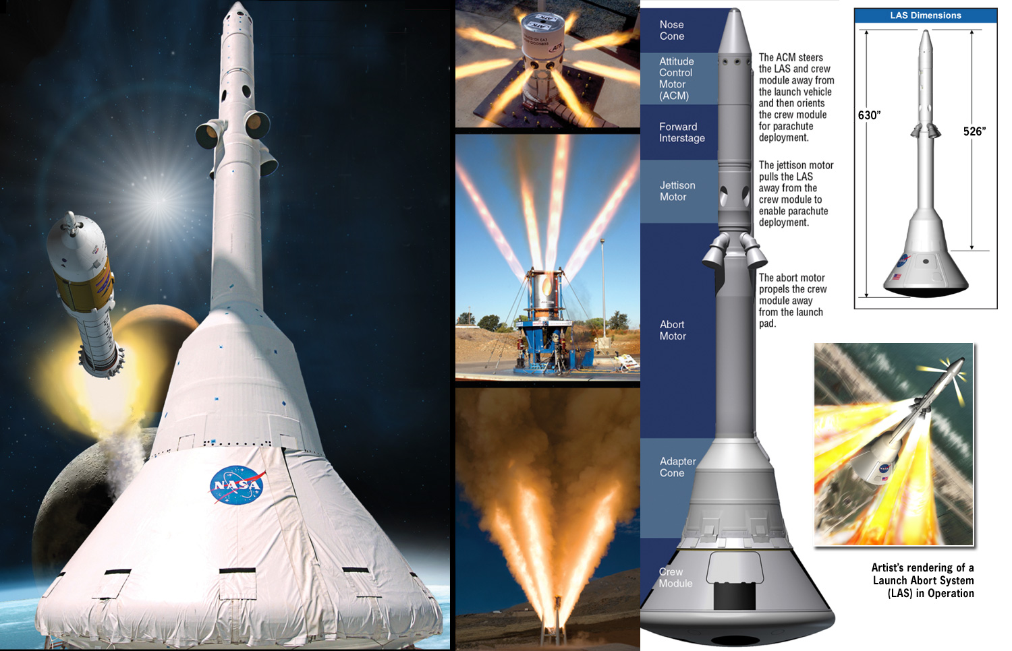
Orion Launch Abort System (LAS)

Slide 12
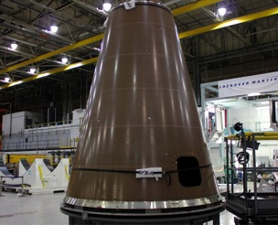
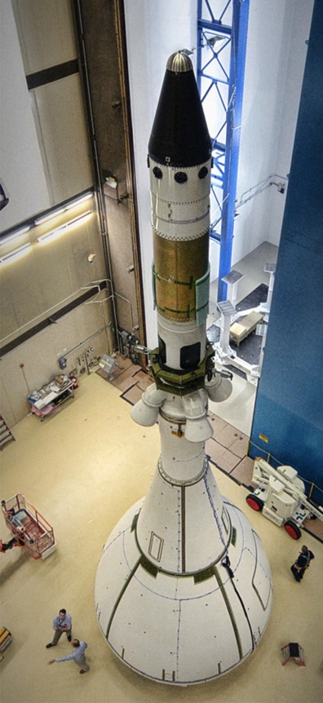
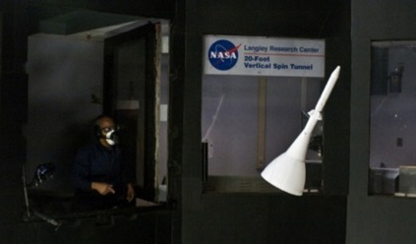

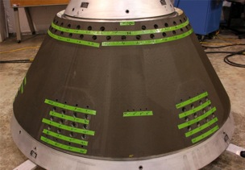
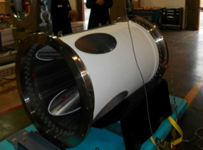
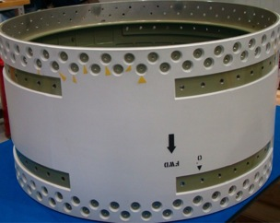
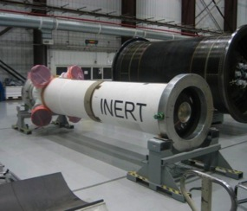
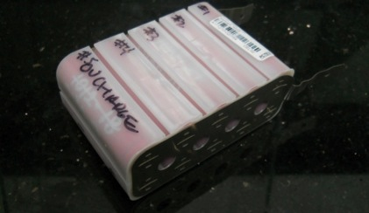
ORION LAS – Preparing for 2014 EFT-1 Launch
EFT-1 Fairing Panel
LAS Tower Test in LaRC VST
EFT-1 Adapter Cone
EFT-1 Jettison Motor
TPS Tests in the MSFC Plasma Torch Test Bed
EFT-1 Aft Interstage
EFT-1 Inert AM
ORION GTA Test Completed
ACM Battery Testing

Slide 13
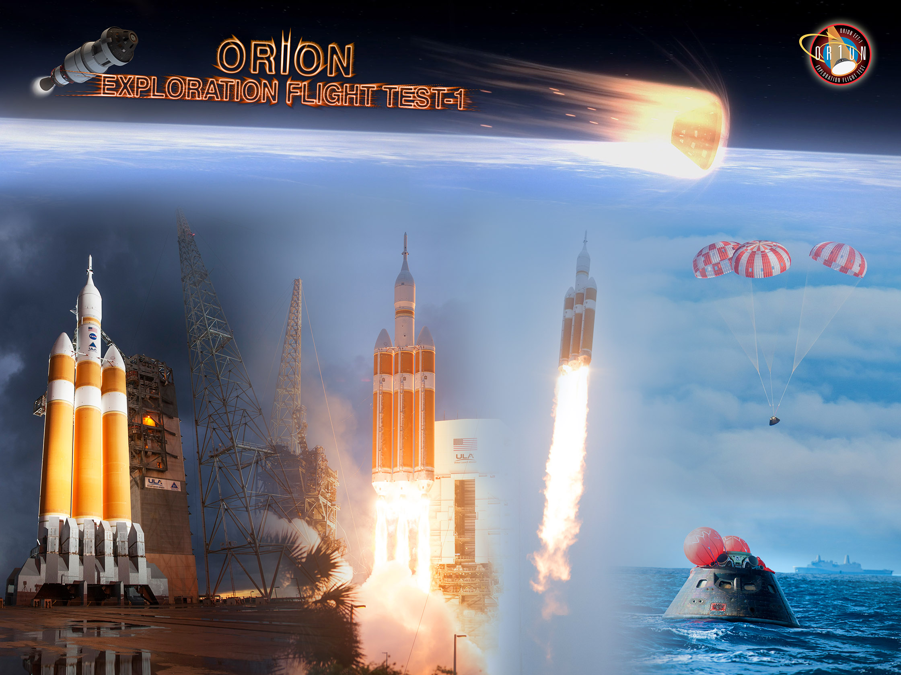
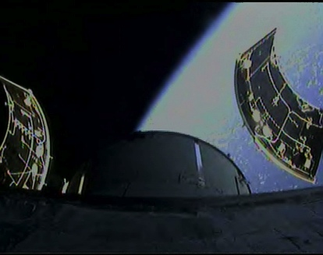
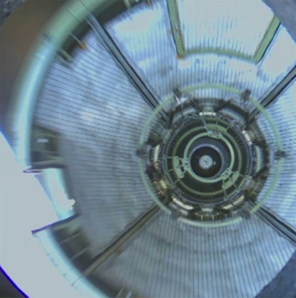

ORION LAS – EFT-1 Launch 12.5.2014

Slide 14

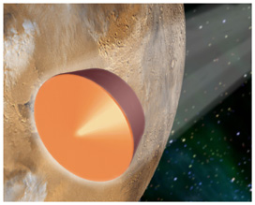
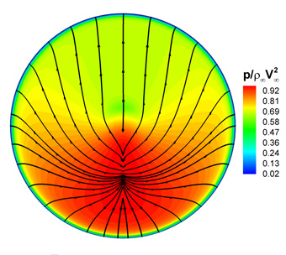
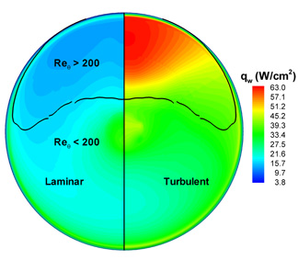
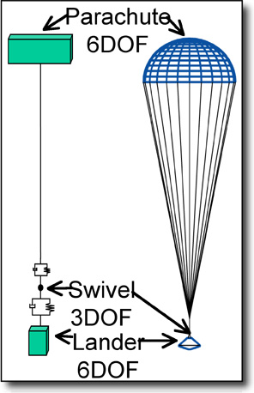
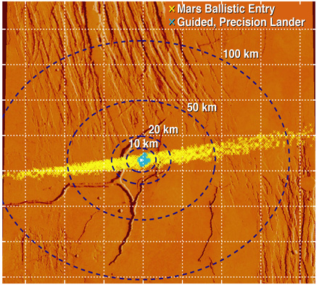
Mars Science Laboratory:
Entry, Descent, and Landing
ESOD
  Launch:
  Oct - Dec 2011
  Mars Arrival:
  Aug - Sep 2012
  LaRC’s Role: Atmospheric Flight, EDL
    Configuration development
    (2001 to present)
    Lead end-to-end atmospheric flight
    simulation for entry, descent
    and landing
    Lead aerodynamic database
    development, analysis, testing
    Lead aerothermal environments,
    analysis, testing
    Parachute design, development
    Aeroshell design support
    Concept trades thru flight operations
    Member of multi-center JPL-led team
28.5
28.0
27.5
27.0
26.5
26.0
25.5
25.0
Latitude(deg)
112.5 112.0 111.5 111.0 110.5 110.0 109.5 109.0
Longitude (deg)

Slide 15

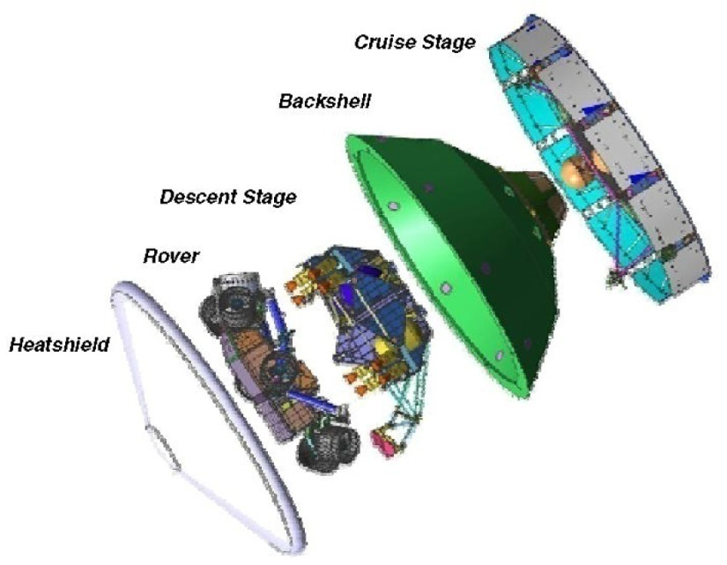
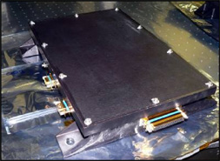
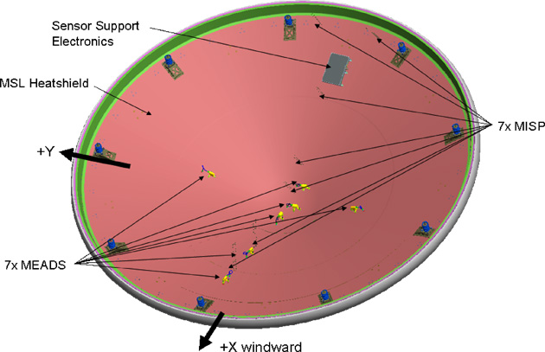
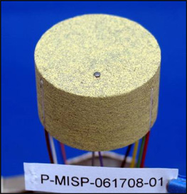
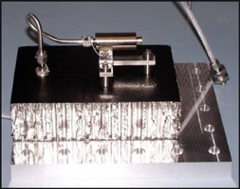
MEDLI
MSL Entry Descent and Landing Instrumentation
STED
ARD
Instrumentation suite installed in the Mars Science Laboratory’s (MSL) forebody heatshield
Will gather engineering data during entry and
descent for future Mars missions:
  Aerothermal, aerodynamic, and thermal protection system (TPS) performance
  Atmospheric density and winds
MEDLI consists of 7 MEADS pressure ports, 7 MISP integrated sensor plugs, and support electronics.
MSL (For Reference)
Sensor Support Electronics (SSE)
MEDLI Instrumented Sensor Plug (MISP)
Mars Entry Atmospheric Data System (MEADS)
Notes:
What are the objectives of the project?

Slide 16
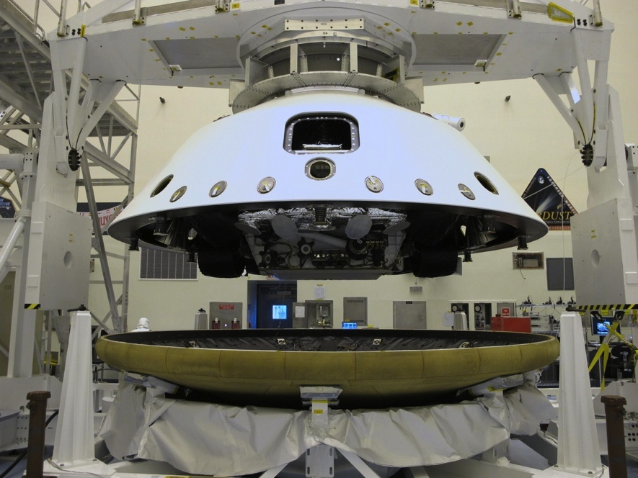
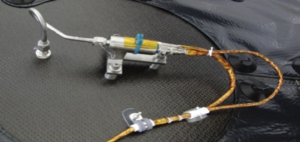
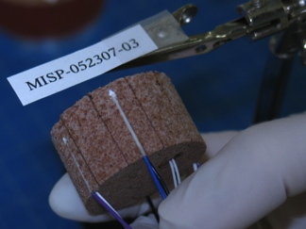

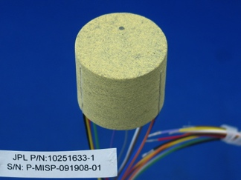
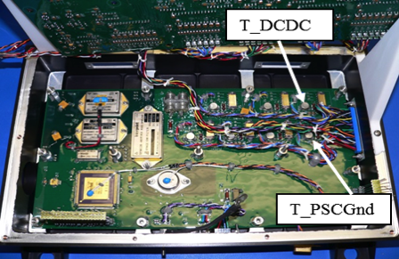
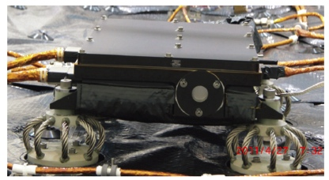
Mars 2020 MEDLI2 Implementation Summary
MEDLI2 complements and extends the MEDLI (MSL) measurements with a more heatshield observation locations, inclusion of supersonic aerodynamics, and backhsell aerothermal and pressure observations.
MISP
6 Sensor Plugs (7 T/C’s) and 3 Heat Flux Sensors on the Backshell (SLA)
MEADS
One pressure Transducer on the Backshell
MISP
11 Sensor Plugs
(20 T/C’s) and 2 HEATs in the Heatshield (PICA)
MEADS
1 PT for Hypersonic regime & 6 PT for Supersonic Regime on the Heatshield
SSE
Data Acquisition System on the Heatshield; & all instra-instrument harnesses

Slide 17
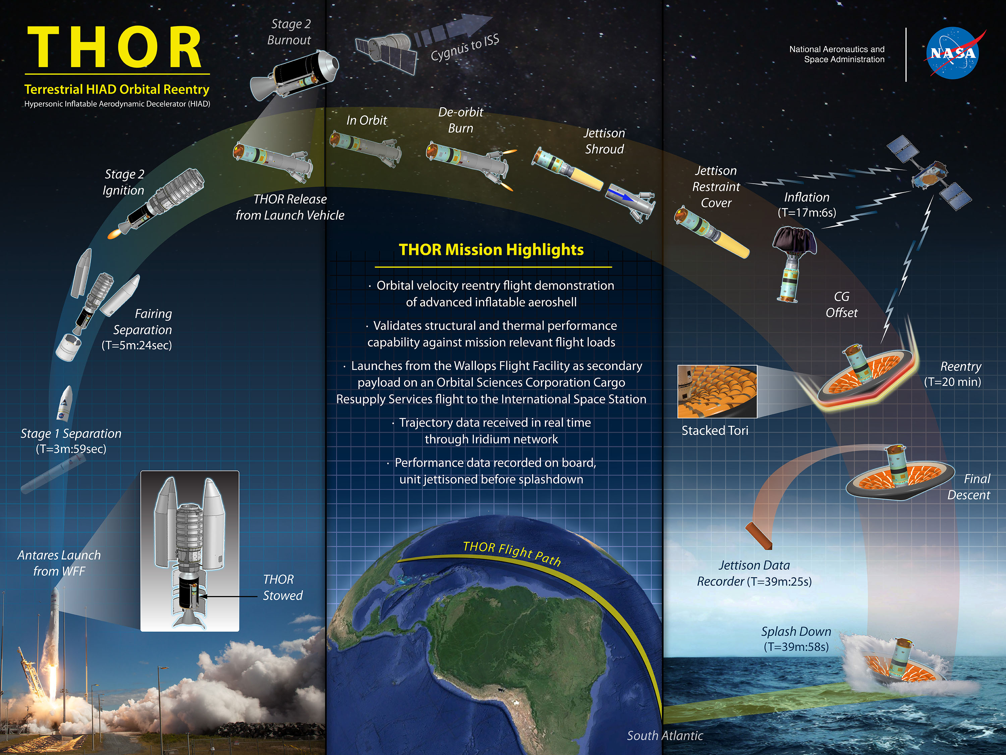

Slide 18


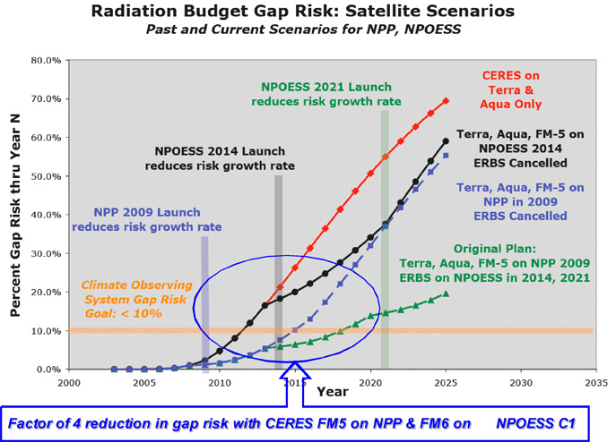
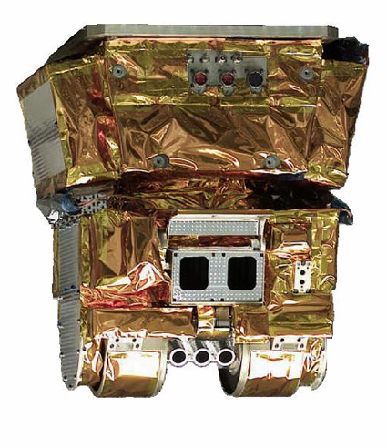
CERES
Clouds and the Earth’s Radiant Energy System
SD
CERES FM5 & FM6 instruments provide the cost effective bridge to maintain the continuity of the decade plus climate data record.
  Flight Model 5 (FM5) on NPP in 2011
    Refurbishment of instrument built in 1999
    Delivered and Integrated to NPP Spacecraft, November 2008
  Flight Model 6 (FM6) on NPOESS C1 in 2016
    “New” instrument from spare and build-to-print parts
    Scheduled for delivery to NPOESS July 2012

Slide 19
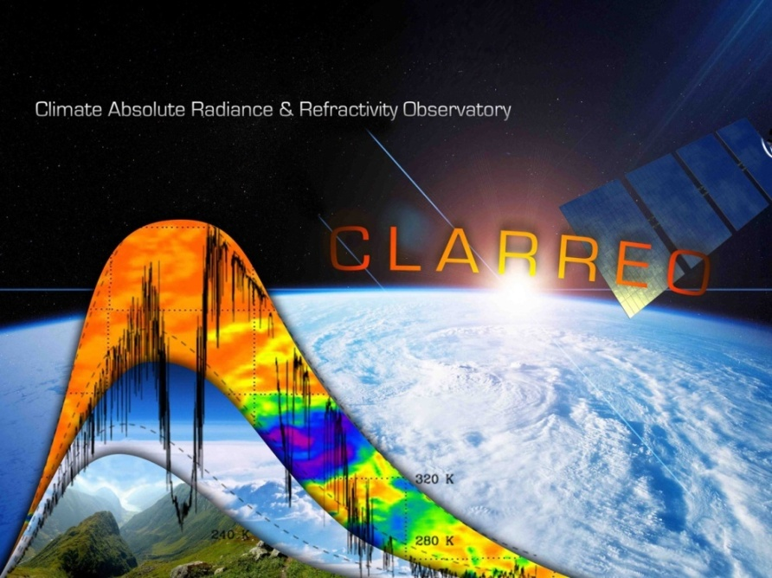
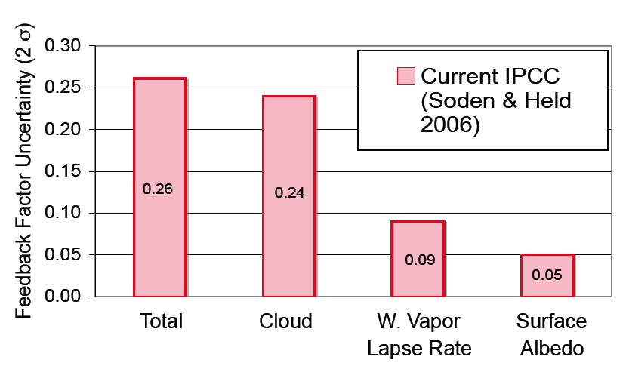
CLARREO
Climate Absolute Radiance and Refractivity Observatory
CLARREO will provide the measurements that we need as a society to make informed decisions about responding to climate change
Keys to Understanding / Predicting Climate Change
Long-Term Trend Detection: Accurately calibrated radiances provide a benchmark from which climate change can be conclusively determined
Calibration: The foundation is on-orbit traceability of instrument accuracy
Testing and Validation of Climate Models: The benchmark radiance measurements provide a consistency check for the climate data records and the climate models
CLARREO attacks the largest climate feedback uncertainties

Slide 20
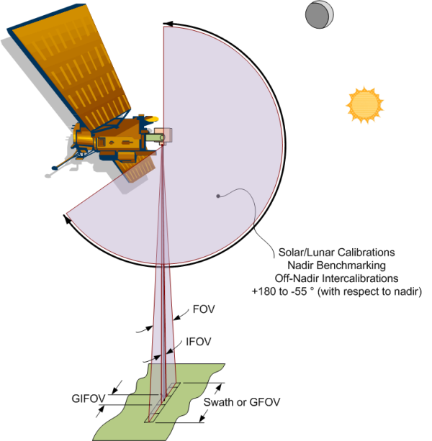
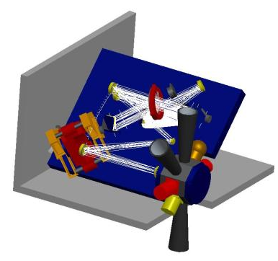
CLARREO
Climate Absolute Radiance and Refractivity Observatory
CLARREO Science Measurements
Reflected Solar
  Measures the solar spectral reflectance of the Earth and its atmosphere relative to the solar irradiance spectrum
  Calibration accuracy attained using the Sun as a calibration reference standard
Infrared Radiance
  Measures the infrared radiance spectra of the Earth and its atmosphere with systematic error that corresponds to < 0.1 K brightness temperature radiometric calibration uncertainty
GNSS Radio Occultation
Tangent Point
GNSS
  Radio occultation of Global Navigation Satellite System (GNSS) signals used to derive atmospheric refractivity
CLARREO
α
Earth
  Calibration accuracy attained with a rigorous on-orbit verification system
GPS

Slide 21
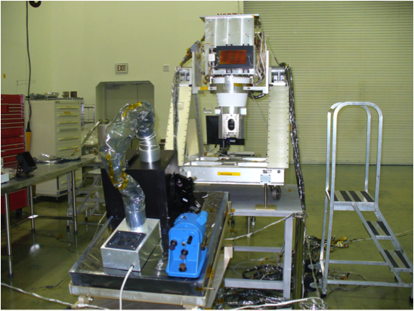
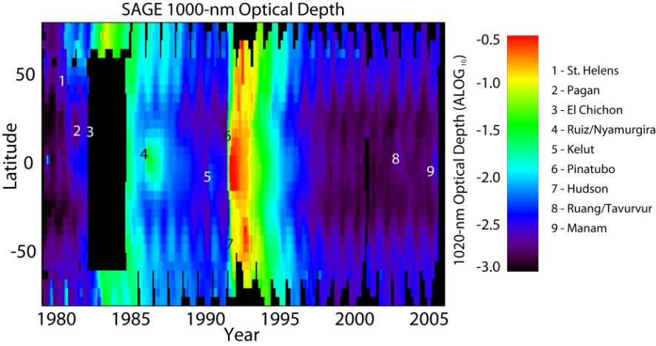
SAGE III
Stratospheric Aerosol and Gas Experiment
SD
SAGE III produces vertical profiles of aerosols and gases such as ozone in the stratosphere and upper troposphere using the solar and lunar occultation measurement technique and the limb scattering measurement technique
Because SAGE occultation measurements are self-calibrating, SAGE measurements are ideal for long term atmospheric chemistry and climate studies. SAGE data has been used widely for:
  Ozone trend assessments
  Climate studies of aerosol forcing
  Atmospheric process studies which utilize the high vertical resolution of SAGE III measurements
A spare SAGE III instrument is being considered for a potential flight opportunity on the International Space Station or as part of the Chemical and Aerosol Sounding Satellite (CASS) mission.
SAGE III configured for testing in the
NASA LaRC 40’ clean room
SAGE III aerosol data has been
identified as a critical data set
for climate studies

Slide 22
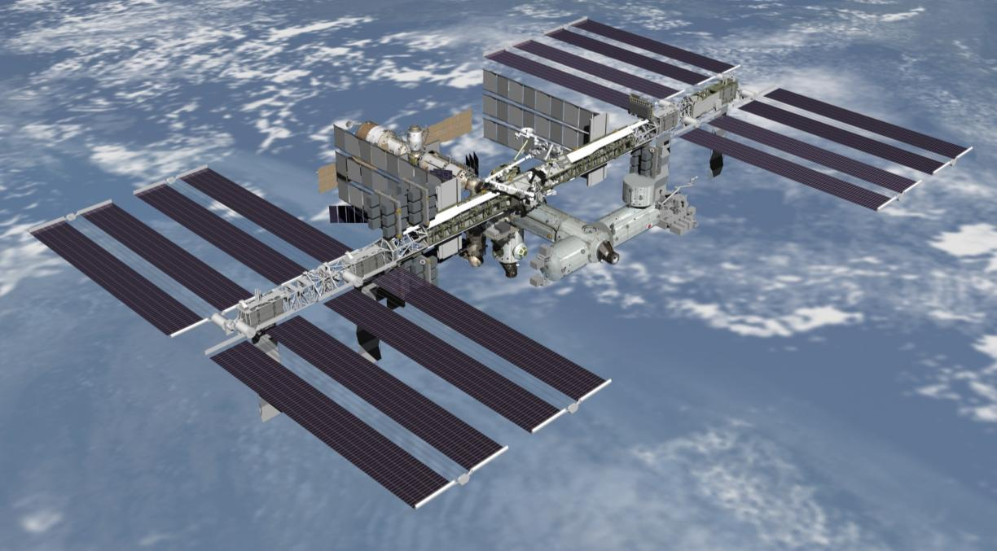
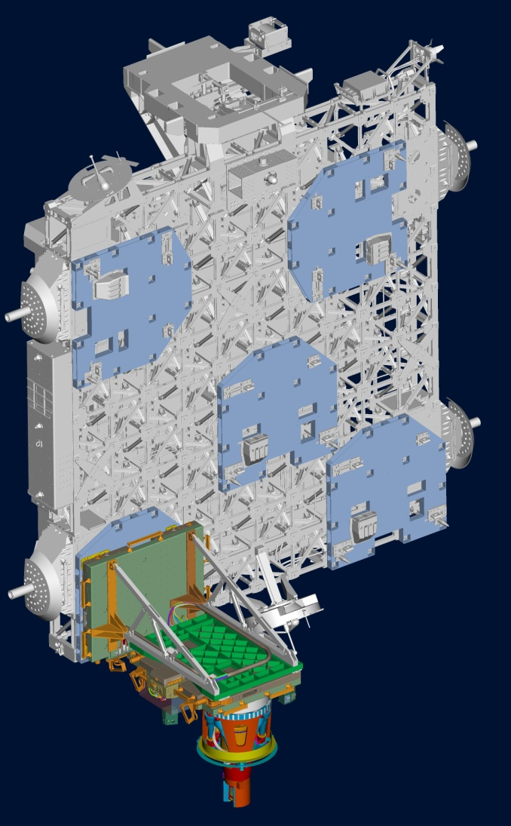
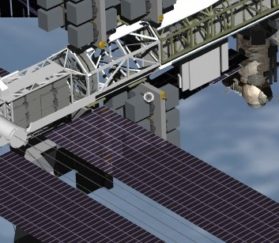
SAGE III on ISS Concept
ELC-4
SAGE III is the Pathfinder for Earth Science Observations from ISS
1.0 Introduction to the Project

Slide 23
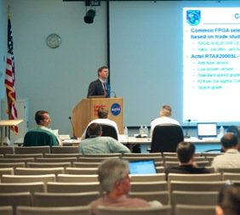
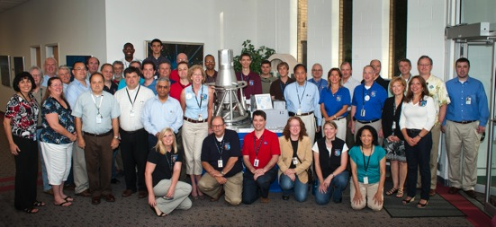
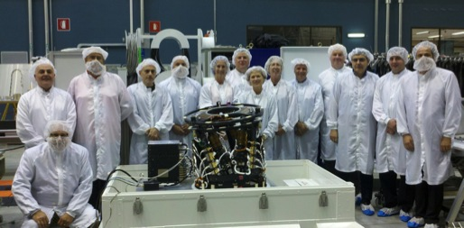
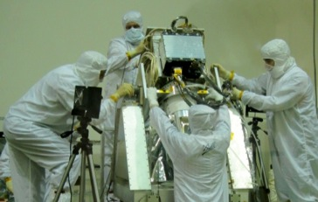
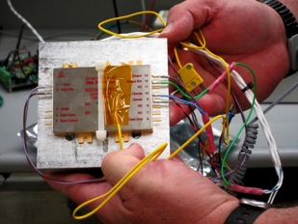
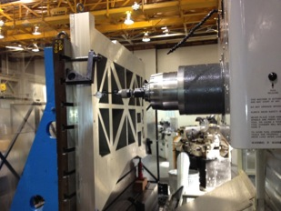
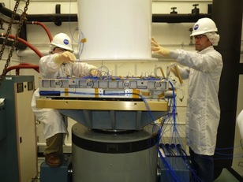
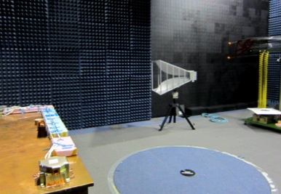
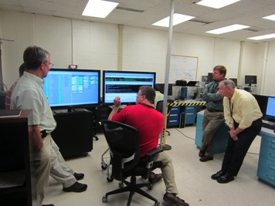


SAGE III on ISS – Preparing for 2016 Launch
Preliminary Design Review
SAGE III on ISS Team at PDR
SAGE III Team at Thales Alenia Space - Italy
Instrument Refurbishment
IAM PDU Electronics
NVP Machining
ExPA Vibration Test
CMP EMI Test
Software Demonstration
IAM EDU
NVP EDU Lift

Slide 24

RBI Overview
Radiation Budget Instrument (RBI)
Partnerships and Team
  NASA/ NOAA
  NOAA provides JPSS-2 satellite for accommodation of RBI
  NASA provides/funds RBI instrument and support through spacecraft I&T and launch/activation
  NASA funds RBI earth radiation budget science data analysis and generation of science products
NASA Langley
  Manages prime contractor development of RBI instrument, provides management, technical, and mission assurance insight and oversight / takes ownership upon delivery to spacecraft and provides I&T and launch plus activation support
Exelis Inc.
  RBI Instrument provider/prime contractor with sub-contractors providing key elements and support (SDL for Calibration, INO for MBA detectors, Sierra Nevada for Azimuth Rotation Assembly)
  NASA/ NOAA
  NOAA provides JPSS-2 satellite for accommodation of RBI
  NASA provides/funds RBI instrument and support through spacecraft I&T and launch/activation
  NASA funds RBI earth radiation budget science data analysis and generation of science products
NASA Langley
  Manages prime contractor development of RBI instrument, provides management, technical, and mission assurance insight and oversight / takes ownership upon delivery to spacecraft and provides I&T and launch plus activation support
Exelis Inc.
  RBI Instrument provider/prime contractor with sub-contractors providing key elements and support (SDL for Calibration, INO for MBA detectors, Sierra Nevada for Azimuth Rotation Assembly)
  Category 3 Mission per NPR 7120.5E
  Risk Classification B per 8705.4
  Follow-on instrument to the Clouds and the Earth’s Radiant Energy System (CERES)
  Flight Instrument Complete – February 2018
  Flight Instrument Delivery – January 2019
  JPSS-2 launch planned for November 2021
Science Goal:
  To continue the measurements from the last two-plus decades in support of global climate monitoring.
  RBI extends the ERB measurements of the Earth Observing System (EOS) and Joint Polar Satellite System (JPSS)

Slide 25

Concept of Operations
INSTRUMENT
PROJECT SCOPE

Slide 26

Concept of Operations

Slide 27
Practices & Processes
Develop practices and processes to ensure that projects don’t reinvent how to manage projects
Using best practices from various sources
Implemented
  LaRC Space Flight Projects Practices Handbook is the portal into those best practices (LPR 7120.5)
  Configuration Management Requirements (LPR-8040.1) — configuration management is extremely important for our products
  Customer Satisfaction
  Project Implementation Process
  We encourage feedback on FPD practices and processes

Slide 28
FPD Pipeline
Pipeline for Project Managers
  Discipline Lead ⇒ Project Systems Engineer ⇒ Project Manager on a Small Project or Deputy Project Manager on a Large Project
  Deputy Project Manager on a Large Project or Project Manager on a Small Project ⇒ Project Manager on a Large Project
  Training (classes, assignments to IPAO, SMO, SMAO, and other Centers)
Pipeline for Deputy Project Managers for Resources
  Junior Program Analysts or Business Coops ⇒ Program Analysts ⇒ Deputy Project Managers for Resources
  Training (classes, participation in Agency teams)

Slide 29
Questions?

Slide 30
Acronyms
AA Ascent Abort
AFT Abort Flight Test
AMA Analytical Mechanics Association, Inc.
ARC Ames Research Center
ARD Aeronautics Research Directorate (LaRC)
ARMD Aeronautics Research Mission Directorate (HQ)
CASS Chemical and Aerosol Sounding Satellite
CERES Clouds and the Earth’s Radiant Energy System
CEV Crew Exploration Vehicle
CFD Computational Fluid Dynamics
CLARREO Climate Absolute Radiance & Refractivity Observatory
CMC Center Management Council
CM/LAS Crew Module and Launch Abort System
CoTR Contracting Officer Technical Representative
CRU Core Resource Unit
CxP Constellation Program
DTO Development Test Objective
EDL Entry, Descent, and Landing
ESMD Exploration Systems Mission Directorate (HQ)
ESOD Exploration & Space Operations Directorate (LaRC)
EVA Extra Vehicular Activity
FPD Flight Projects Directorate
FM Flight Model
FTA Flight Test Article
FTE Full Time Equivalent (Civil Service)
FTP Flight Test Program
FY Fiscal Year
GNSS Global Navigation Satellite System
GSE Ground Support Equipment
GSFC Goddard Space Flight Center
IPAO Independent Program Assessment Office
IPPC Intergovernmental Panel on Climate Change
IRD Interface Requirements Document
IRVE Inflatable Re-entry Vehicle Experiment
ISS International Space Station
JSC Johnson Space Center
KSC Kennedy Space Center
LaRC Langley Research Center
LAS Launch Abort Systems (LASO = LAS Office)
LPRP Lunar Precursor Robotic Program
LRO Lunar Reconnaissance Orbiter
LCROSS Lunar Crater Observation & Sensing Satellite
MAF Michoud Assembly Facility
MEADS Mars Entry Atmospheric Data System
MEDLI MSL Entry Descent and Landing Instrumentation
MISP MEDLI Instrumented Sensor Plug
MSFC Marshall Space Flight Center
MSL Mars Science Laboratory
NC Non-conformance
NRA NASA Research Announcement
PA Pad Abort
PAIDAE Program to Advance Inflatable Decelerators for Atmospheric Entry
PEC Passive Experiment Carriers
PP&C Program Planning and Control
PU Product Unit
RTD Research & Technology Directorate
SACD Systems Analysis & Concepts Directorate
SD Science Directorate (LaRC)
SED Systems Engineering Directorate
SE&I Systems Engineering & Integration
S&E Science and Engineering
SMD Science Mission Directorate (HQ)
SMAO Safety & Mission Assurance Office
SMO Systems Management Office
SOMD Space Operations Mission Directorate
SSE Sensor Support Electronics
TMR Technical Management Representative
VAB Vehicle Assembly Building
VNS Vision Navigation Center
WFF Wallops Flight Facility
WIO Wind Induced Oscilation
WSMR White Sands Missile Range
WYE Work year Equivalent (Contractor)

