Slide 1
Langley Research Center Flight Projects Directorate
Overview
Mary DiJoseph, Director
Stephen Gaddis, Acting Deputy Director
Craig Nickol, Acting Associate Director
Don Shick, Deputy Director, PP&C
August 2016

Slide 2
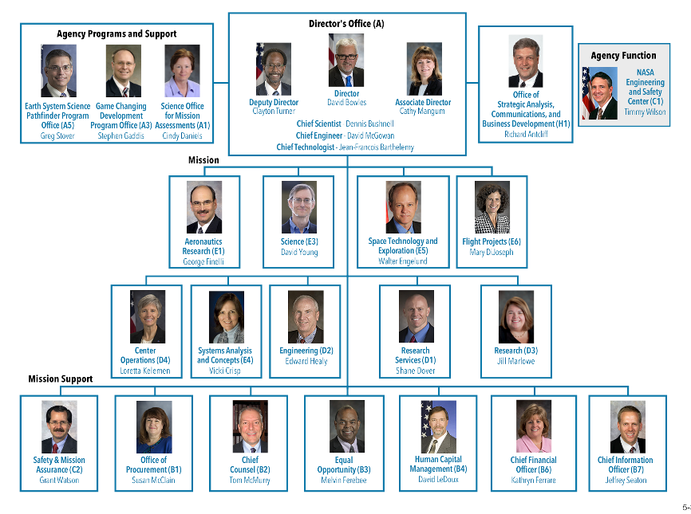
NASA Langley Research Center Organization
Langley is a research, science, technology and development Center that provides
game changing innovations to enable NASA to make significant contributions to the Nation.
We Deliver on Today’s Commitments and Create Tomorrow’s Opportunities

Slide 3
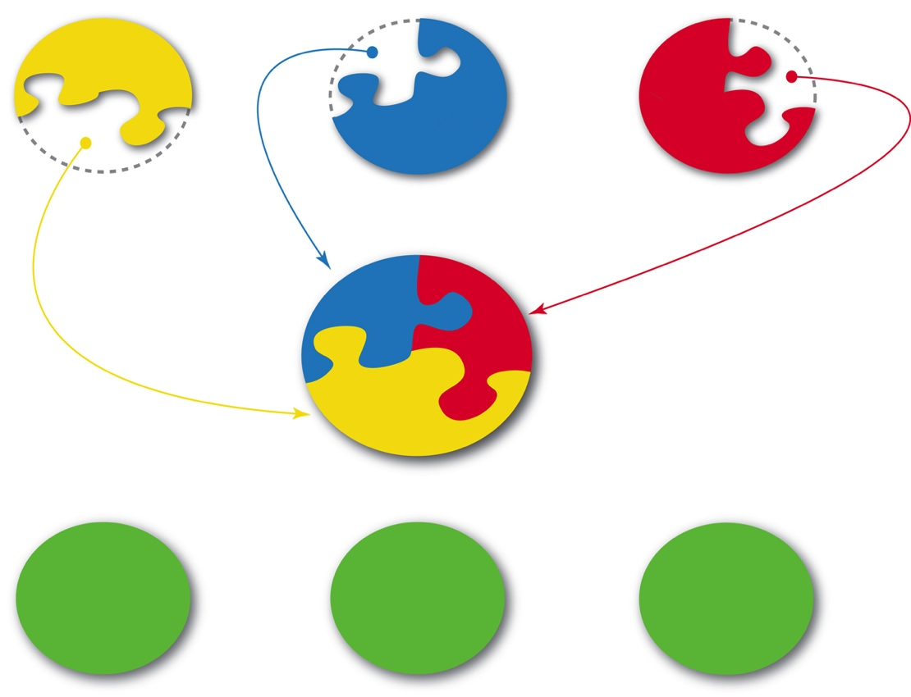
Organizational Roles
Aeronautics , Science and Space Technology and Exploration Directorates
  Overall management responsibility for all ARMD, HEOMD, SMD and STMD work
    Primary Customer Interface (Up and Out)
    Overall Budget Integration
    New Business
Flight
Projects
Flight
Projects
STED
SD
ARD
Flight
Projects
FPD
$
WF, facilities
$
WF,
facilities
$
WF, facilities
RD
ED
SACD
Flight Projects Directorate
  Execution responsibility of all Flight Project work supporting all Mission Directorates
    Lead the execution of assigned flight projects
    Develop and maintain project management practices in alignment with NASA standards and requirements
    Maintain and grow expertise in project leadership, project planning and control, and other project management skills

Slide 4
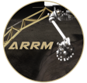







LaRC Fight Projects Directorate
Flight Projects Directorate
Office
PP&C
Support
ARRM
CapM-CRS
AA-2
FTA
CERES FM6
ORION LAS
TEMPO
CLARREO
SAGE III
RBI
SLS/EM-1 MSA Diaphragm
Instrument
MEDLI-2
Mission

Slide 5
FPD Organization Chart
Flight Projects Directorate
Director – Mary DiJoseph
Deputy Director – Stephen Gaddis (acting)
Associate Director for Formulation – Craig Nickol (detailed)
Deputy Director for Program Planning & Control – Don Shick
Business Manager – Staten Spruill
Administrative Officer – Jennifer McCardell*
Graphics Support – Jonathan Behun
Lead Secretary – Terrie Seitz
Program Coordinator – Doree Fitzhugh
PP&C Support
C&DM Lead – Heather Altizer
Schedule & Risk Lead – Sarah Waechter
FPD Archivist – Melanie Lawhorne
* Position shared with STED
ARRM
CapM-CRS
PM – Phil Brown
Sch – Dawn Lomax
PA – Nicki Healey
Risk – Heather Wilson
C&DM - Kennedy Delgado
AA-2
PM – Kurt Detweiler
PM – Barmac Taleghani
PA – Cameron Hartman
Risk – Lauren Bonine
C&DM – Heidi Connolly
Sch – Cyndy McPherson
Orion LAS
PM – Robert DeCoursey
DPM – Deborah Crane (MSFC)
DPM PP&C – Tim Warner
PA – Cameron Hartman
Sch – Bill Guilmette
C&DM – Heidi Connolly
Risk – Robin Flachbart (MSFC)
Admin – Cynthia Weathers
TEMPO
Mission PM – Steve Hall
Instrument PM – Wendy Pennington
DPM – Andrew Panetta
DPM – Crystal Fenn
DPM PP&C – Don Shick
Sch/Risk – Barbara Guilmette
C&DM – Kennedy Delgado, Donna Lewis
Admin – Ericka Meacham
SAGE III
PM – Mike Cisewski
DPM – Dianne Cheek
DPM – Steve Hall
PA – Lisa Yoakum,
Caroline Knight
EVM – Nicki Healey,
Sch – Chris Herdey
C&DM – Dimitri Solga,
Lynn Hadley
Risk – Heather Wilson
Admin – Kris Jones
SLS/ EM1 MSA Diaphragm
MEDLI-2
PM – Henry Wright
DPM – Todd White (ARC)
PA – Sherry Araiza
Risk – Pierre King
Sch – Bill Guilmette
C&DM – Katie King
CERES
PM – Bob Estes
DPM – Kevin Daugherty
PA – Nicki Healey
Sch – Chris Herdey
C&DM – Katie King
Risk – Ed Shea
Admin – Cynthia Weathers
CLARREO
PM – Gary Fleming
DPM/COR – Mike Koch
DPM – Joshua Kinne
PA – Sherry Araiza
Integration Mgr – Vacant
Risk – Pierre King
Sch – Monique Bynum
C&DM – Kennedy Delgado
Admin – Kris Jones
RBI
PM – Alan Little
DPM – Barry Bryant
DPM/COR – Melissa Ashe
DPMs - R. Walker, C. Stimson
DPM PP&C – Tara Tveten
Risk – Lauren Bonine
C&DM – Donna Lewis
Sch – Monique Bynum
EVM/Sch – Jennifer Wrenn
Review Support - Robin Land
Admin – Ericka Meacham
Other Assignments
Stuart Cooke, ARD, QueSST

Slide 6
FPD PP&C Roles & Responsibilities
Program Planning & Control
Deputy Director, Don Shick
Project Coordinator (TEAMS 2)
Resources
Management
Lead, Staten Spruill
CS and Contractors
(TEAMS 2)
Schedule
Management
Lead, Sarah Waechter *
Contractors
(TEAMS 2)
Configuration &
Data Management
Lead, Heather Altizer * Contractors
(TEAMS 2)
Risk
Management
Lead, Sarah Waechter *
Contractors
(TEAMS 2)
Earned Value
Management
Lead, Robin Land *
Contractors
(TEAMS 2)
Assessments
Lead, TBN *
* Denotes FPD employee

Slide 7
Completed FPD Projects
Project Implementation and execution successes:
ALHAT (autonomous GN&C and sensing system for lunar descent vehicles)
X-43A (scram-jet powered hypersonic flight demonstration [3 Flights])
ASCENDS
Ares I-X (first Exploration flight test)
Orion PA-1 (first Orion flight test and critical demonstration of LAS)
STORRM (first flight demo of Exploration Autonomous Rendezvous and Docking)
CERES FM5 (maintenance of critical climate data record)
IRVE-2 (first flight demonstration of inflatable reentry technology)
IRVE-3 (significant maturation of inflatable reentry technology)
MEDLI (first extensive aerothermal flight data from actual planetary entry)
MISSE 6 (investigate effects of long-term exposure of materials to space environment)
HIFiRE (first scramjet flight test under AF/NASA partnership)
CALIPSO (determine effects of clouds and aerosols on changes in the Earth's climate)
Orion EFT-1 (demo of LAS Jettison and first flight of composite MSA Diaphragm)
RaDX – Radiation Dosimetry Experiment (provide first-time indications of how cosmic rays deposit energy at the top of our atmosphere)
LaRC Strategy of a Dedicated Flight Projects Organization
Including Integrated PP&C is Working

Slide 8
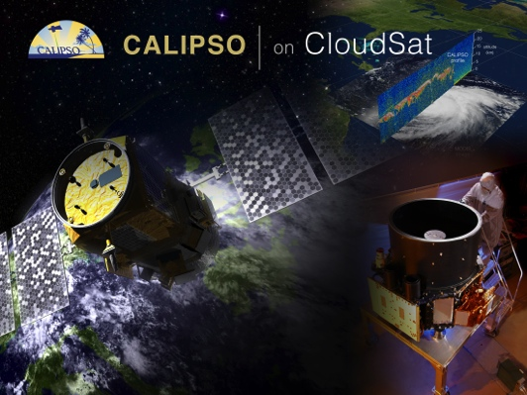
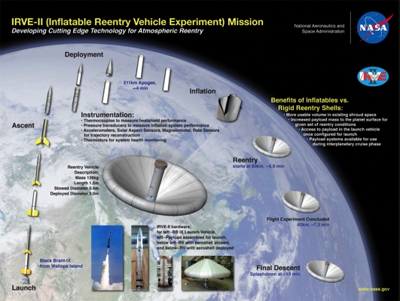
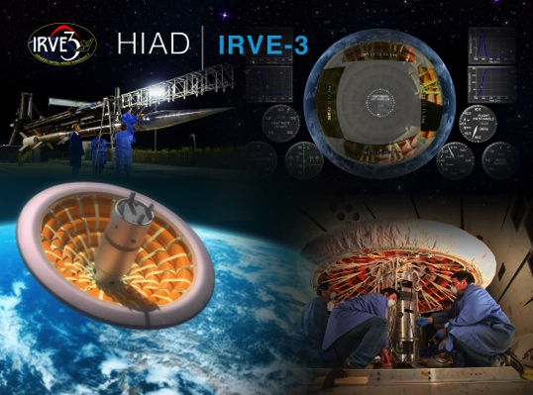
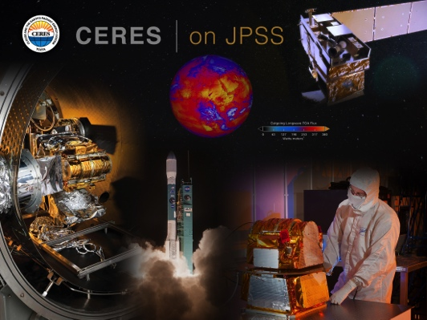
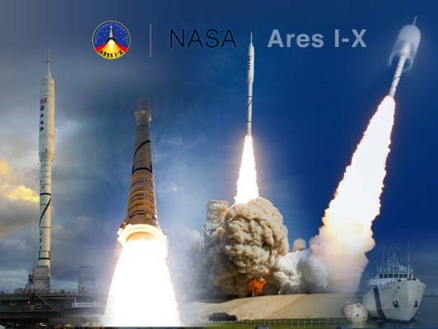
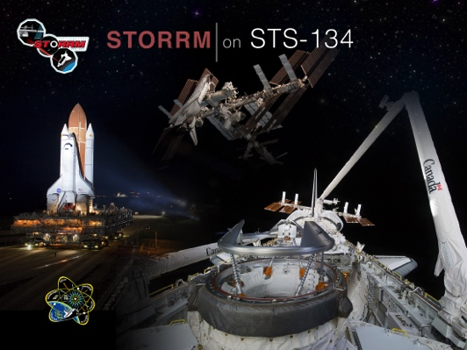
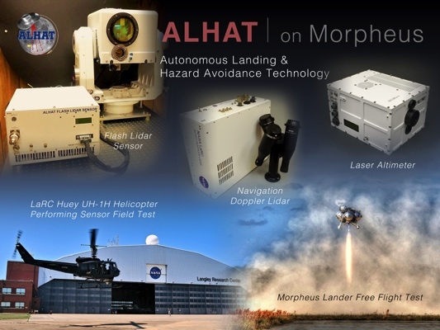
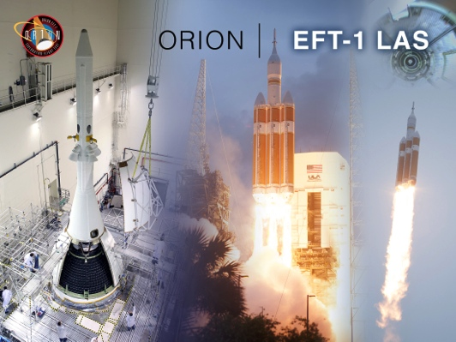
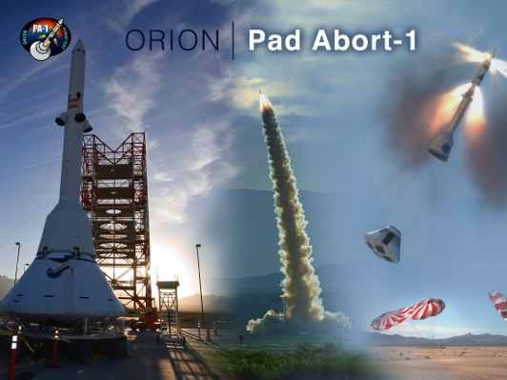
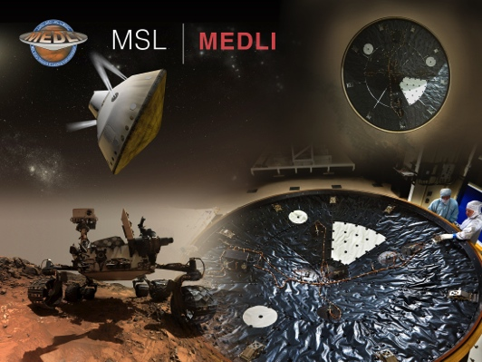
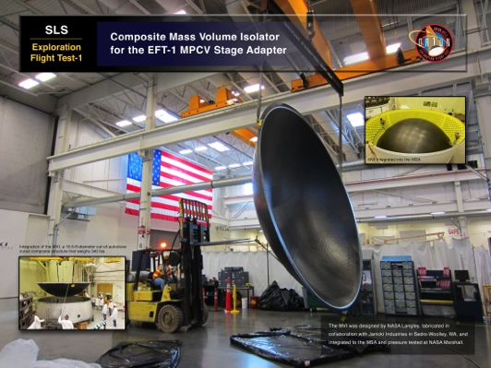
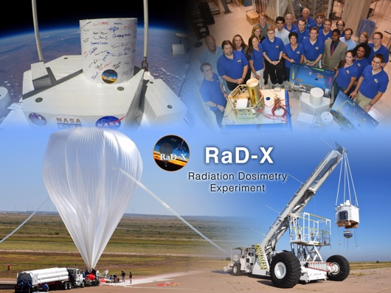
Recent Successes

Slide 9
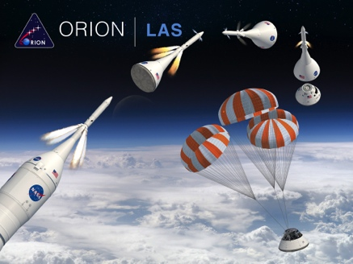
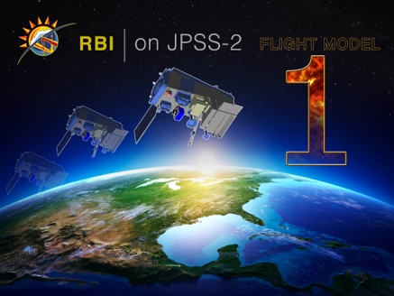
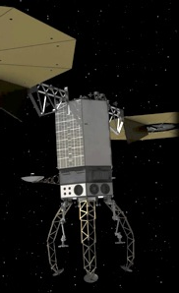
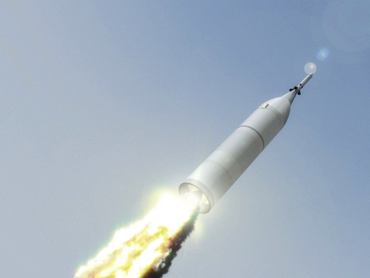
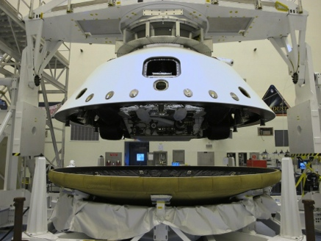

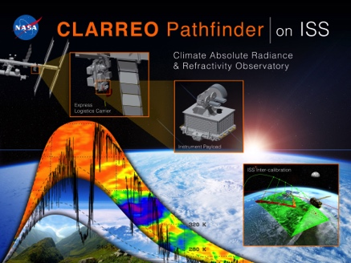
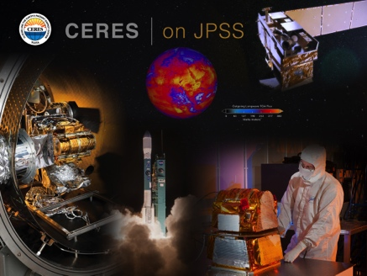
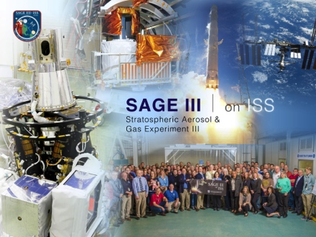
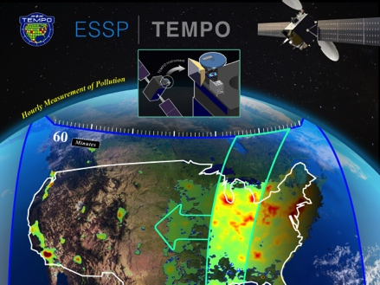
Current FPD Projects
HEOMD
  ARRM CapM-CRS
  Orion LAS
  Orion AA-2 Flight Test Articles
STMD
  MEDLI-2
SMD ESD
  CLARREO
  RBI
  CERES FM6
  SAGE III
  TEMPO Mission
  TEMPO Instrument
The LaRC ARRM CAPM-CRS Project is providing the Capture Module Contact and Restraint Subsystem (CRS)
MEDLI2 complements and extends the MEDLI (MSL) measurements with additional heatshield observation locations, inclusion of supersonic aerodynamics, and backshell aerothermal and pressure observations.
Orion Ascent Abort-2 Flight Test Articles
The Orion AA-2 FTA Project to Provide CM (CM3) & GSE, LaRC to Provide Separation Ring & GSE
and Platforms for SLC-46 Mobile Access Structure
MEADS
CLARREO attacks the largest climate feedback uncertainties
SAGE III is the Pathfinder for Earth Science Observations from ISS

Slide 10
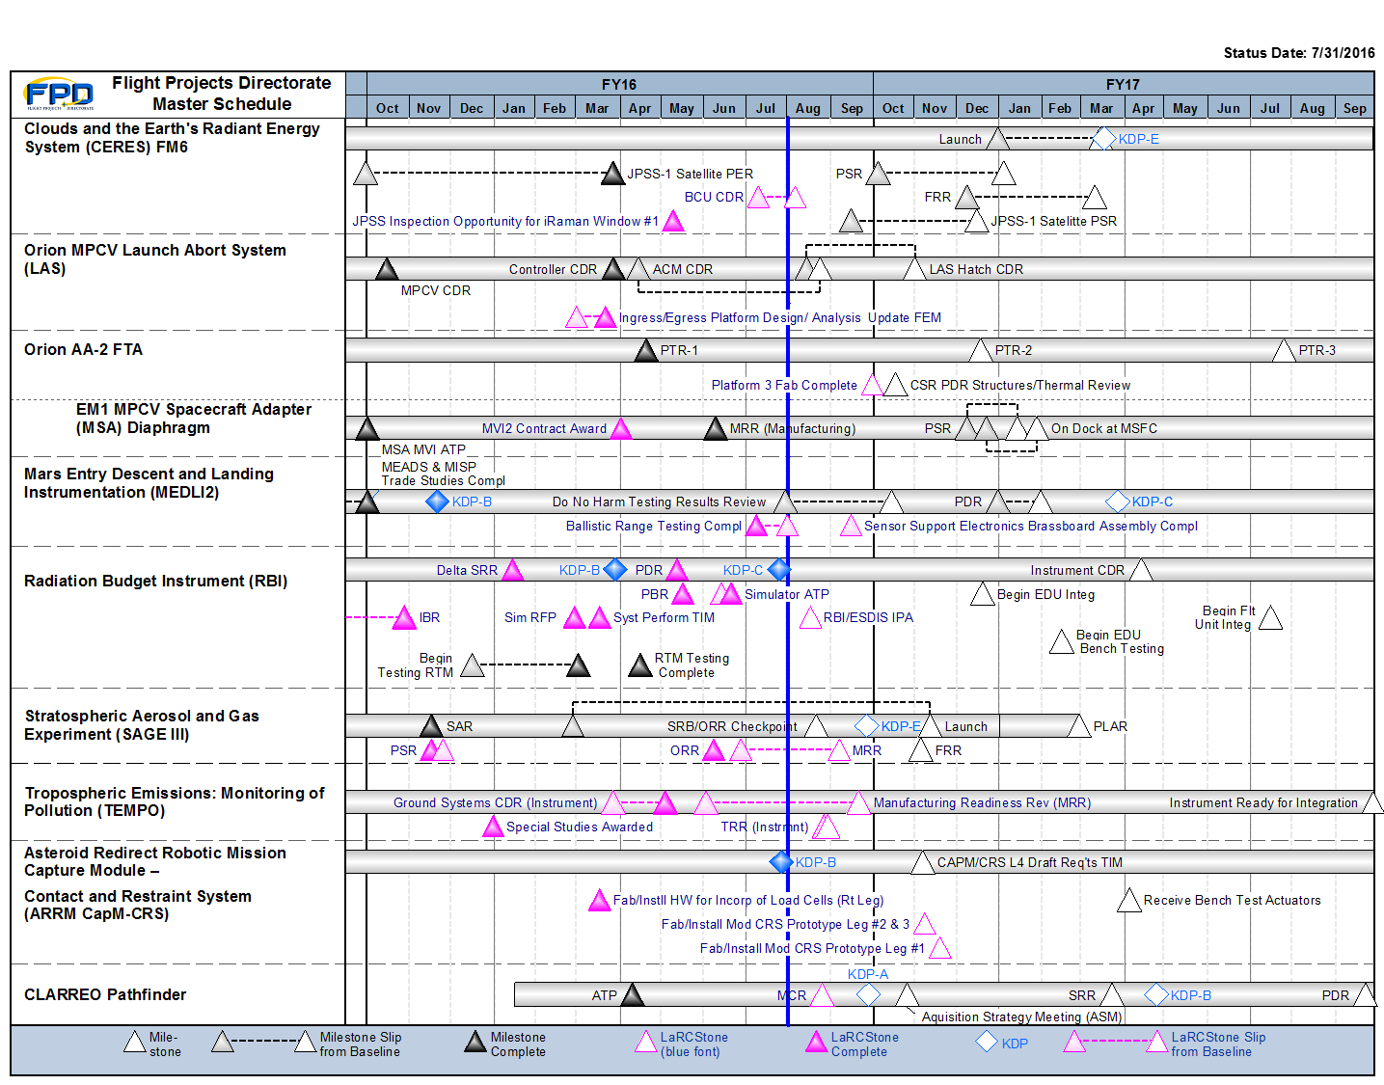
FPD Integrated Master Schedule

Slide 11
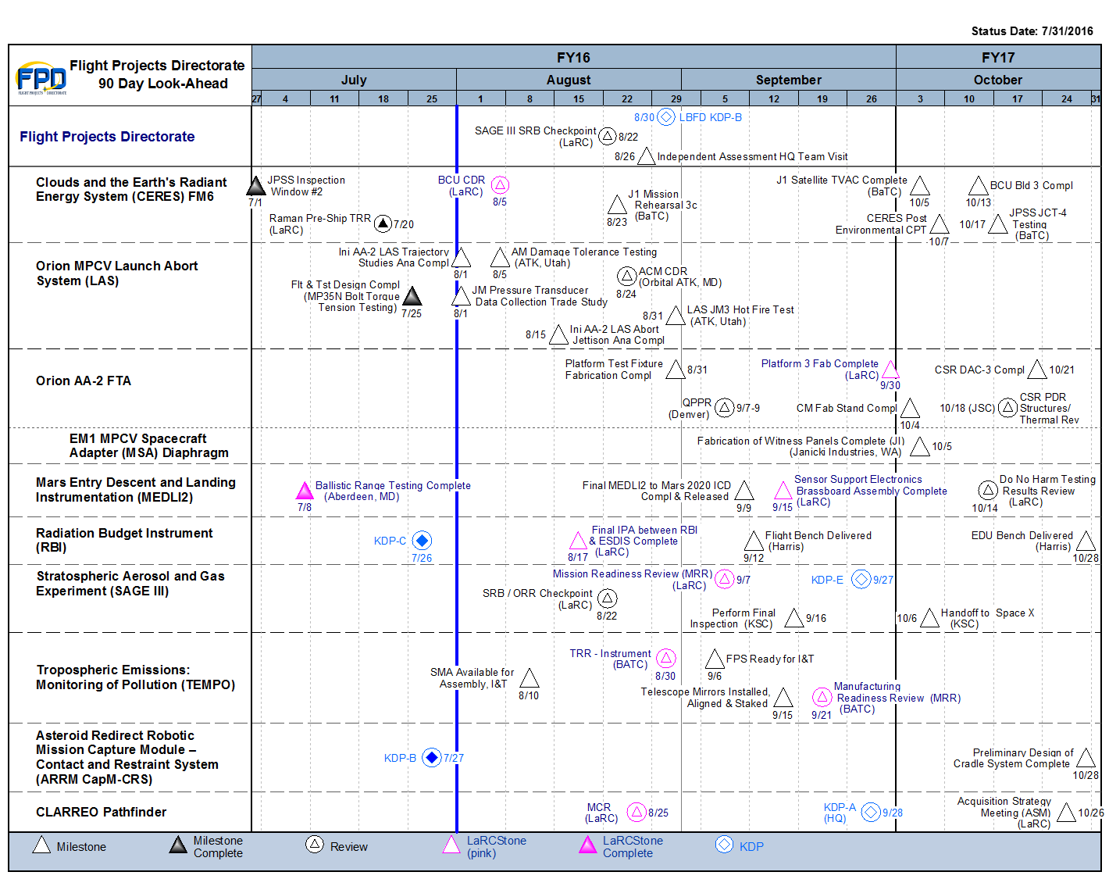
FPD Project Life Cycle Schedule

Slide 12
Practices & Processes
Develop practices and processes to ensure that projects don’t reinvent how to manage projects
Using best practices from various sources
Implemented
  LaRC Space Flight Projects Practices Handbook is the portal into those best practices (LPR 7120.5)
  Configuration Management Requirements (LPR-8040.1) — configuration management is extremely important for our products
  Customer Satisfaction
  Project Implementation Process
  We encourage feedback on FPD practices and processes

Slide 13
FPD Pipeline
Pipeline for Project Managers
  Discipline Lead ⇒ Project Systems Engineer ⇒ Project Manager on a Small Project or Deputy Project Manager on a Large Project
  Deputy Project Manager on a Large Project or Project Manager on a Small Project ⇒ Project Manager on a Large Project
  Training (classes, assignments to SMO, SMAO, and other Centers)
Pipeline for Deputy Project Managers for PP&C
  Program Analysts ⇒ Program Analysts ⇒ Deputy Project Managers for PP&C
  Training (OJT, APPEL and LaRC-specific PP&C modules, participate on Agency Teams)

Slide 14
Discussion Topics
4) Issues from your point of view: Tailoring
  Delegation of authority: more authority to ESD for decision making and action on small Cat3/Class D projects. It seems the decision-making hierarchy within SMD is not commensurate with the intent of small Cat3 / Class D projects.
  Apparently conflicting desires from different HQ organizations Robert and Lesa’s efforts to simplify and streamline and how there appears to be a disconnect on that topic between ESD and flight project implementation.
  How many overseers are needed? The Project Office oversees an instrument development. The Center oversees the PO. Then the SRB is independent overseer. Then the program office oversees the project. Then ESD oversees the project.

Slide 15
Discussion Points
Process questions that you may have and suggested change: Tailoring and transmitting SMD/ESD policies
  CLARREO Pathfinder HQ Acquisition Strategy Meeting for a sole source procurement for approximately $25M
  Suggested Change: No ASM required for CLARREO Pathfinder and future similar projects
  SMD management handbook and Office work instructions: can the PE’s summarize SMD/ESD policies and expectations for PM’s early in the preformulation process?

Slide 16
Questions?

Slide 17
Discussion Points
Aspirations for the future
  More flight project work at Langley Research Center
  HQ-SMD/ESD and the Program Offices have high confidence in LaRC flight project management and execution
  Continued improvement at ESMPO in the philosophy of “adding value” for successful flight project execution (seems like this has been headed in the right direction – keep it going)

Slide 18
BACKUP

Slide 19
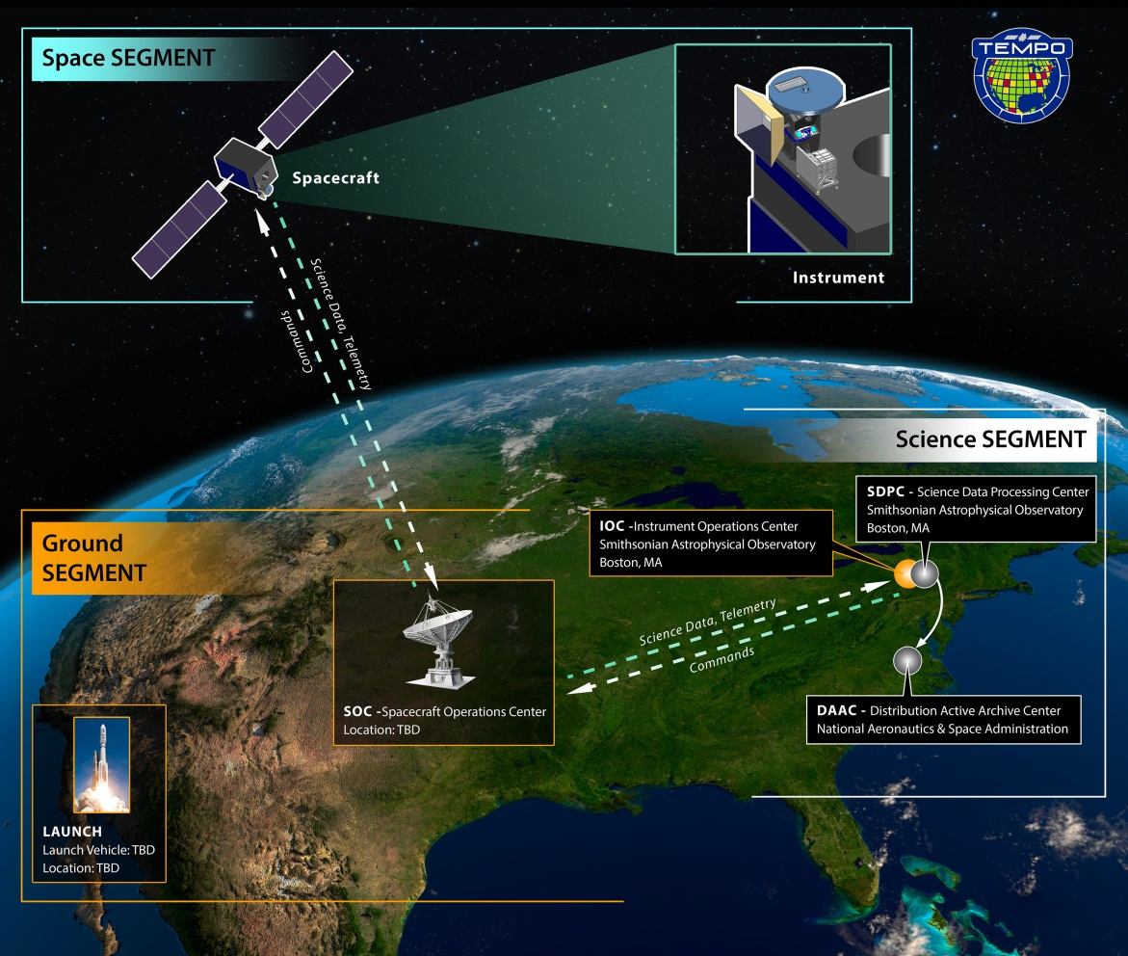
TEMPO Mission Overview
Description: Procure commercial satellite hosting for the TEMPO Instrument including integration and test, launch services, and on-orbit operations support while also serving as a pathfinder for the USAF/SMC hosting contract
Launch: NLT Dec 2021
LaRC Responsibilities: TEMPO Mission develops contracting documents (SOW/CDRLs/Requirements), establishes evaluation criteria, and performs technical assessment of proposals.
TEMPO Mission technically manages host satellite integration through on-orbit operations
Project Team
Smithsonian Astrophysical Observatory: Principal Investigator: Dr. Kelly Chance
NASA Langley: Project Management, Systems Engineering, SMA
  Project Manager: Stephen Hall
USAF Space and Missile Systems Center (SMC): Hosted Payload Solutions (HoPS) Contract Administrator
Ball Aerospace Technologies Corporation: Instrument Manufacturer and Integration Support
Host Spacecraft Vendor: TBD

Slide 20
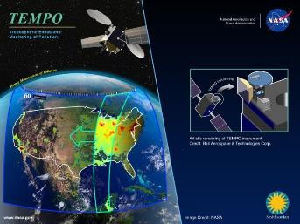
Tropospheric Emissions:
Monitoring of Pollution (TEMPO)
Science Objectives:
Collect simultaneous high temporal and spatial resolution measurements of pollutants over Greater North America (GNA)
Measure the key elements in tropospheric ozone chemistry and aerosol cycles
Observe aerosols and gases for quantifying and tracking evolution of pollution
Integrate observations from TEMPO and other platforms in models to improve representation of processes
Serve as the North American geostationary component of an international constellation for air quality monitoring
Determine the diurnal instantaneous radiative forcings associated with pollutants and other climate agents on the continental scale.
Project Approach:
Earth Venture Instrument-1
Responds to the NRC Decadal Study element of GEO-CAPE
Examine Tropospheric air-pollution from space
Measurements built on heritage from 5 spectrometers flown in LEO, operational algorithms
  TEMPO imaging grating spectrometer
  Targeted for hosting on GEO satellite nadir deck mounted for viewing GNA
  Low resource requirements, ensuring flexibility
  NASA Cost Capped, Schedule constrained
Project Team
Smithsonian Astrophysical Observatory- Principal Investigator, Science Team, Science Data Processing, Instrument Ops Center
  Principal Investigator: Dr. Kelly Chance, Deputy PI: Dr. Xiong Liu
NASA Langley -Project Management, Systems Engineering, Safety/Mission Assurance
  Project Manager: Wendy Pennington
Instrument Provider: Ball Aerospace Technologies Corporation
Science Team and International Science Advisory
NCAR, Harvard, St. Louis U., UC Berkley, U Alabama, GSFC, NOAA, EPA, Carr Astro, Dalhousie U.; GEO Instruments GEMS, Sentinel-4 & PHEOS

Slide 21
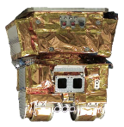
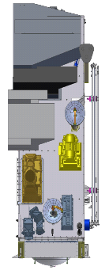
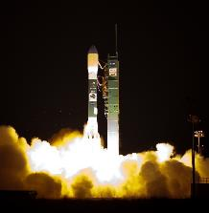
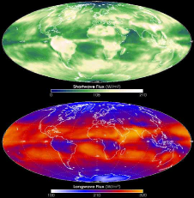
CERES FM6 Instrument Overview
Project Mgr: Robert Estes
Contractor Team: Northrop-Grumman Aerospace Systems (NGAS)
Partners: NOAA/GSFC/JPSS providing spacecraft
Goal: Produce long-term climate data records of radiation budget at the top-of-atmosphere (TOA), within the atmosphere, and at the surface with consistent cloud and aerosol properties at climate accuracy.
LCC: FM6 development, delivery, & post-delivery support thru L+90 = $86M
FM6 Simulators for FVTS = $5.86M
CERES scanning radiometer measuring three spectral bands at TOA
  Total (0.3 to >50 µm)
  Shortwave (0.3 to 5.0 µm)
  Longwave (5 to 50 µm)
Operations, Data Processing, Products, and Science are a continuation of experience developed on
  TRMM (1), EOS Terra (2), EOS Aqua (2), and S-NPP (1)
CERES
CERES Instrument Heritage
Primary CERES Data Products
TRMM – PFM
Launch 11/1997
Terra – FM-1 / FM-2
Launch 12/1999
Aqua – FM-3 / FM-4
Launch 05/2002
S-NPP – FM-5
Launch 10/2011
Reflected Solar Energy
Emitted Thermal Energy
CERES
JPSS-1

Slide 22
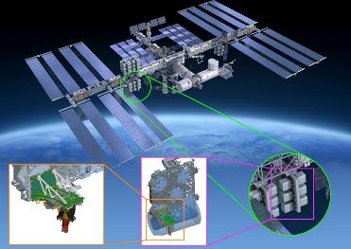
SAGE III/ISS
Science Objectives:
SAGE III/ISS will extend the SAGE climate record of ozone, aerosols & water vapor providing scientists with data necessary for:
  Assessing long-term changes in ozone & aerosol
  Modeling geophysical variability
  Understanding how to combine various methods for measuring aerosols
  Assimilation & reconstruction of fields of long-lived species
Project Approach:
Responds to U.S. Clean Air Act mandate that NASA monitor ozone
Examine stratospheric ozone and aerosols from space
Measurement technique built on heritage from three previous SAGE instruments flown on free-flying satellites
  SAGE III grating spectrometer
  Launch on SpaceX in 2016; mounted to International Space Station- ISS inclined orbit provides excellent global measurement coverage
  Class C Science Mission Directorate Instrument; Governed by NPR: 7120.5E
  Formulation $25.3M; Development $88.6M; Operations $15.8M; Total $129.7M *Full cost (including CS labor)
Project Team
NASA Langley Research Center: Project Manager Mike Cisewski; Project Scientist Joe Zawodny
Instrument Provider: Ball Aerospace Technologies Corporation
Contractor Team: SSAI, AMA, TEAMS2
Partners: ESA/Thales Alenia -- Hexapod (via ISS Program)
Center Participants: GSFC, JSC, MSFC, KSC, GRC
Science Utilization Team: Hampton University, NOAA ESRL, NASA GSFC, NWRA, NCAR, University of Maryland, STC, Johns Hopkins University, Harvard University

Slide 23
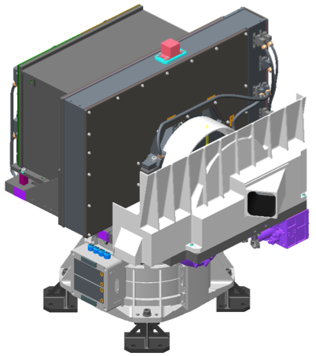
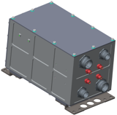
Radiation Budget Instrument (RBI)
A New Instrument developed as a Follow-on to the CERES Instruments
Science Goal
Provide an instrument to support global climate monitoring by continuing the sequence of Earth Radiation Budget (ERB) measurements obtained by NASA and NOAA over the past thirty years
Instrument Description
  A three-telescope broadband scanning radiometer designed to measure the solar reflected and Earth emitted thermal radiation at the top of the atmosphere
  Electrically redundant design to meet Level 1 life and reliability
  Flight calibration Sources
    Infrared Calibration Target,
    Visible Calibration Target,
    Solar Calibration Target,
    space views,
    and Lunar views
  Each telescope utilizes redundant thermopile detectors
  Partnerships and Teams
  NASA/NOAA Partnership
  NOAA accommodates RBI on the JPSS-2 satellite
  NASA provides RBI instrument & support through spacecraft I&T and launch/activation
NASA Langley – Project Manager: Alan Little
  Manages prime contractor development of RBI instrument, provides management, technical, and mission assurance insight and oversight; provides support to spacecraft I&T thru launch and early on-orbit checkout (thru Phase D); develops L0-L1 science algorithms
  Hand-over and release of RBI instrument ownership by RBI Project occurs at the JPSS-2 Operational Hand-over Review (OHR)
Instrument Provider: Harris Corporation
  RBI prime contractor with sub-contractors providing key elements and support (SDL for Calibration, JPL for Thermopile Detectors, Sierra Nevada for Azimuth Rotation Module)
Characteristics:
  Life at 85%: 3 years ground + 7 years on orbit (minimum mission is 6 years on-orbit)
  Risk Class B, Category 2
  Spectral Range: ~ 320 nm – 100+ microns
  Field of View (FOV): ~1.3 x 2.6 degrees (~19 x 37 km at nadir)
  Geolocation: < 2.5 km at nadir
  Data Interface: MIL-STD-1553
    Rate: ~50 kbps (CBE) / <300 kbps (allocation)
  Mass: ~76 kg (CBE) / 90 kg (allocation)
  Power: ~67 W (Cross-track mode)
  Envelope: ~815x640x375 (circular) mm³

Slide 24
