Slide 1
IndEcol
USGS Seminar, Reston, 24 March, 2016
Mapping and forecasting global material cycles
Daniel B. Müller
Trends and drivers
4 dimensions of analysis
Illustration with examples of aluminium and iron
MinFuture project

Slide 2
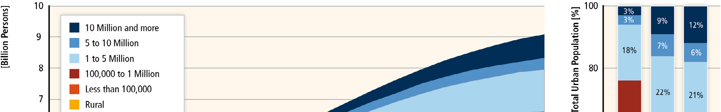
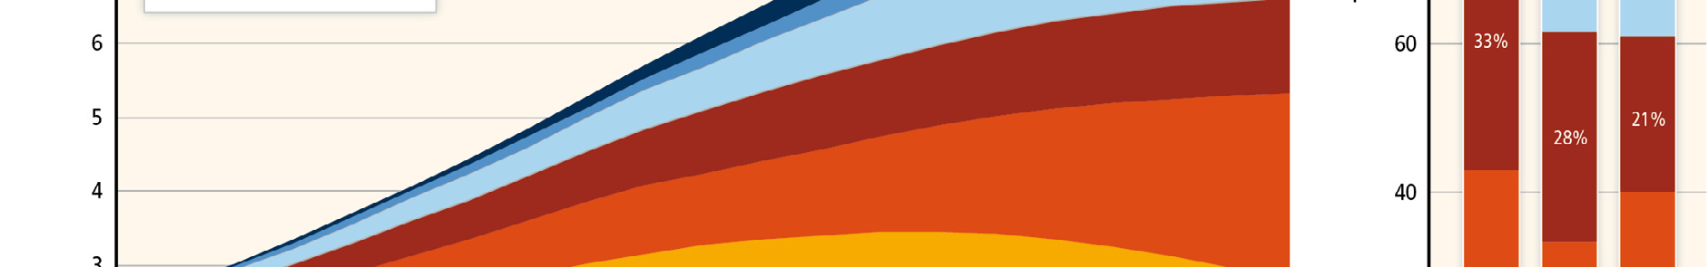
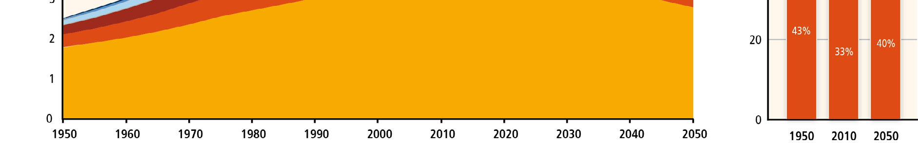
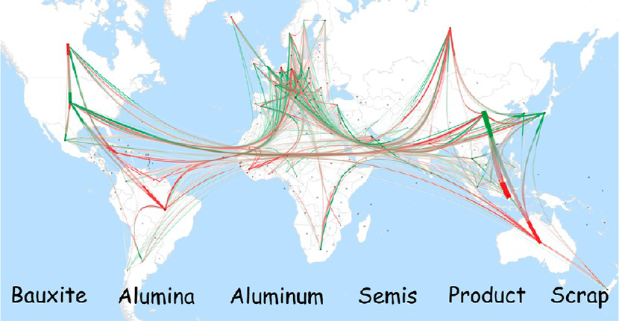
Three key drivers for global material cycles
1. Population growth and
urbanization / industrialization
→ Moves materials from the ground into use
2. Globalization
→ Moves materials around the world
3. Climate change & sustainable development
→ Incentives for recycling and clean energy

Slide 3
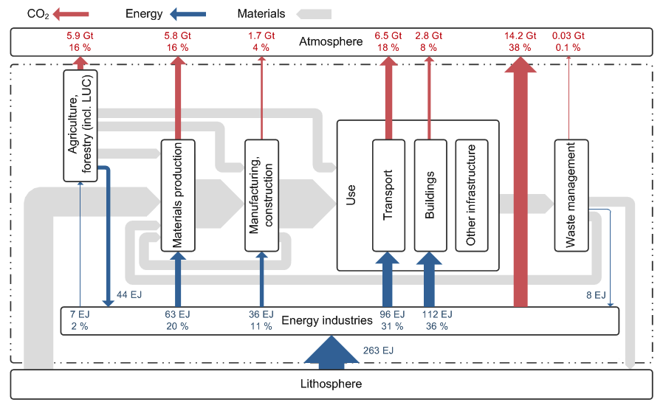
Linkages between materials, energy, and emissions:
“socio-economic metabolism”
Data sources for 2008:
Emissions: EDGAR
Energy: IEA
Müller et al. 2013
1. The socio-economic metabolism shapes the quality of our life
(services provided by stocks in use and environment)
2. Current socio-economic metabolism is not sustainable:
- poverty / inequality (lack of access to essential services)
- resource depletion, limited sinks for pollutants
3. Sustainable development requires transformation of socio-metabolic system
→ from design of processes/products to design of systems

Slide 4

4 dimensions of analysis
Stages
Trade
Linkages
Time

Slide 5
1. Stages

Slide 6
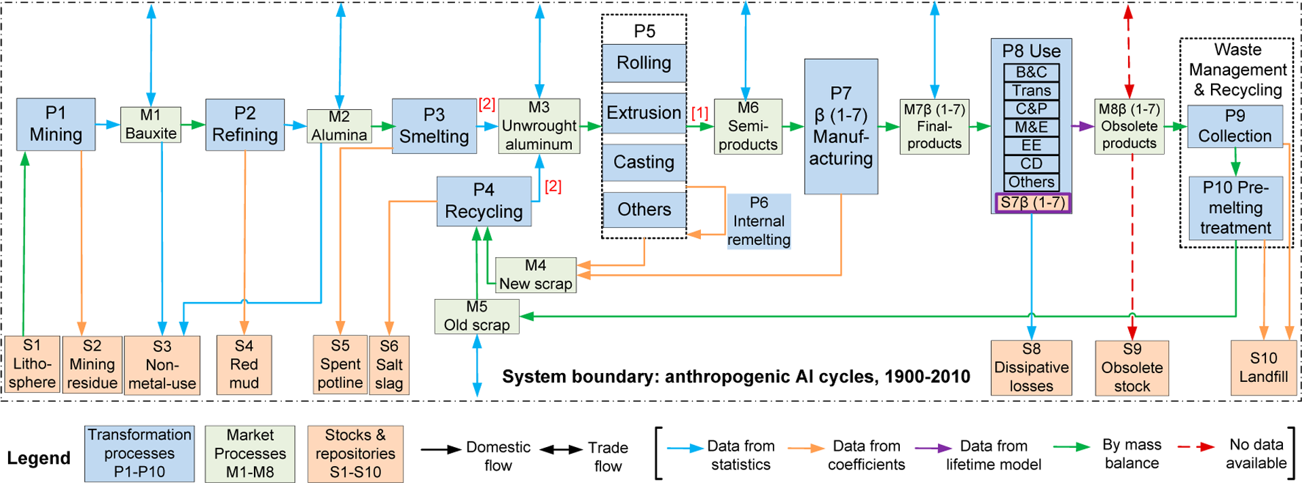
1. Stages of the aluminium cycle
Source: Liu and Müller (2012)

Slide 7
1. Stages of the aluminium cycle
Source: Liu and Müller (2012)
Main Al sources for the future

Slide 8
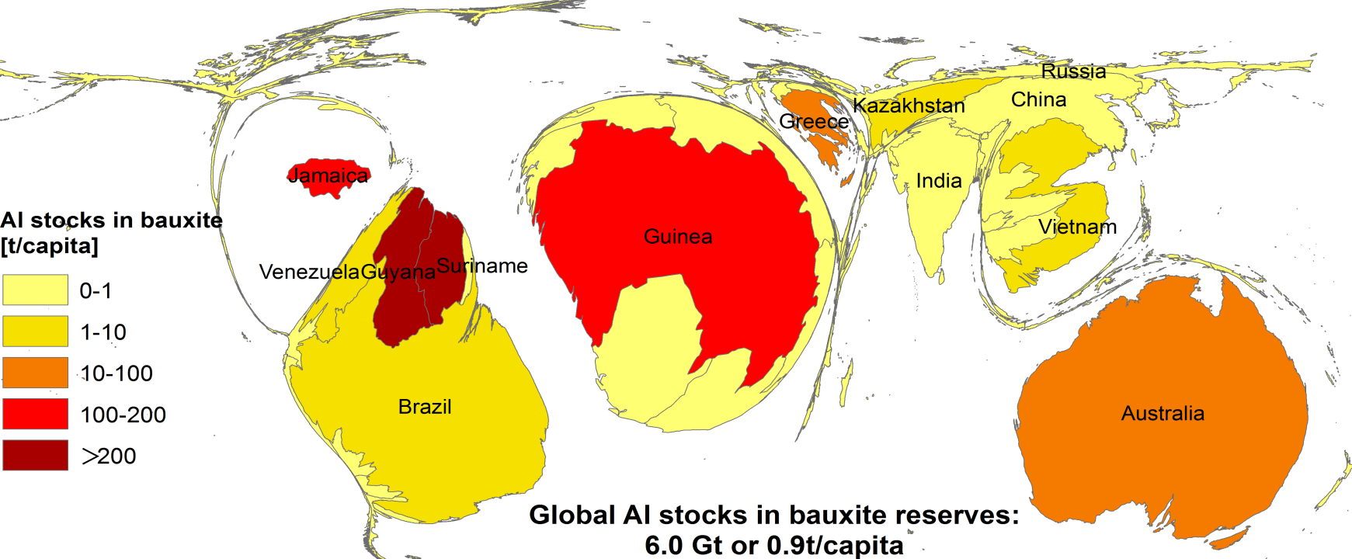
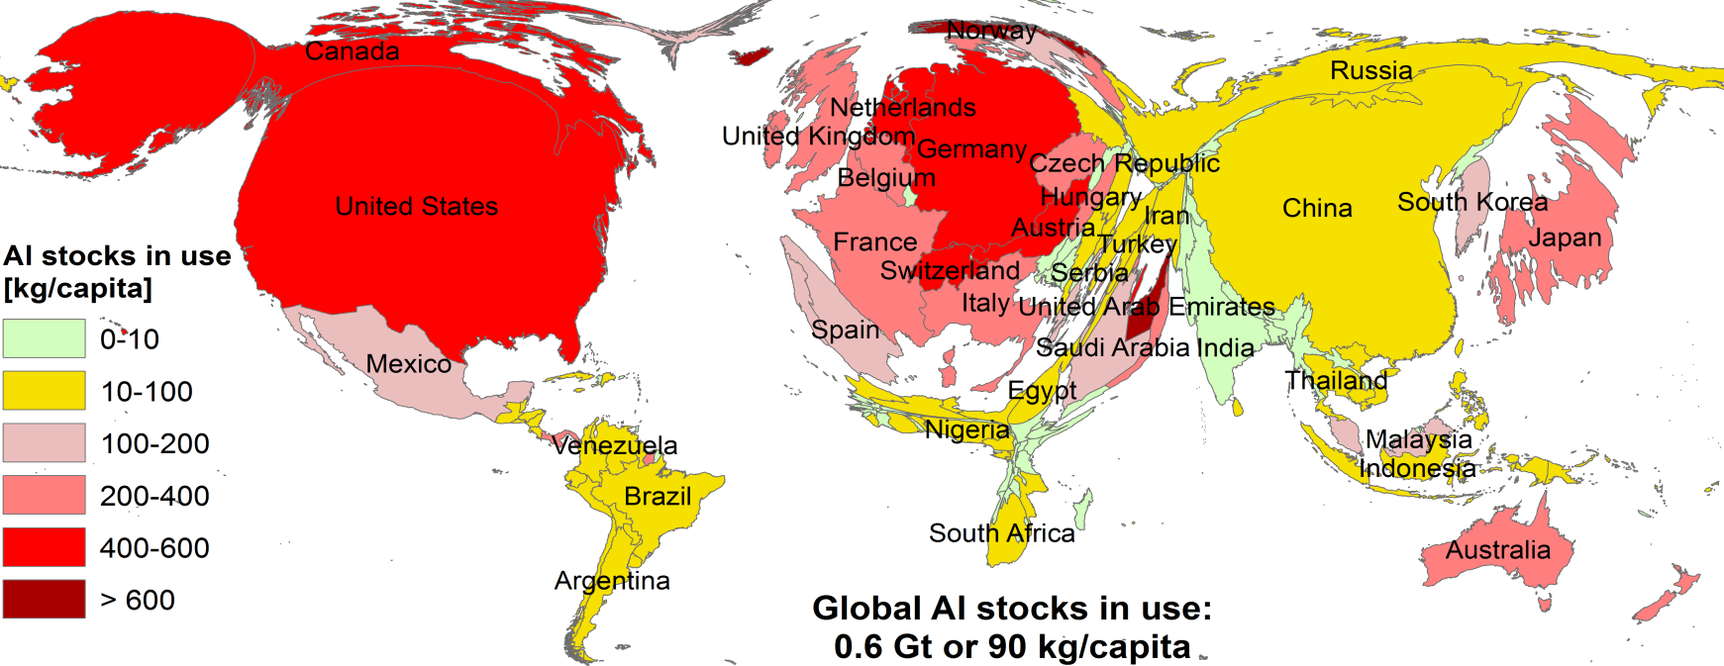
Aluminium stocks under and above ground (2010)
Source: Liu and Müller (2012)

Slide 9
2. Trade

Slide 10
System definition for trade-linked aluminium cycle
Source: Liu and Müller (2013)

Slide 11
Global trade in Al-containing products, 2008
Source: Liu and Müller (2013)
Global Al cycle relies significantly on trade (twice the production in 2008)
Main exporters tend to be mining countries, main importers tend to be main
consuming countries

Slide 12
Trade-linked global aluminium cycle (2008)
Specialization of countries
in different stages of the cycle
Consequences for metal
services and environmental
impacts
Tendency:
- mining in few poorer countries
- production in energy countries
- consumption in growing and
rich countries
- obsolete scrap generation in
rich countries

Slide 13
3. Time
https://www.jasondavies.com/truthstudio/

Slide 14
Linkages with energy and GHG emissions

Slide 15
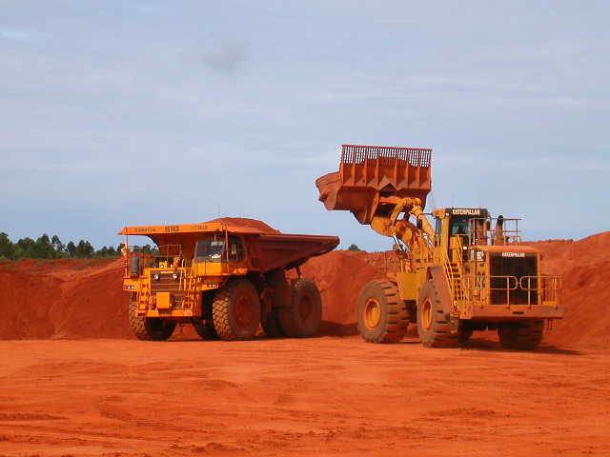

Climate change mitigation options for the Al industry
Twin-challenge
1. Growth in demand expected (factor 3-4)
2. Reduction in GHG emissions required to reach 2°C target (50-85% by 2050)
Emission (E) = Production (P) * emission per ton (e)
E → /2 (-50%)
P → *3
e → /6 (-85%)
→ Process efficiency in primary production alone: impossible
→ Recycling: reduces energy use by over 90%...
- Al stocks in use approach saturation
- Achieve a 100% recovery of scrap
- Resolve quality challenge (accumulation of alloying
elements)
Industry
Notes:
Emissions cut compared to level of 2000

Slide 16
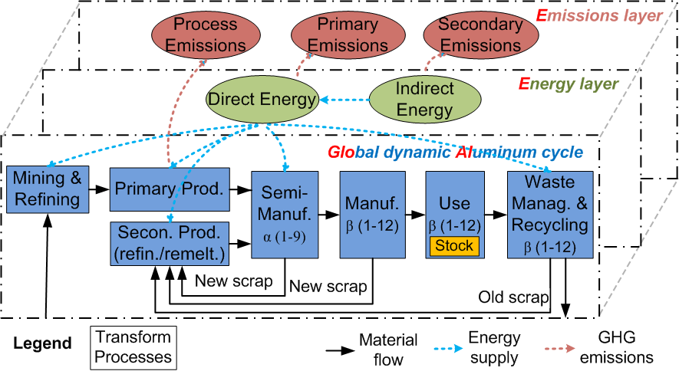
Three layers approach
Source: Liu, Bangs, and Müller (2012): Nature Climate Change
Notes:
Process emissions: e.g. PFC emissions in smelting (fluorcarbons, perfluorcarbons)
Primary emissions: e.g., CO2 emissions from use of hard coal in bauxite refining
Secondary emissions: e.g. CO2 emissions from electricity production

Slide 17
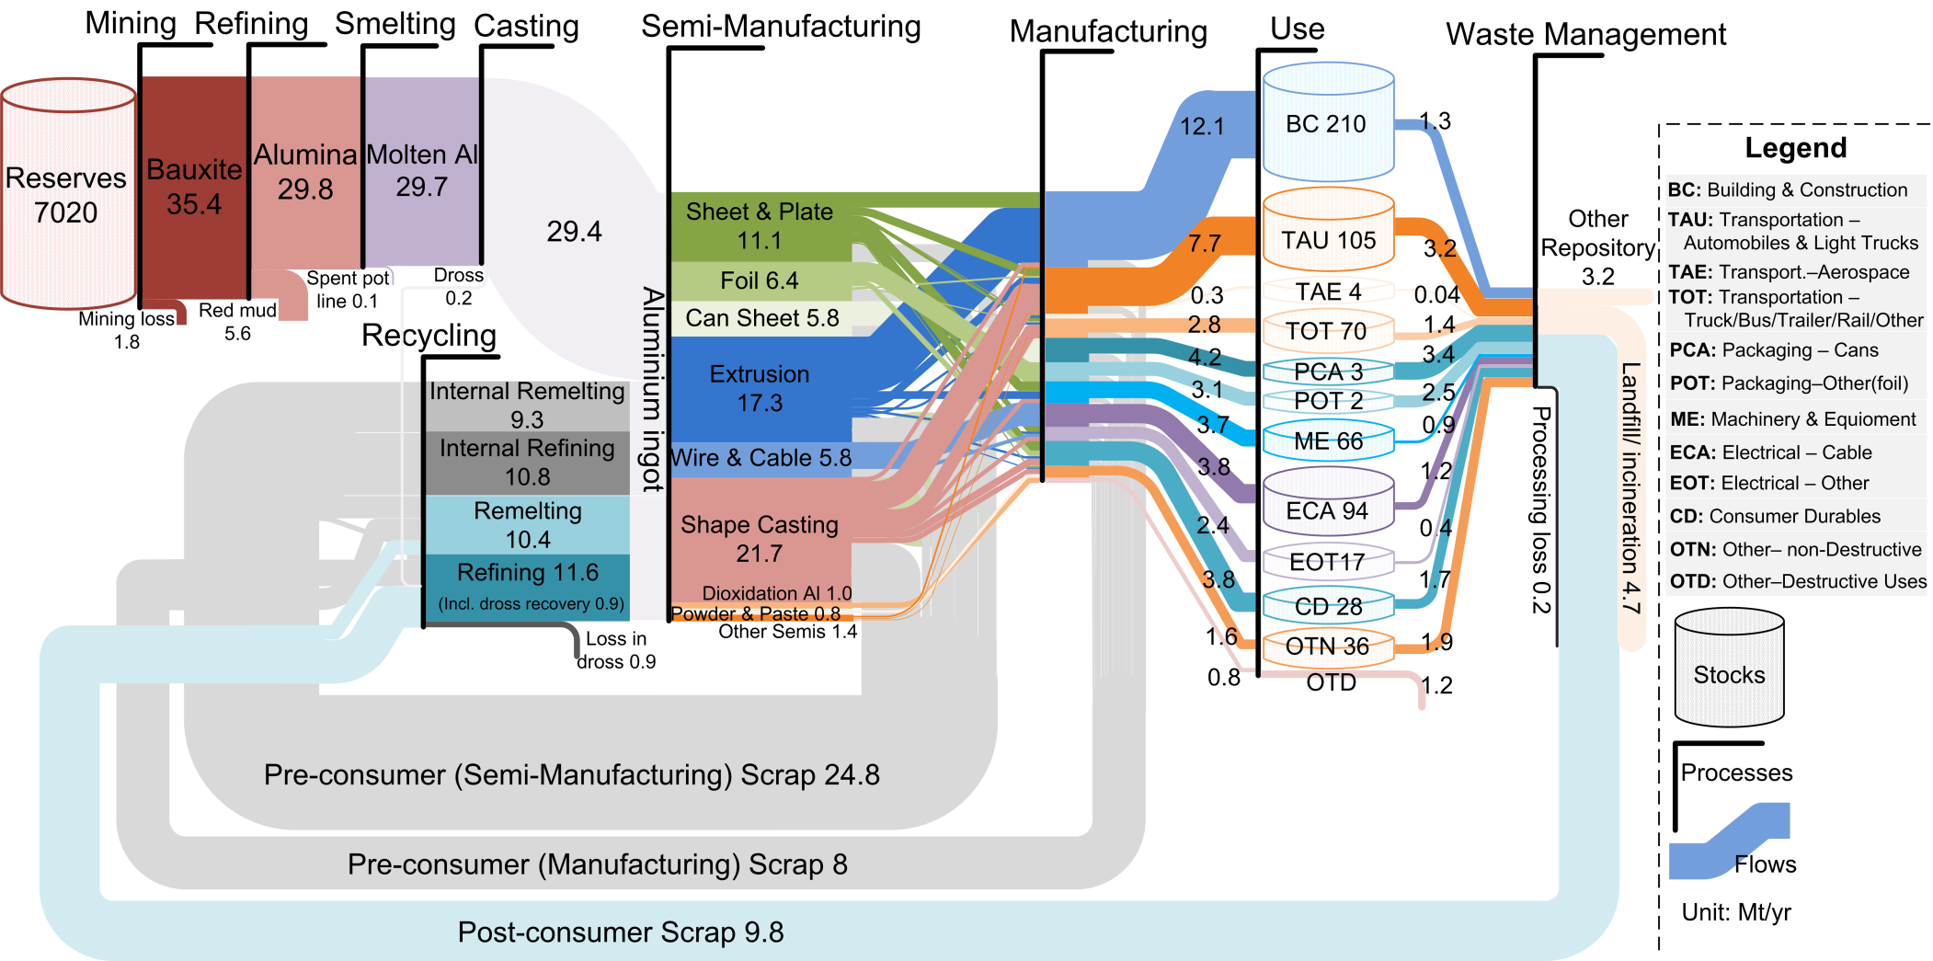
Global anthropogenic metallurgical Al cycle in 2009
Source: Liu, Bangs, and Müller 2012: Nature Climate Change

Slide 18
GHG emissions of the global Al cycle in 2009
(Mt CO₂-eq)
Source: Liu, Bangs, and Müller 2012: Nature Climate Change

Slide 19
How do we calculate future emissions?
Al stock patterns
Al flows
Material efficiency
Energy flows
Energy efficiency
Emission flows
C intensity of energy
Process emission
efficiency

Slide 20
Historical country-wise and
future global stock patterns (scenarios)
Source: Liu, Bangs, and Müller 2012: Nature Climate Change

Slide 21
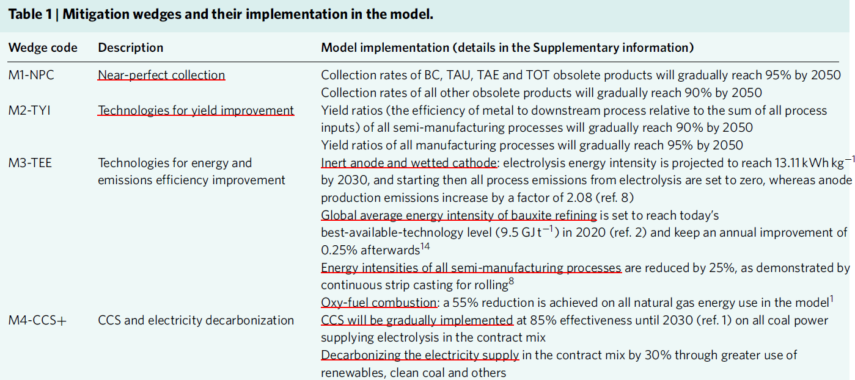
Mitigation wedges and their implementation in the model

Slide 22
GHG emission pathways and mitigation wedges
for the nine dynamic stock scenarios
Source: Liu, Bangs, and Müller 2012: Nature Climate Change
M1: Near perfect collection
M2: Technologies for yield improvement
M3: Technologies for energy and emissions efficiency improvement
M4: CCS and electricity decarbonization

Slide 23
Linkages with other metals – alloying

Slide 24
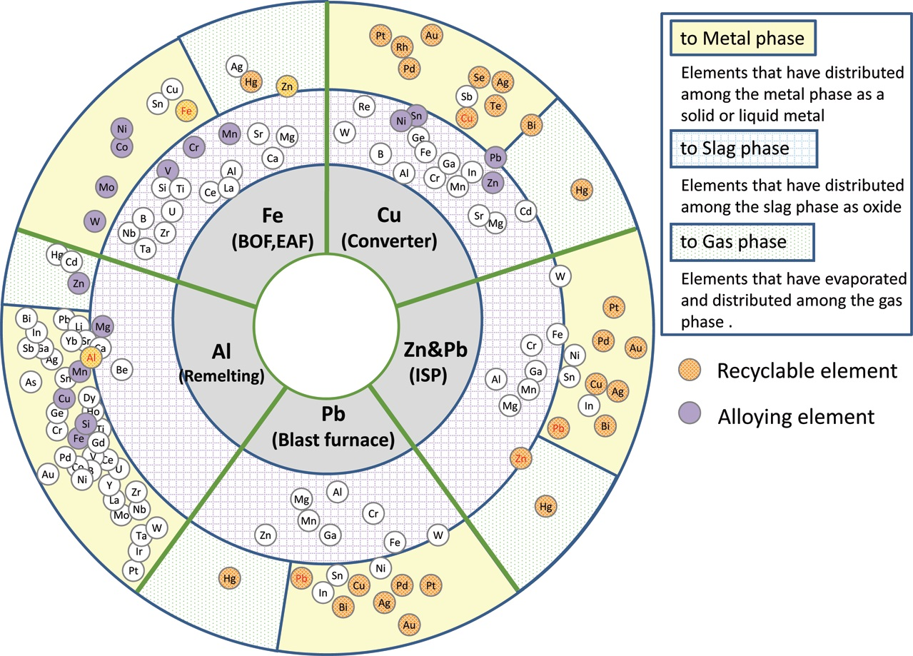
Thermodynamic challenges of Al recycling
Source: K. Nakajima et al. (2010)
Removal of metal impurities is not thermodynamically favoured
Aluminium will tend to oxidize before other metals
There are technologies that work (e.g. electrochemical, directional solidification)
but they are too energy intensive (similar to primary production)
➔ Sorting and blending are critical for Al recycling

Slide 25
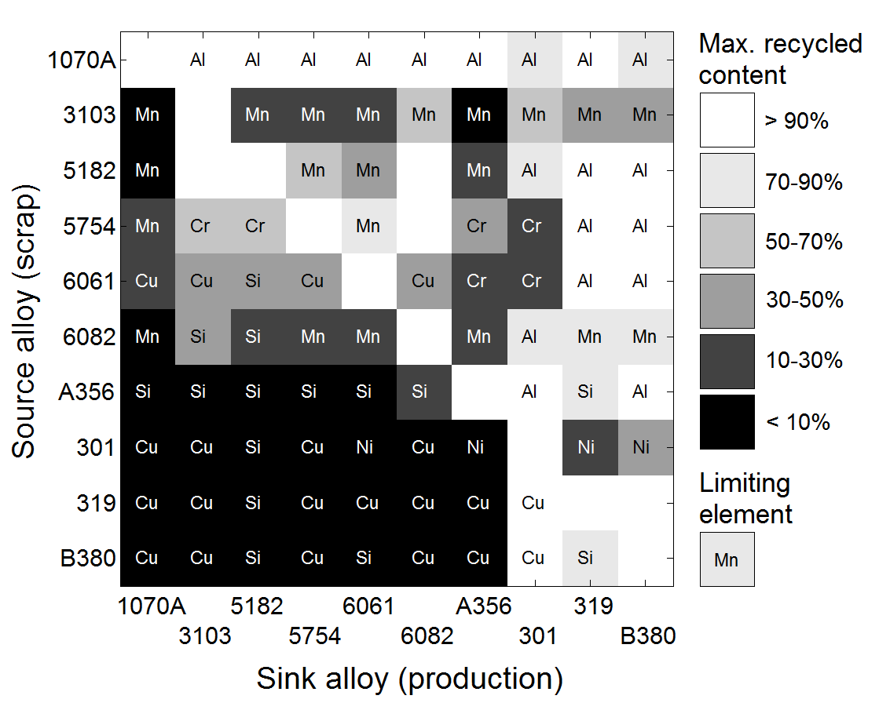
Alloy recycling diagram
Typical automotive alloys
Source: Løvik, Modaresi and Müller (2014)
Notes:
This diagram illustrates the difficulty of recycling scrap of a source alloy into a different sink alloy
Assume we want to produce an alloy (the sink alloy) using recycled material
Scrap is available as alloys (the source alloys)
How much of each source alloy (recycled content) can go into the production of a sink alloy, assuming that the non-recycled metal is available as pure elements?
Maximum recycled content for a given recycling path is indicated by color
Black → almost no recycling possible
White → (almost) full recycling possible
The element that constrains recycling is indicated within each square
Even Al can be a limiting factor, e.g. when producing B380, less than 85% of it should be Al, while 1070A contains more than 99% Al.
Calculations were done by assuming:
Source alloys have concentrations in the middle of the range given by AA specifications
Sink alloys have upper concentration limit as defined in AA specifications
Magnesium is not considered as a limiting factor
The following elements are considered: Al, Si, Fe, Cu, Mn, Cr, Ni, Zn, Ti

Slide 26
Alloy recycling diagram
Typical automotive alloys
1070A is a good source…
… but a bad sink
Source: Løvik, Modaresi and Müller (2014)
Notes:
This diagram illustrates the difficulty of recycling scrap of a source alloy into a different sink alloy
Assume we want to produce an alloy (the sink alloy) using recycled material
Scrap is available as alloys (the source alloys)
How much of each source alloy (recycled content) can go into the production of a sink alloy, assuming that the non-recycled metal is available as pure elements?
Maximum recycled content for a given recycling path is indicated by color
Black → almost no recycling possible
White → (almost) full recycling possible
The element that constrains recycling is indicated within each square
Even Al can be a limiting factor, e.g. when producing B380, less than 85% of it should be Al, while 1070A contains more than 99% Al.
Calculations were done by assuming:
Source alloys have concentrations in the middle of the range given by AA specifications
Sink alloys have upper concentration limit as defined in AA specifications
Magnesium is not considered as a limiting factor
The following elements are considered: Al, Si, Fe, Cu, Mn, Cr, Ni, Zn, Ti

Slide 27
Alloy recycling diagram
Typical automotive alloys
319 is a good sink…
… but a bad source
Source: Løvik, Modaresi and Müller (2014)
Notes:
This diagram illustrates the difficulty of recycling scrap of a source alloy into a different sink alloy
Assume we want to produce an alloy (the sink alloy) using recycled material
Scrap is available as alloys (the source alloys)
How much of each source alloy (recycled content) can go into the production of a sink alloy, assuming that the non-recycled metal is available as pure elements?
Maximum recycled content for a given recycling path is indicated by color
Black → almost no recycling possible
White → (almost) full recycling possible
The element that constrains recycling is indicated within each square
Even Al can be a limiting factor, e.g. when producing B380, less than 85% of it should be Al, while 1070A contains more than 99% Al.
Calculations were done by assuming:
Source alloys have concentrations in the middle of the range given by AA specifications
Sink alloys have upper concentration limit as defined in AA specifications
Magnesium is not considered as a limiting factor
The following elements are considered: Al, Si, Fe, Cu, Mn, Cr, Ni, Zn, Ti

Slide 28
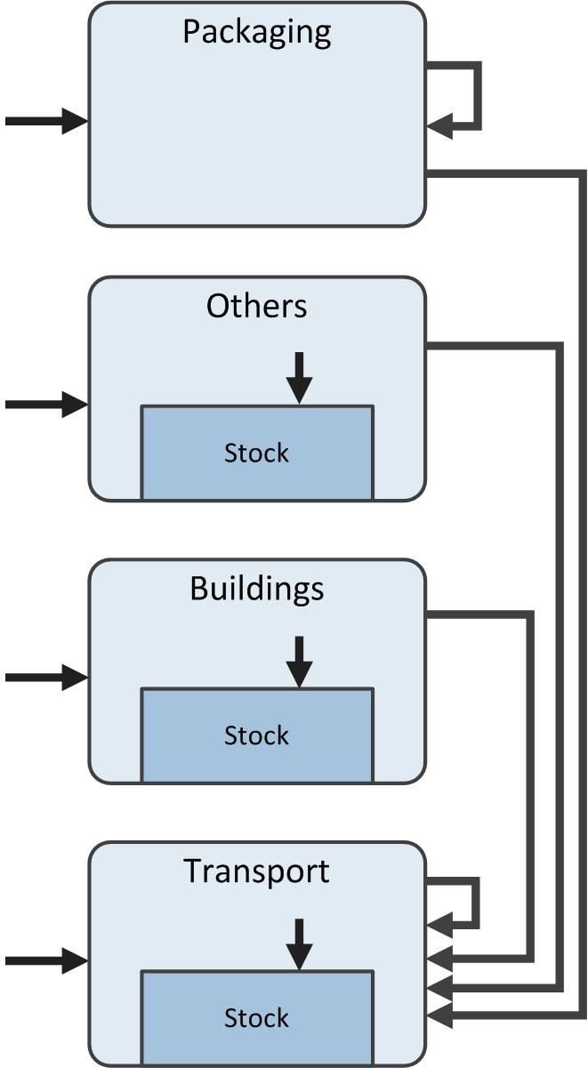
Today’s aluminium recycling system:
cascading use
The bottom reservoir is formed by
automotive secondary castings
(mainly engine parts).
Today, the cascading system is
economically and ecologically meaningful.
→ It makes use of all the metals
(aluminium, alloying elements,
other elements)
→ This saves alloying elements for
secondary casting
In the future, the same system with
the same resources may become
unsustainable.
→ Increasing amounts of scrap
→ Limited capacity of engine parts
to absorb this scrap
→ Scrap surplus?

Slide 29
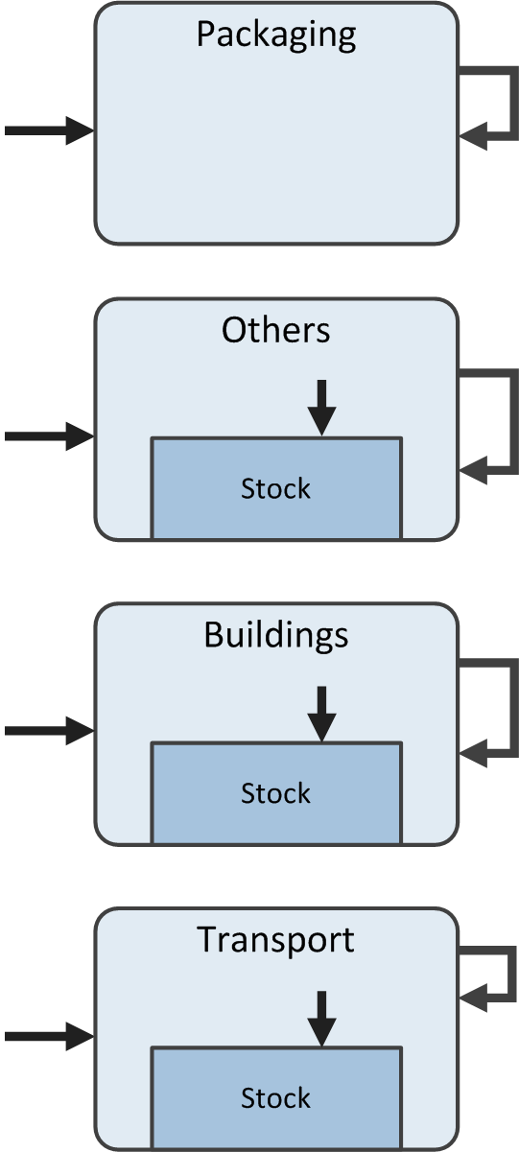
Tomorrow’s aluminium recycling system:
Closed alloy cycles?
A closing of alloy cycles would reduce
the amount of scrap to be absorbed by
automotive secondary castings.
→ Use scrap for alternative applications
(sinks)
How could this be achieved in the
transport sector?
→ Currently, there is a cascading use
of about 200 aluminium alloys used
in vehicles.

Slide 30
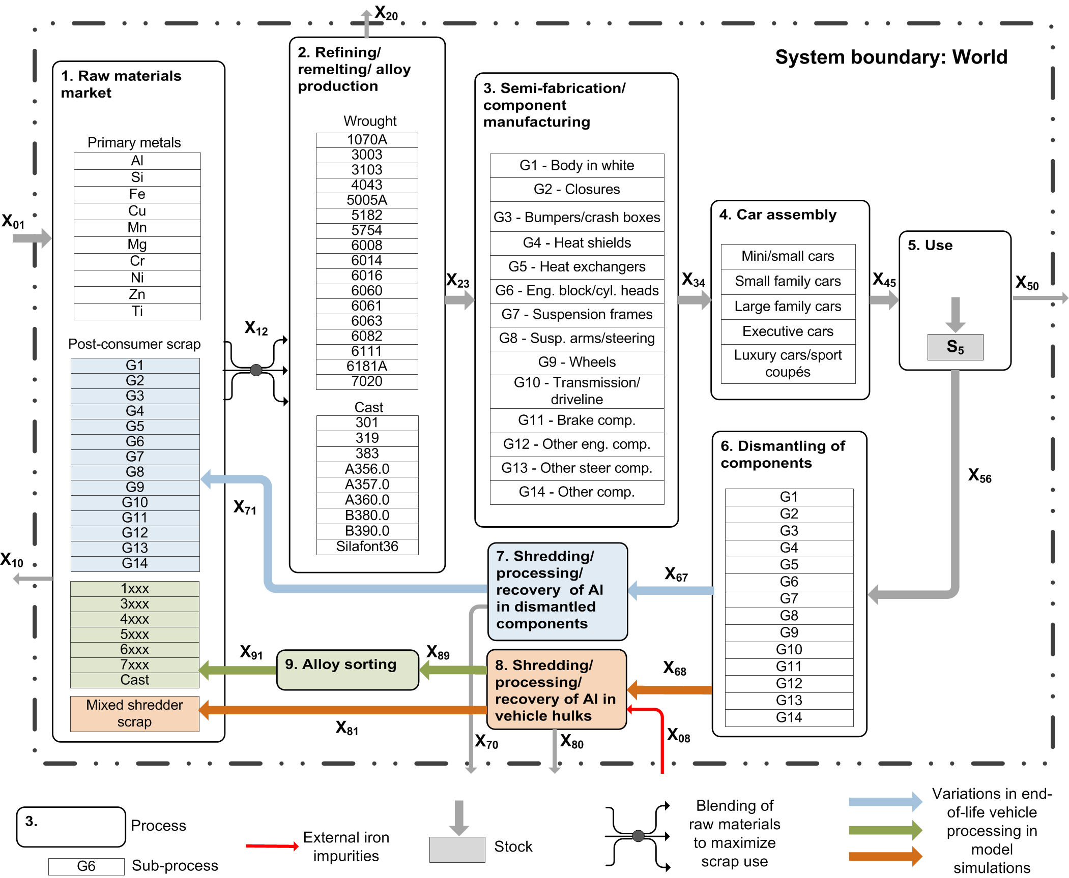
Automotive aluminium recycling model
Layered, dynamic MFA model of Al in vehicles
Tracing:
Components
Alloys
Elements
Blending to maximize scrap use within sector
System interventions:
Dismantling
Alloy sorting
Reduced alloy diversity
Scrap allowed in high purity cast alloys
Source: Løvik, Modaresi and Müller (2014)
Notes:
Model of the automotive sector
Why?
Identified as a critical sector because of:
Large diversity of alloys and applications
Home to the most important secondary cast alloys
The model tracks aluminium and 9 alloying elements through the production, use and recycling of automotive alloys and components worldwide. No geographical resolution. Time frame: 1900-2050.
In-use stock driving demand:
vehicles in use = population * vehicle ownership
Lifetime model → demand for vehicles
To calculate demand for alloys:
Segmentation (time dependent). E.g. small family cars, large family cars
Average weight of components (time dependent) per segment type
Recipe for alloys used as a function of component type (time independent). E.g. 90% of wheels produced from A356.0.
Dynamic model connects past production to future scrap availability (quantity and chemical composition)
Different types of scrap available:
Depends on level of dismantling for each component group
Assuming that dismantled parts are kept separate to obtain different scrap streams
What’s not dismantled goes into the «mixed shredded fraction»
Depends on whether alloy sorting is used or not
Different EOL strategies investigated in scenarios
Optimization at X12 to maximize utilization of scrap within the system
Scrap of different types are blended with primary metals to produce the right amount of each alloys (as given by demand), with compositions within limits defined in AA specifications
Optimization allows us to find possible new recycling paths
Assumptions
No new scrap
Assuming that new scrap is not a major limitation because it can relatively easily be sorted for closed alloy loop recycling
95% collection rate (ambitious)
90% shredder yield
92% remelting yield
Alloy and components use is based on European auto manufacturing technology. May overestimate the use of wrought aluminum.
Magnesium can be removed from process 2. Included as part of the optimization procedure, with cost equal to alloying element addition.
Alloy composition ranges are taken from standard designations. Elements with lower limit 0% are therefore underestimated.
Free iron contamination in mixed shredded scrap: X08=0.4% * X68

Slide 31
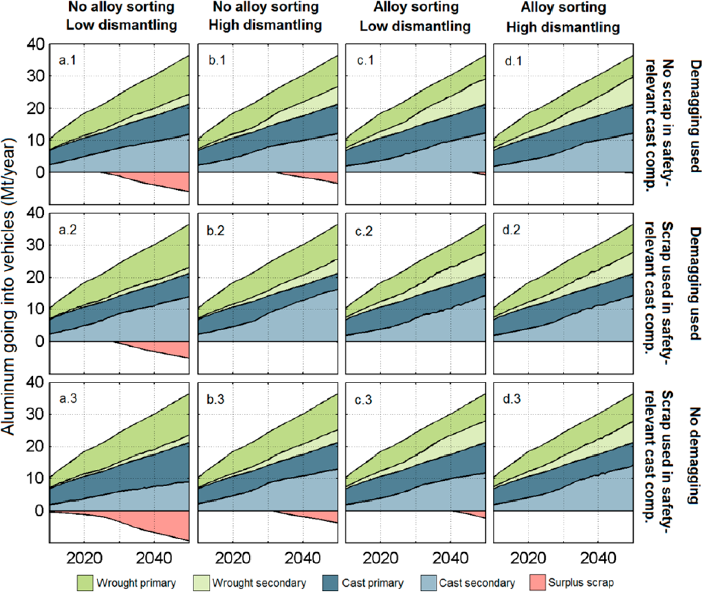
Scrap surplus from the automotive sector
Source: Løvik, Modaresi, Müller (2014)

Slide 32
Scrap surplus from the automotive sector
No changes:
→ scrap surplus
in a few years
Source: Løvik, Modaresi, Müller (2014)

Slide 33
Scrap surplus from the automotive sector
No changes:
→ scrap surplus
in a few years
Increased dismantling:
→ scrap surplus
delayed
Source: Løvik, Modaresi, Müller (2014)

Slide 34
Scrap surplus from the automotive sector
No changes:
→ scrap surplus
in a few years
Increased dismantling:
→ scrap surplus
delayed
Alloy sorting
→ scrap surplus
largely avoided,
→ techn. immature
Source: Løvik, Modaresi, Müller (2014)

Slide 35
Scrap surplus from the automotive sector
No changes:
→ scrap surplus
in a few years
Increased dismantling:
→ scrap surplus
delayed
Alloy sorting
→ scrap surplus
largely avoided,
→ techn. immature
Scrap in safety-relev.
comp. (e.g. wheels)
+ dismantling/sorting:
→ solution
Source: Løvik, Modaresi, Müller (2014)

Slide 36
Scrap surplus from the automotive sector
No changes:
→ scrap surplus
in a few years
Increased dismantling:
→ scrap surplus
delayed
Alloy sorting
→ scrap surplus
largely avoided,
→ techn. immature
Scrap in safety-relev.
comp. (e.g. wheels)
+ dismantling/sorting:
→ solution
Avoiding demagging:
→ only if wide scrap
use + high dism.
+ high sorting
Source: Løvik, Modaresi, Müller (2014)

Slide 37
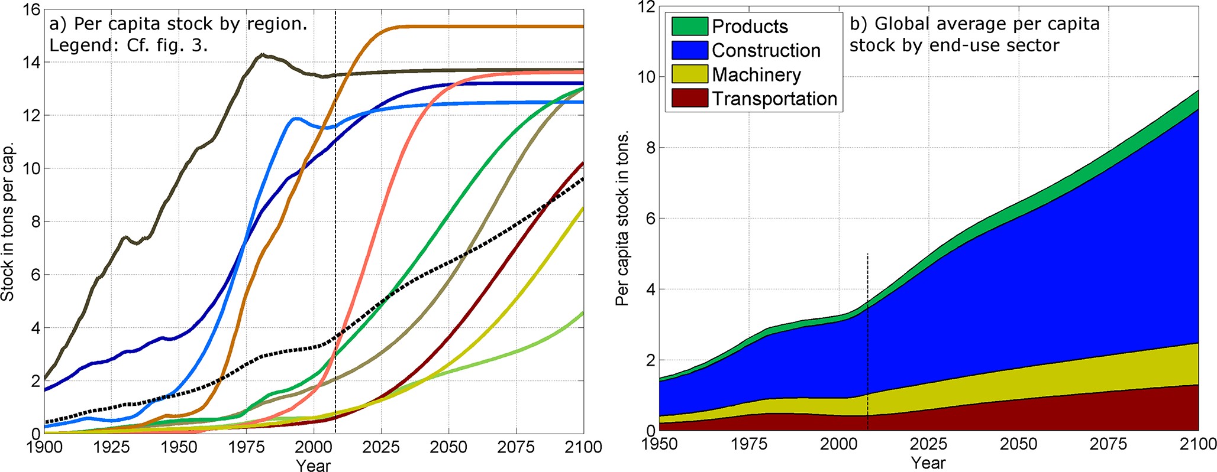
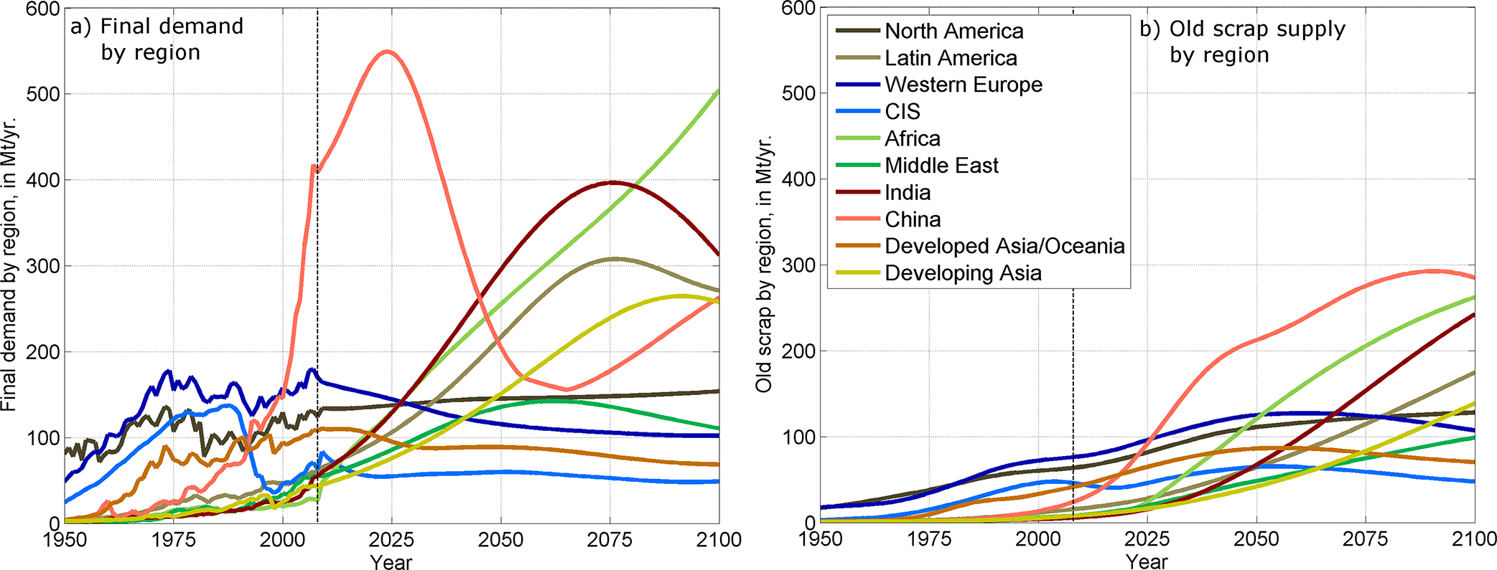
Forecasting steel use based on in-use stock patterns
Source: Pauliuk, Milford, Müller, and Allwood 2013

Slide 38
Results final steel demand and old scrap supply by region
Source: Pauliuk, Milford, Müller, and Allwood 2013

Slide 39
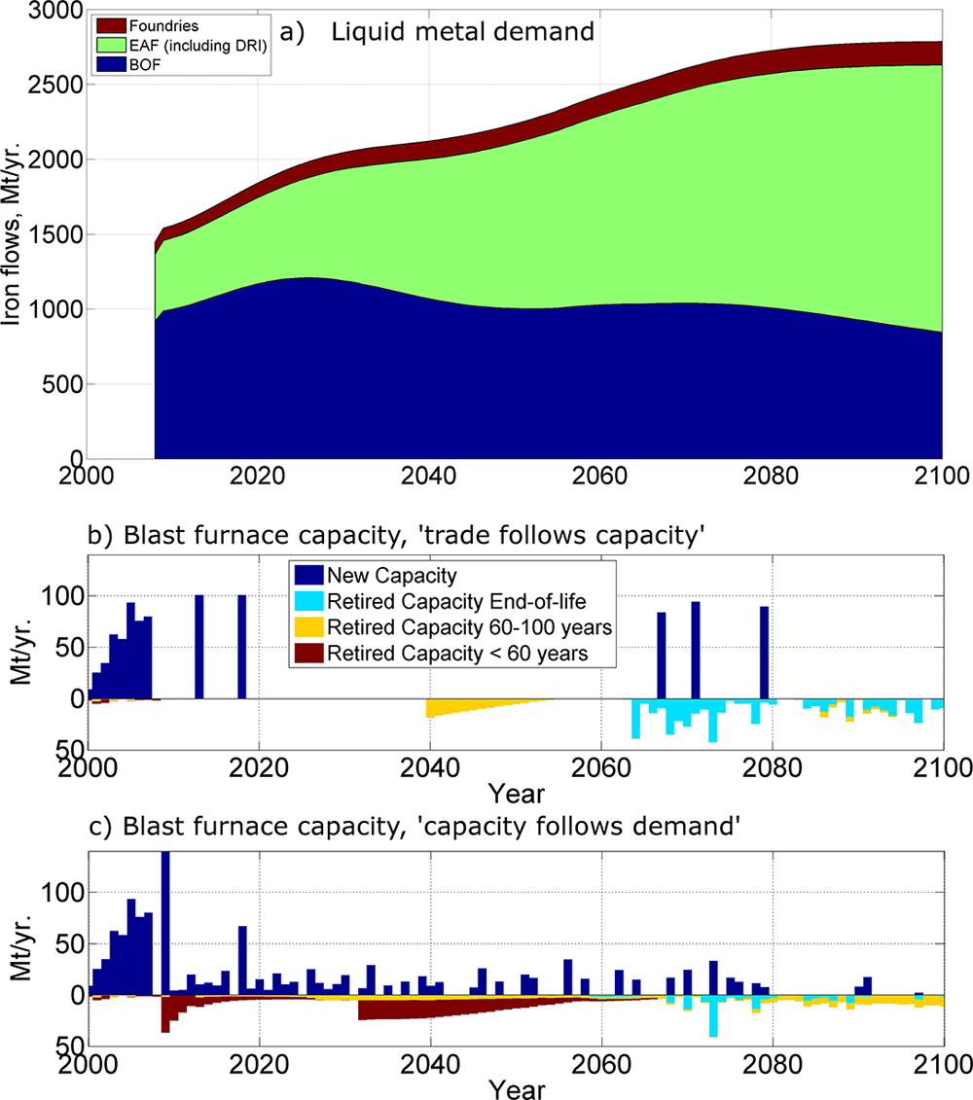
Steel demand and
two scenarios for
primary steel supply
Scenario 1:
“trade follows capacity”
(open markets)
Scenario 2:
“capacity follows regional
demand”
(protectionism)
Source: Pauliuk, Milford, Müller, and Allwood 2013

Slide 40
Conclusions
Models of the global aluminium cycle can indicate future
challenges and opportunities.
Patterns of in-use stocks set important boundary conditions
for the effectiveness of technological solutions.
→ demand for aluminium and scrap availability
Aluminium recycling can effectively reduce primary resource
use (bauxite and energy) and emissions, however:
- current challenges: mainly quantity of available scrap
- future challenges: maintain value of materials in cycle

Slide 41
MinFuture
Global material flows and demand-supply forecasting for mineral strategies
EU H2020 project proposal
Call “Raw Materials International Co-operation”
Scope A: “Demand-supply forecast and raw materials flows at global scale”
Call type: Coordination and Support Action (CSA)
Budget: 1 mio EUR
Period: 2 years (2016-2018)

Slide 42
Challenge
Securing sustainable access to raw materials is relevant for many countries.
EU Raw Materials Initiative has three pillars:
1. Fair and sustainable supply of RM from global markets
→ understand international trade / transparent markets
2. Sustainable supply of RM within the EU
→ understand primary resource supply
3. Resource efficiency and supply of “secondary raw materials” through recycling
→ understand in-use stocks and their dynamics
Three domains of minerals intelligence: primary resource supply, secondary
resources supply, and international trade
→ Have historically worked separately
→ Need to be integrated to capture global material cycles and their linkages
→ However, information is fragmented and incomplete
Many research institutions, government agencies, and industry associations
around the World have started to fill the gaps.
→ Different approaches, redundancies, inconsistencies, gaps, harmonization needs
→ Need for cooperation across countries and sectors

Slide 43
MinFuture approach
Relevance
Strategies
Scenarios
Assumptions &
Uncertainties
Knowledge
Models
Information
Systems
Data
Measurements
MinFuture develops a platform for minerals data providers and users aiming at
1. Consistency/robustness at the bottom (data & systems)
→ Develop a concept (roadmap) for mapping the global physical economy
→ System definition in 4 dimensions (stages, trade, linkages, time)
→ Map data sources of regular statistics and larger past and ongoing projects
→ Identification of gaps, inconsistencies, harmonization needs
→ Identification of priority areas and synergy potentials
2. Plurality at the top (models & scenarios)
→ Focus on models and scenarios that have their roots in consistent

Slide 44

Angels or devils?
It depends on the system definition
M.C. Escher (1960): Circle Limit IV
Thank you!
daniel.mueller@ntnu.no

Slide 46
Advisory Board
Primary resources
Nedal Nassar, USGS (confirmed interest)
Magnus Ericsson, SNL / LTU (confirmed)
Sigurd Heiberg, Petronavit / UNFC (confirmed)
Secondary resources
Christian Hagelüken, Umicore (confirmed)
Stefan Bringezu, WI / IRP (confirmed)
International trade
Ronald Jansen, UN Comtrade (confirmed)
Networks
Karen Hanghøj, KIC EIT Raw Materials (confirmed)

Slide 47
Workshops
M1
M6
M12
M18
M24
M26
Kick-off
Trondheim
WS 1
Vienna
WS 2
Brussels
WS 3
Brussels
Final conf.
Brussels
Fin. Review
Brussels

Slide 48
WP2 Challenges, systems, and data
WP3 Models
WP4 Pilot case wind energy
WP5 Recommendations
T4.1 Selection and system definition
T4.2 Illustration of methodology (in pilot case)
T4.3 Implications
WP6 Communication & dissemination
T6.1
Stakeholder analysis
T6.2
Stakeholder dialogue
T6.3
Web platform
T6.4
Visual identity
T6.5
Final conference

Slide 49
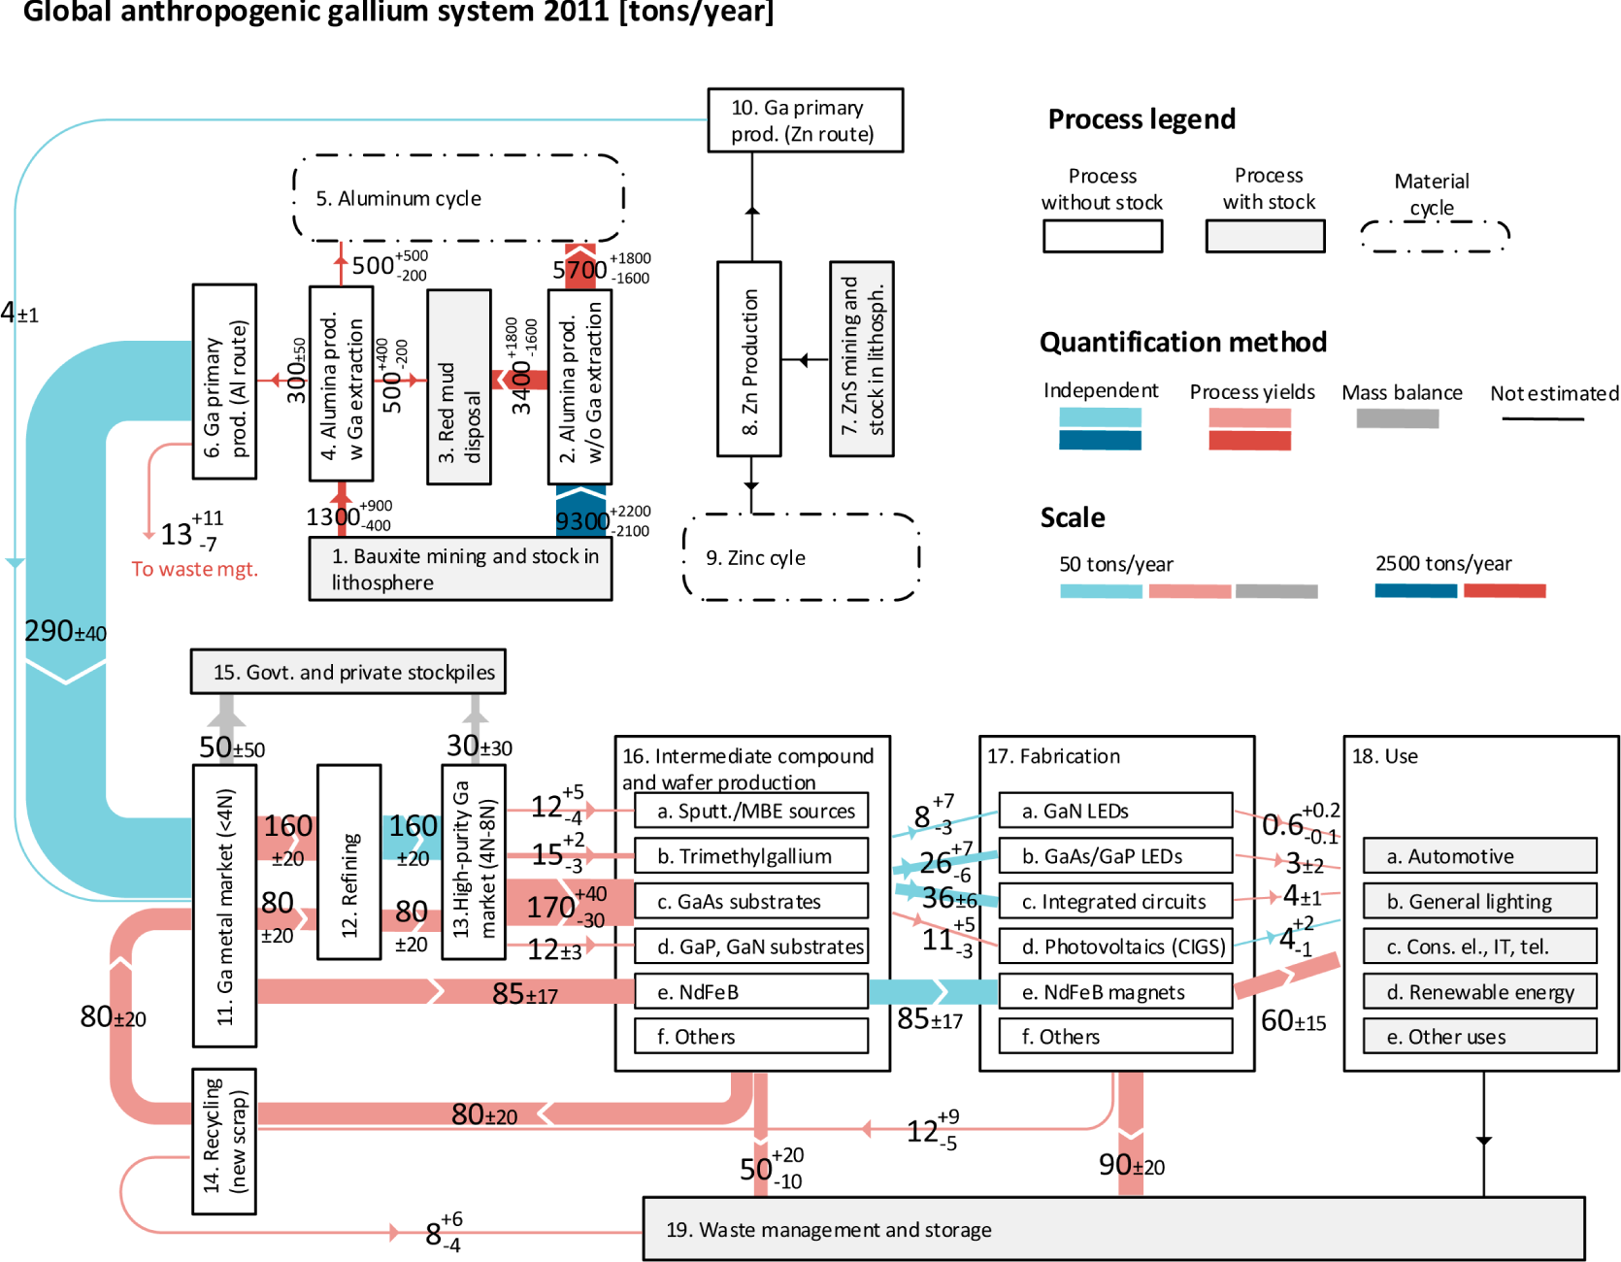

Slide 50
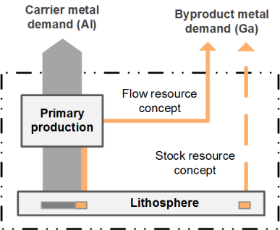

Slide 51
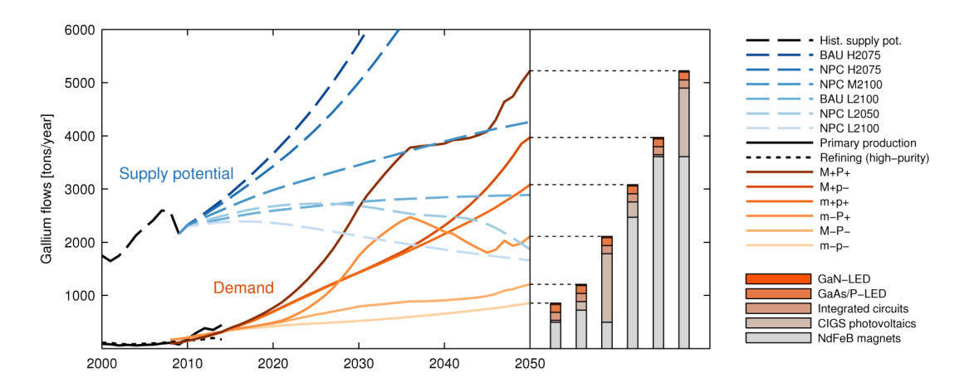

Slide 52
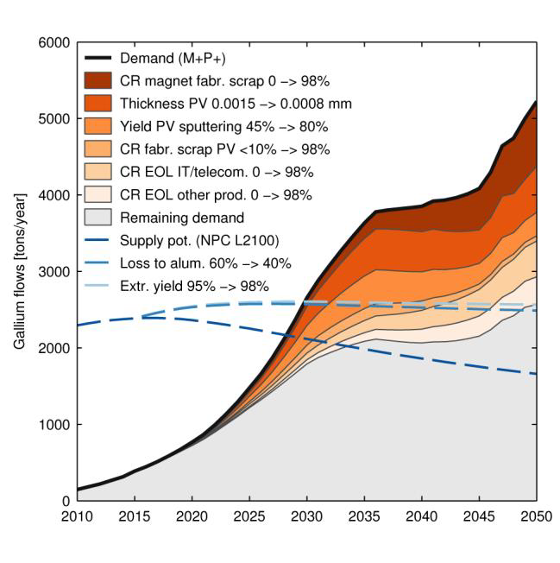

Slide 53
Post-Kyoto climate agreement
To be developed by 2015 and implemented by 2020
Needs to include developing countries (DCs) in order to reach necessary goals
New framework needed if DCs should be allowed to urbanize and industrialize under fair conditions
→ Contraction and Convergence (C&C) framework
→ Open question: How to operationalize the C&C framework?
→ What emissions budget needs to be allocated to urbanization?
Here: stock approach
- industrialization and urbanization = build up of stocks
- take stocks/services of industrialized countries (ICs) as benchmark
- determine emissions in DCs to reach IC’s stock levels
assuming state of the art technologies

Slide 54
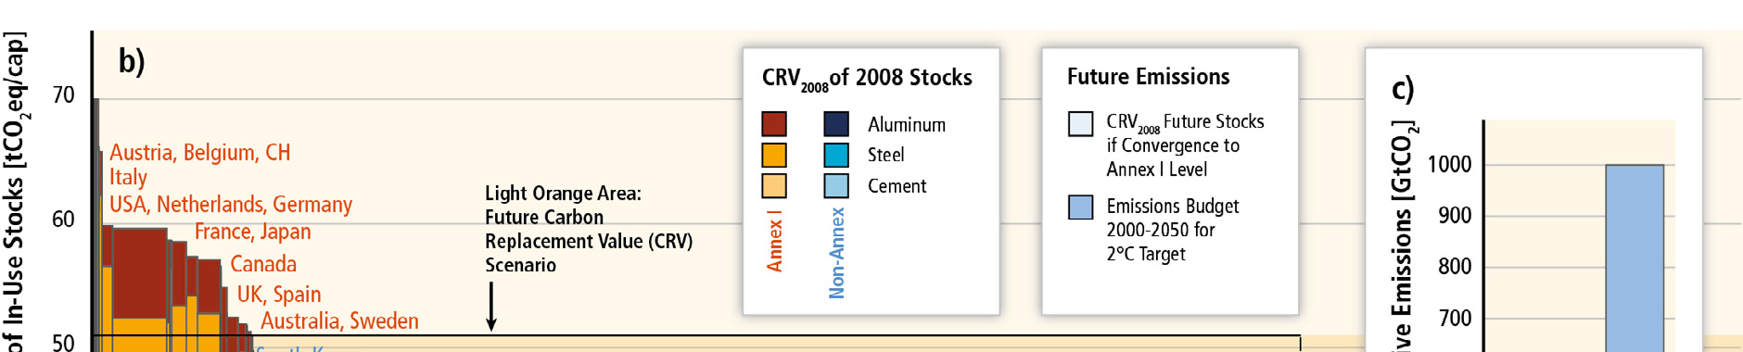
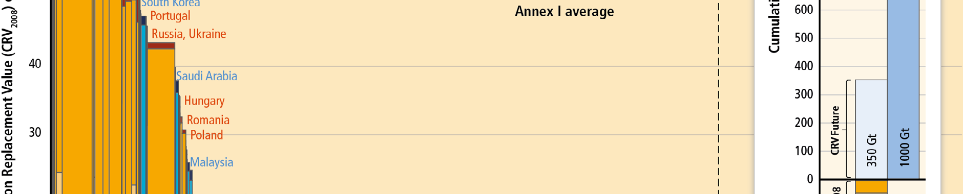
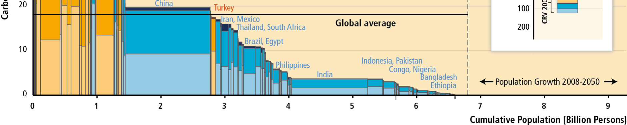
Build-up of infrastructure results in large emissions
+ 350 Gt CO₂
120 Gt CO₂
Source: Müller et al. 2013
Carbon footprint of existing stock: large differences rich – poor, but small differences among rich
A globalization of Western infrastructure stocks could pose a significant challenge for 2° target
→ post-Kyoto agreements
Mitigation options: materials production and materials use (urban form → poorly understood)
Notes:
Figure 12.12. (b) Carbon Replacement Value (CRV2008 ) per capita of existing stocks by country (red/yellow and blue) and as yet
unbuilt stocks if developing countries converge on the current average Annex I level (light orange area); (c) comparison with emission
budget for the period 2000− 2050 to reach the 2 °C target with a 75% probability. Of this emission budget (1000 Gt CO2 ), approximately
420 GtCO2 was already emitted during the period from 2000 to 2011.Source: (Müller et al., 2013).

