Slide 1
Materials in the Defense Industrial Base
USGS Mineral Information Seminar Series
5/25/2016

Slide 2
Outline
Mission Overview
2015 Requirements Report Results
2017 Requirements Report Update
FY17 Legislative Proposals
Possible FY 18 Legislative Proposals

Slide 3
Mission Overview
DLA Strategic Materials is the operational arm of The Strategic and Critical Materials Stockpiling Act (50 U.S.C. 98 et seq.)
“It is the purpose of this Act to …”
Provide for the acquisition & retention of stocks of certain strategic & critical materials.
Encourage conservation and development of such materials within the United States.
Decrease and preclude when possible a dangerous and costly dependence by the United States upon foreign or single sources for supplies of such materials in times of National Emergencies.
*Consider our mission as a kind of material supply chain insurance policy.

Slide 4
Supply Chain Responsibilities
Source Material
Ore, crude petroleum, crops or scrap
Manufacturing and
Industrial Base Policy
Timely availability of industrial resources
to meet national defense requirements
Concentrate
Oxide, Matte, Etc.
Refined Material
Purified element, alloy or chemical compound
Semi-manufactured product
Specialized performance specs, shape, particle size or crystal structure,
National
Defense
Stockpile
Emergency Preparedness
Simple Component
Shaped/formed for final consumption,
Usually incorporates more than 1 element or compound
Assembly
“Shop replaceable” multiple components
Unit
“Line or weapon replaceable”
multiple assemblies
Sub-system
System
Can be used by multiple platforms
Platform
e.g. B-52, F35, Aegis class destroyer

Slide 5
DLA-SM Definition of S&C
DLA Strategic Materials is the operational arm of The Strategic and Critical Materials Stockpiling Act (50 U.S.C. 98 et seq.). The term ‘‘strategic and critical” (S&C) materials is defined in this Act:
“…means materials that
(A) would be needed to supply the military, industrial, and essential civilian needs of the United States during a national emergency, and
(B) are not found or produced in the United States in sufficient quantities to meet such need.”

Slide 6
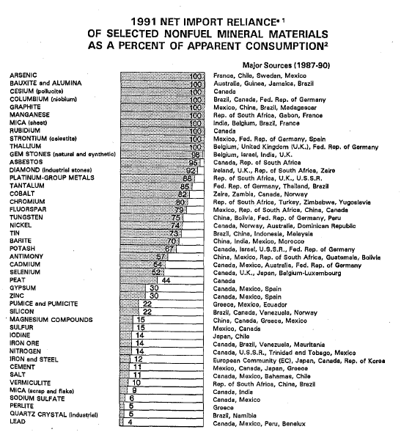
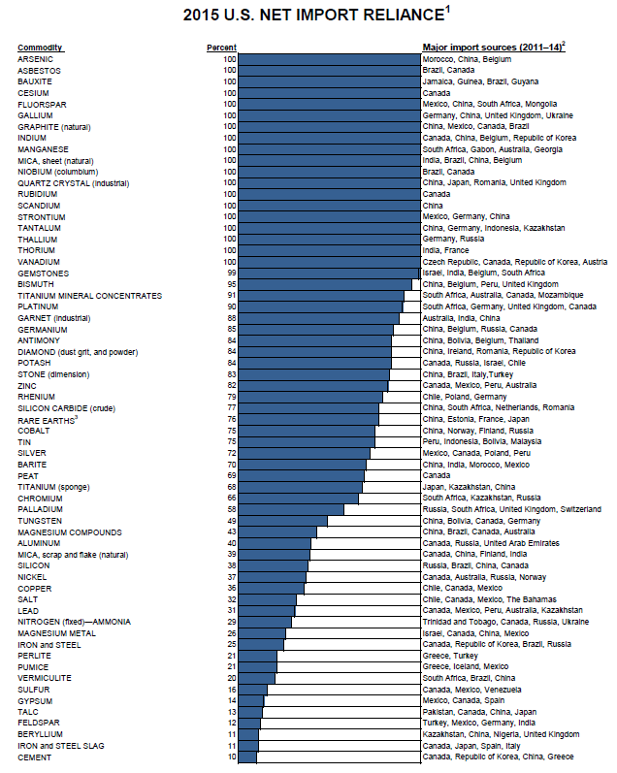
Import Reliance (USGS): 1991 vs 2015
Notes:
China- 8 Matl’s in 91. Lead in 4. 16 Materials in 2015. Lead in 8.
China- lost position only in tin

Slide 7
What’s a “National Emergency”
SEC. 14. [50 U.S.C. 98h–5] (a) Not later than January 15 of
every other year, the Secretary of Defense shall submit to Congress
a report on stockpile requirements. Each such report shall include—
(1) the Secretary’s recommendations with respect to stockpile
requirements; and
(2) the matters required under subsection (b).
(b) Each report under this section shall set forth the national
emergency planning assumptions used by the Secretary in making
the Secretary’s recommendations under subsection (a)(1) with respect
to stockpile requirements. The Secretary shall base the national
emergency planning assumptions on a military conflict scenario
consistent with the scenario used by the Secretary in budgeting
and defense planning purposes.

Slide 8
S&C Materials Research Process
Watch List
Supply Chain or Market Anomaly
Program Management Office Input
Assess Demand vs. Supply
Requirements Report (Shortfall?)
Decompose Tiers
Downstream Supply Chain Assessment
Qualify Risk vs. Cost
Business Case Analysis
Develop Solution Options
Determination
Material Requiring Action
Obtain Authorities

Slide 9
Top Down v Bottom Up
Economy
Sector
Industry
Top Down Approach:
United States Geological Survey (USGS) is our primary supply data source for the Top Down Materials. DLA-SM provides funding to USGS to support this data collection.
Products
Materials
Platform
Bottom Up Approach:
DLA-SM seeks data from all available, reputable sources. Provides for verification of data and analysis. Industry and Contractor support
is crucial.
Sector/Service
Defense Industry
Products/Components
Material/Material Issue

Slide 10
FY 15 Requirements Report (RR)
NDS Program monitors over 160 materials on a “Watch List”
92 meet criteria for inclusion in the FY15 RR analysis process
68 materials could be undergo full economic modeling (top down)
11 “non-standard proprietary” materials could be partially modeled
13 “bottom up” materials analyzed by supply-chain analysis methods.
Results: 30 materials were shown to have a gross shortfall under the base case scenario which amounts to ~$3.2 billion
Anticipated market responses (conservation/thriftiness, substitution, and an “extra sell”) reduced the shortfall to net of 21 materials for $389 million

Slide 11
2017 Requirements Report
Due to Congress Jan 15th, 2017
Into Coordination September 30th, 2016
Will Contain 132 Materials including sub-specifications
87 materials will go through the Risk Analysis and Mitigation Framework- Strategic Materials
Will contain a standalone appendix on Rare Earth Permanent Magnet Supply Chains for DOD
Macroeconomic modeling DOD demand for magnet alloys at the alloy level (NdFeB and SmCo )
Identification of specific defense requirements
Review of current and potential capacities for a domestic supply chain
Working on expanding to world current and potential capacities

Slide 12
FY17 Legislative Proposals
Seven materials being considered for the National Defense Stockpile
High modulus and high strength carbon fibers.
Tantalum.
Germanium.
Tungsten rhenium metal.
Boron carbide powder.
Europium.
Silicon carbide fiber.
Disposal being sought for excess beryllium metal (not all), ferrochrome, Chrome metal, Platinum, tungsten metal powder and tungsten O&C
New Authorities
Expanded recycling authorites for DLA-SM
Expanded qualification authorities for Stockpile Manager OSD(AT&L)
55

Slide 13
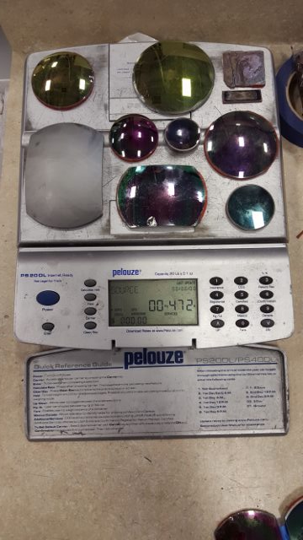
Recycling of Strategic Materials
Recovery/recycling authority granted in 2014 NDAA
First program: established a joint project with Army—Recover germanium from excess night vision windows
Recovered germanium will offset stockpile requirements
Any excess could be sold to generate revenue for Stockpile operations (pending legislative authority)
Creates domestic supply
Exploring expansion of similar opportunities

Slide 14
Possible FY18 Legislative Proposals
RDX- Critical to multiple explosive formulations
HMX- Critical to multiple explosive formulations
Aerospace Grade Rayon for Solid Rocket Motor Throats
May pursue qualification of alternatives/substitutes
Electrolytic Manganese Metal (EMM)- Steel Production
Antimony- Various forms including trisulfide for munition primers
DLA-SM is following AF/Army project on evaluation of N. American material

Slide 15
2015 Requirements Reports Defense Shortfalls (U)
Material | Primary Applications
High Modulus & High Strength Carbon Fibers | Rocket motors, space launch vehicles, UCAVs, satellites
Synthetic Rubber | Cables, tires, waterproofing
Tungsten Rhenium Metal | Traveling wave tubes, thermocouples, electronics
Boron Carbide Powder | Hard body armor
Beryllium Metal | Structural, optical; anti-missile, targeting systems, neutron reflectors
Borosilicate Float Glass | Transparent armor windows, ballistics protection
High Purity Yttria | Lasers for range finders and target designators
HFC-236fa | Fire extinguishers

Slide 16
2015 Requirements Reports Defense Shortfalls
In DLA-SM’s opinion, DOD is already fulfilling most of the SMPB duties
Material | Duty 1: Determine the need for long term secure supply | Duty 2: Analyze the risk and effect of nonavailability | Duty 3: Recommend a Strategy to Secretary of Defense | Duty 4: Recommend other Strategies to ensure Industrial Base
High Modulus & High Strength Carbon Fibers | See 2015 Req. Report | See 2015 Req. Report | Stockpile Leg Proposed Qualification of Domestic Sources (DLA, IBAS, DPA Title III) | R&D of Substitutes being considered
Chlorosulfonated polyethylene (CSM) | See 2015 Req. Report | See 2015 Req. Report | Track natural rubber and CSM demand with Req. Reports
Tungsten Rhenium Metal | See 2015 Req. Report | See 2015 Req. Report | Stockpile Leg Proposed DPA Title III Program
Boron Carbide Powder for Hard Body Armor | See 2015 Req. Report | See 2015 Req. Report | Stockpile Leg Proposed
Beryllium Metal | See 2015 Req. Report | See 2015 Req. Report | Upgrade/Maintain stockpile | Monitor health of Industrial Base
Borosilicate float Glass | See 2015 Req. Report | See 2015 Req. Report | 1. Track with Req. Reports 2. Consider Warstopper?
High Purity Yttria for Lasers | See 2015 Req. Report | See 2015 Req. Report | Stockpile Leg Proposed
HFC-236fa | See 2015 Req. Report | See 2015 Req. Report | Navy has alternatives for new vessels DLA Aviation and Navy are stockpiling?

